Slide 1
Continued Logarithms
my W25 1L project

Slide 2
An investigation
Continued logarithm-based arithmetic: why does nobody use it???

Slide 3
What I did
(attempted a) proof-of-concept fixed width clog representation
numerical investigation
proof-of-concept calculator app (unfinished)
writeup!

Slide 4
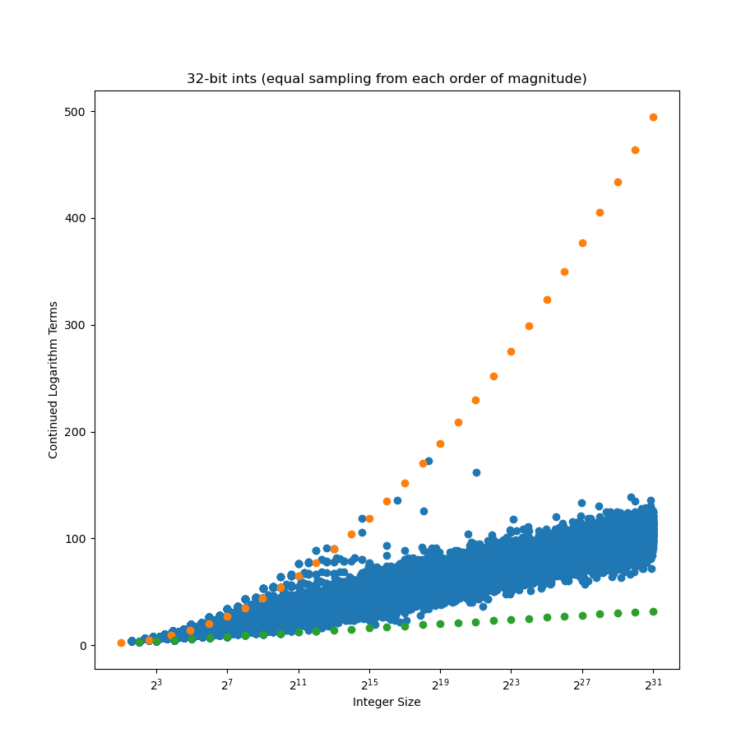
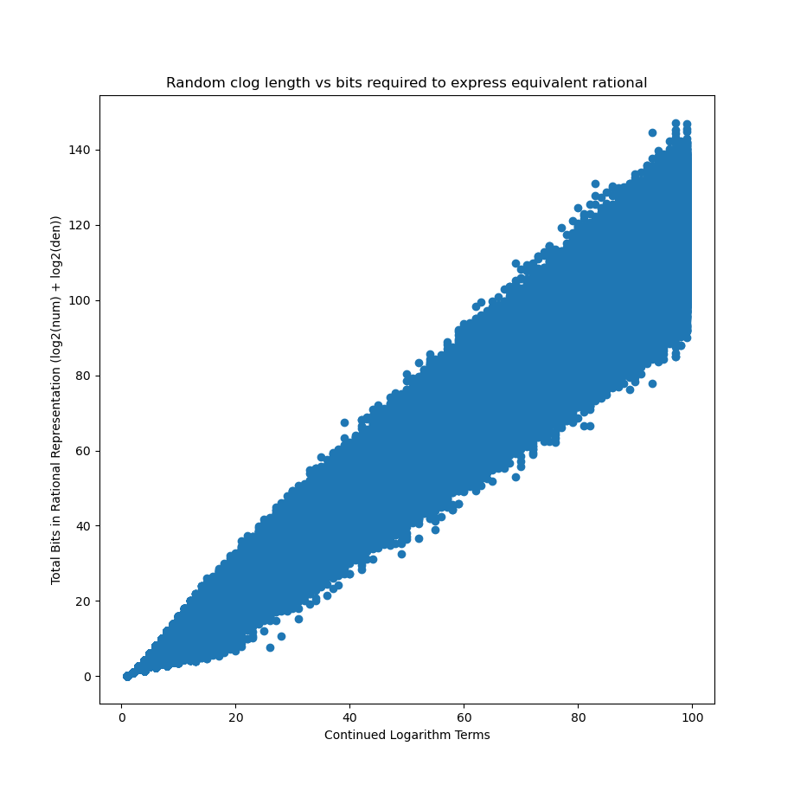
The precision spread is bad

Slide 5
But that’s not the end of it!
speculatively redundant clogs exist!
an easier way to mix real and rational arithmetic mayhaps??
let’s try a calculator!

Slide 6
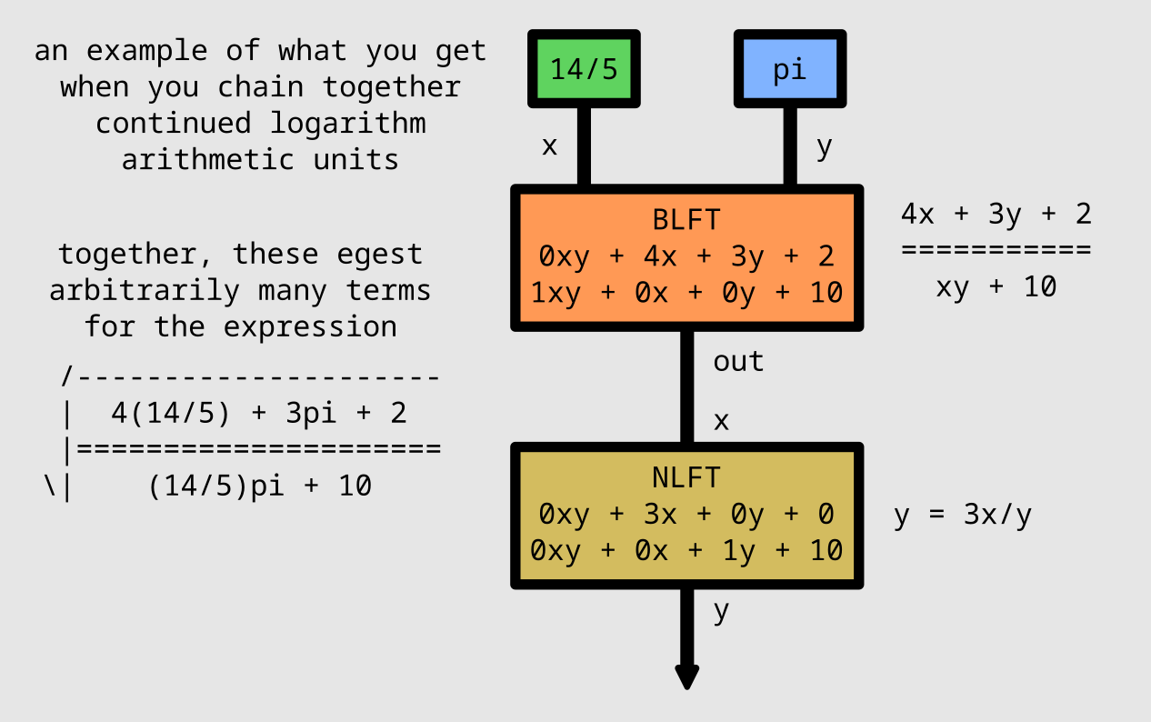
The calculator (+demo)

Slide 7
What I learned
Continued logarithms merit more investigation (I can count on one hand the number of resources that have something novel to say)
Continued logarithms are kinda bad for most purposes (for reasons outlined before)
Continued logarithms do provide a pretty elegant way to mix real and rational arithmetic

Slide 8
Where would I go from here?
Lots of things!
More feature complete calculator (trig stuff!!)
Mathematical investigation of precision spread/clog equivalent of SB tree
Mathematical investigation of redundant clog scheme

