Slide 1
Project 3 – Phase 3/4/5
GSBA 505 – STATS
Cardinal Section – Group 6
Matt Foxworthy, Aretha Fung-A-Wing,
Rachel Herrera, Michael Kim, and Allison Kozulla

Slide 2
Agenda
Goal Definition
Data Collection
Variables
Joined Set Variables
Correlation
Linear Regression
ANOVA
Potential Business Outcomes

Slide 3
Goal Definition
Who are we? - Recruitment firm
Who is the client? - Firms looking to hire employees for various jobs and employees looking for jobs
Goals: What factors influence the hunt for a new job? How can companies better position themselves for hiring by having a better understanding of the candidate pool?
Notes:
Identify the specific variables that have the highest correlation to employee attrition.
Determine what increases employment longevity by analyzing the tenured employee data, and proactively utilize this information to help reduce attrition.
Minimize employee turnover in order to reduce HR training/on boarding costs and retain valuable talent, by identifying key conditions which lead employees to leave the firm.
Determine how employee work/life balance (including travel time, traveling for work) factors into employee attrition
Identify if monthly income is dependent on age, gender, marital status
Establish if overtime is dependent on age, gender, marital status
Does job satisfaction and involvement increase employee salary or is it determined by level of education and seniority. Would that cause more qualified employees to quit. What factors retain employees and decreases attrition? Are the right employees being rewarded?
Determine rate of promotions and increases for women in the company in comparison to men and if that contributes to their high turnover rate
Determine if development plans are helpful by tying job satisfaction and attrition with promotions and years in role
Determine if more resources should be implemented for people in different seasons of life, divorced/ married
Determine if compensation rates for travel frequently should be adjusted to lower attrition

Slide 4
Data Collection
Google Survey
Distributed to variety of people from a variety of industries
208 respondents
2496 data points
12 variables

Slide 5
Variables
Independent Variables
Location (C)
Work-life-balance/key needs (C)
Years of Experience (N)
Willing to relocate (C)
Remote or in-person or hybrid (C)
Percentage in salary increase (N)
Age (N)
Gender (C)
Current industry (C)
New industry or same industry (C)
Years at current job (N)
Dependent Variables
Searching for new job

Slide 6
Secondary Data Set
US COVID – 19 Vaccinations
About: Vaccination rate by state/region
Created by: John Hopkins
4 columns, 5 rows – data was provided by state, we utilized the data to calculate by region
LINK: https://coronavirus.jhu.edu/vaccines/us-states
Independent Variables
Region (South, Midwest, West, Northeast) (C)
Calculated Dependent Variables
Population of Region (N)
Vaccinated Population of Region (N)
% Vaccinated by Region (N)

Slide 7
Collected Data Set + Joined Set
17 Columns
208 Rows
8 Categorical Variables
7 Numerical Variables

Slide 8
Missing Data Considerations
No missing data – we made sure each survey participant had to answer all questions

Slide 9
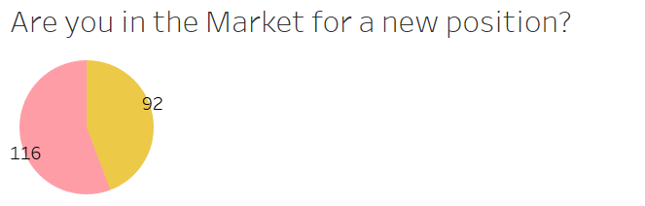

Data Breakdown
208 total respondents, 116 (55.7%) are job seekers, and 92 (44.2%) are not currently looking to change jobs
Of the 208 respondents 126 (60.5%) were female, 76 (36.5%) were male. Female job seekers make up the largest proportion of the data set at 72 (34.66%)
Notes:
allie

Slide 10
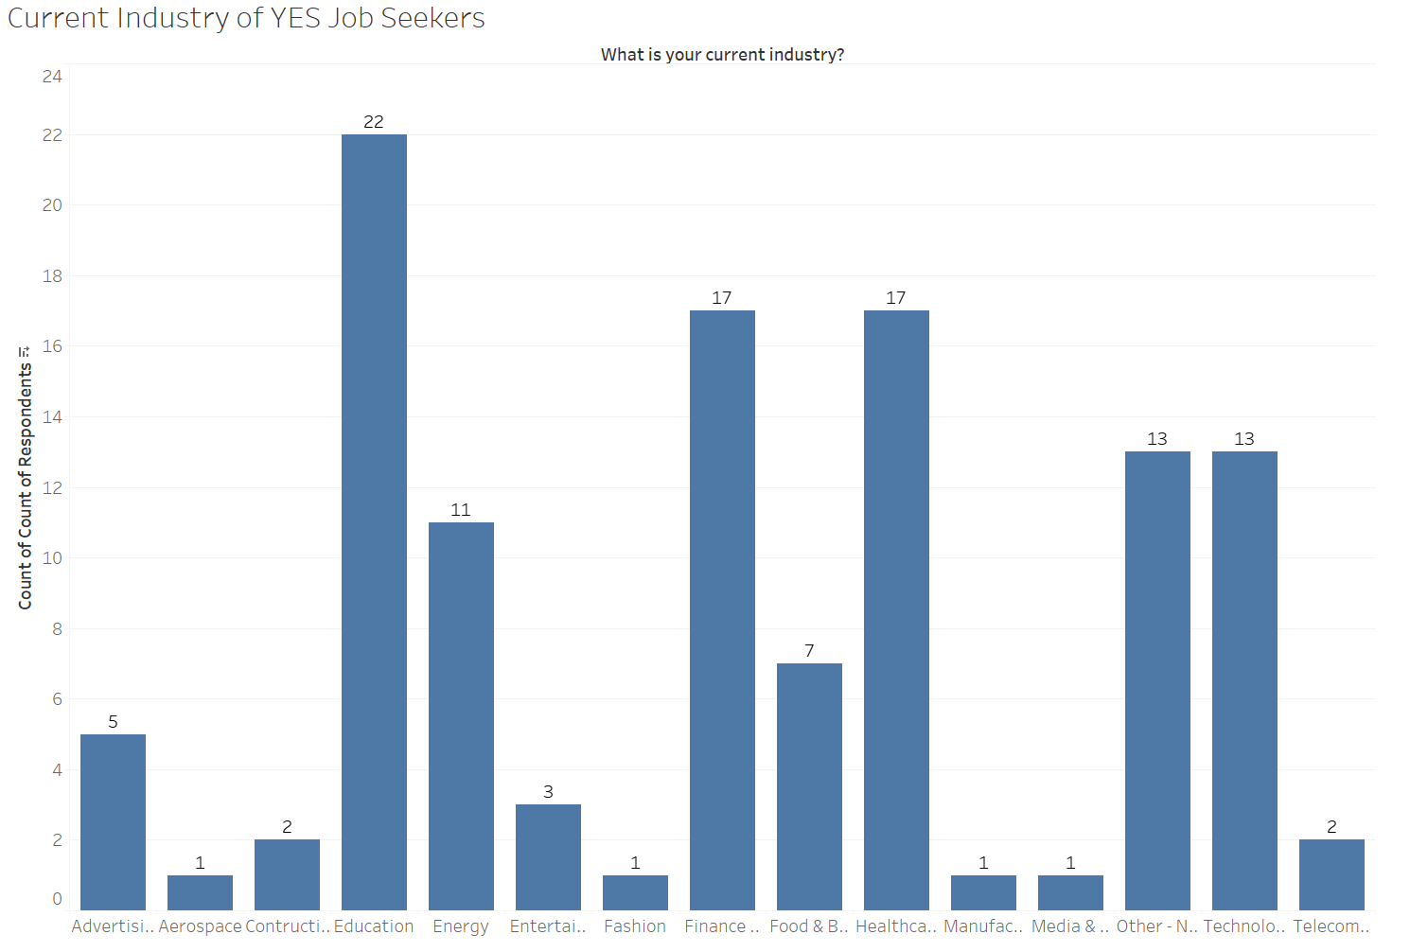
Current Industries of Current Job Seekers
Education professionals make up the largest proportion of job seekers in our data set, 22 (18.9% of the job seekers are in education currently)
Healthcare and finance are the next highest (both 14.6% of current job seekers)
Notes:
allie

Slide 11
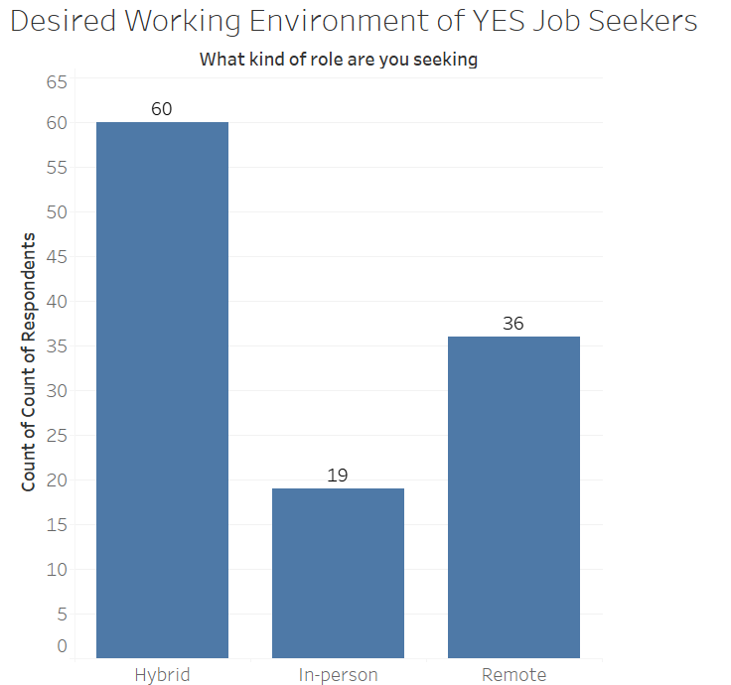
Desired Work Environments
Of the respondents seeking a new job, 51.7% (60/116) would desire a hybrid working environment, 31.0% remote and 16.3% in-person
Notes:
allie

Slide 12
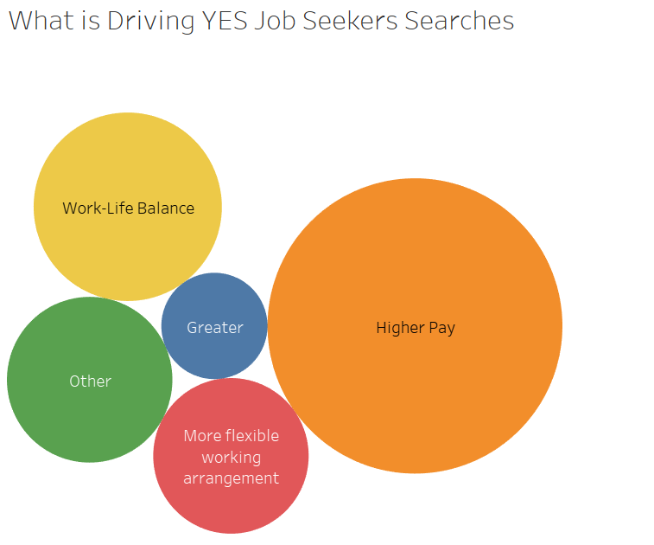
Key Driving Factors of Job Seekers
Of the respondents seeking a new job, 46.5% are driven by higher pay and 18.9% by work-life balance
Notes:
allie

Slide 13
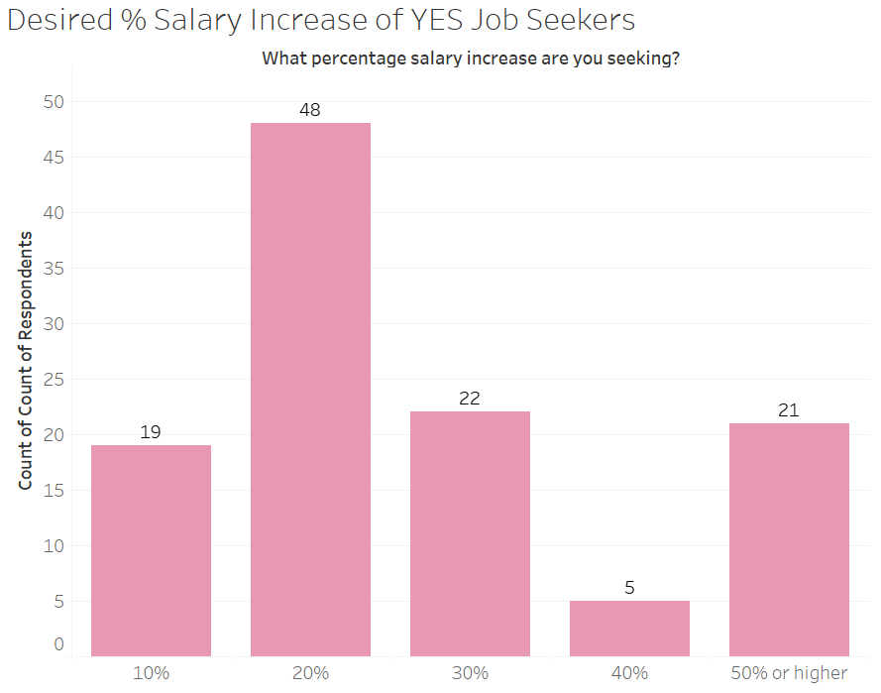
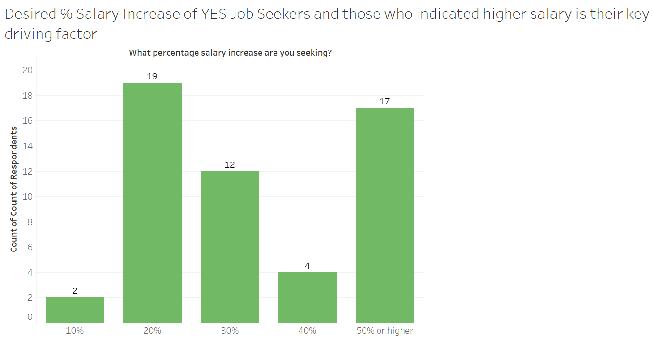
Salary Increases
20% Salary Increase is most desired % salary increase among all current job seekers
Among job seekers who’s key driving factor is “Higher Salary” 20% is the most common, but with 50% or higher at a close second.
Notes:
allie

Slide 14
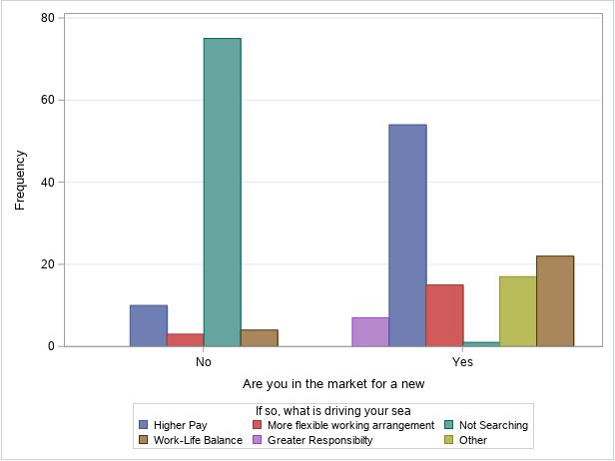
Of those looking for a new job, it is in large part due to a need for a higher salary. The second highest percentage was due to placing value in work-life balance.
Mike
Notes:
Mike

Slide 15
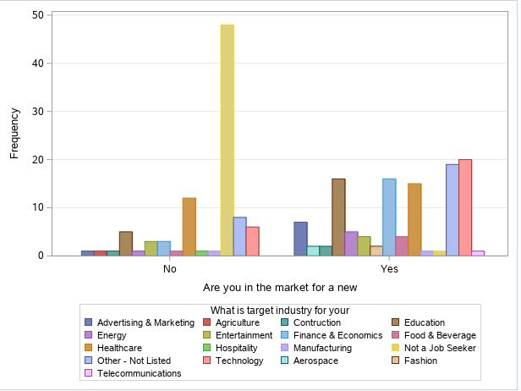
Participants in the Technology industry make up majority of those seeking a new role.
Majority of participants are not in the hunt for a new position. It would be beneficial to find out what components of their current firm is contributing to their ability to retain employees and what makes their company attractive to those seeking new positions.
Notes:
Mike

Slide 16
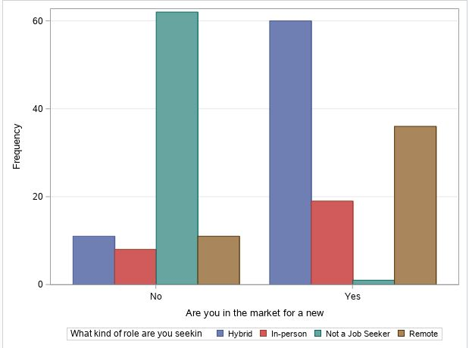
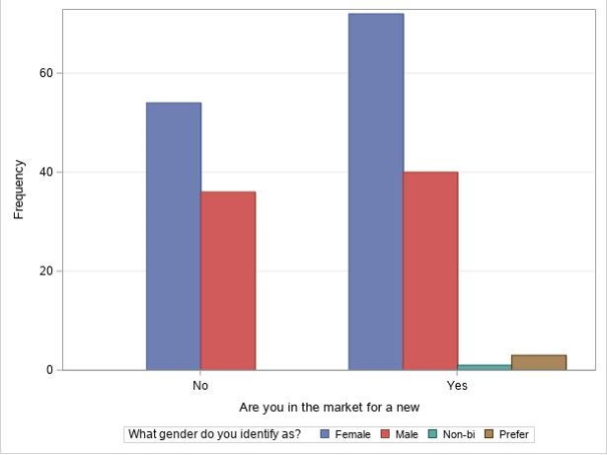
1. Job seekers prefer a hybrid role. Partially in-person and remote. 2. Second preferred is a purely remote position. 3. Those that responded yes for being in the market for a new position, are looking for a full in-person working model at about a frequency of 20. 4. Women lead the search for a new position.
Notes:
Mike

Slide 17
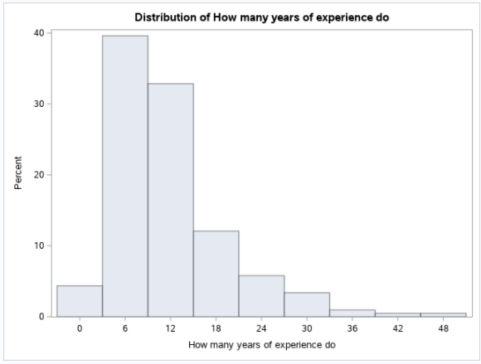
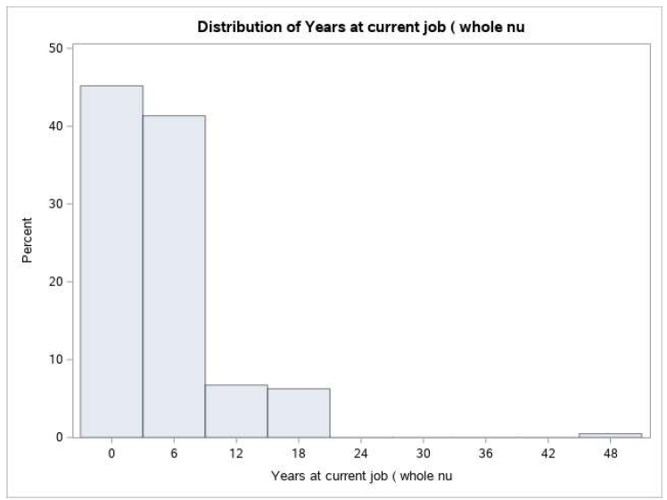
Visualizations - Distributions
Distribution in selection of respondents and years of experience : 6-12 Year Midpoint ranges for the highest bins of responses making up > 70% of the population
Distribution in selection of respondents and years at current job: new to a midpoint of 6 years make up > 80% of the population
Notes:
Rachel

Slide 18
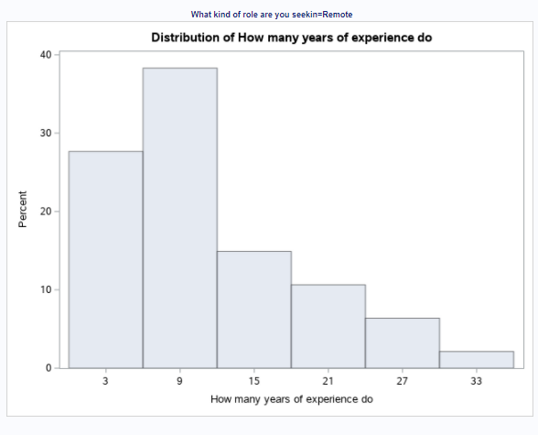
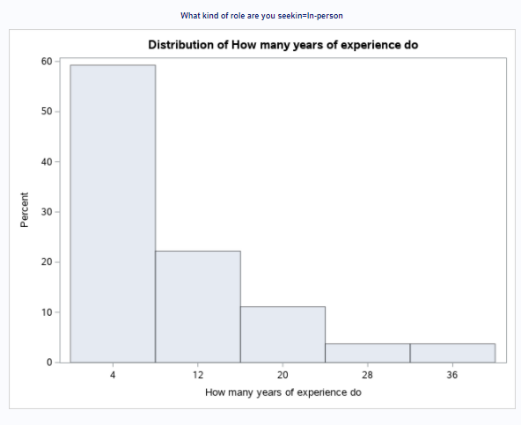
Visualizations - Distributions
Distribution in selection of Job setting in job seekers and years of experience
Remote work has more representation of selection across all tenure of employees
Not as experienced employees (Midpoint of 4 Years) that is a favorability towards In person work as shown on the bottom table with 60% of those that chose In-person making up that sample.
Notes:
Rachel

Slide 19
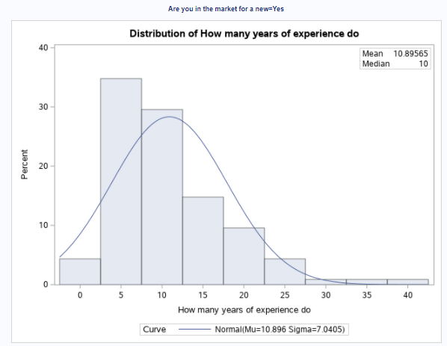
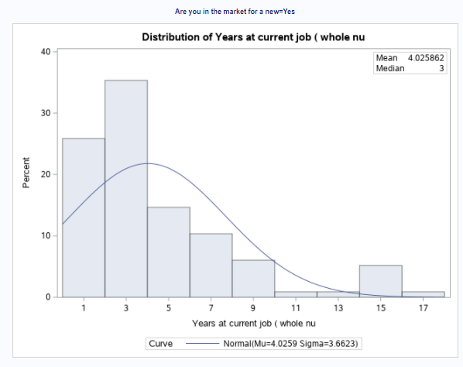
Visualizations - Distributions
Distribution in selection of respondents that are job seekers:
Greatest distribution on years of experience making up ~80% of the population are from 5- 15 median years.
Greatest distribution of years of years in current role ~75% of the population are from 1-5 median years.
Notes:
Rachel

Slide 20
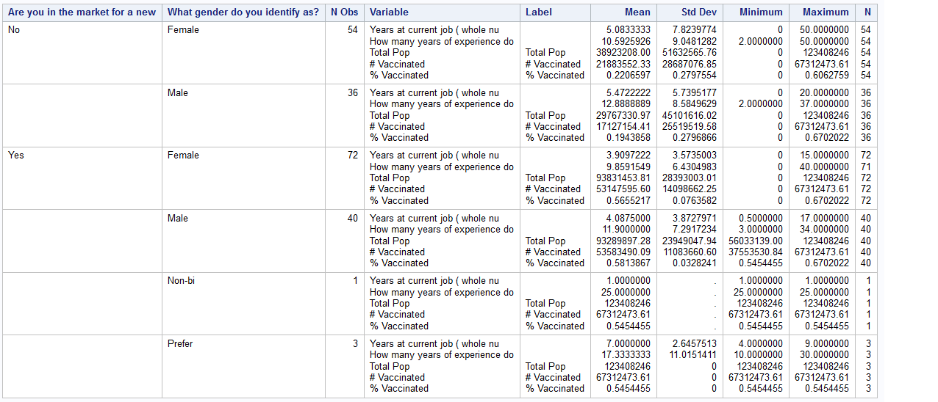
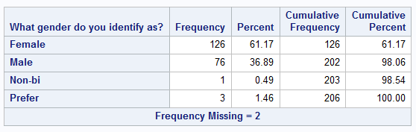
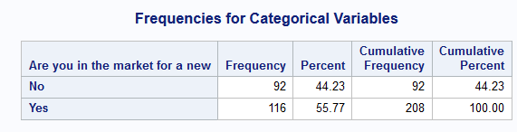
Descriptive Statistics
New Job
A large majority of the population looking for a new job is Female (62%)
The average work experience of Females ~9.8 years vs. Males at 11.9 years
Years at current job for both Male and Female is ~4 years
No New Job​
Females were more responsive to our survey representing 61%.
The standard deviation for % vaccinated for Male and Female are statistically similar
Notes:
Matt

Slide 21
Possible Outcomes/Business Goals
Utilize findings to determine what type of candidates are currently in the market for a new job, and analyze if the demographic fits firms' needs (ie career level, desired salary)
Utilize findings to determine key needs of potential new hires
Utilize findings to better understand candidate pools background
Better help candidates find appropriate jobs to apply for
We could expand our search to determine why most participants aren't looking for a new position.
What benefits/working environment does their current company provide that allows them to retain employees and attract those seeking a new role

Slide 22
Appendix

Slide 23
Project 3 – Phase 1/2
GSBA 505 – STATS
Cardinal Section – Group 6
Matt Foxworthy, Aretha Fung-A-Wing,
Rachel Herrera, Michael Kim, and Allison Kozulla

Slide 24
Agenda
Goal Definition
Data Collection
Variables
Joined Set Variables
Visualizations
Potential Business Outcomes

Slide 25
Goal Definition
Who are we? - Recruitment firm
Who is the client? - Firms looking to hire employees for various jobs and employees looking for jobs
Goals: What factors influence the hunt for a new job? How can companies better position themselves for hiring by having a better understanding of the candidate pool?
Notes:
Identify the specific variables that have the highest correlation to employee attrition.
Determine what increases employment longevity by analyzing the tenured employee data, and proactively utilize this information to help reduce attrition.
Minimize employee turnover in order to reduce HR training/on boarding costs and retain valuable talent, by identifying key conditions which lead employees to leave the firm.
Determine how employee work/life balance (including travel time, traveling for work) factors into employee attrition
Identify if monthly income is dependent on age, gender, marital status
Establish if overtime is dependent on age, gender, marital status
Does job satisfaction and involvement increase employee salary or is it determined by level of education and seniority. Would that cause more qualified employees to quit. What factors retain employees and decreases attrition? Are the right employees being rewarded?
Determine rate of promotions and increases for women in the company in comparison to men and if that contributes to their high turnover rate
Determine if development plans are helpful by tying job satisfaction and attrition with promotions and years in role
Determine if more resources should be implemented for people in different seasons of life, divorced/ married
Determine if compensation rates for travel frequently should be adjusted to lower attrition

Slide 26
Data Collection
Google Survey
Distributed to variety of people from a variety of industries
208 respondents
2496 data points
12 variables

Slide 27
Variables
Independent Variables
Location (C)
Work-life-balance/key needs (C)
Years of Experience (N)
Willing to relocate (C)
Remote or in-person or hybrid (C)
Percentage in salary increase (N)
Age (N)
Gender (C)
Current industry (C)
New industry or same industry (C)
Years at current job (N)
Dependent Variables
Searching for new job

Slide 28
Secondary Data Set
US COVID – 19 Vaccinations
About: Vaccination rate by state/region
Created by: John Hopkins
4 columns, 5 rows – data was provided by state, we utilized the data to calculate by region
LINK: https://coronavirus.jhu.edu/vaccines/us-states
Independent Variables
Region (South, Midwest, West, Northeast) (C)
Calculated Dependent Variables
Population of Region (N)
Vaccinated Population of Region (N)
% Vaccinated by Region (N)

Slide 29
Collected Data Set + Joined Set
17 Columns
208 Rows
8 Categorical Variables
7 Numerical Variables

Slide 30
Missing Data Considerations
No missing data – we made sure each survey participant had to answer all questions

Slide 31
Data Breakdown
208 total respondents, 116 (55.7%) are job seekers, and 92 (44.2%) are not currently looking to change jobs
Of the 208 respondents 126 (60.5%) were female, 76 (36.5%) were male. Female job seekers make up the largest proportion of the data set at 72 (34.66%)
Notes:
allie

Slide 32
Current Industries of Current Job Seekers
Education professionals make up the largest proportion of job seekers in our data set, 22 (18.9% of the job seekers are in education currently)
Healthcare and finance are the next highest (both 14.6% of current job seekers)
Notes:
allie

Slide 33
Desired Work Environments
Of the respondents seeking a new job, 51.7% (60/116) would desire a hybrid working environment, 31.0% remote and 16.3% in-person
Notes:
allie

Slide 34
Key Driving Factors of Job Seekers
Of the respondents seeking a new job, 46.5% are driven by higher pay and 18.9% by work-life balance
Notes:
allie

Slide 35
Salary Increases
20% Salary Increase is most desired % salary increase among all current job seekers
Among job seekers who’s key driving factor is “Higher Salary” 20% is the most common, but with 50% or higher at a close second.
Notes:
allie

Slide 36
Of those looking for a new job, it is in large part due to a need for a higher salary. The second highest percentage was due to placing value in work-life balance.
Mike
Notes:
Mike

Slide 37
Participants in the Technology industry make up majority of those seeking a new role.
Majority of participants are not in the hunt for a new position. It would be beneficial to find out what components of their current firm is contributing to their ability to retain employees and what makes their company attractive to those seeking new positions.
Notes:
Mike

Slide 38
1. Job seekers prefer a hybrid role. Partially in-person and remote. 2. Second preferred is a purely remote position. 3. Those that responded yes for being in the market for a new position, are looking for a full in-person working model at about a frequency of 20. 4. Women lead the search for a new position.
Notes:
Mike

Slide 39
Visualizations - Distributions
Distribution in selection of respondents and years of experience : 6-12 Year Midpoint ranges for the highest bins of responses making up > 70% of the population
Distribution in selection of respondents and years at current job: new to a midpoint of 6 years make up > 80% of the population
Notes:
Rachel

Slide 40
Visualizations - Distributions
Distribution in selection of Job setting in job seekers and years of experience
Remote work has more representation of selection across all tenure of employees
Not as experienced employees (Midpoint of 4 Years) that is a favorability towards In person work as shown on the bottom table with 60% of those that chose In-person making up that sample.
Notes:
Rachel

Slide 41
Visualizations - Distributions
Distribution in selection of respondents that are job seekers:
Greatest distribution on years of experience making up ~80% of the population are from 5- 15 median years.
Greatest distribution of years of years in current role ~75% of the population are from 1-5 median years.
Notes:
Rachel

Slide 42
Descriptive Statistics
New Job
A large majority of the population looking for a new job is Female (62%)
The average work experience of Females ~9.8 years vs. Males at 11.9 years
Years at current job for both Male and Female is ~4 years
No New Job​
Females were more responsive to our survey representing 61%.
The standard deviation for % vaccinated for Male and Female are statistically similar
Notes:
Matt

Slide 43
Possible Outcomes/Business Goals
Utilize findings to determine what type of candidates are currently in the market for a new job, and analyze if the demographic fits firms' needs (ie career level, desired salary)
Utilize findings to determine key needs of potential new hires
Utilize findings to better understand candidate pools background
Better help candidates find appropriate jobs to apply for
We could expand our search to determine why most participants aren't looking for a new position.
What benefits/working environment does their current company provide that allows them to retain employees and attract those seeking a new role

Slide 44
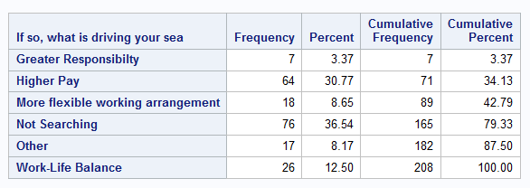
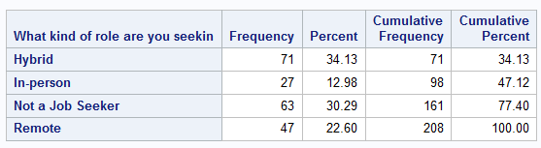
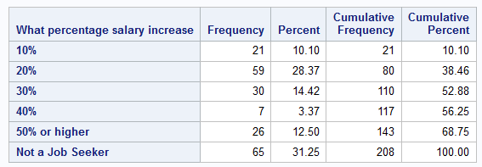
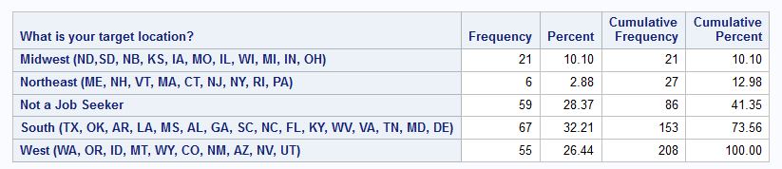
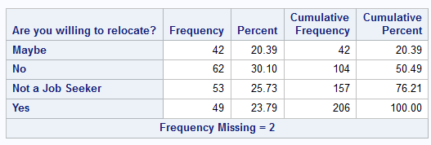
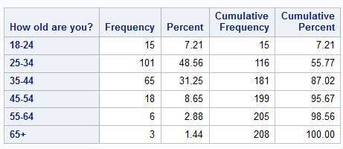
Descriptive Statistics - Continued
Notes:
Matt

Slide 45
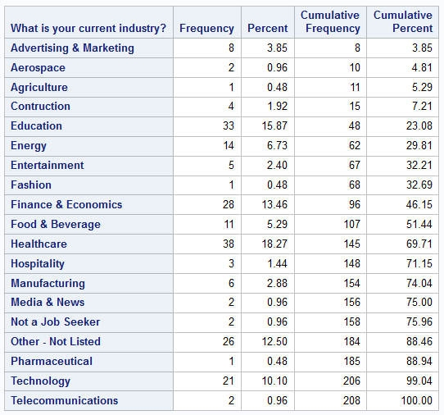
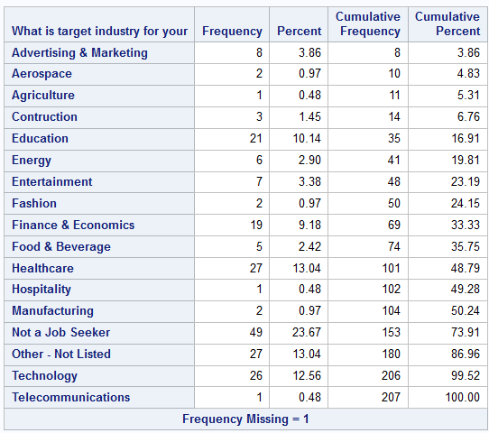
Descriptive Statistics - Continued
Notes:
Matt

