Slide 1
FriendDetector
A Face Recognition System for Android
Alexander Afanasyev
Charles Fleming
Karthikeyan Natarajan
May 25, 2010

Slide 2
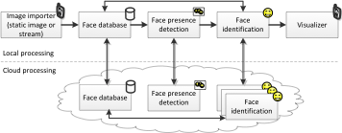
Components

Slide 3
Features
Static image importer
from gallery
from camera through gallery
from camera directly from our app
NO REAL-TIME VIDEO SUPPORT ☹
Local face detection (using Android API)
Local face recognition (Java implementation of EigenFaces algorithm)
Remote face detection and recognition (OpenCV library)
RPC using ZeroC Ice library

Slide 4
ZeroC Ice for RPC
…
sequence<FacePictureWithName> FacePicturesWithNames;
interface Recognizer
{
Faces findFacesAndRecognizePeople( File jpegFile );
Faces findFaces( File jpegFile );
string recognizeFace( File jpegFileOfFace );
void learn( File jpegFileOfFace, string name );
int getTrainSetSize( );
FacePictureWithName getTrainSetFace( int num );
void unLearn( int id );
};
…
Java
C++
Python, PHP, …

Slide 5
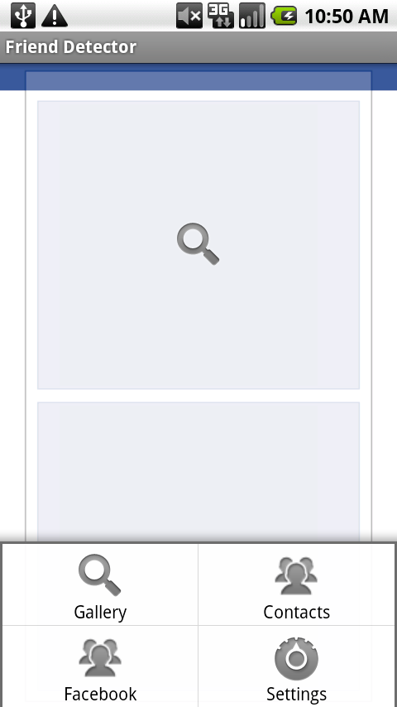
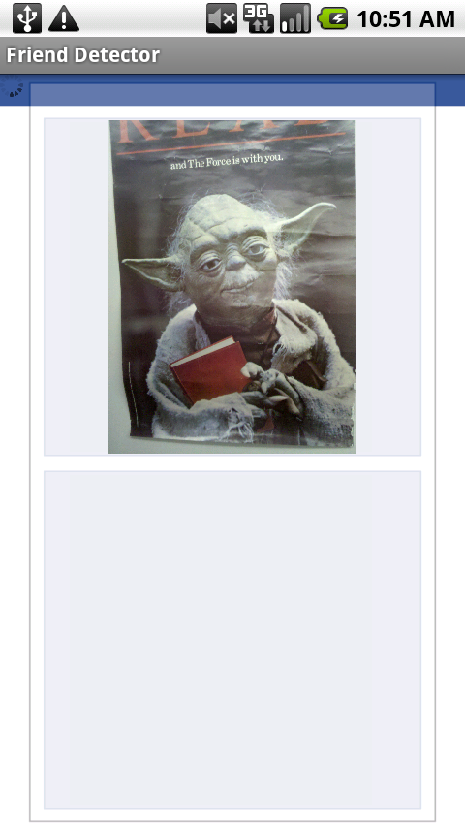
Selection image from the gallery or take image directly from camera

Slide 6
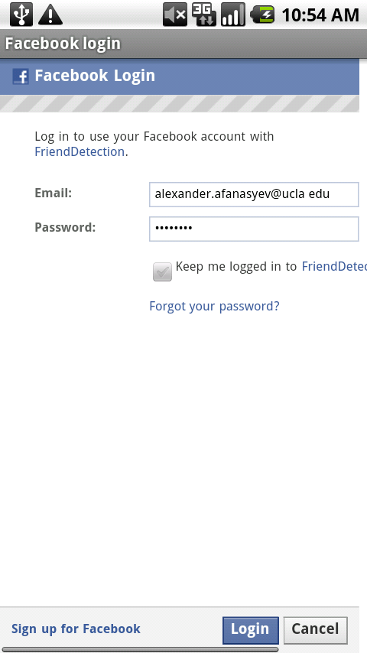
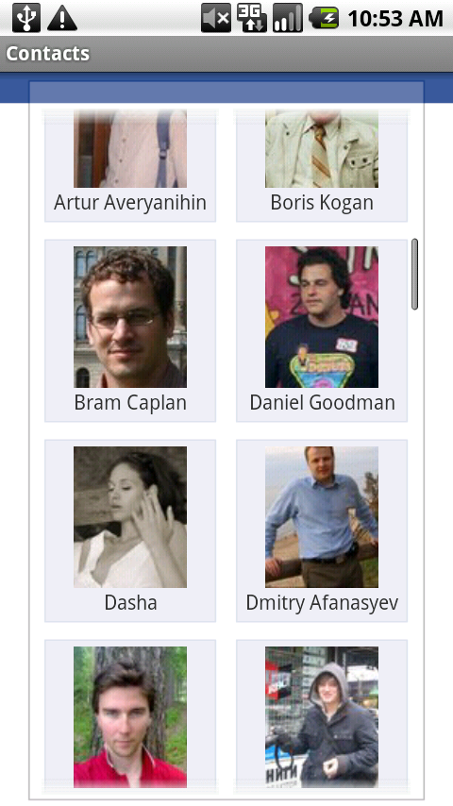
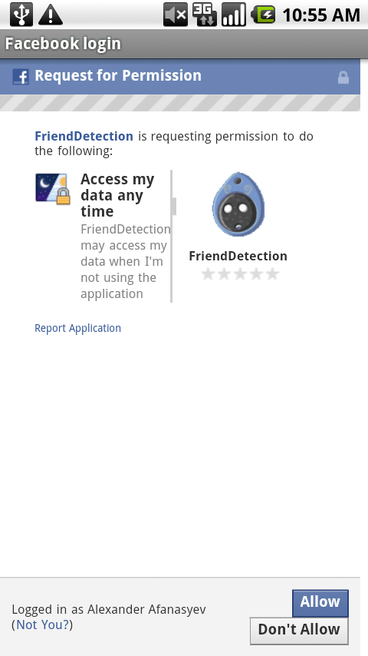
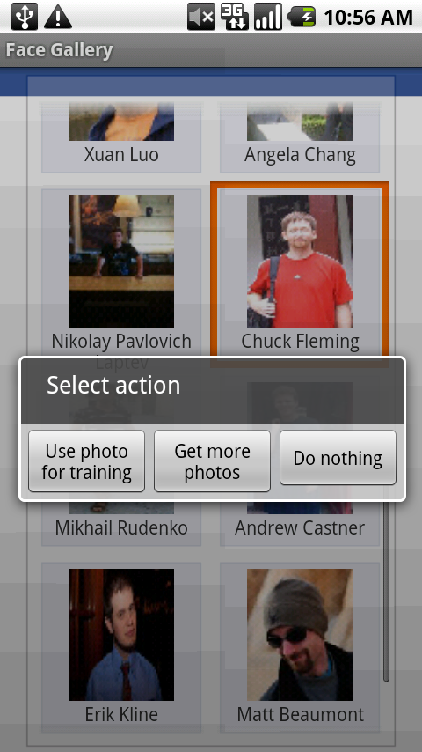
Contacts and Facebook integration

Slide 7
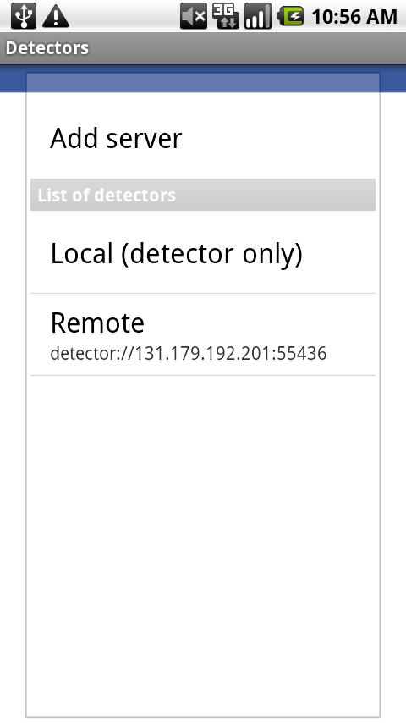
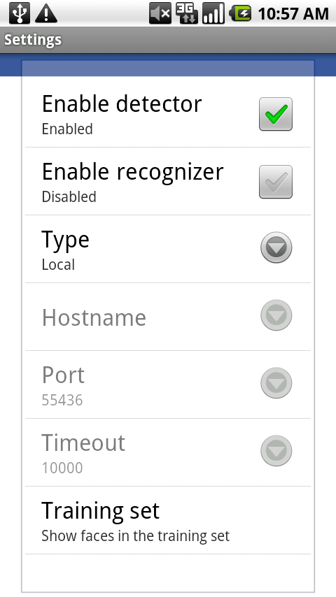
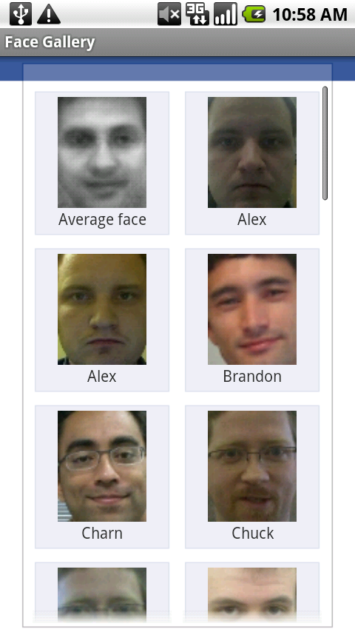
Settings

Slide 8
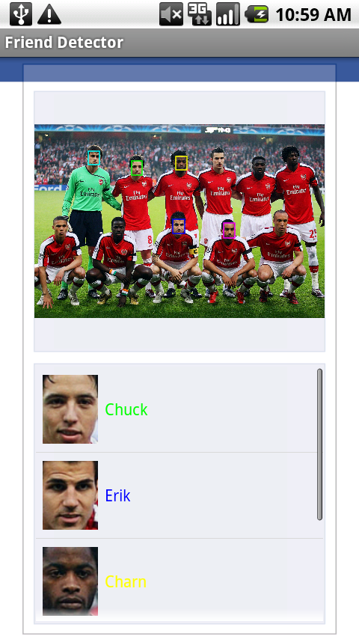
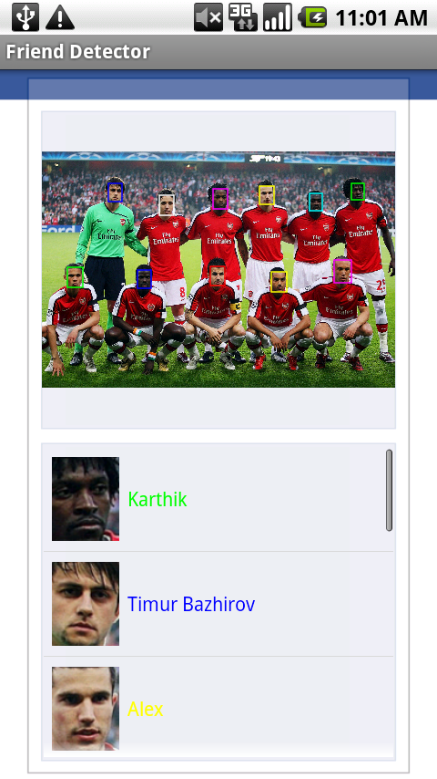
Differences in face detection
Local detection: search is limited to 5 faces (limit has to be hardcoded)
Remote detection: different order, unlimited number of detected faces, slightly different rectangles

Slide 9
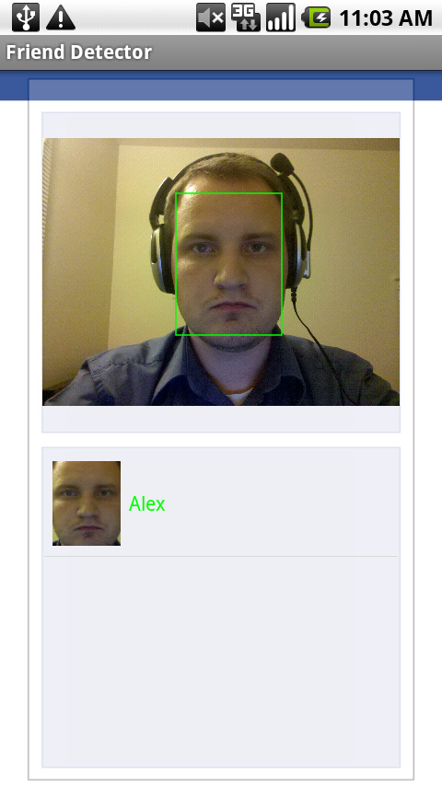
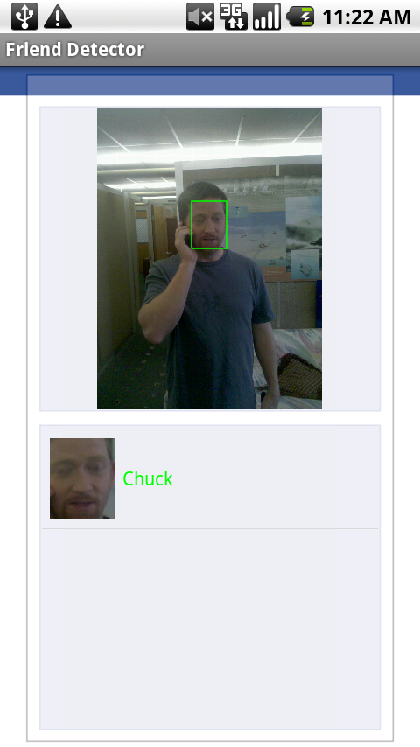
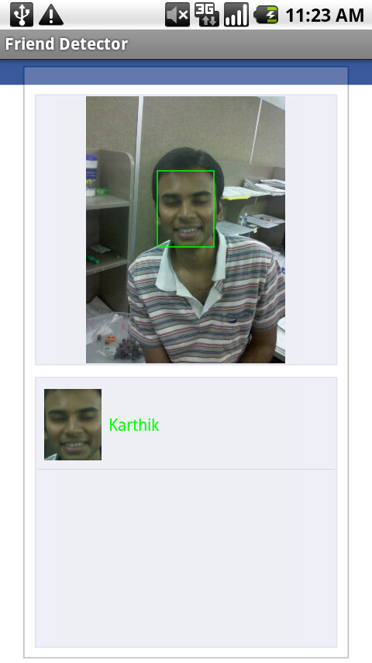
It works…. Sometimes…

Slide 10
Evaluation
Local face detector and face recognizer
Remote detector and face recognizer over 3G
Remote detector and face recognizer over WiFi
Local face detector and remote face recognizer over 3G
Local face detector and remote face recognizer over WiFi

Slide 11
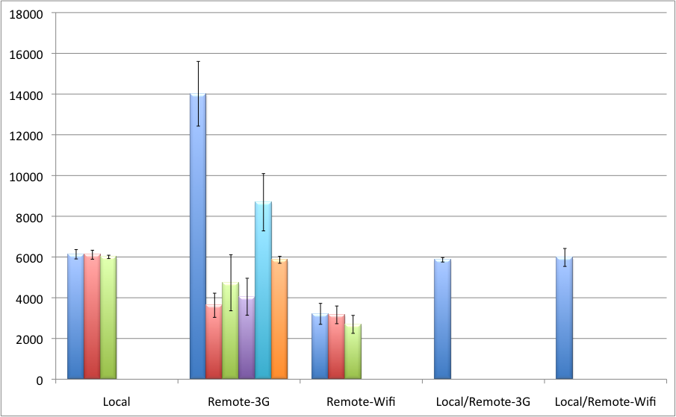
Numbers
milliseconds

Slide 12
Future work
Server-side Facebook integration
leveraging friend graphs to improve recognition quality
pull images directly from Facebook without slow mobile connection
Release software to Android Market and start making big money

