Slide 1
WEBSITE DEVELOPMENT PROJECT
BAGEL BUNCH
WESLEY DASHNER: SENIOR DEVELOPER
ELI HERMANN: TECHNICAL COORDINATOR
ANDREW MCMULLIN: SYSTEM INTEGRATOR
ALLISON OBORN: PROJECT MANAGER

Slide 2
DESIGN
We decided to use Vue and Firebase. Eli and Andrew had a lot of experience with Vue. Wesley had a lot of experience with Firebase and backend functionality.
We felt that our design and Vue/Firebase definitely had the power to fulfill the requirements.
The hardest decisions were how to design the backend and database for ordering and the menu. We had long discussions and drew lots of pictures on a whiteboard to decide the best way to do it.
We decided to represent the menu as a list of items. We used the name of the item as the unique ID. We also stored the inventory in each item object.
Writing the backend for ordering was tough. We decided to have the backend do everything when an order is placed or updated, so that the frontend didn’t have to make more API calls.

Slide 3
AGILE PRACTICES
Our team became much better at coordinating our efforts towards the end of the project. At the beginning our scrum meetings consisted of assigning tasks to different team members and then completing them on our own. This worked well at the beginning when the tasks were easily separated, but became harder as we needed more coordination. We eventually changed our scrum meetings to assigning tentative tasks and then working together until someone completed their task and then we would reevaluate what needed to be completed. This was much more effective and our productivity velocity improved significantly at this point.

Slide 4
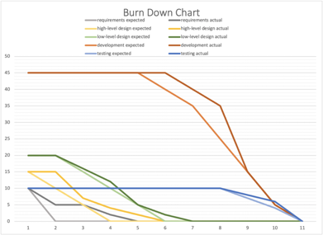
FIVE COLOR BURN DOWN CHART
Average Team Velocity: 9.09 story points per week
Tasks include:
Use Case Diagrams
Project Plan
readMe.md
Requirements Definition
Class Diagram
High Fidelity Prototype
Low Fidelity Prototype
Users Activity Diagram
Employees Activity Diagram
Low Fidelity User View
Low Fidelity Admin View
Backend for Account info/login
Account info page
Login page
Create Account page
Backend/Front end communication
Menu backend
Admin create accounts
Customer menu/ordering
Admin edit menu
Chef view
Cashier view
Ordering Backend
Testing

Slide 5
TESTING AND DEPLOYMENT
The project is ready to move into deployment because we have fulfilled the necessary requirements and thoroughly tested it.
We coordinated our efforts to connect the backend and frontend seamlessly. We made everything as organized and simple as possible, so it would be easy to use.
Good documentation was also important to make sure everything was correct and easy to connect together.
We wrote automated tests to test the backend and the connection to the frontend. We thoroughly tested the frontend and confirmed that it worked as expected every time.

Slide 6
REQUIREMENT #1 - DESCRIPTION
All the actors need to have a login
FURPS - Functionality
Audience Oriented - User and Functional
MOSCOW - Must

Slide 7
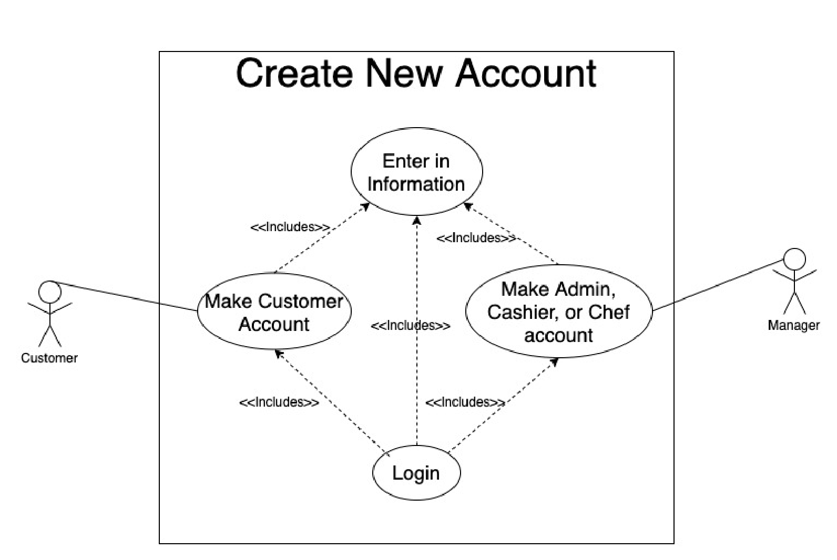
REQUIREMENT #1 - MODELING
We decided to store all accounts in a Firebase collection.
This required several backend functions:
/createAccount
/login
/updateName
/updatePassword
/addMoney

Slide 8
REQUIREMENT #1 - DEVELOPMENT AND TESTING
Issue #17 - Completed by Eli Hermann
Issue #16, #21 - Completed by Allie Oborn
Issue #15 - Completed by Andrew McMullin
Issue #14 - Completed by Wesley Dashner
For testing, we created multiple accounts for each account type. We checked and confirmed that we could login and edit each account. We also confirmed that an account could only access the features it is supposed to be able to access. We also tested the backend functions with an automated Python script.

Slide 9
REQUIREMENT #6 - DESCRIPTION
All the actors need to be able to view the menu and order
FURPS - Functionality
Audience Oriented - User and Functional
MOSCOW - Must

Slide 10
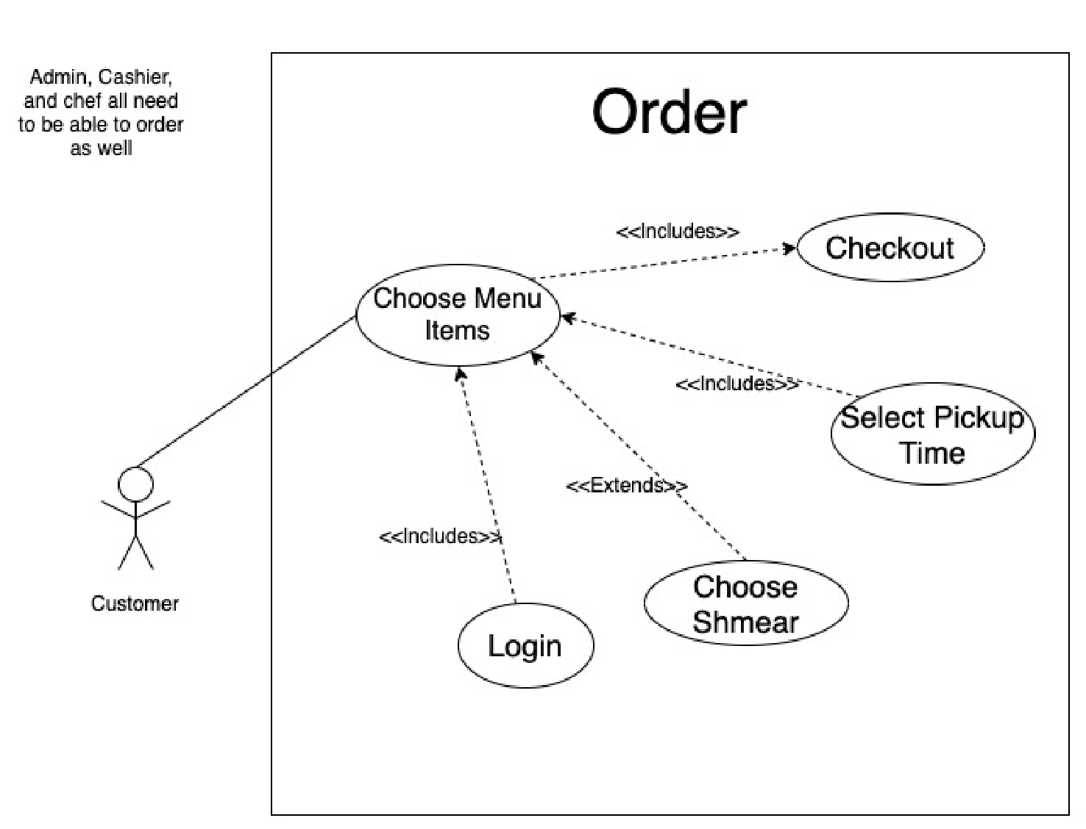
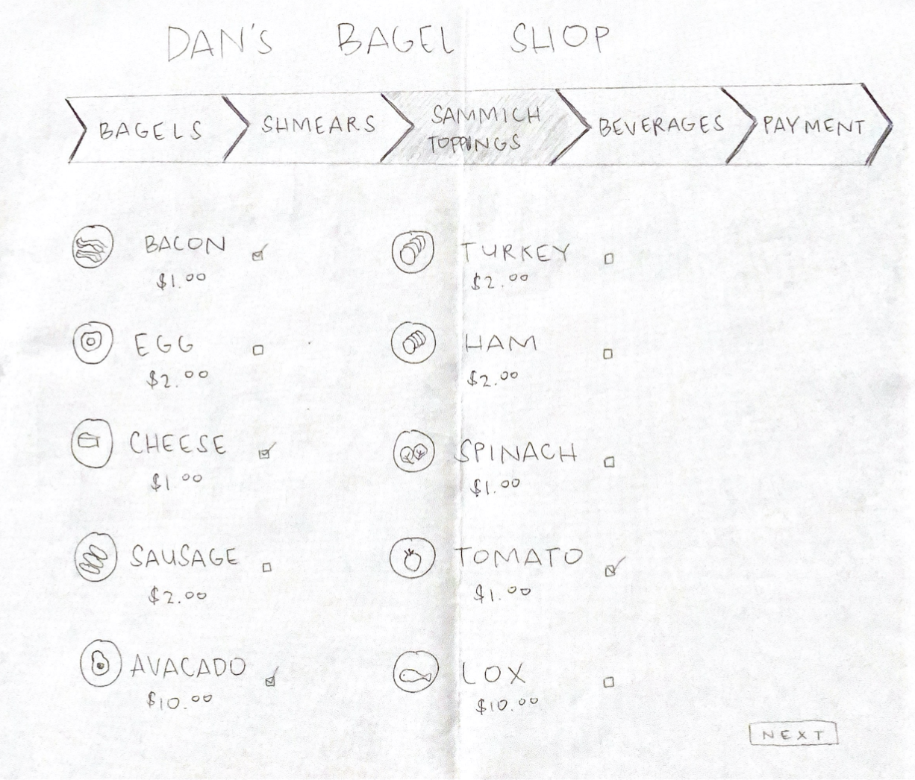
REQUIREMENT #6 - MODELING
We decided to store all orders and the menu in a Firebase collection.
We stored the inventory amounts of each item in the menu as well.
This required several backend functions:
/getMenu
/updateMenu
/order
/getOrders
/updateOrderStatus

Slide 11
REQUIREMENT #6 - DEVELOPMENT AND TESTING
Issue #22 - Completed by Eli Hermann
Issue #26 - Completed by Wesley Dashner
For testing, we created a bunch of orders and updated their statuses and followed them throughout the system. We confirmed that everything worked as expected each step of the way. We also tested the backend functions with an automated Python script.

Slide 12
REQUIREMENT #25 - DESCRIPTION
Managers are able to see all future and past orders.
Chef, Cashier are able to see all current Orders
FURPS - Functionality
Audience Oriented - User and Functional
MOSCOW - Must

Slide 13
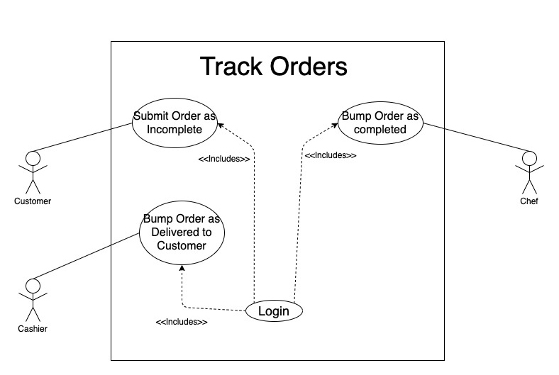
REQUIREMENT #25 - MODELING
All Orders are tracked using another Firebase collection called orders.
Required backend functions:
/getOrders
/updateOrderStatus

Slide 14
REQUIREMENT #25 - DEVELOPMENT AND TESTING
Issue #25 - Completed by Andrew McMullin
Issue #24 - Completed by Andrew McMullin
For testing, we created a bunch of orders and tried viewing them while signed into different types of accounts. We confirmed that everything worked as expected each step of the way. We also tested the backend functions with an automated Python script.

Slide 15
RESOURCES
A Comprehensive App Development Platform. (2016). Retrieved October 01, 2020, from
https://firebase.google.com
A Material Design Framework for Vue.js. (2016). Retrieved November 01, 2020, from
https://vuetifyjs.com/en/
Where Developers Learn, Share, & Build Careers. (2008). Retrieved December 04, 2020,
from https://stackoverflow.com/
Where good ideas find you. (2014). Retrieved November 04, 2020, from
https://medium.com/
You, E. (2014). Vue.js. Retrieved November 01, 2020, from https://vuejs.org

Slide 16
QUESTIONS?

