Slide 1
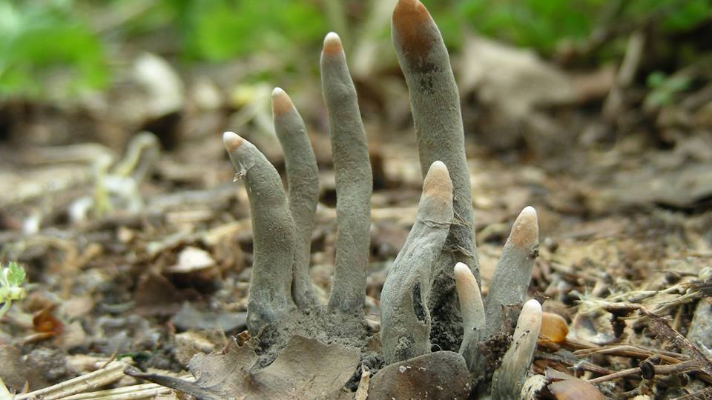
Dead Mans Fingers

Slide 2
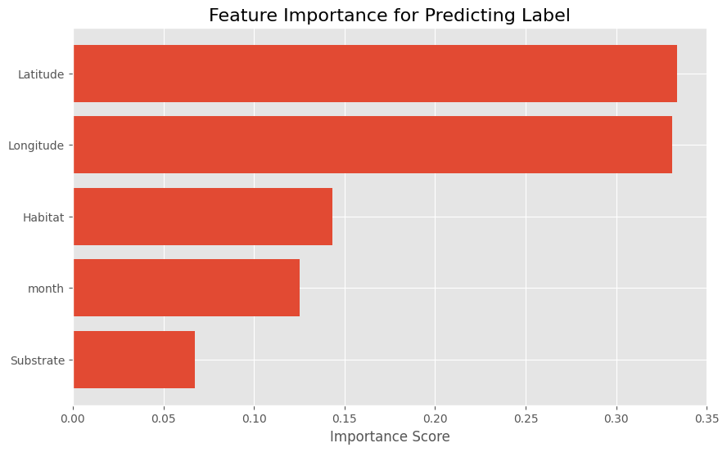
Methods – Metadata selection
Bought all columns of metadata – prioritizing classes < 200 samples
Random Forest classifier → Evaluation of feature importance
Primarily latitude and longitude data
Prioritized classes < 200 samples & Attain even distribution geographically
Removing outliers (ex. Hand drawn images)

Slide 3
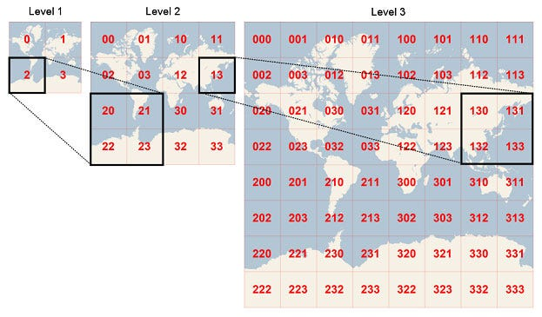
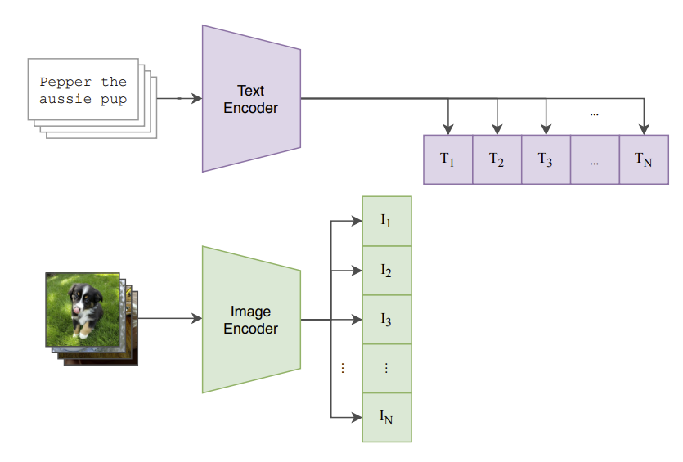
Preprocessing of metadata
Longitude + Latitude → Geohash
EventDate → Month (circular embedding)
Habitat & Substrate → CLIP

Slide 4
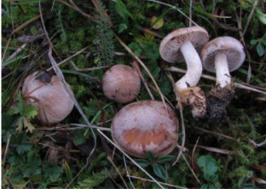
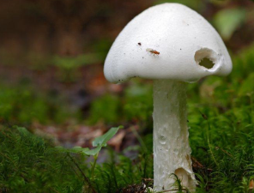

Multimodal learning – Methods
[384]
DINO
Classification
[input
dim.]
[500]
[183]
Concat
Metadata
Embedding
…
…
…

Slide 5
Multimodal learning – Methods
[384]
DINO
Classification
MLP
Classification
[384]
[500]
[183]
[183]
Metadata
[384]
+
Linear layer
…
…
…

