Slide 1
Link Creators: Yifeng Huang, Matthew Burn, David Bernstein, Alli MacMillan, and Sam busser Team identity: meeting masters

Slide 2
Project overview
Link is a website designed to aid students in finding a common meeting time.
One user will create a group by proposing meeting dates and times.
On this same page, the user can invite others.
Once a user logs in they can view groups they’re a part of or create a new group.
How does it work?
By putting all users availability's on a page where everyone can view convenient times the group can decide when to meet.

Slide 3
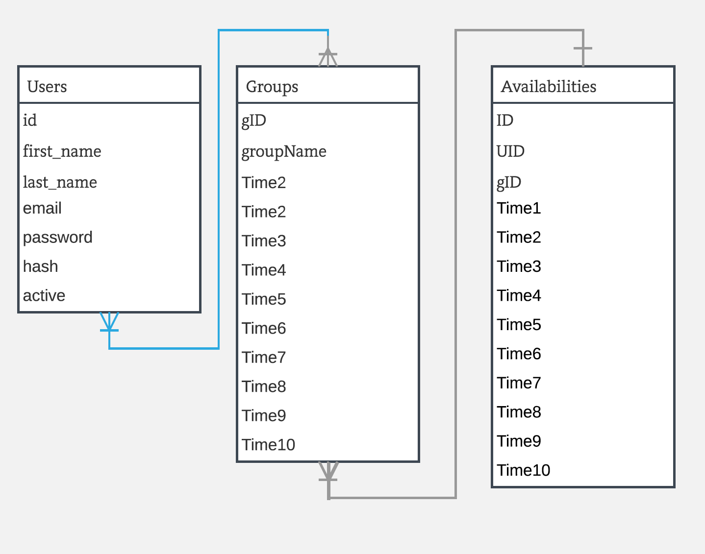

Slide 4
Things working vido

Slide 5






Tools list - score 1-5
Javascirpt and HTML for front end website design.
MySql and PHP for backend database.
Trello for project management & GroupMe for communication
PHPUNIT for testing
Github for version control

Slide 6
Overview of methodology followed
We followed the agile methodology throughout the semester to help us decide who will work on what and what to work on each sprint.
The first sprints started with learning the tools we choose to use, then we focused on the actual creation of the site.
Our team met once a week to share what we’ve been working on and decide what was next.

Slide 7
Challenges encountered
Difficult to meet as much as a proper agile implementation should.
We overcame this by communicating on groupme and scheduling tasks on trello
Our initial design tough to implement
We changed the scope of our project to only track users availability to proposed times instead of propose times based on availability
Did not know how to use the majority of our tools
Spent a lot of time learning and more time troubleshooting

Slide 8
Key lessons learned
Tools
How PHP, mysql interact with eachother and are displayed using HTML and Javascript
Methods
Do not try to use agile methodology without being able to meet several times a week.
Be prepared to change the scope of your project
Software development process
Allow more time than expected for everything
Important to work closely with group
Be prepared to choose which features to cut out

