Slide 1
Link Creators: Yifeng Huang, Matthew Burn, David Bernstein, Alli MacMillan, and Sam busser Team name: meeting masters

Slide 2
Project overview
Link is a website designed to aid students in finding a common meeting time.
One user will create a group by proposing meeting dates and times.
On this same page, the user can invite others.
Once a user logs in they can access the group page and view others / edit their availability.
How does it work?
By putting all users in a groups availability on one page, everyone can see which times work for who.

Slide 3
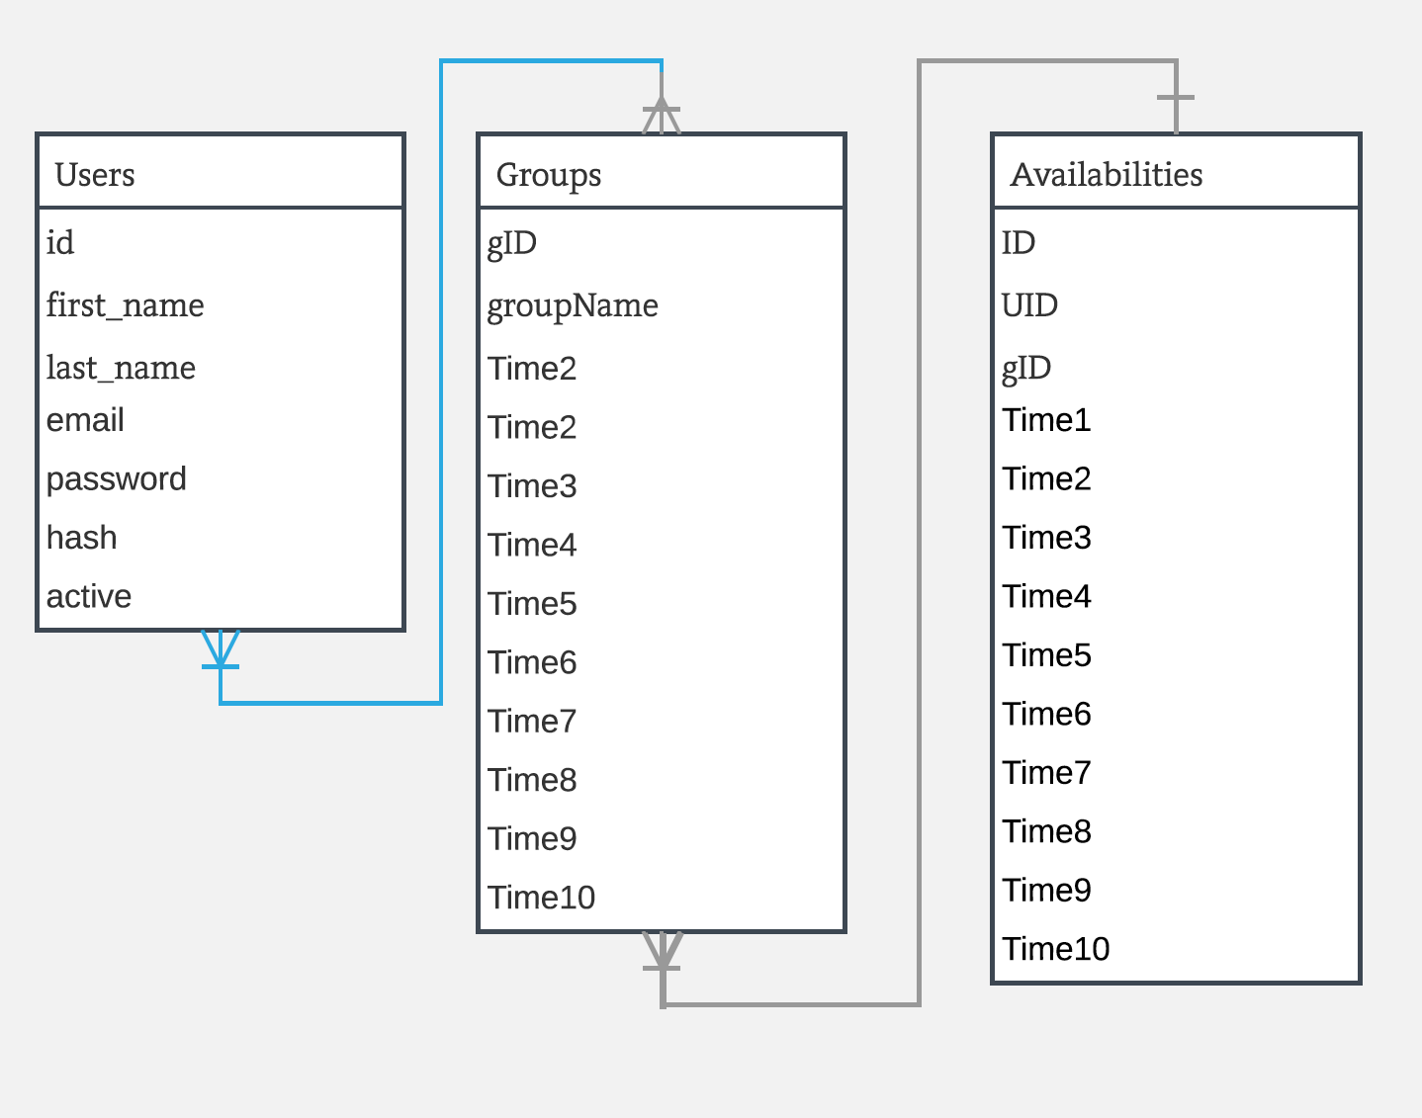

Slide 4
Link to video of shit working

Slide 5





Tools list - score 1-5
Javascirpt and HTML for front end website design.
MySql and PHP for backend database.
Trello for project management & GroupMe for communication
PHPUNIT for testing

Slide 6
Overview of methodology followed
We followed the agile methodology throughout the semester to help us decide who will work on what.
The first sprints started with learning the tools we choose to use, then we focused on the actual creation of the site.
Our team met once a week to share what we’ve been working on and decide what was next.

Slide 7
Challenges encountered
Difficult to meet as much as a proper agile implementation should.
We overcame this by communicating on groupme and scheduling tasks on trello
Our initial design tough to implement
We changed the scope of our project to only track users availability to proposed times instead of propose times based on availability
Did not know how to use the majority of our tools
Spent a lot of time learning and more time troubleshooting

Slide 8
Key lessons learned

