Slide 1


Deep Learning-based Sentiment Classification for Amazon Products Reviews
Allison Selwah, Subhasish Bhaumik & Bowen Yang

Slide 2
Motive & Background
Project Goal: Develop a deep learning-based sentiment analysis model using RNNs and LSTMs to classify Amazon product reviews into positive or negative sentiments, aiming to understand contextual details in customer feedback.
Importance of Product Reviews: Online reviews significantly influence consumer purchasing decisions (93% of consumers are impacted) and provide valuable insights for businesses to improve customer service and product offerings.
Business & Economic Impact: Poor sentiment analysis can cost companies billions, while positive reviews can boost conversion rates by up to 3 times, highlighting the importance of real-time sentiment insights for product performance.
Challenges in Manual Review Analysis: The sheer volume of daily reviews makes manual sentiment assessment time-consuming and subjective, creating the need for automated, scalable solutions like deep learning models.
Relevance to NLP: RNNs are ideal for sentiment analysis as they process sequential data, capturing the temporal dependencies and contextual nuances in text, making them more effective for understanding sentiment in complex reviews.

Slide 3
Data
Amazon Reviews Dataset from Kaggle
Structure:
Binary classification:
__label__1: 1-2 star reviews (negative sentiment)
__label__2: 4-5 star reviews (positive sentiment)
Excludes neutral 3-star reviews
Includes review titles and text
Primarily English reviews, some multilingual content
Volume:
Training: 468 MB (3.6 million rows)
Test: 52 MB (400K rows)
Dataset: https://www.kaggle.com/datasets/bittlingmayer/amazonreviews

Slide 4
Expected Outcomes
Comparative performance analysis of RNN and LSTM models
Understanding of deep learning model's sentiment classification capabilities
Using Accuracy to evaluate the percentage of correctly classified sentiment labels (positive, negative, neutral) to the total number of samples

Slide 5
Model Building
Data Pre-Processing
PySpark was used for preprocessing the large dataset (4 million reviews) due to its ability to handle scalable, distributed processing, which is essential for tasks like cleaning, tokenization, and applying UDFs on such a large volume of data. By leveraging Apache Spark's parallel processing across multiple CPU cores or machines, PySpark significantly speeds up preprocessing and makes it feasible to work with datasets that would exceed the memory capacity of a single machine.
Processing Steps:
Environment Setup
Spark Session Initialization
Data Loading
Data Shaping and Feature Extraction
NLP Setup
Text Cleaning and Preprocessing Functions
Preprocessing Pipeline Execution
Saving Processed Data
Creating and Saving Sampled Datasets
Cleanup
Code Repository: https://github.com/alliselwah/IE7500_GroupF.git

Slide 6
Model Training
After each training and evaluation, the model is saved to enable reuse
save_complete_model() function was created to save the entire model, including the network architecture, learned weights, and configuration of the optimizer, and utilized the Keras model.save() method
Alongside of the model file, a JSON file containing metadata, such as model type, save date, and framework version is saved for tracking purposes.
Process Steps:
Load Data
Preprocess Text Data
Define Model Architecture
Compile the Model
Set Up Callbacks
Train the Model
Evaluate the Model
Generate Predictions

Slide 7
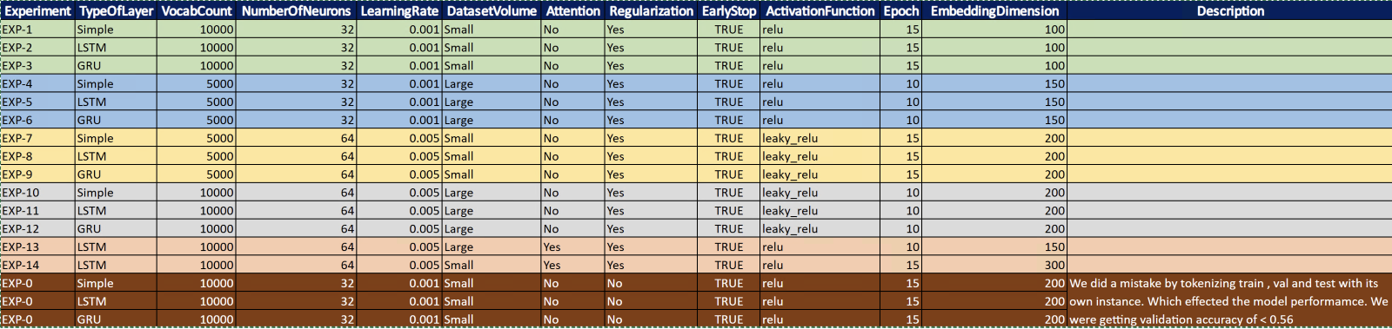
Model Evaluation
A systematic experimentation process was conducted to identify the most effective model architecture and hyperparameters by testing combinations of recurrent layer types (Simple RNN, LSTM, GRU), vocabulary sizes (11,092 or 422,794 words), neuron counts (32 or 64), learning rates (0.001 or 0.005), activation functions (ReLU or Leaky ReLU), dataset sizes ('Small' vs. 'Large'), and mechanisms like Attention layers and Early Stopping. Each unique configuration was treated as a separate experiment, logged using MLflow, with validation accuracy used as the primary metric for performance comparison.

Slide 8
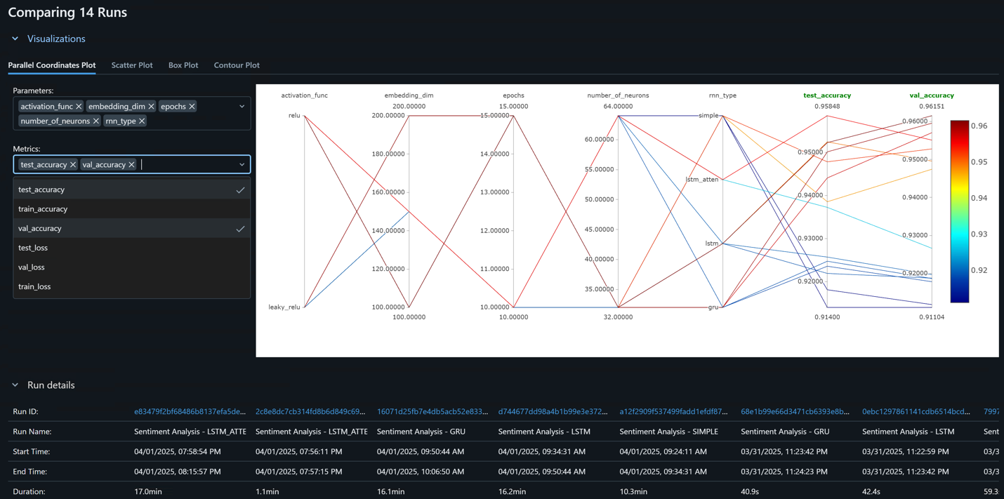
Model Evaluation (continued...)
The plot illustrates how different hyperparameter settings relate to performance metrics across experiments, with each line representing a run and its color indicating validation accuracy—warmer colors (yellow/orange) for higher accuracy (~0.95–0.96) and cooler colors (blue/purple) for lower accuracy (~0.91–0.92).

Slide 9
Outcomes
The parallel coordinates plot highlights that using a higher number of neurons (e.g., 64), a larger embedding dimension (e.g., 150-200) and selecting specific RNN architectures (likely LSTM or GRU) were crucial factors in achieving the best validation and test accuracies (around 0.96) in these experiments. The number of epochs showed an optimal range rather than a simple linear trend. The results also showed good consistency between validation and test performance across the runs.

Slide 10
Observations
Parameters vs. Metrics:
The plot maps activation_func, embedding_dim, epochs, number_of_neurons, and rnn_type against test_accuracy and val_accuracy.
Performance Range:
Validation and test accuracies across the 14 runs range from approximately 0.91 to 0.96.
Validation vs. Test Accuracy:
The relative heights of lines between the val_accuracy and test_accuracy axes were generally similar.
This suggests good generalization, as models that performed well on validation also performed well on the test set.
The best runs achieved both high validation and test accuracy (~0.96).

Slide 11
Observations (continued...)
Key Parameter Influences:
Number of Neurons:
Higher neuron counts (likely 64) consistently resulted in higher validation and test accuracies (warmer colored lines).
Lower neuron counts (likely 32) generally led to lower performance (cooler colored lines).
Embedding Dimension:
Higher embedding dimensions (e.g., 150 and 200) strongly correlated with better performance.
Lower dimensions (e.g., 100) were associated with lower accuracy.
RNN Type:
High-performing runs (brightest lines) clustered around specific RNN types, likely LSTM and possibly GRU.
Lower-performing runs were associated with the Simple RNN type.
Epochs:
High-performing runs clustered around 10 to 15 epochs, but no strict linear correlation was observed.
Some runs with more epochs had lower performance, while one strong performer used ~10 epochs, suggesting an optimal range that interacts with other parameters.
Activation Function:
High-performing runs appeared across multiple activation function values, suggesting activation function had less impact compared to other parameters and worked well when combined with the right settings.

Slide 12
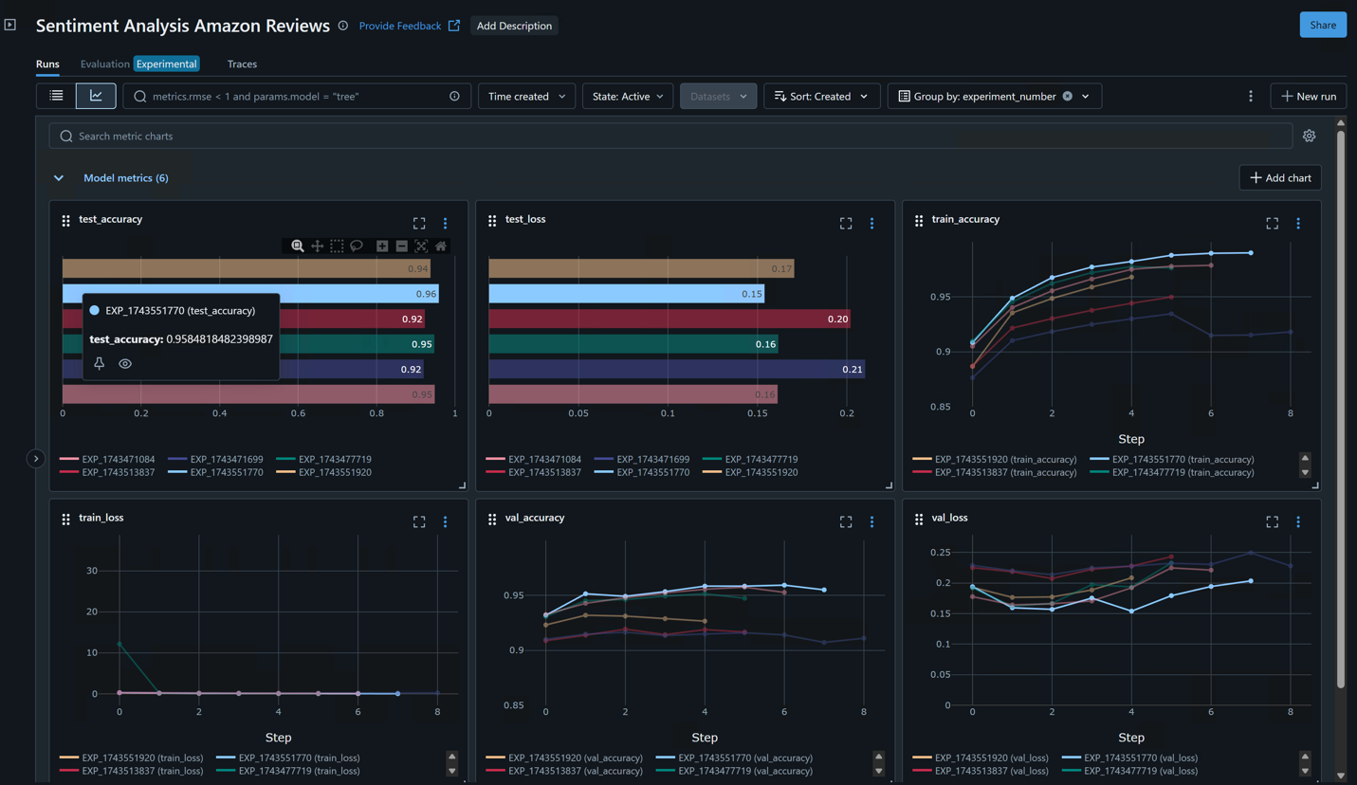
Additional Observations
The Sentiment Analysis experiments showed that Run EXP_1743551770 outperformed other runs, achieving the highest test accuracy (~0.9585) and the lowest test loss (~0.17). The experiment's learning curves indicated steady improvement in training accuracy and loss, while validation accuracy showed more fluctuations, with validation loss initially decreasing before flattening, suggesting overfitting in some runs; overall, EXP_1743551770 demonstrated the best generalization to the test set.

Slide 13
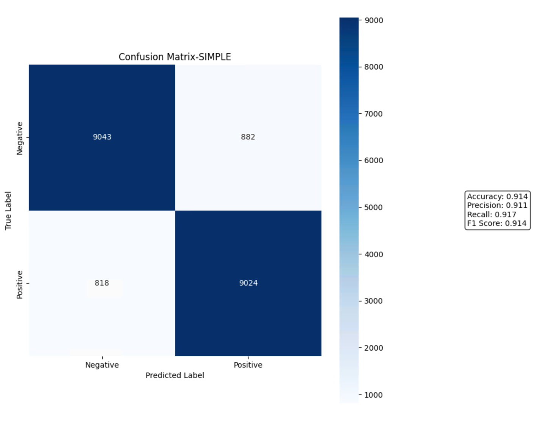
Confusion Matrix
The confusion matrix for the "SIMPLE" RNN model on a binary sentiment classification task shows it correctly classified 9043 Negative (True Negatives) and 9024 Positive (True Positives) instances, with errors in 882 False Positives and 818 False Negatives. The model achieved 91.4% accuracy, 91.1% Precision, 91.7% Recall, and a balanced 91.4% F1 Score, indicating strong overall performance.

Slide 14
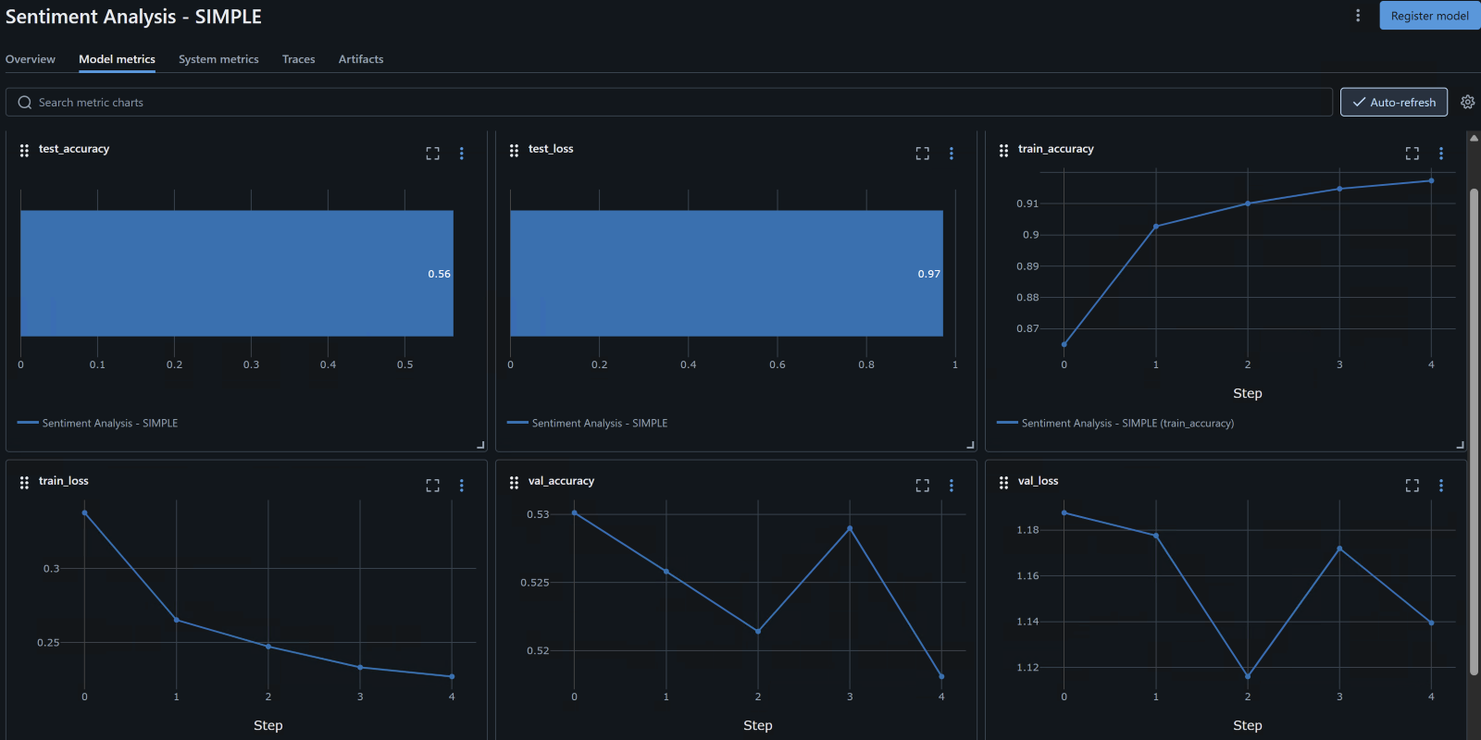
Error Analysis
In an earlier experiment, using different tokenizers for the test, train, and validation datasets led to poor validation performance. While the training accuracy improved steadily, the validation accuracy remained low and erratic (around 0.52-0.53), with high volatility in validation loss, due to inconsistent word-to-index mappings caused by separate tokenization, preventing the model from generalizing properly.

Slide 15
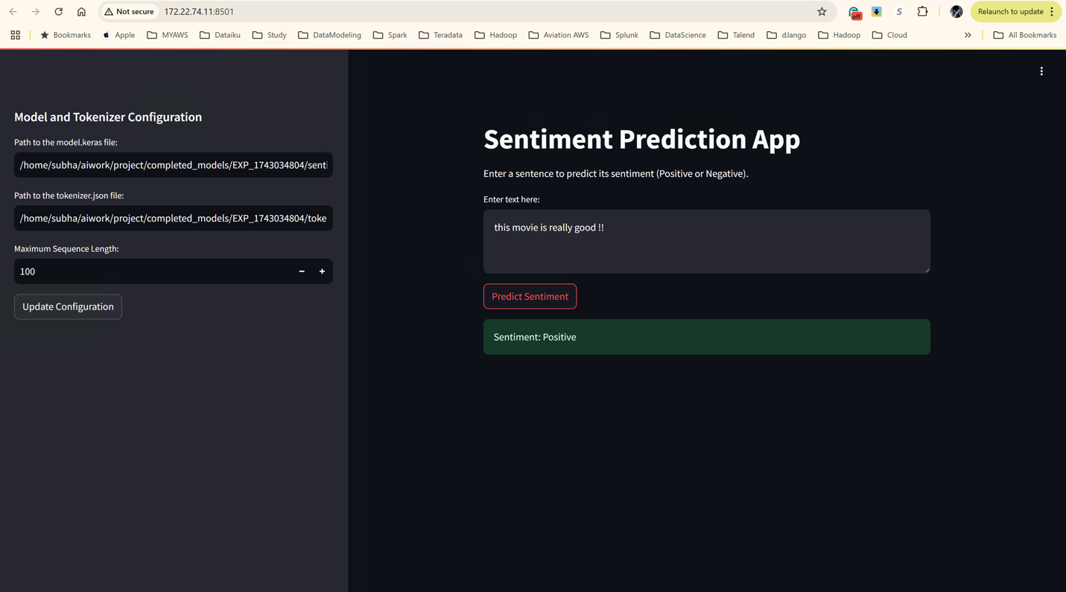
Model Inference
We built a Streamlit app that allows users to predict sentiment using a pre-trained Keras model by providing the model path, tokenizer JSON file, and maximum sequence length through the sidebar. The tokenizer is saved in JSON format alongside the model for easy loading and configuration. The app loads a saved model and tokenizer using load_model_and_tokenizer when "Update Configuration" is clicked, storing them in session state. Users enter text in a text area, and upon clicking "Predict Sentiment," the input is tokenized, padded, and passed to the model for inference; the result is classified as Positive or Negative based on a 0.5 threshold and displayed accordingly.

