Slide 1
Eyetracking Lab Rotation Winter Semester 23-24 Chris Allison
Introduction to Prediction

Slide 2
Prediction 101: Foundations
What is the main idea of the predictive revolution?
The human mind is a prediction machine
What is some of the early evidence of predictive processing?
von Helmholtz
Perception is learned prediction
Notes:
Helmholtz: perception is not a born skill

Slide 3
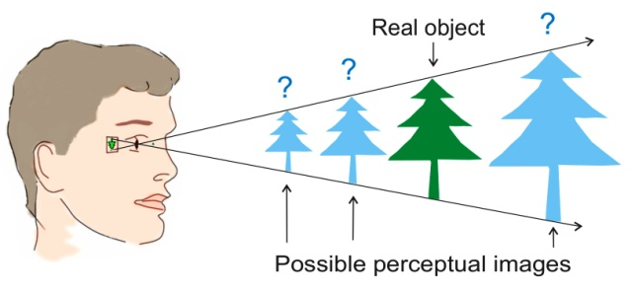
Prediction 101: Foundations
The brain requires multiple cues to make sense of the size and distance of objects
What kinds?
These cues are learned through experience

Slide 4


Prediction 101: Foundations
Prior knowledge shapes what we see
Top-down processing
The brain (top) sends information (down) to the sensory system
Consequence of how the mind anticipates input
Notes:
What do you see?

Slide 5
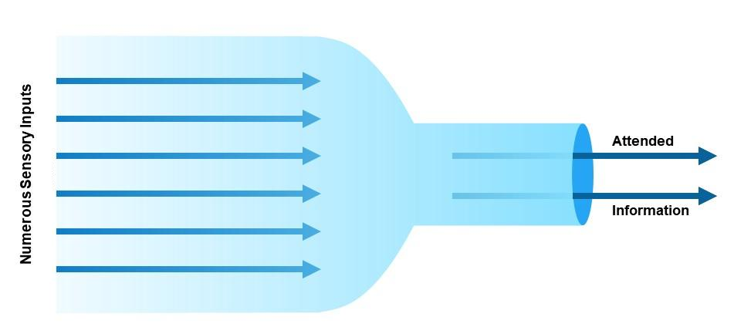
Prediction 101: Foundations How did we get here?
The bottleneck problem
Notes:
Why does the brain do this?

Slide 6
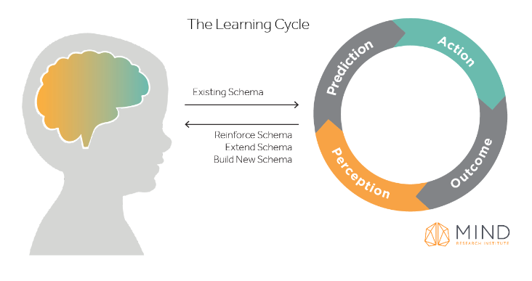
Prediction 101: Foundations How did we get here?
Perception-action cycle
Perception supports action
The brain makes sense of the world by creating and testing hypotheses about the world
Our brains make prediction based on previous experience
The result either reinforces the existing schema or begins the creation of a new one

Slide 7


Slide 8
Prediction 101: Foundations How did we get here?
The predictive brain is an elegant and possibly unifying theory that can combine cognition and behavior
Notes:
What’s nice about the predictive brain?

Slide 9
Prediction 101: Definitions
What is prediction?
What isn’t prediction?
Why is prediction useful for language comprehension?

Slide 10
Prediction 101: Definitions
Prediction
Top-down processing
Expectation
Anticipation
Context effects
Priming

Slide 11
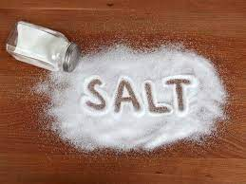
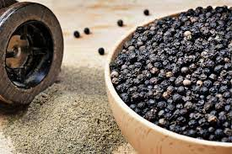
Priming vs Predicting

Slide 12
Priming vs Predicting
Can you pass the salt and ______
Notes:
Where do you draw the line?

Slide 13
Prediction 101: Definitions
All of these involve the use of previous knowledge/experience to facilitate the processing of upcoming information

Slide 14
Prediction 101: Definitions
Prediction is about the future
The definition must be inclusive and not arbitrarily exclude phenomena that are clearly about the future

Slide 15
Prediction 101: Definitions
Prediction is the conscious or subconscious use of information from previous experiences for the conscious or subconscious processing of information about future states of the body and environment

