Slide 1
Eyetracking Lab Rotation Winter Semester 23-24 Chris Allison
Introduction to Visual World Paradigm

Slide 2
VWP 101: What is it?
A family of closely related experimental methods
Physical
On a screen
In VR
Participant eve movements are tracked while they listen to or produce language

Slide 3
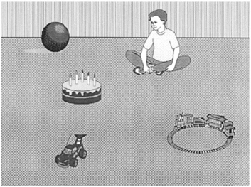
VWP 101: What is it?
The boy will move the cake
The boy will eat the cake

Slide 4
VWP 101: What is it?
Participants were more likely to make anticipatory eye movements to the target object when the semantics of the verb were consistent with only one of the objects
Only cake can be eaten, all items could be moved

Slide 5
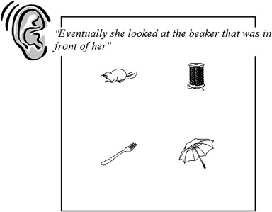
VWP 101: What is it?

Slide 6
VWP 101: What is it?
Notes:
Phonological competitor

Slide 7
VWP 101: What is it?
Notes:
Shape competitor

Slide 8
VWP 101: What is it?
Notes:
semantic competitor

Slide 9

VWP 101: Assumptions
What is the major assumption of the visual world paradigm?
Notes:
Eye movements are a behavioral measure that are theoretically related to processing

Slide 10
VWP 101: Assumptions
Behavioral measures (technically) require a linking hypothesis
Linking behavioral measures to what the brain is doing is generally quite difficult
What is the link between eye movements during VWP and what’s happening in the brain?
Visual attention shifts as a result of comprehending an utterance. This is followed by a higher probability of a saccadic eye movement to the area of visual attention. Therefore, where a participant is looking and when saccadic eye movements begin can provide insight into online language processing

Slide 11
VWP 101: Linking Hypotheses
Coordinated interplay
Stage 1: Integrate new words
Stage 2: Search for referents in the visual field
Stage 3: Match linguistic input with objects and actions

Slide 12
VWP 101: Linking Hypotheses
Common Representational Substrate
The process of interpreting linguistic input and comprehending visual scenes are intertwined
Linguistic information, visual information and world knowledge are stored in one unitary system and jointly contribute to the dynamic representation of situations.
Notes:
Altmann and Mirkovi (2009)

Slide 13
VWP 101: Linking Hypotheses
Goal Based
The goal of the task effects language processing
Visual objects directly related to a goal gather more attention
Additional tasks (e.g., clicking) contribute to the goal and influence eye movements
Notes:
Salverda et al. (2011)

Slide 14
VWP 101: Logic
All VW experiments use similar logic and design
A visual workspace (typically pictures on a screen)
Speech (typically spoken sentence comprehension)
Eye tracking measurements (typically measures of eye looks at an object at a specified time)

Slide 15
VWP 101: Terminology
Each picture may be referenced one or more time as language is spoken
The picture of interest at a given point in time is called the target
Some pictures may be manipulated to be somehow similar to the target
These are called competitors
Semantic, phonologic, shape, color, features, etc…
Unrelated pictures are called distractors

Slide 16
VWP 101: What does a trial look like?
Display Types
Realistic or semirealistic
Allows us to assess how world knowledge or contextual information may affect understanding of spoken utterances
Arrays
Minimizes the impact of real world knowledge or context
Well suited for studying the activation of conceptual and lexical knowledge

Slide 17
VWP 101: What does a trial look like?
Utterance types
Direct action
“Put the apple that is on the towel in the box”
Explicit tasks can change looking behavior
Look and listen
“The boy drinks from the cup”
Examines more general features of language-vision interactions

Slide 18
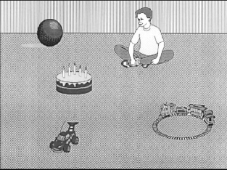
VWP 101: Stimulus timing
The boy will eat the cake
The boy will move the cake
Notes:
So you have these two things (array and sentence), when to display each? Implications?

Slide 19
VWP 101: Stimulus timing
The presentation of the visual display typically begins shortly before the onset of the spoken utterance
Likelihood of fixating objects depends on the preview time of the stimuli

Slide 20
VWP 101: The data
What kind of data do we get from a VWP trial?
What is the question we are interested in during a VWP trial and how can we look at that with our data?
Notes:
In what time frames are people more likely to be looking at the target?

Slide 21
VWP 101: The data
The boy will eat the cake
Region(s) of interest
Time window

Slide 22
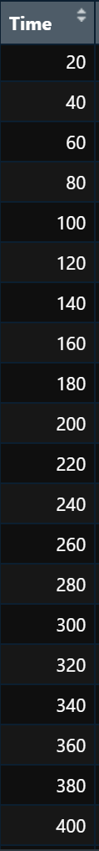
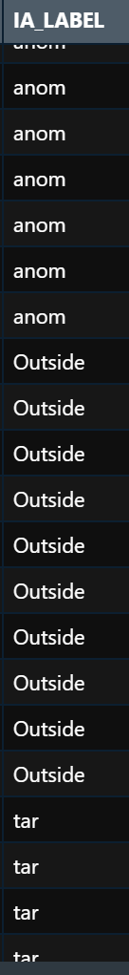
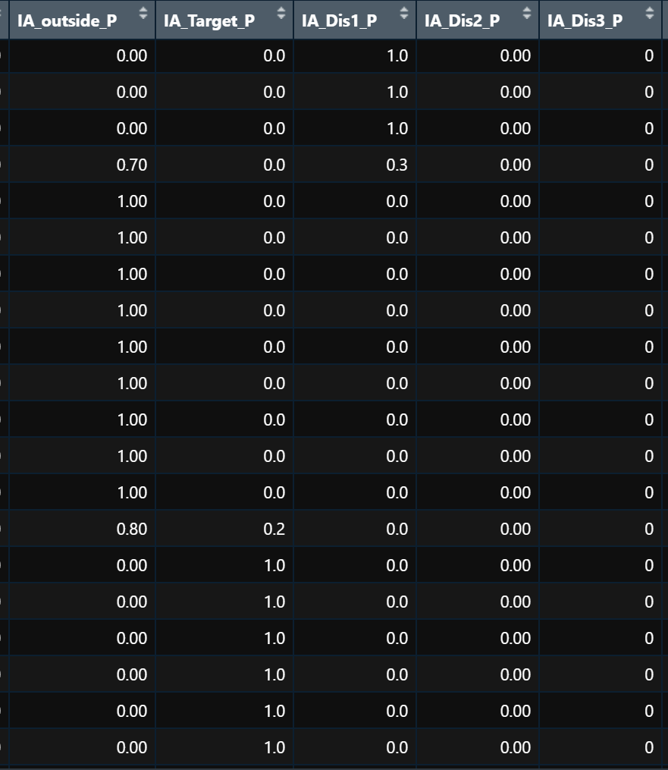
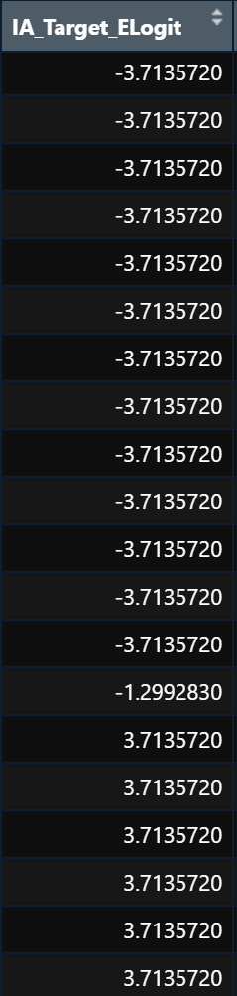
VWP 101: The Data

Slide 23
VWP 101: What can we study using VWP?
Sentence processing
How and when language users integrate different types of information
How context modulates sentence processing

Slide 24
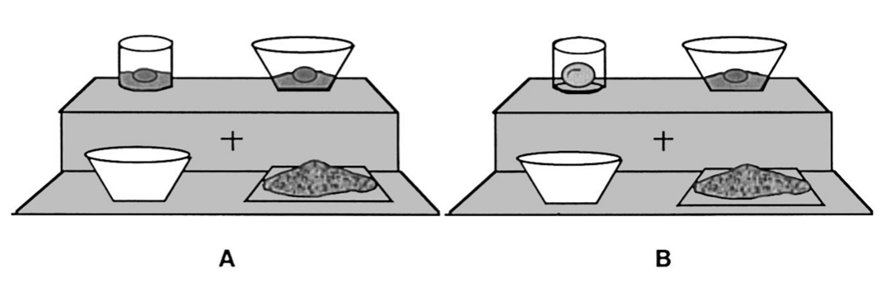
VWP 101: What can we study using VWP?
“Pour the egg in the bowl over the flour”
Notes:
in the bowl: modifier when two liquid eggs and
In the bowl: location when one liquid one solid

Slide 25
VWP 101: What can we study using VWP?
“Pour the egg in the bowl over the flour”
Notes:
in the bowl: modifier when two liquid eggs and
In the bowl: location when one liquid one solid

Slide 26
VWP 101: What can we study using VWP?
Prosody
Differences in prosody can cause people to look at either new or previously mentioned objects
Prosody influences the interpretation of syntactically ambiguous phrases

Slide 27
VWP 101: What can we study using VWP?
Single word processing
Phonological processing
Cohort effects
Word frequency effects
Subtle phonetic cues can modulate lexical activation
Notes:
Words that share their first phoneme with many other words are processed more slowly

Slide 28
VWP 101: What can we study using VWP?
Bilingual word recognition
Mainly focused on cross linguistic lexical access
Is lexical access language-specific or are both languages activated?
Age of acquisition, acoustic information, proficiency all seem to interact with cross linguistic activation

Slide 29
VWP 101: What can we study using VWP?
Prediction!
Listeners use linguistic and visual information to predict upcoming linguistic input
Language-mediated eye movements reflect continuously updated mental representations based on both linguistic and visual input

Slide 30
VWP 101: Prediction
What are some ways that language is predictable?

Slide 31
VWP 101: Prediction
Syntactic prediction
Using grammatic cues like gender or inflections to predict upcoming information
Typically robust in L1 but not in L2 speakers
Modulating factors?
Semantic prediction
Using verb or noun meanings to predict upcoming information
Typically robust in both L1 and in L2 speakers
Modulating factors?

Slide 32
VWP 101: Prediction
Factors that have been shown to modulate prediction
Working memory
General processing speed
Age
Literacy
Proficiency (in L2 contexts)
Crosslinguistic similarities (in L2 contexts)

Slide 33
VWP 101: Prediction
The paradox of prediction
Prediction is supposed to make language processing more efficient
Prediction is however not effortless
Prediction is constrained by cognitive resources

Slide 34
VWP 101: L2 Prediction
L2 language processing is typically more cognitively demanding than L1 processing
L2 processing is less automatized
Slower lexical access
Weaker syntactic representations
Unidirectional interference from L1

Slide 35
VWP 101: L2 Prediction
Despite differences in predictive abilities in L1 and L2 listening, the current leading hypothesis is that the fundamental mechanisms of predictive processing do not differ between L1 and L2 speakers.
The same factors that influence L1 prediction should influence L2 prediction
Stored lexical information (e.g., frequency, lexical associations)
Exposure to target language

Slide 36
VWP 101: Limitations
VWP always involves the interaction of visual and auditory input
Arrays may discourage more elaborative processes
May lead to inferences that would not otherwise be drawn
VWP shows what listeners CAN do, not necessarily ALWAYS do
Absence of eye gaze behavior does not necessarily rule out that activation occurred

