Slide 1
Eyetracking Lab Rotation Winter Semester 23-24 Chris Allison
Introduction to Visual World Paradigm

Slide 2
VWP 101: What is it?
A family of closely related experimental methods
Physical
On a screen
In VR
Participant eve movements are tracked while they listen to or produce language

Slide 3
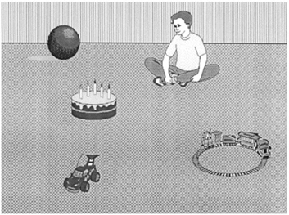
VWP 101: What is it?
The boy will move the cake
The boy will eat the cake

Slide 4
VWP 101: What is it?
Participants were more likely to make anticipatory eye movements to the target object when the semantics of the verb were consistent with only one of the objects
Only cake can be eaten, all items could be moved

Slide 5
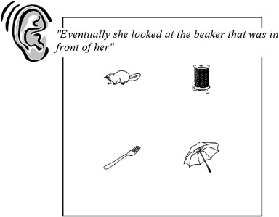
VWP 101: What is it?

Slide 6
VWP 101: What is it?

Slide 7
VWP 101: What is it?

Slide 8
VWP 101: What is it?

Slide 9

VWP 101: Assumptions
What is the major assumption of the visual world paradigm?

Slide 10
VWP 101: Assumptions
Behavioral measures require a linking hypothesis
Linking behavioral measures to what the brain is doing is generally quite difficult
What is the link between eye movements during VWP and what’s happening in the brain?
Visual attention shifts as a result of comprehending an utterance. This is followed by a higher probability of a saccadic eye movement to the area of visual attention. Therefore, where a participant is looking and when saccadic eye movements begin can provide insight into online language processing

Slide 11
VWP 101: Logic
All VW experiments use similar logic and design
A visual workspace (typically pictures on a screen)
Speech (typically spoken sentence comprehension)
Eye tracking measurements (typically measures of eye looks at an object at a specified time)

Slide 12
VWP 101: Terminology
Each picture may be referenced one or more time as language is spoken
The picture of interest at a given point in time is called the target
Some pictures may be manipulated to be somehow similar to the target
These are called competitors
Semantic, phonologic, shape, color, features, etc…
Unrelated pictures are called distractors

Slide 13
VWP 101: What does a trial look like?
Display Types
Realistic or semirealistic
Allows us to assess how world knowledge or contextual information may affect understanding of spoken utterances
Arrays
Minimizes the impact of real world knowledge or context
Well suited for studying the activation of conceptual and lexical knowledge

Slide 14
VWP 101: What does a trial look like?
Utterance types

Slide 15
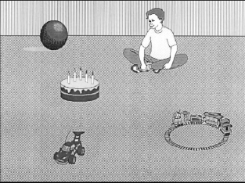
VWP 101: Stimulus timing
The boy will eat the cake
The boy will move the cake

Slide 16
VWP 101: Stimulus timing
The presentation of the visual display typically begins shortly before the onset of the spoken utterance
Likelihood of fixating objects depends on the preview time of the stimuli

