Slide 1
Eyetracking Lab Rotation Winter Semester 23-24 Chris Allison
Introduction to Visual World Paradigm

Slide 2
VWP 101: History
The Visual World Paradigm has a long history
Proto version used in 1974
Found that listeners automatically look towards mentioned or relevant objects

Slide 3
VWP 101: What is it?
A family of closely related experimental methods
Physical
On a screen
In VR
Participant eve movements are tracked while they listen to or produce language

Slide 4
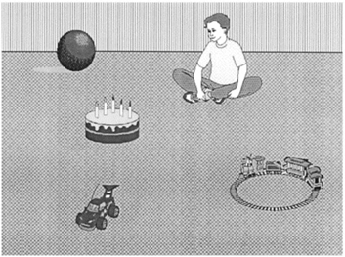
VWP 101: What is it?
The boy will move the cake
The boy will eat the cake

Slide 5
VWP 101: What is it?
Participants were more likely to make anticipatory eye movements to the target object when the semantics of the verb were consistent with only one of the objects
Only cake can be eaten, all items could be moved

Slide 6
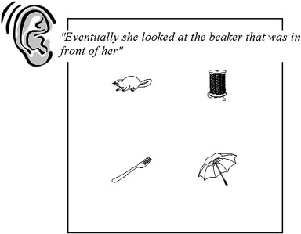
VWP 101: What is it?

Slide 7
VWP 101: What is it?

Slide 8
VWP 101: What is it?

Slide 9
VWP 101: What is it?

Slide 10
VWP 101: Logic
All VW experiments use similar logic and design
A visual workspace (typically pictures on a screen)
Speech (typically spoken sentence comprehension)
Eye tracking measurements (typically measures of eye looks at an object at a specified time)

Slide 11
VWP 101: Logic
Each picture may be referenced one or more time as language is spoken
The picture of interest at a given point in time is called the target
Some pictures may be manipulated to be somehow similar to the target
These are called competitors
Semantic, phonologic, shape, color, features, etc…
Unrelated pictures are called distractors

