Slide 1
Eyetracking Lab Rotation Winter Semester 23-24 Chris Allison
Prediction and the Visual World Paradigm

Slide 2
Introduction to Prediction: Foundations
We are in the predictive revolution
What is some of the early evidence of predictive processing?
von Helmholtz
Perception is learned prediction
Notes:
Helmholtz: perception is not a born skill

Slide 3
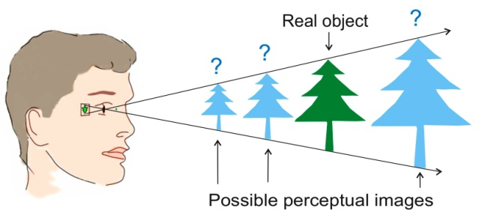
Introduction to Prediction : Foundations
The brain requires multiple cues to make sense of the size and distance of objects
What kinds?
These cues are learned through experience
Notes:
Just seeing an object requires prediction

Slide 4
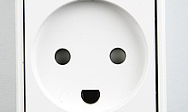
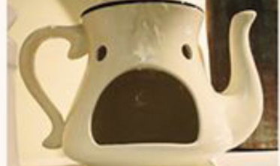
Introduction to Prediction : Foundations
Prior knowledge shapes what we see
Top-down processing
The brain (top) sends information (down) to the sensory system
Consequence of how the mind anticipates input
Notes:
What do you see?

Slide 5
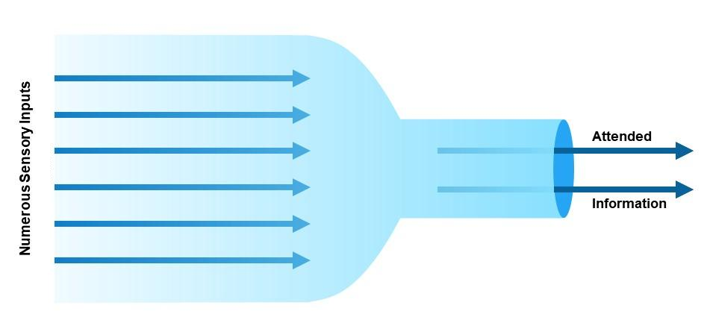
Introduction to Prediction: Foundations How did we get here?
The bottleneck problem
Notes:
Why does the brain do this?

Slide 6
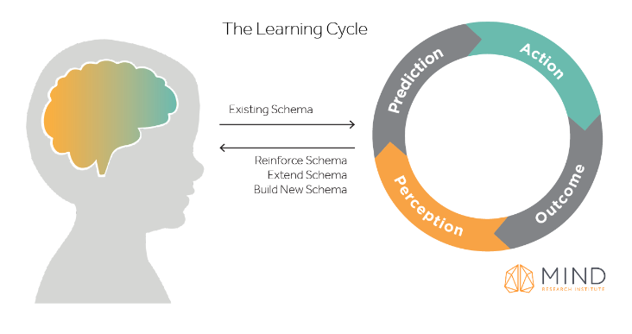
Introduction to Prediction: Foundations How did we get here?
Perception-action cycle
Perception supports action
The brain makes sense of the world by creating and testing hypotheses about the world
Our brains make prediction based on previous experience
The result either reinforces the existing schema or begins the creation of a new one

Slide 7
Introduction to Prediction: Foundations How did we get here?
The predictive brain is an elegant and possibly unifying theory that can combine cognition and behavior
Notes:
What’s nice about the predictive brain?

Slide 8
Introduction to Prediction: Definitions
What is prediction?
What isn’t prediction?
Why is prediction useful for language comprehension?

Slide 9
Introduction to Prediction: Definitions
Prediction
Top-down processing
Expectation
Anticipation
Context effects
Priming

Slide 10
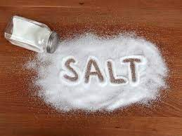
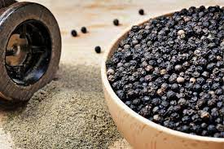
Priming vs Predicting

Slide 11
Priming vs Predicting
Can you pass the salt and ______
Notes:
Where do you draw the line?

Slide 12
Introduction to Prediction: Definitions
All of these involve the use of previous knowledge/experience to facilitate the processing of upcoming information

Slide 13
Introduction to Prediction: Definitions
Prediction is about the future
The definition must be inclusive and not arbitrarily exclude phenomena that are clearly about the future

Slide 14
Introduction to Prediction: Definitions
Prediction is the conscious or subconscious use of information from previous experiences for the conscious or subconscious processing of information about future states of the body and environment

Slide 15
The Visual World Paradigm (VWP): What is it?
A family of closely related experimental methods
Physical
On a screen
In VR
Participant eye movements are tracked while they listen to or produce language

Slide 16
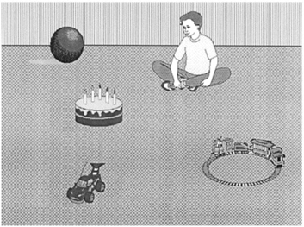
VWP: What is it?
The boy will move the cake
The boy will eat the cake

Slide 17
VWP: What is it?
Participants were more likely to make anticipatory eye movements to the target object when the semantics of the verb were consistent with only one of the objects
Only cake can be eaten, all items could be moved

Slide 18

VWP 101: Assumptions
What is the major assumption of the visual world paradigm?
Notes:
Eye movements are a behavioral measure that are theoretically related to processing

Slide 19
VWP: Assumptions
Behavioral measures (technically) require a linking hypothesis
Linking behavioral measures to what the brain is doing is generally quite difficult
What is the link between eye movements during VWP and what’s happening in the brain?
Visual attention shifts as a result of comprehending an utterance. This is followed by a higher probability of a saccadic eye movement to the area of visual attention. Therefore, where a participant is looking and when saccadic eye movements begin can provide insight into online language processing

Slide 20
VWP: Logic
All VW experiments use similar logic and design
A visual workspace (typically pictures on a screen)
Speech (typically spoken sentence comprehension)
Eye tracking measurements (typically measures of eye looks at an object at a specified time)

Slide 21
VWP: Terminology
Each picture may be referenced one or more time as language is spoken
The picture of interest at a given point in time is called the target
Some pictures may be manipulated to be somehow similar to the target
These are called competitors
Semantic, phonologic, shape, color, features, etc…
Unrelated pictures are called distractors

Slide 22
VWP: What does a trial look like?
Display Types
Realistic or semirealistic
Allows us to assess how world knowledge or contextual information may affect understanding of spoken utterances
Arrays
Minimizes the impact of real world knowledge or context
Well suited for studying the activation of conceptual and lexical knowledge

Slide 23
VWP: What does a trial look like?
Utterance types
Direct action
“Put the apple that is on the towel in the box”
Explicit tasks can change looking behavior
Look and listen
“The boy drinks from the cup”
Examines more general features of language-vision interactions

Slide 24
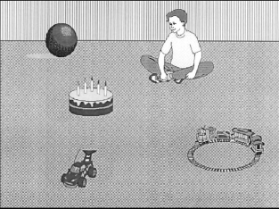
VWP: Stimulus timing
The boy will eat the cake
The boy will move the cake
Notes:
So you have these two things (array and sentence), when to display each? Implications?

Slide 25
VWP: Stimulus timing
The presentation of the visual display typically begins shortly before the onset of the spoken utterance
Likelihood of fixating objects depends on the preview time of the stimuli

Slide 26
VWP: The data
What kind of data do we get from a VWP trial?
What is the question we are interested in during a VWP trial and how can we look at that with our data?
Notes:
In what time frames are people more likely to be looking at the target?

Slide 27
VWP: The data
The boy will eat the cake
Region(s) of interest
Time window

Slide 28
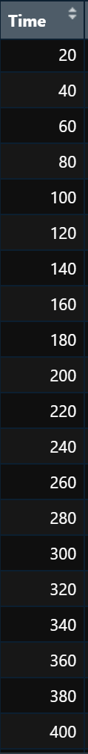
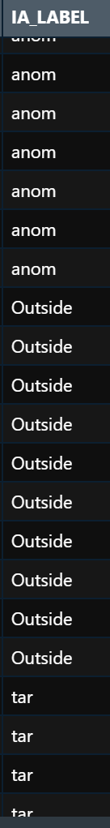
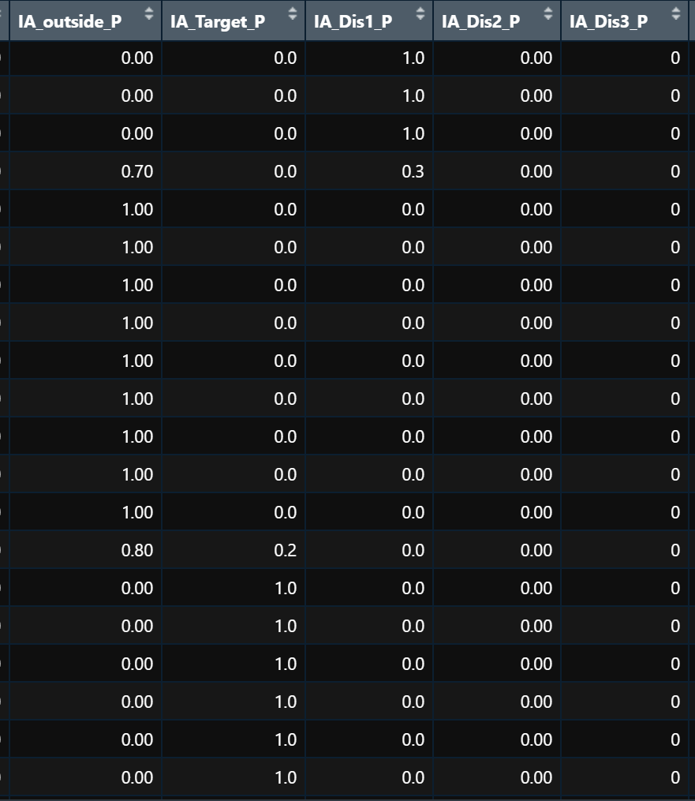
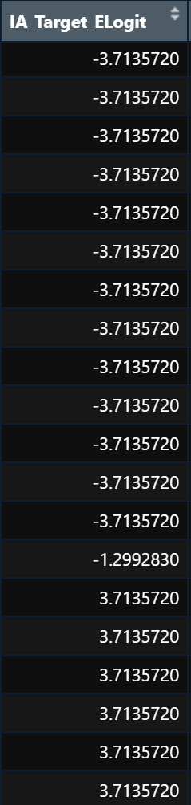
VWP: The Data

Slide 29
VWP: What can we study using VWP?
Sentence processing
How and when language users integrate different types of information
How context modulates sentence processing

Slide 30
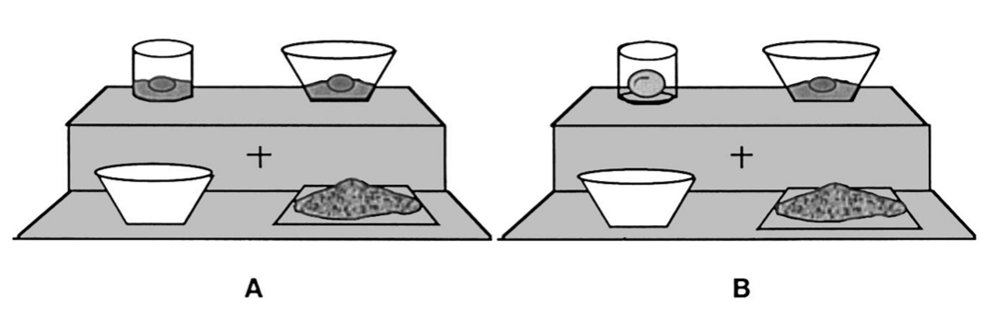
VWP: What can we study using VWP?
“Pour the egg in the bowl over the flour”
Notes:
in the bowl: modifier when two liquid eggs and
In the bowl: location when one liquid one solid

Slide 31
VWP: What can we study using VWP?
“Pour the egg in the bowl over the flour”
Notes:
in the bowl: modifier when two liquid eggs and
In the bowl: location when one liquid one solid

Slide 32
VWP: What can we study using VWP?
Prediction!
Listeners use linguistic and visual information to predict upcoming linguistic input
Language-mediated eye movements reflect continuously updated mental representations based on both linguistic and visual input

Slide 33
VWP 101: Prediction
What are some ways that language is predictable?

Slide 34
VWP: Prediction
Syntactic prediction
Using grammatic cues like gender or inflections to predict upcoming information
Typically robust in L1 but not in L2 speakers
Modulating factors?
Semantic prediction
Using verb or noun meanings to predict upcoming information
Typically robust in both L1 and in L2 speakers
Modulating factors?

Slide 35
VWP: Prediction
Factors that have been shown to modulate prediction
Working memory
General processing speed
Age
Literacy
Proficiency (in L2 contexts)
Crosslinguistic similarities (in L2 contexts)

Slide 36
VWP: Prediction
The paradox of prediction
Prediction is supposed to make language processing more efficient
Prediction is however not effortless
Prediction is constrained by cognitive resources

Slide 37
VWP 101: L2 Prediction
L2 language processing is typically more cognitively demanding than L1 processing
L2 processing is less automatized
Slower lexical access
Weaker syntactic representations
Unidirectional interference from L1

Slide 38
VWP: L2 Prediction
Despite differences in predictive abilities in L1 and L2 listening, the current leading hypothesis is that the fundamental mechanisms of predictive processing do not differ between L1 and L2 speakers.
The same factors that influence L1 prediction should influence L2 prediction
Stored lexical information (e.g., frequency, lexical associations)
Exposure to target language

Slide 39
VWP: Limitations
VWP always involves the interaction of visual and auditory input
Arrays may discourage more elaborative processes
May lead to inferences that would not otherwise be drawn
VWP shows what listeners CAN do, not necessarily ALWAYS do
Absence of eye gaze behavior does not necessarily rule out that activation occurred

