Slide 1
Visualization Tutorial
Allison Thompson
Lisa Bramer, Daniel Claborne, David Degnan,
Rachel Richardson, and Chaevien Clendinen
Notes:
Image: Abstract Data Visualization – Stock Photo

Slide 2
GitHub
https://github.com/Allison-Thompson/EMSLIntegration2019_VisualizationTutorial

Slide 3
Agenda
Overview presentation (~ 30 minutes)
Working groups (~ 75 minutes)
Future directions and feedback (~ 15 minutes)

Slide 4
Background
At PNNL, a lot of data is generated
Large amounts
Very quickly
Researchers may, or may not, know how to analyze these large data sets
Efficiently
Robustly
So, we created packages to assist in quality checking and analysis
Amplicon sequencing
Fourier transform mass spectrometry
Proteomics, metabolomics, and lipidomics (LC-/GC-MS)

Slide 5
Packages
Amplicon sequencing
pmartRseq
QC, filtering, normalization, diversity indices, ordinations, differential abundance, indicator species, network analysis
mead
Fourier transform mass spec
ftmsRanalysis
QC, filtering, stoichiometric calculations (NOSC, DBE, etc), van Krevelen plots, Kendrick mass defect, ordinations
FREDA
Proteomics, metabolomics, lipidomics
pmartR
QC, filtering, normalization, correlations, hypothesis testing, ordinations
PSpecteR

Slide 6
Packages
All of these packages are set up in roughly the same format
All have defined data objects that the functions operate on, which ensures similarity between the different packages
Today, I’m going to walk through the background data structure and generic workflow across all packages
Then we’ll break into small groups and go through workflows for individual packages

Slide 7
Data Objects

Slide 8
S3 Data Objects
Each package workflow begins with creating an S3 object, dependent on the data type
These S3 objects are all a list of ~3 data frames
All have attributes that carry through information about the processing
Which filters were implemented and what they filtered
Grouping variables
Transformation and normalization parameters
Creating these specific class objects enables easy downstream analysis
plot() and summary() functions for specific data classes
Functions check that data is of appropriate type

Slide 9
S3 Object
Sample Name | Temperature
Sample1 | Hot
Sample2 | Hot
Sample3 | Cold
Identifier | Kingdom
A | Archaea
B | Bacteria
C | Bacteria
Identifier | Sample1 | Sample2 | Sample3
A | 110 | 100 | 115
B | 75 | 0 | 0
C | 200 | 200 | 199

Slide 10
e_data
Identifier | Sample1 | Sample2 | Sample3
A | 110 | 100 | 115
B | 75 | 0 | 0
C | 200 | 200 | 199

Slide 11
e_data
p rows, equal to the number of variables observed (proteins, peptides, metabolites, compounds, OTUs, etc)
n + 1 columns, with one column for the variable identifier and n columns for n samples
Identifier | Sample1 | Sample2 | Sample3
A | 110 | 100 | 115
B | 75 | 0 | 0
C | 200 | 200 | 199

Slide 12
e_meta
Identifier | Kingdom
A | Archaea
B | Bacteria
C | Bacteria
Identifier | Sample1 | Sample2 | Sample3
A | 110 | 100 | 115
B | 75 | 0 | 0
C | 200 | 200 | 199

Slide 13
e_meta
p rows, equal to the number of variables observed (proteins, peptides, metabolites, compounds, OTUs, etc) – this needs to be exactly the same as the identifier column in e_data
Other columns relating extra information about the identifier, e.g.
Taxonomy for OTUs
Proteins that the peptide maps to
Molecular formula or compound class information
Identifier | Kingdom
A | Archaea
B | Bacteria
C | Bacteria
Identifier | Sample1 | Sample2 | Sample3
A | 110 | 100 | 115
B | 75 | 0 | 0
C | 200 | 200 | 199

Slide 14
f_data
Sample Name | Temperature
Sample1 | Hot
Sample2 | Hot
Sample3 | Cold
Identifier | Kingdom
A | Archaea
B | Bacteria
C | Bacteria
Identifier | Sample1 | Sample2 | Sample3
A | 110 | 100 | 115
B | 75 | 0 | 0
C | 200 | 200 | 199

Slide 15
f_data
n rows, equal to the number of samples in the data
These must be the same as the column headers in e_data
Other columns relating extra information
about the samples
Time of sampling
Treatment group
Replicate number
Sample Name | Temperature
Sample1 | Hot
Sample2 | Hot
Sample3 | Cold
Identifier | Kingdom
A | Archaea
B | Bacteria
C | Bacteria
Identifier | Sample1 | Sample2 | Sample3
A | 110 | 100 | 115
B | 75 | 0 | 0
C | 200 | 200 | 199

Slide 16
cnames
Column identifiers are needed
from each data frame, which
enables the columns to
be in any order.
fdata_cname
Sample Name | Temperature
Sample1 | Hot
Sample2 | Hot
Sample3 | Cold
edata_cname
emeta_cname
Identifier | Kingdom
A | Archaea
B | Bacteria
C | Bacteria
Identifier | Sample1 | Sample2 | Sample3
A | 110 | 100 | 115
B | 75 | 0 | 0
C | 200 | 200 | 199

Slide 17
as.xxData(e_data, e_meta, f_data, (the three data frames)
edata_cname, emeta_cname, fdata_cname, (column names)
…)
pmartR | pmartRseq | ftmsRanalysis
as.pepData | as.seqData | as.peakData
as.metabData |  | as.compoundData
as.lipidData |  | as.moduleData
as.isobaricpepData

Slide 18
Preprocessing

Slide 19
Groups
Create groups of samples using up to two main effects
Main effects should be found in f_data
In pmartR, can also have covariates or indicate time series data
Sample | Group | Temperature | Moisture
Sample1 | Hot_Dry | Hot | Dry
Sample2 | Hot_Dry | Hot | Dry
Sample3 | Cold_Wet | Cold | Wet

Slide 20
Filters
Multiple filters are possible in each package
Variables seen once across all samples
pmartR | pmartRseq | ftmsRanalysis
Proteomics | Taxonomic | Mass range
Coefficient of variation | k/a | Formula assignment
imd-anova | Abundance | Elemental composition

Slide 21
Normalization and Transformation
There are often many normalization options present and some packages offer help in choosing the best normalization method for your specific dataset
SPANS – implemented in both pmartR (for proteomics data) and (soon) ftmsRanalysis
Determines which normalization method will introduce the least bias
pmartR | pmartRseq | ftmsRanalysis
Mean | CSS | Mean
MAD | TMM | MAD
Z-score | DESeq-VS | Z-score

Slide 22
Calculations and Statistics

Slide 23
Calculations
A number of different sample-specific calculations are possible in each package
pmartR | pmartRseq | ftmsRanalysis
Missingness | Alpha diversity | NOSC
pPCA | Evenness | DBE
 | Richness | AI

Slide 24
Statistics
Hypothesis testing
Correlations
Uniqueness determinations
pmartR | pmartRseq | ftmsRanalysis
ANOVA | Beta diversity | G-test
G-test | Differential abundance | Kruskal-Wallis
Correlation | Indicator species | Kolmogorov-Smirnov

Slide 25
Other Useful Functions

Slide 26
summary()
There is a summary function for nearly every object created
Summary statistics – median, first quartile, etc
Number of biomolecules and number of samples
Amount of missing data
Number of significant biomolecules

Slide 27
plot()
There’s a plotting method for nearly every object created
Often, just call the plot() function
Other parameters to optionally specify include:
Axis labels and title
Color and/or shape variable
Color palette
Type of plot – bar, volcano, heatmap, etc

Slide 28
Workflows

Slide 29
Workflow
Each package follows similar workflows
Generally,
Upload data
Create groups
Quality check
Filter(s)
Normalization
Statistical Analyses

Slide 30
GUI
Many packages have a User Interface that enable most of the same functionality as the R package without needing to be able to code
pmartR | pmartRseq | ftmsRanalysis
pmartRshiny | mead | FREDA
Coming Soon | http://github.com/pmartR/mead | http://msc-viz.emsl.pnnl.gov/FREDA

Slide 31
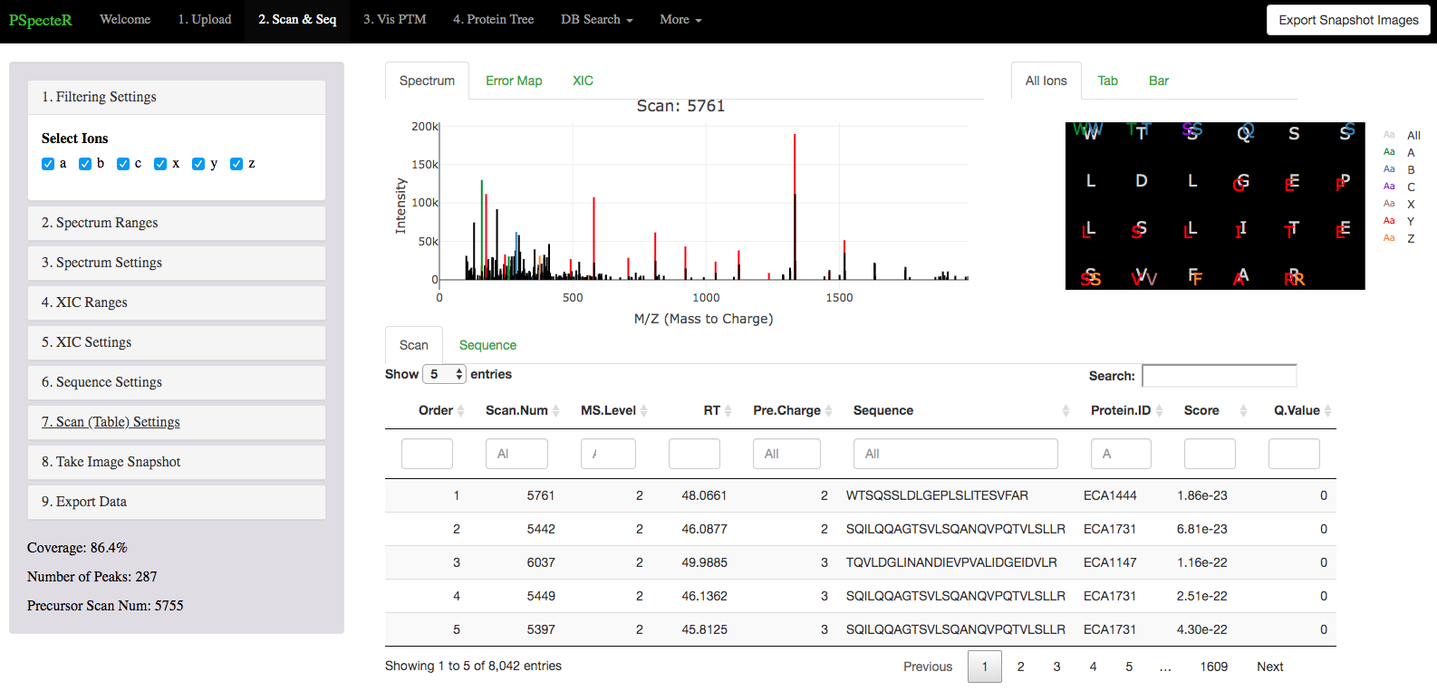
PSpecteR – an app to visualize fragmentation patterns and modifications from mass spec data

Slide 32
Working Groups
We’re going to break into working groups and actually work through an analysis.
Please decide if you want to work on amplicon sequencing, Fourier transform mass spectra, spectra, or proteomics/metabolomics/lipidomics.
Each group has example data, though you’re also free to use your own data.
Each group also has a script, giving an example workflow for the different packages.
https://www.github.com/allison-thompson/EMSLIntegration2019_VisualizationTutorial

Slide 33
Thank you!
This research was supported by the intramural program at the Environmental Molecular Sciences Laboratory (grid.436923.9), a DOE Office of Science User Facility sponsored by the Office of Biological and Environmental Research and operated under Contract No. DE-AC0576RL01830
This work was supported by the National Cancer Institute of the National Institutes of Health via Grant U01 CA184783-02, by the U.S. Department of Energy (DOE), Office of Biological and Environmental Research, under Contract FWP 71226
Microbiomes in Transition Initiative Laboratory Directed Research and Development Program at Pacific Northwest National Laboratory (PNNL).
PNNL is a multiprogram national laboratory operated by Battelle for the U.S. DOE under Contract DE-AC0576RL01830.

Slide 34
https://github.com/allison-thompson/EMSLIntegration2019_VisualizationTutorial
f_data
Sample Name | Temperature
Sample1 | Hot
Sample2 | Hot
Sample3 | Cold
e_meta
Identifier | Kingdom
A | Archaea
B | Bacteria
C | Bacteria
Identifier | Sample1 | Sample2 | Sample3
A | 110 | 100 | 115
B | 75 | 0 | 0
C | 200 | 200 | 199
e_data
34

Slide 35
Future Work
GUIs for every package
More statistics in packages
Similar packages for more data types
NMR ?
Metaproteomics ?
Imaging ?
ToF-SIMS ?

Slide 36
Feedback?
Allison.Thompson@pnnl.gov

