Slide 1

MPAA and the Box Office
Allison Chau

Slide 2
MPAA Problems
Who are they?
No standard
Targets independents
System is set up to favor the big studios
Claim: MPAA rating will favor big studios, with milder ratings positively affecting box office gross.

Slide 3
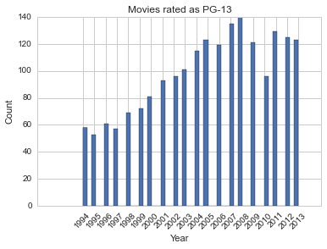
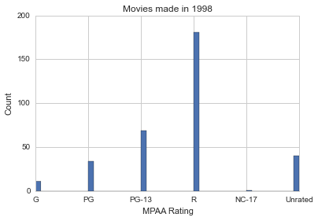
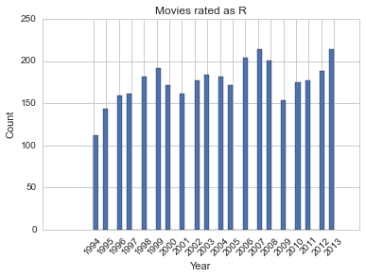
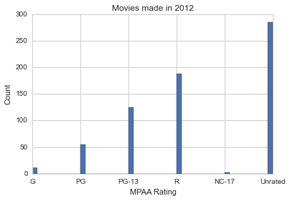

Slide 4
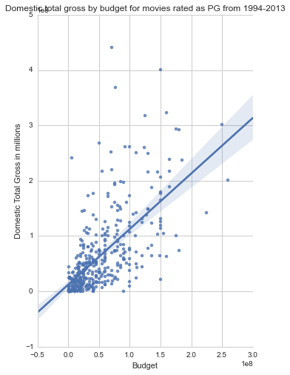
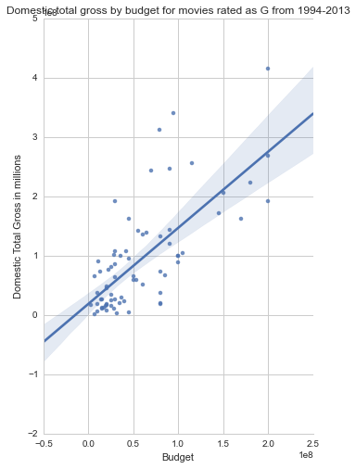
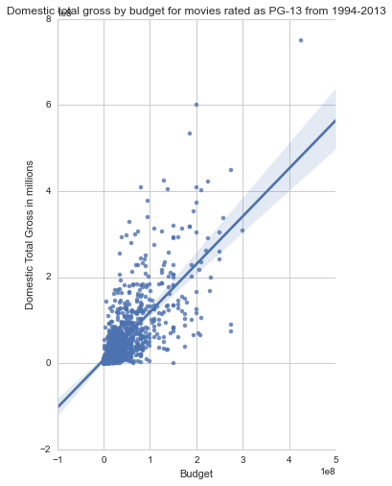
Domestic total gross by budget of movies from 1994 - 2013
G
PG
PG-13
Adj. R
Squared:
0.507
0.411
0.496

Slide 5
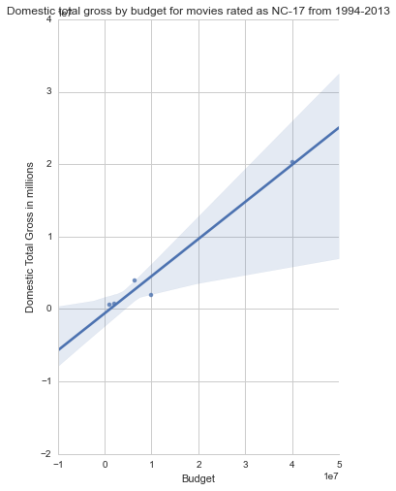
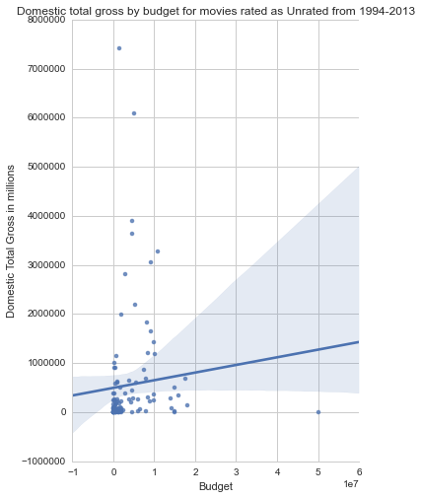
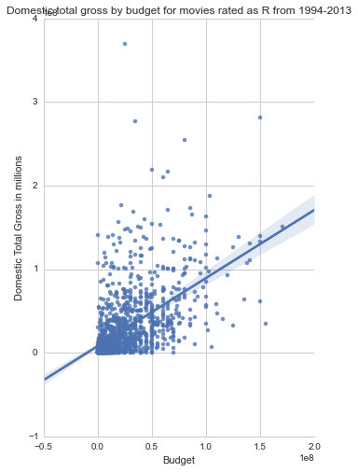
Domestic total gross by budget of movies from 1994 - 2013
R
NC-17
Unrated
Adj. R
Squared:
0.305
0.960
0.007

Slide 6
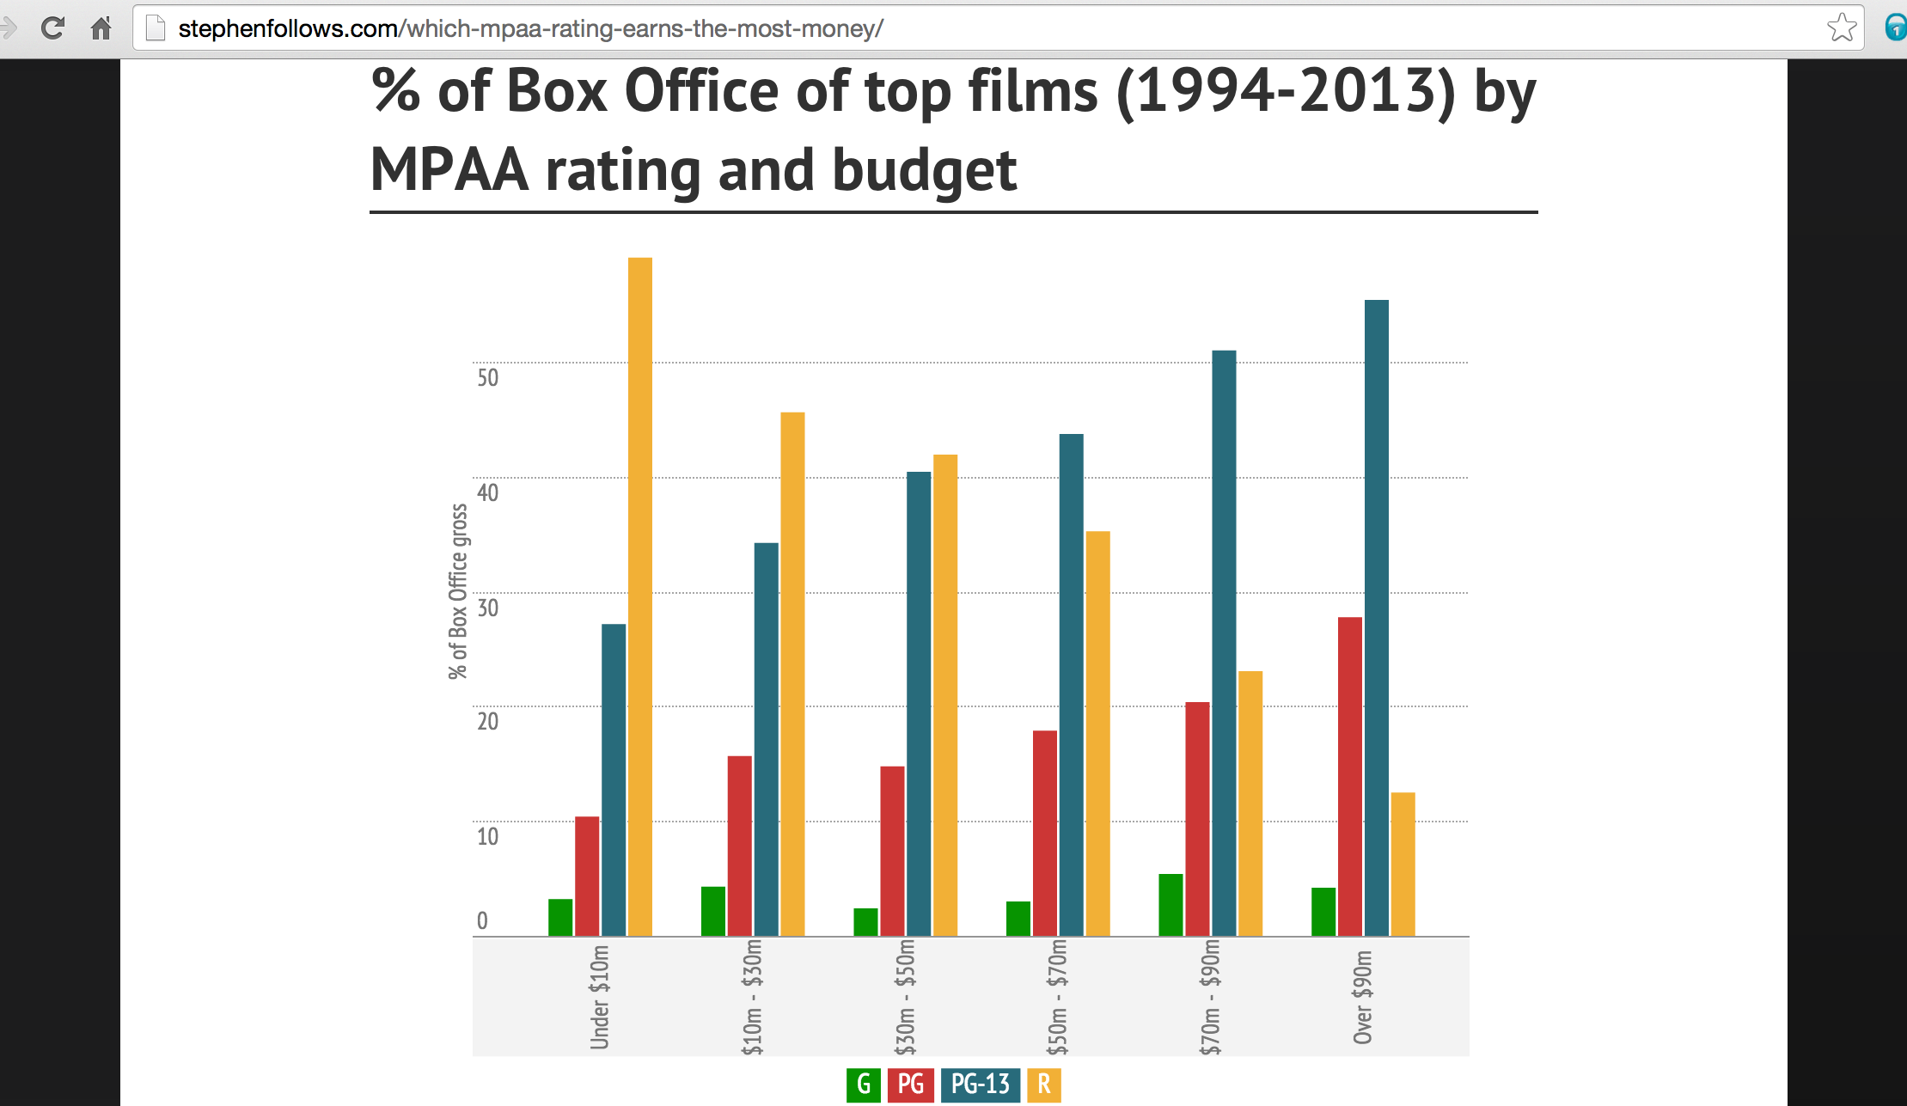
Bigger films will seek a milder rating to maximize number of cinema-goers

Slide 7
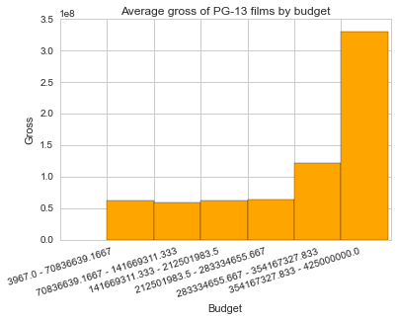

Slide 8
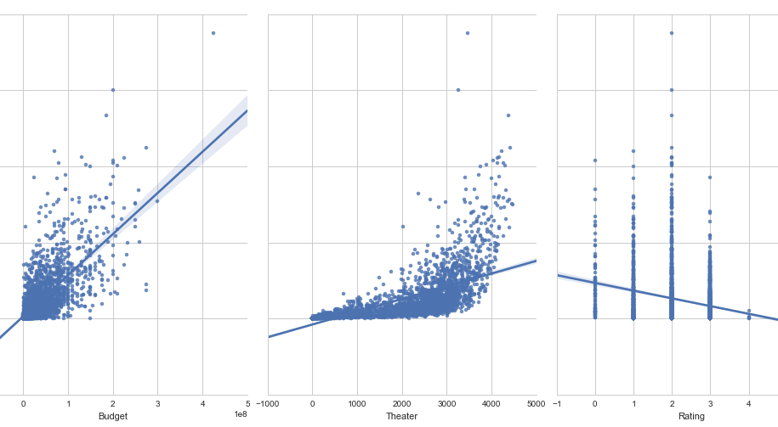
Features vs. Total Domestic Gross from 1994 – 2013
Gross

Slide 9
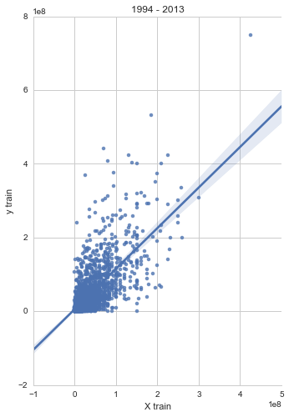
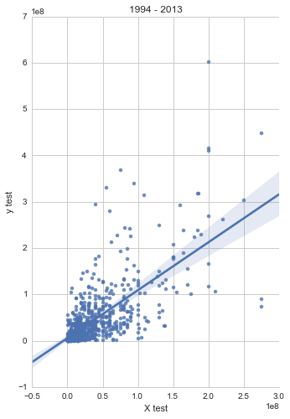
Train-test-split with all ratings as a feature
Train: 0.5643
Test: 0.5335

Slide 10
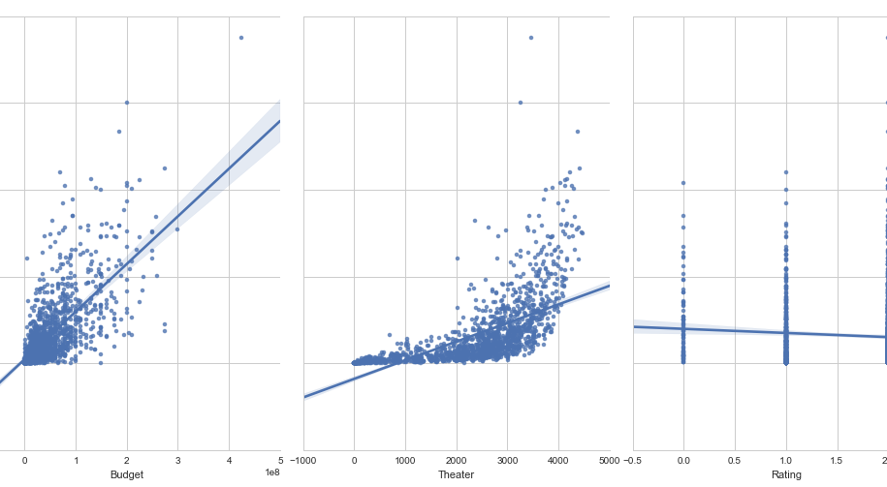
Features vs. Total Domestic Gross from 1994 – 2013
Gross
G, PG, PG-13

Slide 11
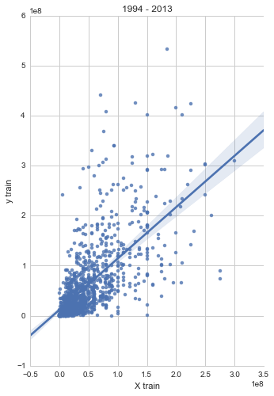
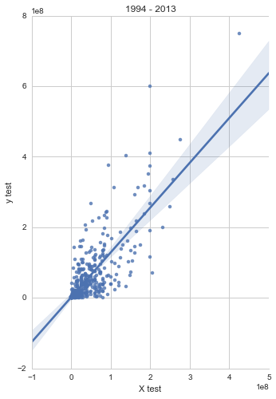
Train-test-split without R, NC-17, and Unrated in the ratings feature
Train: 0.5198
Test: 0.5646

Slide 12
What else?
Average number of submissions it takes to get accepted as R rating
Inflation rate
Other rating sites
Kidsinmind.com
Screenit.com

