Slide 1
From First Purchase to Loyal Customer
A Data-Driven Retention Strategy for Olist
Presented by: Hanyu Chen, Yuejia Yang, Alex Wilson, Diem Vo, Andrea Miranda
Team 1 | BAMA 520 Customer Analytics | UBC Sauder | March 2026

Slide 2
THE BUSINESS PROBLEM
97% of Olist Customers Never Come Back
97%
1.9×
57%
of customers make only one purchase
higher lifetime revenue from repeat buyers
of revenue from top 20% of customers
Repeat buyers are 1.9× more valuable — yet converting them is Olist's biggest untapped opportunity.
Olist Brazilian E-Commerce Dataset | 93,358 unique customers | 2016–2018

Slide 3
THE ANALYTICS QUESTION
Turning a Business Problem Into a Testable Question
Can we predict — from a customer's first order alone — who is likely to buy again?
Who to target?
What is it worth?
Identify the subset of first-time buyers with repeat probability high enough to justify outreach cost.
Quantify the profit difference between model-guided targeting and random contact in dollar terms.
Outcome variable: is_repeat — did the customer place a second order? (customer_unique_id)

Slide 4
DATA & APPROACH
What We Built and Why
93,358
22
3.0%
Unique customers (delivered orders, 2016–2018)
Engineered features across 7 experience dimensions
True repeat-purchase rate (extreme class imbalance)
① Balance
② Model
50/50 undersampling — match 2,801 repeat buyers with 2,801 one-time buyers so the model learns rare patterns
Logistic regression (22 features) — identifies which first-order signals predict repeat purchase
③ Correct
④ Target
Probability recalibrated from 50% sample rate → 3% true base rate via log-odds shift (−3.48)
Flag customers with P(repeat) > 7.5% break-even threshold for outreach
No code on this slide — full reproducible R script submitted separately

Slide 5
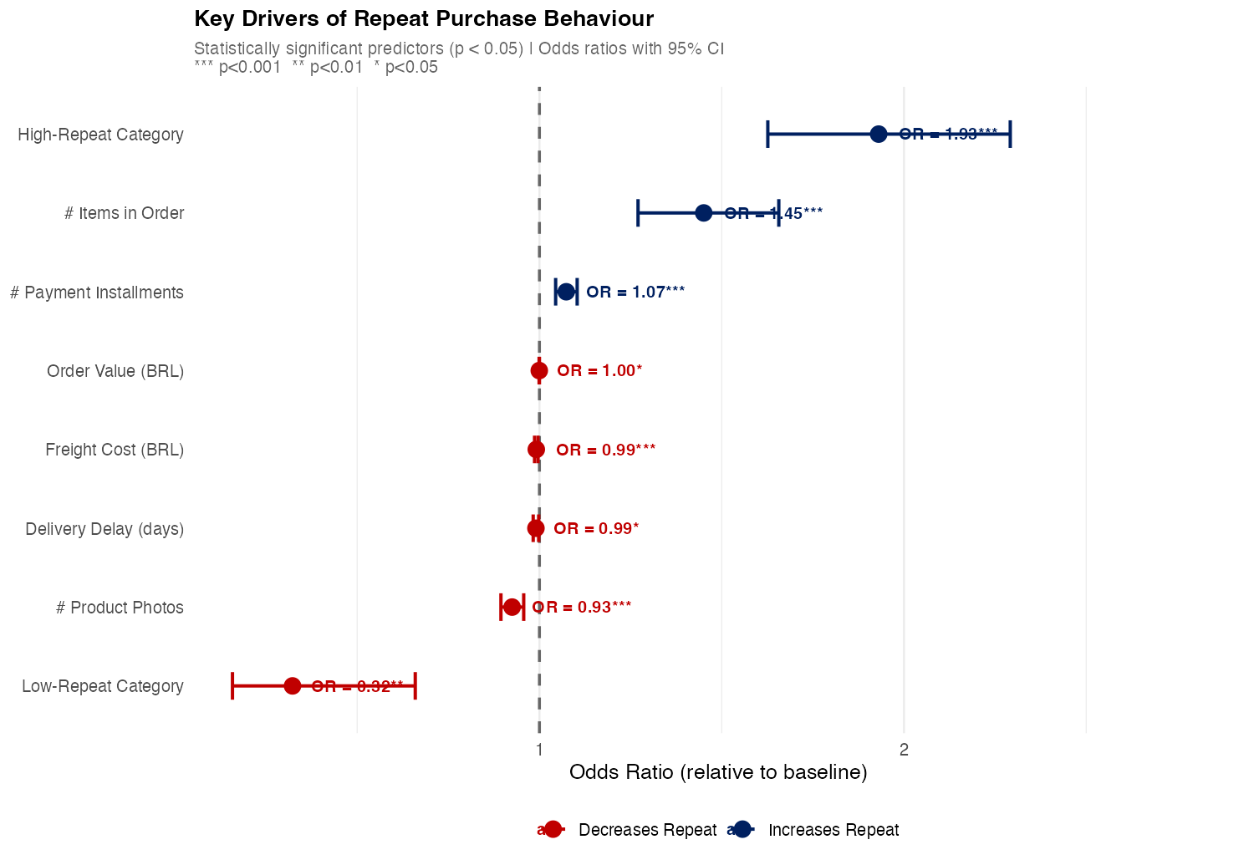
KEY FINDING 1
What a Customer Buys Predicts Whether They Return
Strongest signal: Product category
Buying in a high-repeat category (health & beauty, food, perfumery) almost doubles repeat odds OR = 1.93
Basket size matters
More items in the order signals deeper platform engagement OR = 1.45
Low-repeat categories are a strong negative signal (furniture, electronics) OR = 0.32
Insight: Category is more predictive than price, delivery speed, or review score. This unlocks a differentiated targeting strategy.
Logistic regression | Balanced sample n=5,574 | AUC = 0.6117 | 8 significant predictors (p < 0.05)

Slide 6
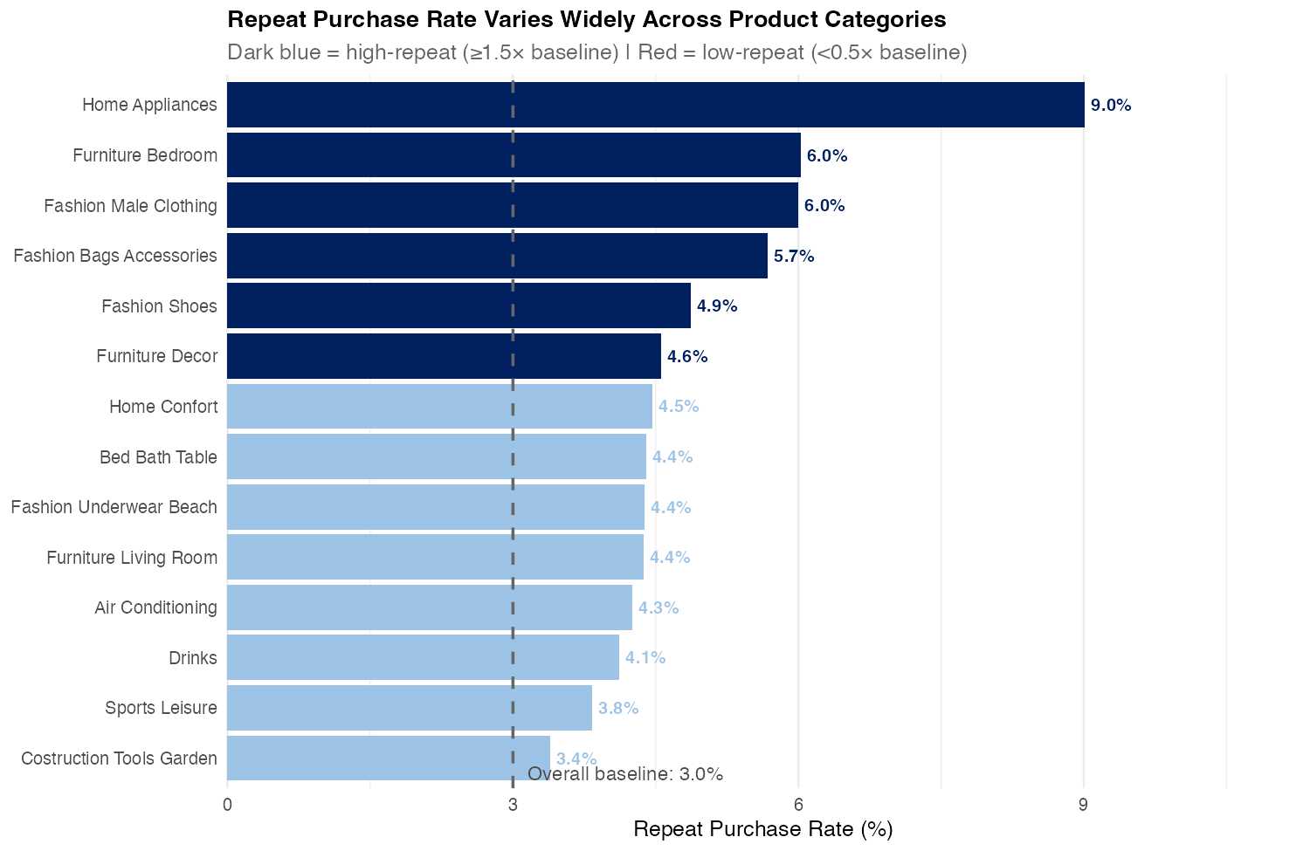
KEY FINDING 2
Not All Products Are Equal — Category Defines the Opportunity
High-Repeat Categories
Health & beauty · Food & drink Perfumery · Baby · Diapers
Consumable — customers run out and return naturally
Low-Repeat Categories
Furniture · Electronics Construction tools · Auto
Durable — customers buy once and don't need more
Category repeat rates computed from first-order customers only (≥ 50 obs per category)

Slide 7
THE RECOMMENDATION
Target 960 Customers — With Two Differentiated Messages
Send a re-engagement email within 7 days of delivery to all first-time buyers with model-predicted P(repeat) > 7.5% → 960 customers (1.0% of base)
Tier 1 — Replenishment
Tier 2 — Discovery
Consumable category buyers
High-odds, non-consumable
Health & beauty, food, perfumery, baby
Message: "Ready to restock? Your favourites are waiting."
Offer: 10% loyalty coupon on next purchase of same category
Expected response: higher — repurchase is purchase-cycle driven
Model-flagged buyers outside consumable categories
Message: "Discover what else Olist has for you."
Offer: Curated cross-category recommendation + free shipping
Expected response: model-driven — P(repeat) above break-even
Why two messages? The strongest predictor (OR = 1.93) is category type — not demographics. Matching the message to purchase logic lifts response rate and avoids wasted creative spend.
Contact channel: email | Trigger: within 7 days of first delivery confirmation

Slide 8
ECONOMIC IMPACT · DOLLAR SIGN RULE
Model Targeting Delivers BRL 1,818 More Than Random Contact
Assumptions: BRL 2.00 / email | BRL 26.60 incremental margin / conversion | Break-even threshold: 7.5% | 960 customers targeted
Random Outreach
Model-Targeted
960 random contacts
960 flagged contacts
Conversions
29
Conversions
BRL 1,818 swing
97
Gross Margin
BRL 766
Gross Margin
BRL 2,584
Contact Cost (960 × BRL 2)
BRL 1,920
Contact Cost (960 × BRL 2)
BRL 1,920
Net Profit
BRL −1,154
Net Profit
BRL +664
Upper bound: some targeted customers are Sure Things who would repurchase without intervention — see Slide 9

Slide 9
VALIDATION DESIGN
A 90-Day Experiment to Confirm Causality Before Scaling
⚠ BRL 664 is an upper bound — some targeted customers are Sure Things who would repurchase anyway. We need a randomised experiment to isolate the true effect of outreach.
① RANDOMISE
② MEASURE
③ DECIDE
768 treated 192 control (20%)
90-day window
Scale / pause rule
Randomly withhold the email from 20% of the 960 targeted customers. Control group receives no outreach.
Track repeat purchase rate in treated vs. control. Primary metric: incremental repeat rate (lift).
If lift × BRL 26.6 > BRL 2.0 (i.e. lift > 7.5 pp), roll out to full customer base. If not, pause and diagnose.
→
→
Why this design? The experiment converts our predictive finding into a causal claim. Only then can we confidently recommend full deployment across 93K customers.
Design: 2-arm RCT | Sample: 960 targeted customers | Duration: 90 days | Decision threshold: 7.5 pp lift

Slide 10
Risks & Limitations
BRL 664 is an upper bound
Some of the 960 targeted customers are Sure Things — they would repurchase without our email. The true incremental profit is lower. The RCT on Slide 9 measures the true causal lift.
Model predicts, not guarantees
AUC = 0.61 means the model performs meaningfully better than random, but 39% of variation remains unexplained. Predictions are probabilities, not certainties.
Observational data only
The training data is not from a randomised trial. Predictors may reflect customer intent rather than platform-controllable factors. We cannot claim causality without the experiment.
3% base rate limits scale
Even at perfect precision, only ~2,800 of 93,000 customers will ever repeat. The programme targets the highest-probability subset — most repeat buyers remain unreachable.
Acknowledging limitations is not a weakness — it demonstrates the analytical maturity that separates a credible recommendation from a sales pitch.

