Slide 1



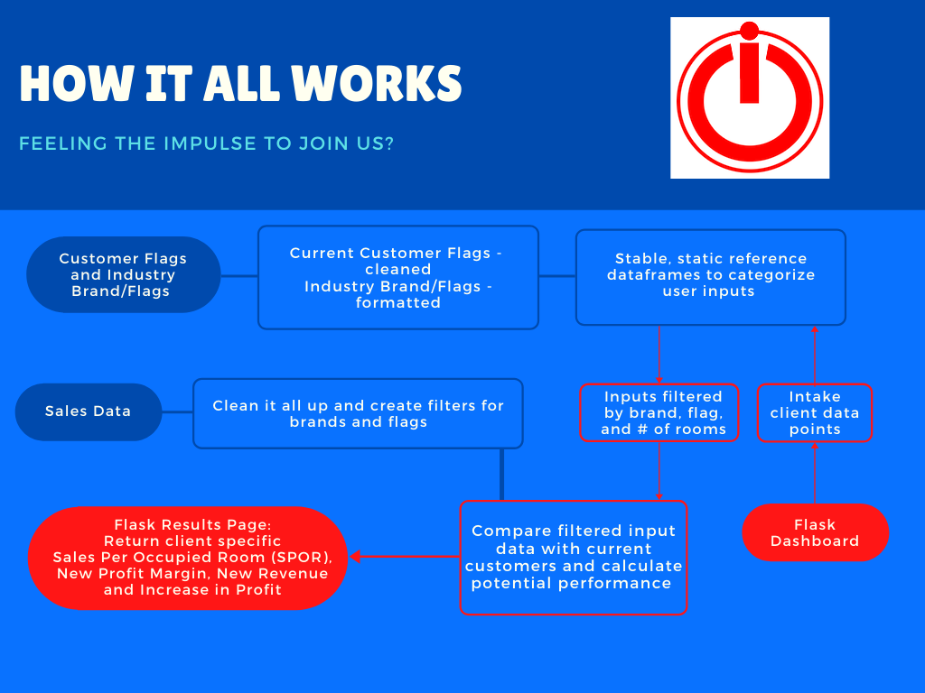
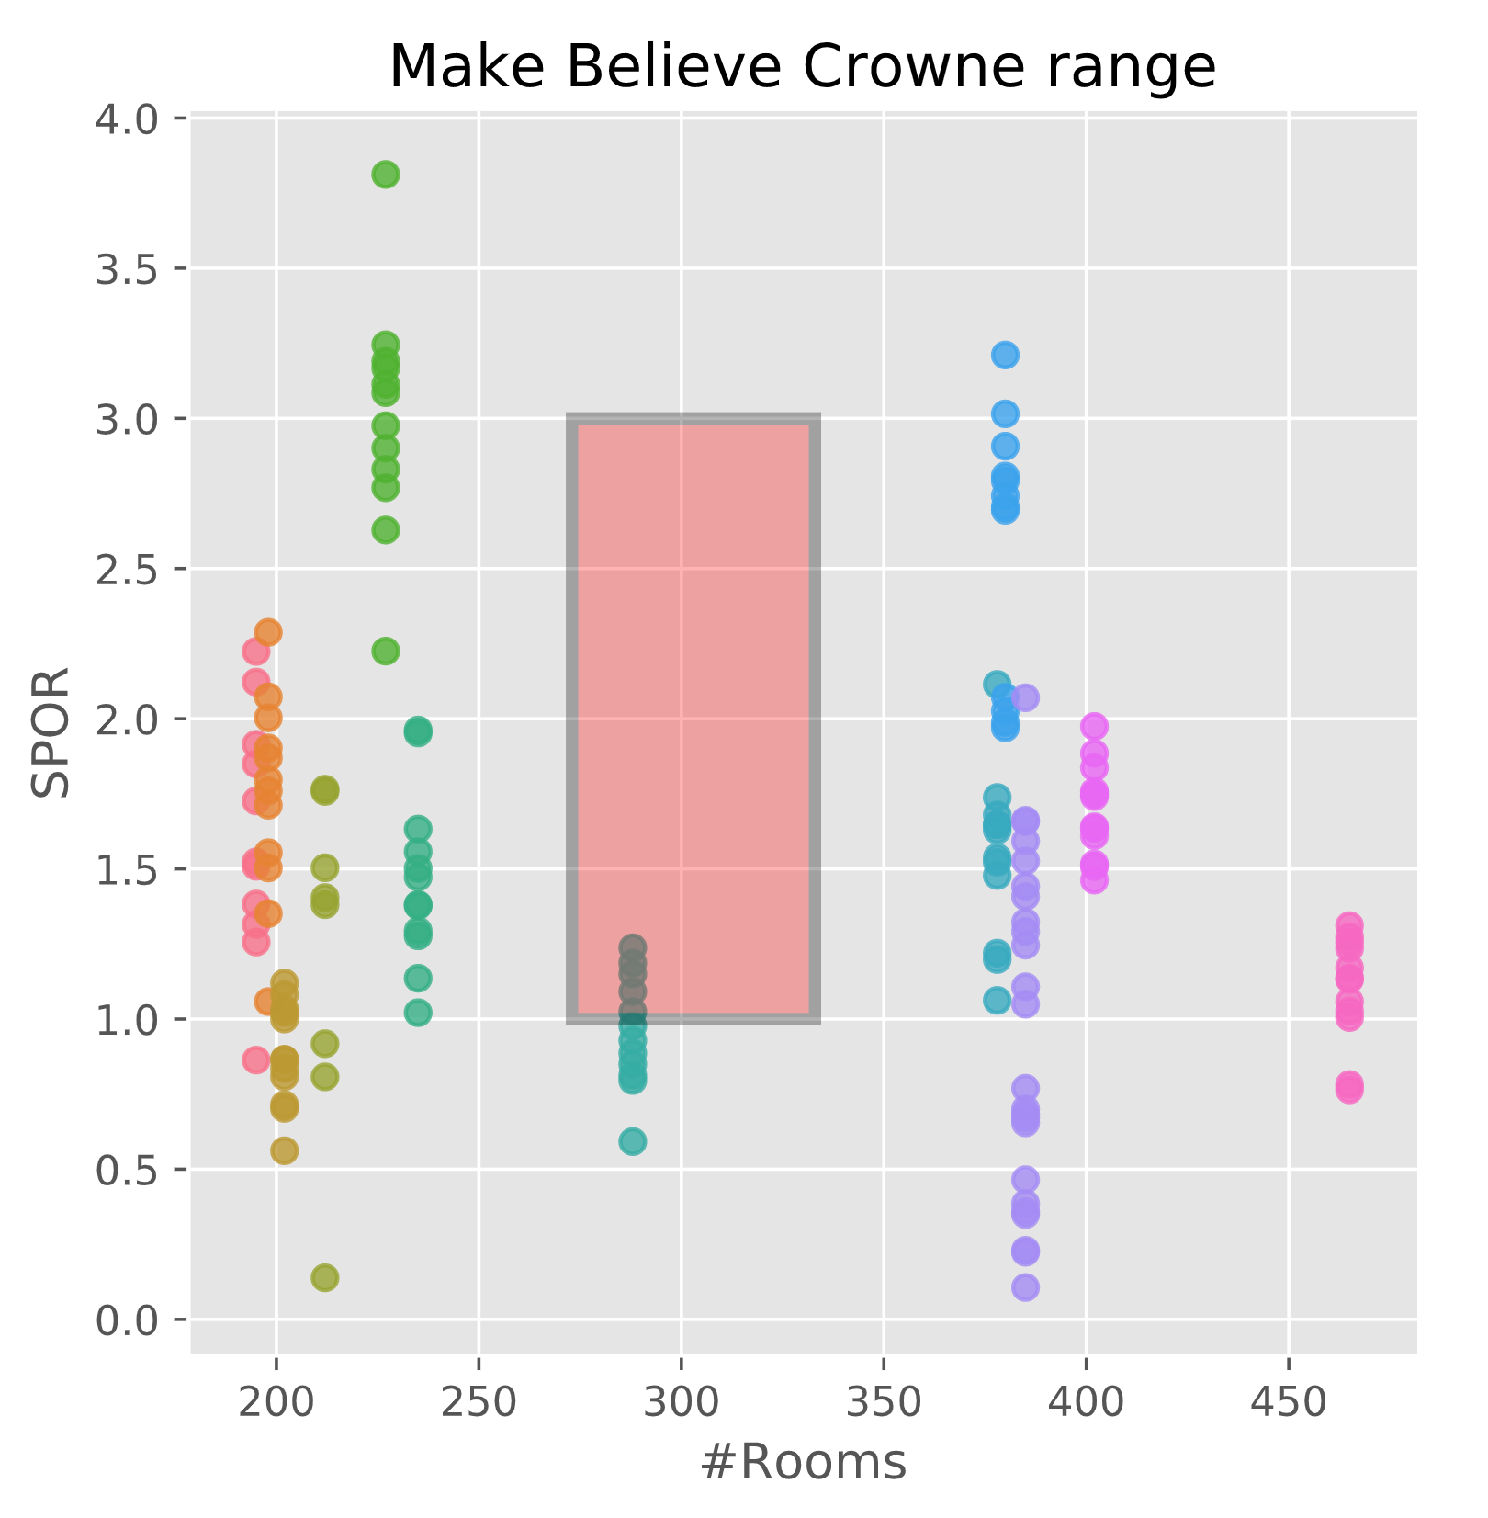
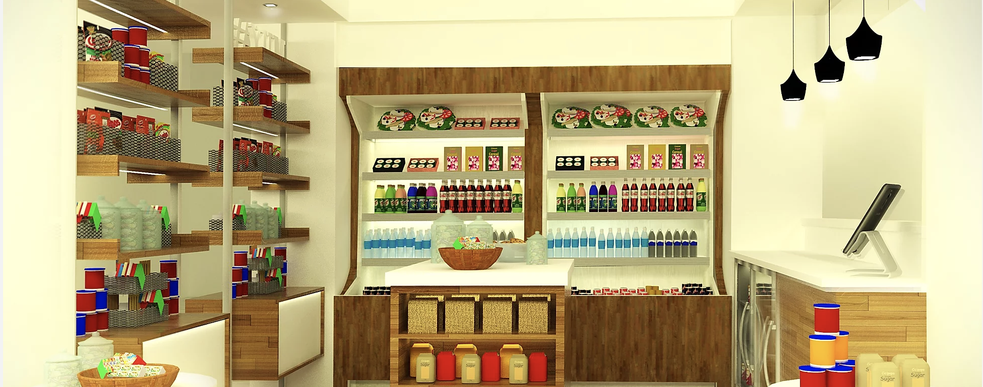
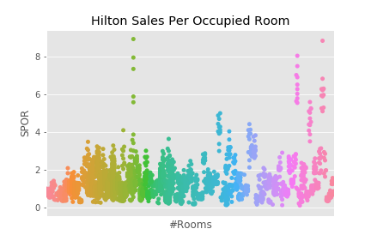
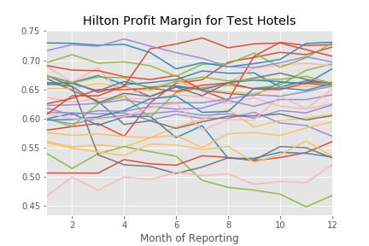
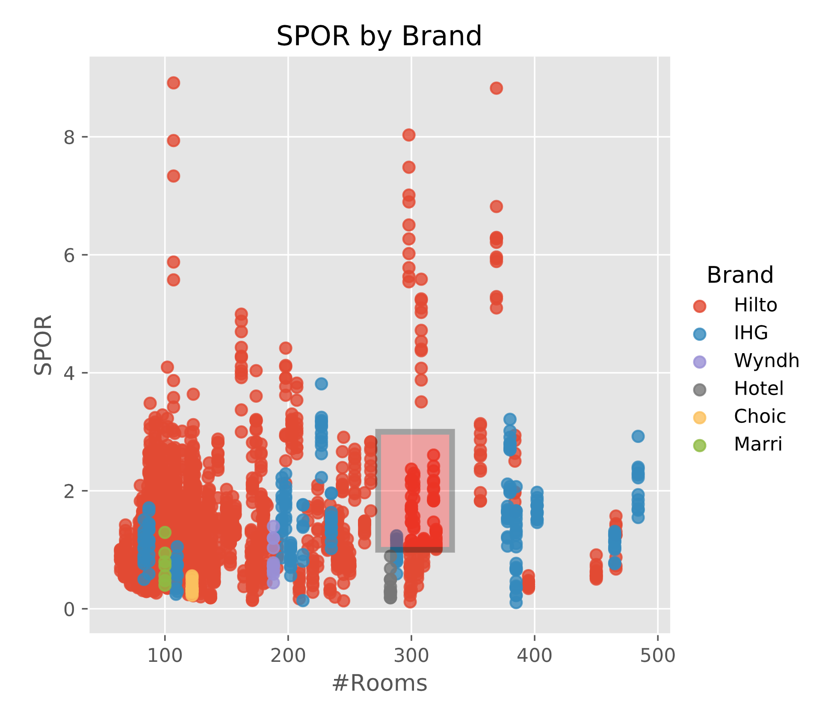
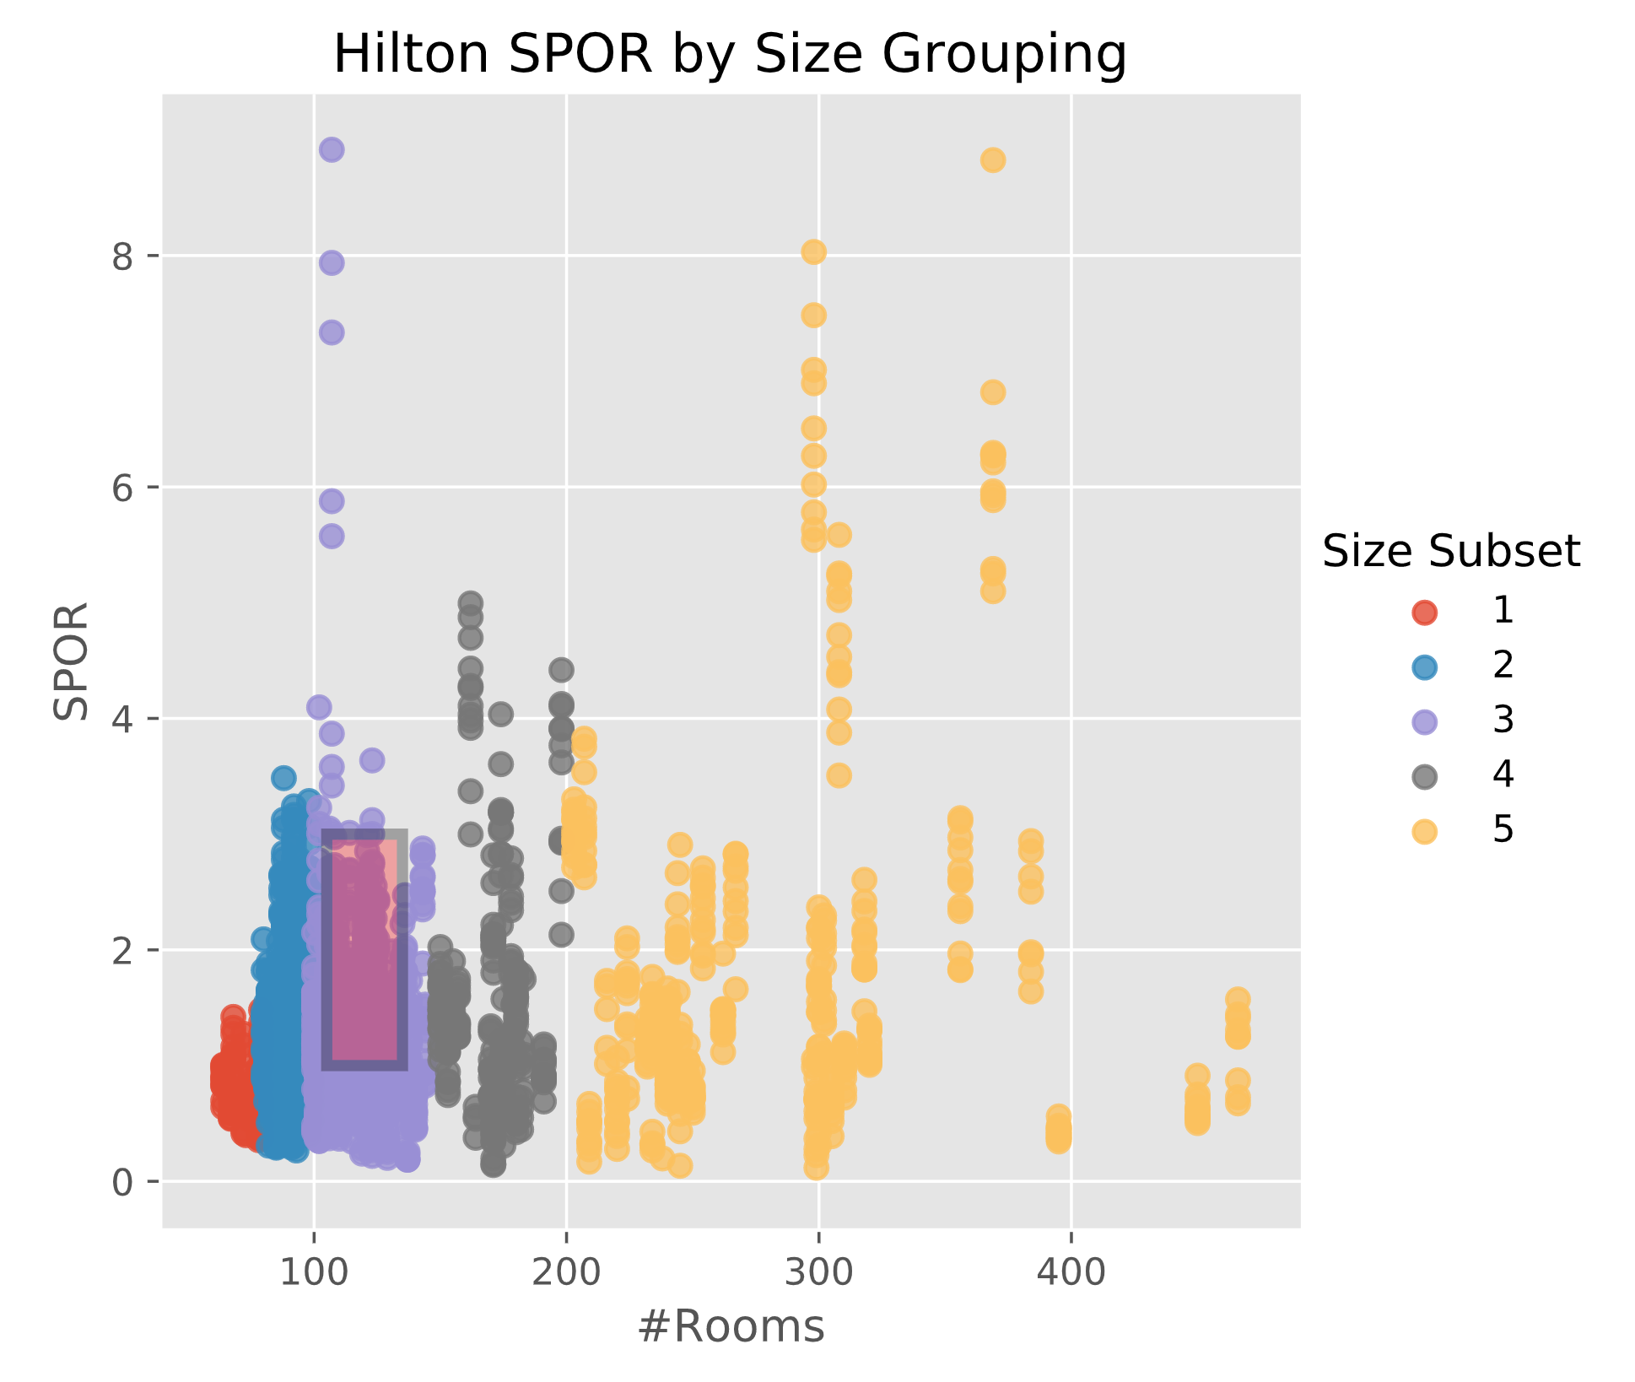
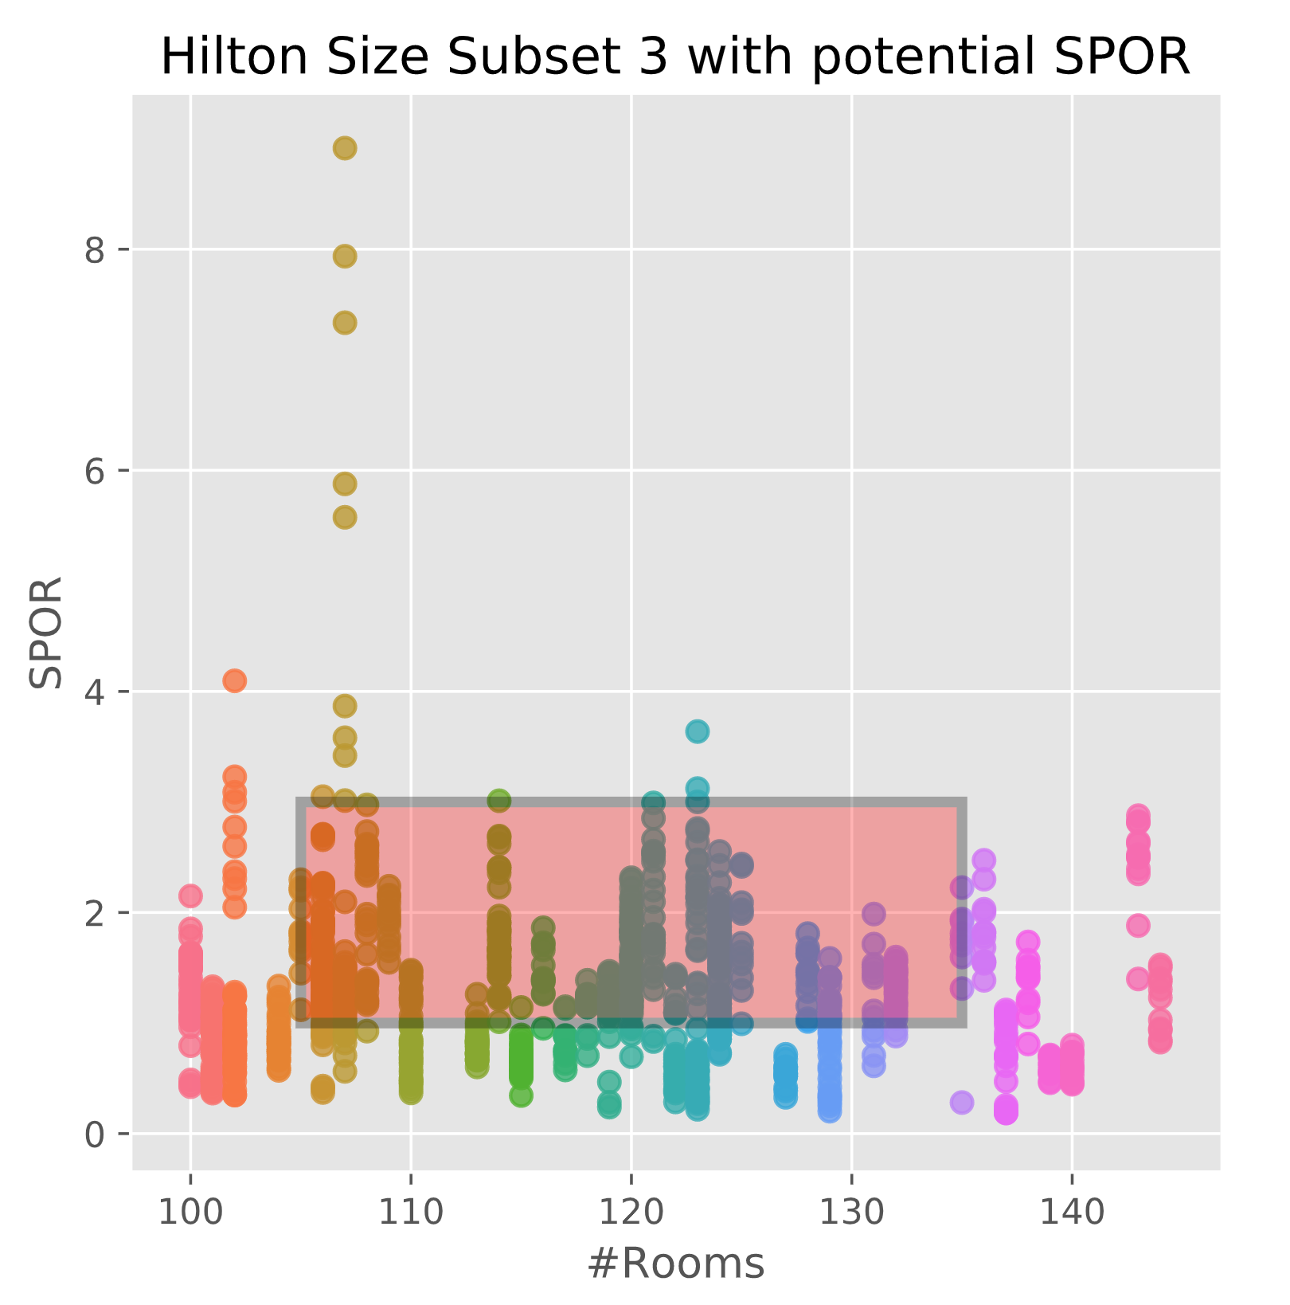
Feeling the Impulse to Join Us?
Allison Hengemuhle
/github.com/allisonhenge
in
/in/allisonhenge
allisonhenge@gmail.com
Background
Methods
Results
ImpulsePoint by Impulsify is a top-rated front desk point-of-sale and retail management system for hotel lobbies. It automates nearly the entire retail system, from inventory maintenance to guest checkout. This system is built on data and it allows hotels to focus on exactly what guests want and respond accordingly.
Each hotel client gets a personalized performance metric, based on brand, flag, and number of rooms. If there is not enough data to build a prediction, they are compared to hotels of the same type/group.
Test Hotel #1
--------------------------------------------------------------------------------
Input Data
--------------------------------------------------------------------------------
Name The Make Believe Crowne
Brand IHG
Flag Crowne Plaza
Number of Rooms 303
Specialty Service None
Average Occupancy Rate 0.8 (80%)
Revenue $20,018.67 / mo
Profit Margin 0.45 (45%)
---------------------------------------------------------------------------------
Output Performance
---------------------------------------------------------------------------------
Sales Per Occupied Room (SPOR) $1.50
New Profit Margin 0.68 (68%)
New Revenue $25,873.45 / mo
Increase in Profit Margin 0.23 (23%)
Increase in Revenue $5854.78 / mo
Return on Investment 285%
Measures
Objectives
Create a live app that would let customers input their brand, the number of rooms in their hotel, the current average monthly revenue for pre-existing retail space, and their current profit or profit margin. These metrics would be used to predict potential performance if they use an Impulsify System.
Measures include Sales per Occupied Room (SPOR), profit margin, and revenue.
Conclusion
Discussion
When given fake data points for a made up hotel, the flask app provided details to help make an informed decision.
The Data
The data was presented in 3 Excel spreadsheets; 2019 Sales Data, Current Hotel Brands and Flags, and a Hotel Brand and Flag Master list. It was read into Pandas dataframes. Initially the sales and flag data was for 800+ hotels that are current customers, and the master list represented most major hotel brands around the world and the flags that represent them.
References
All data is proprietary property of Impulsify Inc.
The Impulsify logo and store front are both images provided by Impulsify and can be found at www.impulsifyinc.com.
Hotel performance varies hugely. It’s dependant on all of the features, but even within brands and flags, the number of rooms and the type of service are indicative of how a retail space might do.

