Slide 1
Text-Mining and Analysis Project Kickoff
Day 8

Slide 2
Two Major Themes
Harvesting Data from the Web: grabbing data from the Internet for analysis
Computational linguistics: making sense of linguistic data using a computer

Slide 3
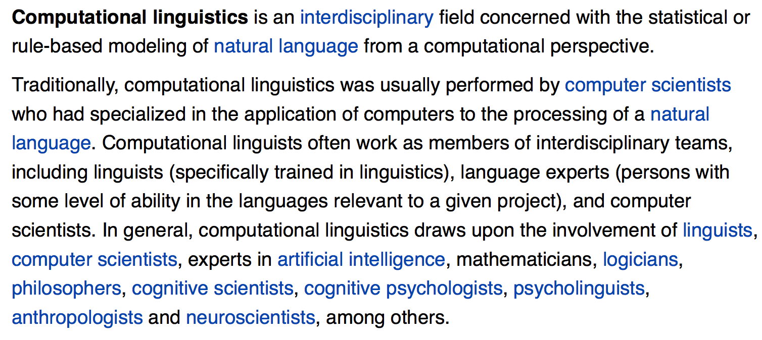
Computational Linguistics (Courtesy of Wikipedia)

Slide 4
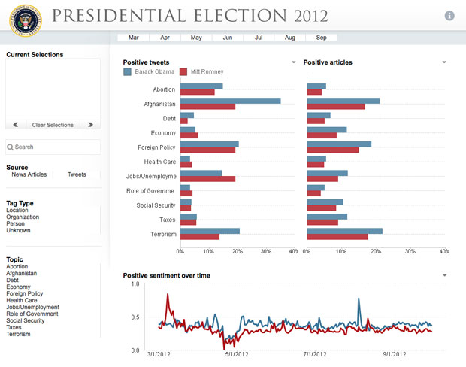
Notes:
Automatically categorized tweets and articles into: (1) topic, (2) positive / negative

Slide 5
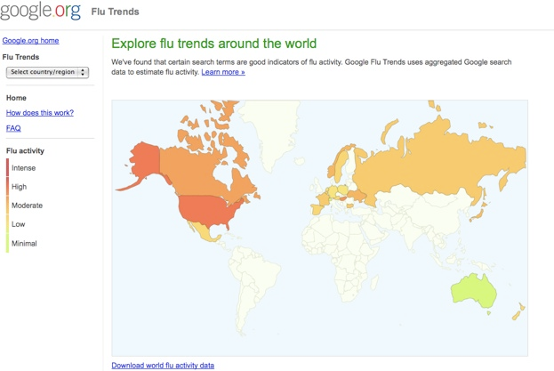
Flu Trends

Slide 6
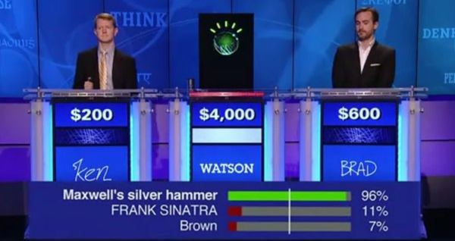
Natural Language Processing

Slide 7
Watson Under the Hood
FERRUCCI’S MAIN breakthrough was not the design of any single, brilliant new technique for analyzing language. Indeed, many of the statistical techniques Watson employs were already well known by computer scientists. One important thing that makes Watson so different is its enormous speed and memory. Taking advantage of I.B.M.’s supercomputing heft, Ferrucci’s team input millions of documents into Watson to build up its knowledge base — including, he says, “books, reference material, any sort of dictionary, thesauri, folksonomies, taxonomies, encyclopedias, any kind of reference material you can imagine getting your hands on or licensing. Novels, bibles, plays.”
Source: NY Times Article
http://www.nytimes.com/2010/06/20/magazine/20Computer-t.html?pagewanted=all

Slide 8
Watson Under the Hood
Ferrucci showed me how Watson handled this sample “Jeopardy!” clue: “He was presidentially pardoned on Sept. 8, 1974.” In the first pass, the algorithms came up with “Nixon.” To evaluate whether “Nixon” was the best response, Watson performed a clever trick: it inserted the answer into the original phrase — “Nixon was presidentially pardoned on Sept. 8, 1974” — and then ran it as a new search, to see if it also produced results that supported “Nixon” as the right answer. (It did. The new search returned the result “Ford pardoned Nixon on Sept. 8, 1974,” a phrasing so similar to the original clue that it helped make “Nixon” the top-ranked solution.)
Source: NY Times Article
http://www.nytimes.com/2010/06/20/magazine/20Computer-t.html?pagewanted=all

Slide 9
Google’s Word2Vec
http://rare-technologies.com/word2vec-tutorial/

Slide 10
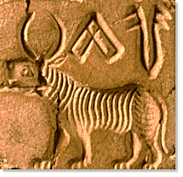
Linguistics
Does Indus Script constitute a language?
Notes:
Language or Pre-Writing (e.g. http://en.wikipedia.org/wiki/Vin%C4%8Da_symbols)
Despite a large number of attempts, the script of the Indus civilization (circa 2500-1900 BC) remains undeciphered. The absence of a multilingual "Rosetta stone" as well as our lack of knowledge of the underlying language have stymied decipherment efforts. Rather than attempting to ascribe meaning to the inscriptions, we are applying statistical techniques from the fields of machine learning, information theory, and computational linguistics to first gain an understanding of the sequential structure of the script. The goal is to discover the grammatical rules that govern the sequencing of signs in the script, with the hope that such rules will aid future decipherment efforts.

Slide 11
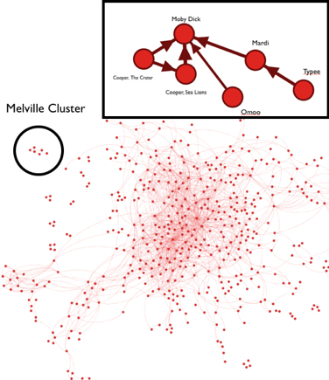
Clustering Novels
Notes:
Melville viewed James Fenimore Cooper as a major influence of his writing

Slide 12
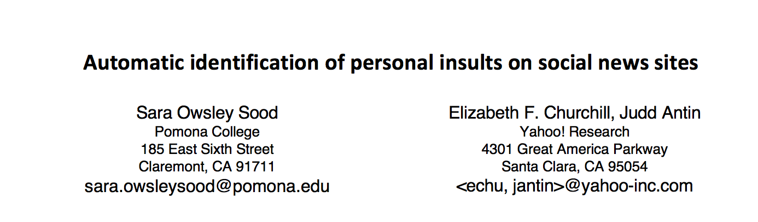
http://www.cs.pomona.edu/~sara/Site/Publications_files/JASIST_r1.pdf
Potential Application: detect cyber bullying

Slide 13
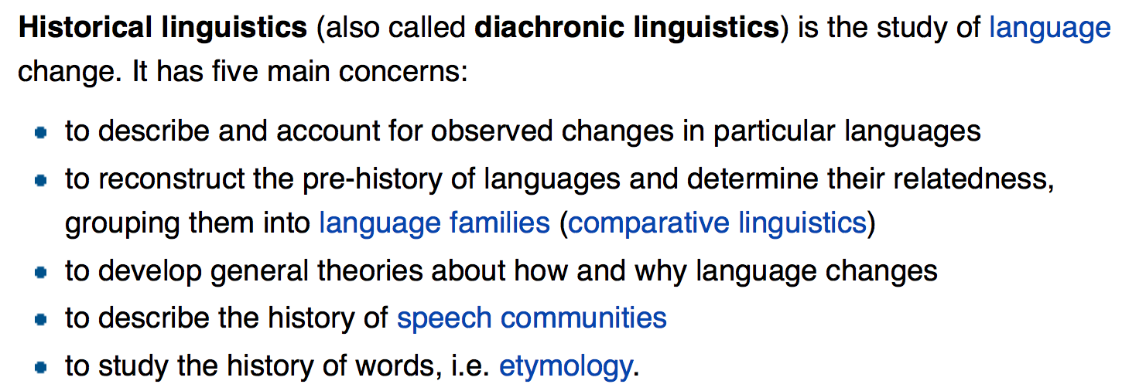
Diachronic (or Historical) Linguistics

Slide 14
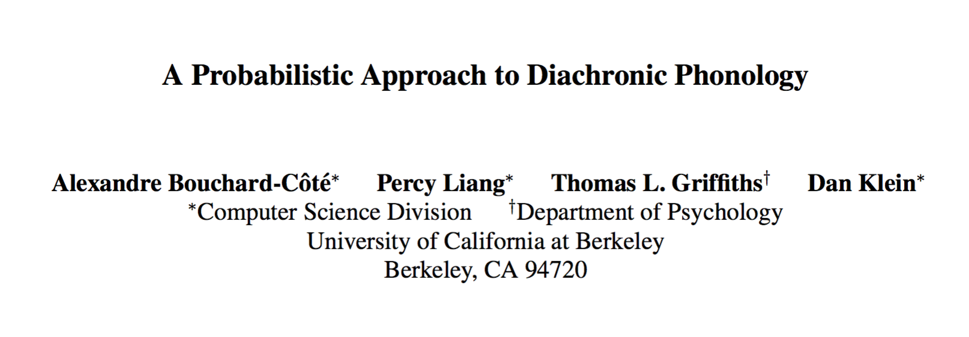
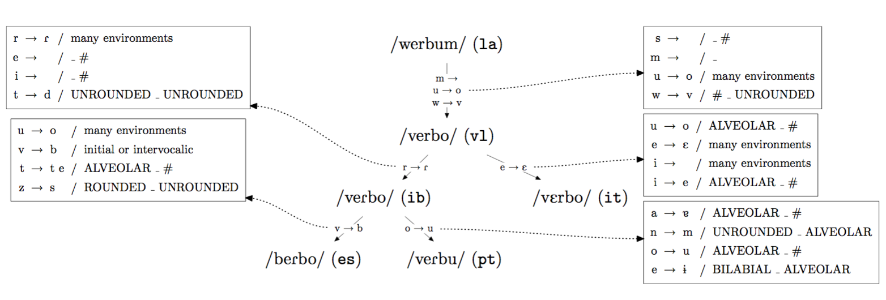

Slide 15
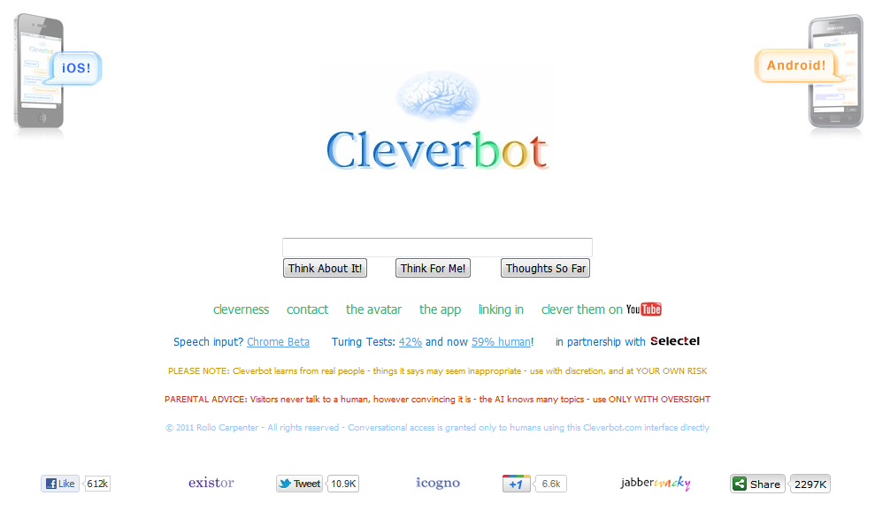
http://en.wikipedia.org/wiki/Cleverbot

Slide 16
And just for fun….
https://www.youtube.com/watch?v=WnzlbyTZsQY

Slide 17
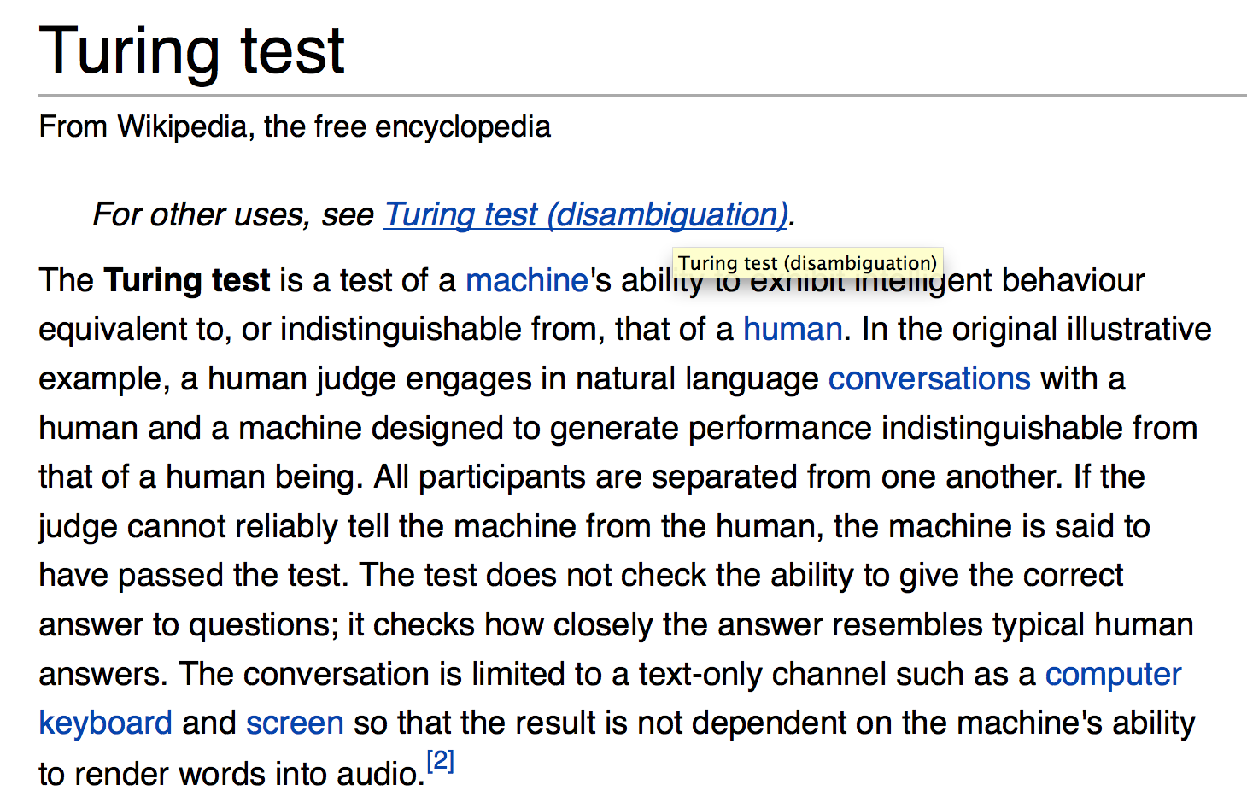

Slide 18
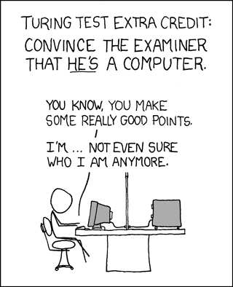

Slide 19
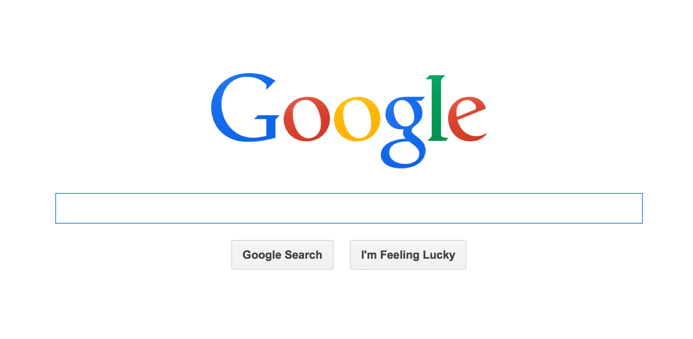

Slide 20
Project Kickoff

