Slide 1

Literature searching for your project
Jessica Emerton, Subject Librarian for Physics and Astronomy
EmertonJ@cardiff.ac.uk
Log in and load the tutorial supporting this session: https://bit.ly/PHYSXlibrary2022

Slide 2

Outline
1. What is good quality academic information and how do I use it in my literature review?
2. What are the tools of the trade for literature searching and how do I use them effectively?
3. How do I keep track of what I’ve found and avoid plagiarism?

Slide 3
Worksheet, slides and tutorial
Worksheet and slides from today will be added to Learning Central
Supplementary online tutorial:
https://bit.ly/PHYSXlibrary2022

Slide 4

1. What is good quality academic information and how do I use it in my literature review?

Slide 5
Interim report
From Year 3 project handbook
Produce a formal report (including an abstract) that provides an overview of the project and its status. Include appropriate aims and objectives, present a review of relevant literature and use it to explain the context of the project. Provide a summary of the relevant techniques and approaches and their theoretical basis. Provide a summary of progress (e.g. select results and analysis) and include an explanation of proposed aims and objectives for the remainder of the project.
A minimum of 10 academic references should be provided and 20 is usually sufficient. Appropriate web references may be included but are not considered part of the academic literature.

Slide 6
What is an academic reference?
“…it would be very useful to teach the project students what is regarded as a 'reputable' research source, as many of their reports lose marks for relying too much on popular articles, blogs, online lecture notes from uncredited universities”
Professor Jane Greaves

Slide 7


Exercise 1
Scholarly information: a starter exercise
(Search on Google and Google Scholar and compare the results)

Slide 8

Have you used Google Scholar before?

Slide 9
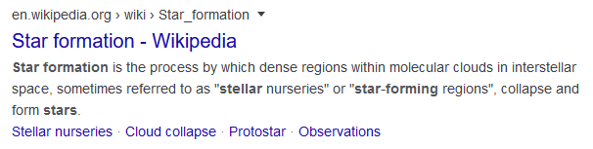
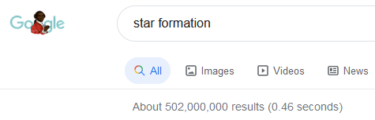

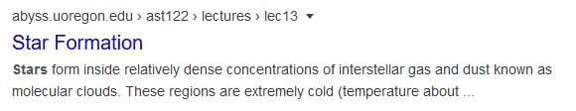

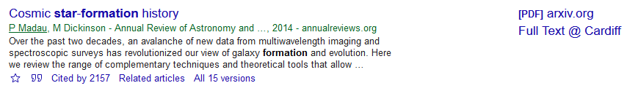
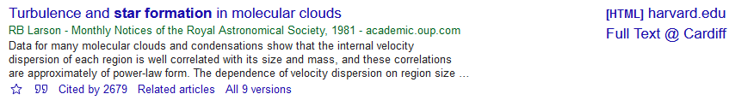
Exercise 1 follow-up: Google and Google Scholar demo
Notes:
Limits results to items in PDF format with a list of references
Set up Google Scholar to find CU full text
Full Text @ Cardiff links from own laptop via Settings – Library links
[PDF] arxiv.org links also appear – open access
Less curated & less sophisticated than a database like Scopus, but simple to use & effective

Slide 10
Good quality information
Journal articles
Textbooks
Webpages from reliable sources
Check for bias, currency, authority etc
‘Lateral reading’
Look for organisations you trust
Wikipedia to be used for background research only and to lead onto scientific articles – it’s best not to reference it in your assessed work

Slide 11
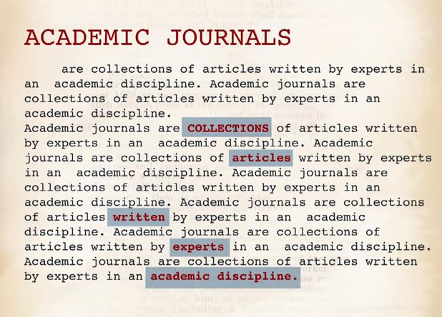
Video: What are academic journals? (Watch up to 00:45)
https://www.youtube.com/watch?v=KKIbnNLCh8g

Slide 12
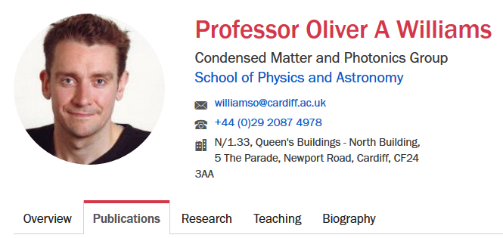
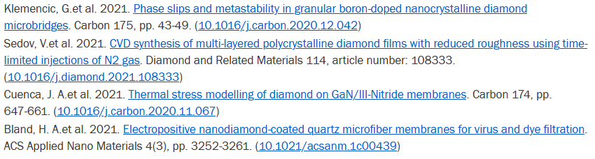

Slide 13
Scholarship is a conversation
As a student, you will contribute to the ongoing scholarly conversation just as Professors do
By citing & referencing, you acknowledge other voices in the conversation
You will be able to illustrate things like a change in the scholarly perspective over time or the contribution a particular source has made to the conversation
“ ”
“ ”
“ ”

Slide 14
A literature review provides background
why did you choose that design?
Practical project involving design
Classroom project
where did the lesson plan come from?

Slide 15

What does a literature review do?
Gives context for your project
Identifies and acknowledges significant research
Provides evidence to support your viewpoint
Identifies sources you disagree with
Shows where your project fits in with other research in the subject area
Displays your understanding: not a simple narrative, involves evaluation and synthesis

Slide 16

Evaluate where to spend your reading time
Skim articles:
Read the abstract
Scan the article looking at headings and graphs/tables
Look for key issues and findings in the discussion/conclusion
Track what is important

Slide 17
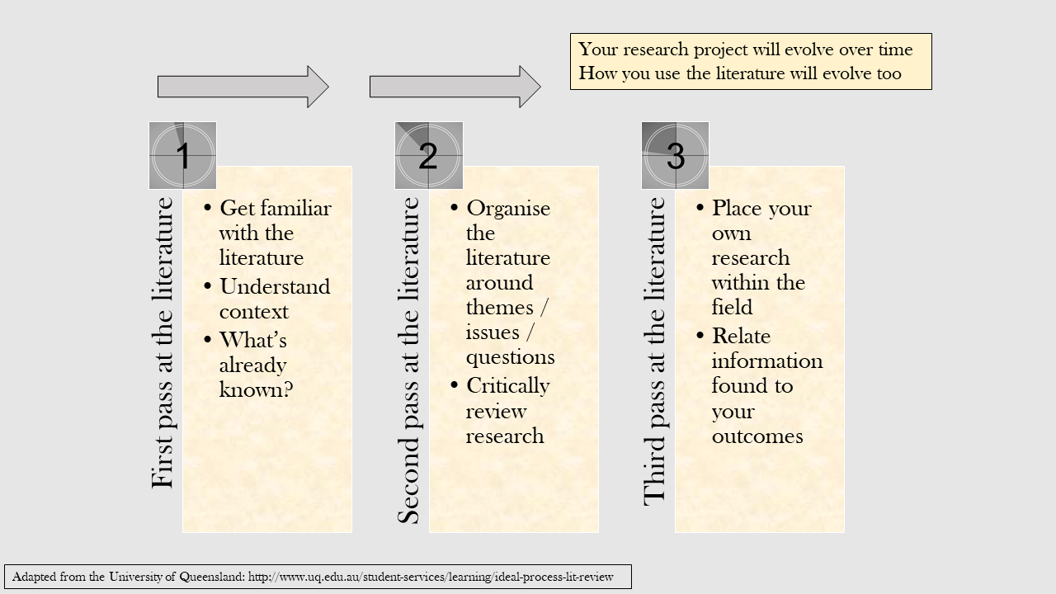
One way of approaching the literature: take three ‘passes’ or attempts at reading it

Slide 18
2. What are the tools of the trade for literature searching and how do I use them effectively?

Slide 19
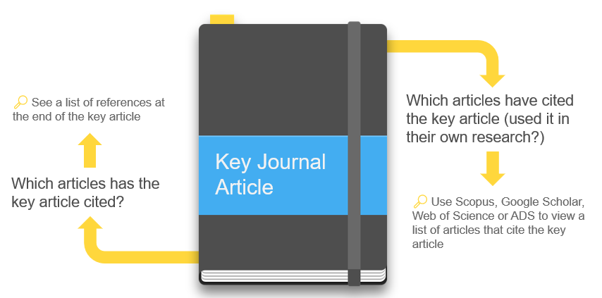
Starting with a seminal paper

Slide 20
Has your supervisor given you a key paper?

Slide 21
Search is not linear
"We are giving students open ended research projects and part of the task is to explore the literature to see what progress has been made by others.
By definition then, what they need to find out and what the key concepts and ideas are at least partly outcomes of the search rather than inputs.”
Dr Dave Westwood
Might do extensive searching nearer Christmas, comes later sometimes

Slide 22
Why plan your search?
An initial search for the topic may retrieve no hits, or many may be irrelevant, or the volume may be overwhelming
Many academic search tools work best if break your topic down into key words and short phrases
Notes:
Before you start any research for a big piece of work, it’s essential to put some effort into planning first. Having a good plan, will save you lots of time in the long run….

Slide 23
Keywords and related terms
Topic: acoustics of concert halls
Acoustics | Concert halls
acoustic* | “concert hall”
“acoustical design” | auditorium
sound | auditoria
“sound insulation” | etc
etc
Notes:
So this is an example of a topic and simple keyword plan
Notice we have broken the question down into some key concepts. These will be the focus of our search. Important to think of as many synonyms and alternatives as you can, to make sure you don’t miss anything. Databases can only retrieve results which match your keywords. You may miss important sources, if you don’t include keywords which might retrieve them.
Explain double quotes and asterisk – more on this in the video

Slide 24
Key academic search tools
Multi-disciplinary:
LibrarySearch
Google Scholar
Scopus
Web of Science
Astronomy, Astrophysics, Physics - arXiv via ADS
Medical Physics – PubMed
Physics – IEEE Xplore
Computational Physics – MathSciNet
Nanoscience – Springer Materials
Notes:
arXiv – Key source: Astronomy and Astrophysics, Physics and the arXiv e-prints. Has wide coverage including Physics teaching
LibrarySearch - ‘Discovery tool’ – not just library catalogue. Includes books available in the library/online. Finds academic articles & more

Slide 25
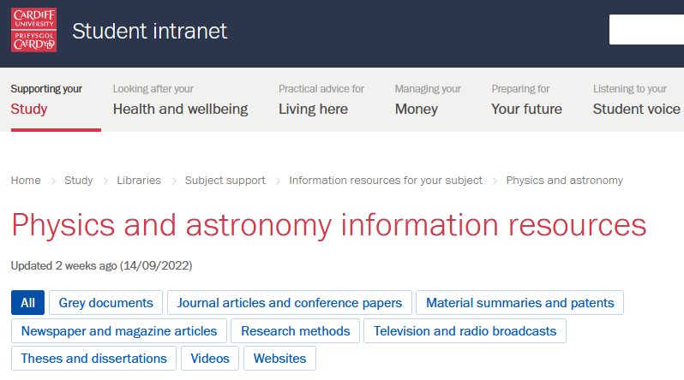
Find key academic search tools listed on the Physics and astronomy information resources page

Slide 26
Scopus: benefits
Searches widely for published academic literature
Sophisticated search options, multiple refine options
Mainly journal articles
Multidisciplinary
Use ‘check for full text’ buttons to see if Cardiff has the journal article
Ability to track citations
Alerting services
Smart tools to track, analyse and visualize research
Notes:
So you are all now very familiar with using LibarySearch and we would still recommend this as a good starting point for your dissertation or critical translation research. But it’s important to remember that LibrarySearch is limited to searching what we have in our collections – either print or online. It won’t search the contents of journals we don’t have online.
So for your dissertation, you’ll be keen to ensure that you have found all the main sources related to your research. So this where bibliographic databases help. Some of you may already be familiar with resources such as JSTOR for example, but there are lots more out there. So what are bib databases and what do they do?

Slide 27

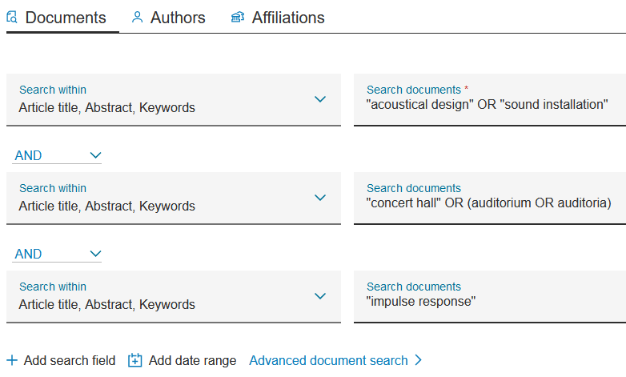
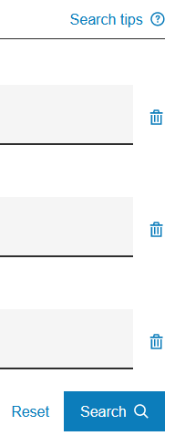
Combining keywords in Scopus

Slide 28
Exercise 2: Identifying keywords
Exercise 3: Combining keywords and refining your search
Exercise 4: Highly recommended search tool: Scopus
Exercise 5: Additional things to try with search tools

Slide 29
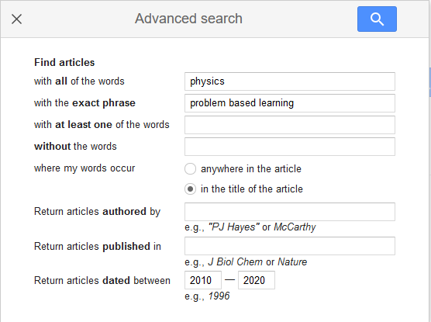
Exercises 2 and 3 follow-up: Identifying keywords, combining them and refining your search
Demo problem based learning physics search on Google Scholar
(includes Advanced Search page)
Show Planning your search page in online tutorial https://bit.ly/PHYSXlibrary2022
If you’ve found too many references:
Use more specific subject terms
Search in narrow fields (eg title)
Apply limits (eg publication date)
If you’ve found too few references:
Use broader subject terms
Use OR to combine alternative terms)
Search in broad fields eg keyword, abstract
Notes:
Limits results to items in PDF format with a list of references
Set up Google Scholar to find CU full text
Full Text @ Cardiff links from own laptop via Settings – Library links
[PDF] arxiv.org links also appear – open access
Less curated & less sophisticated than a database like Scopus, but simple to use & effective

Slide 30
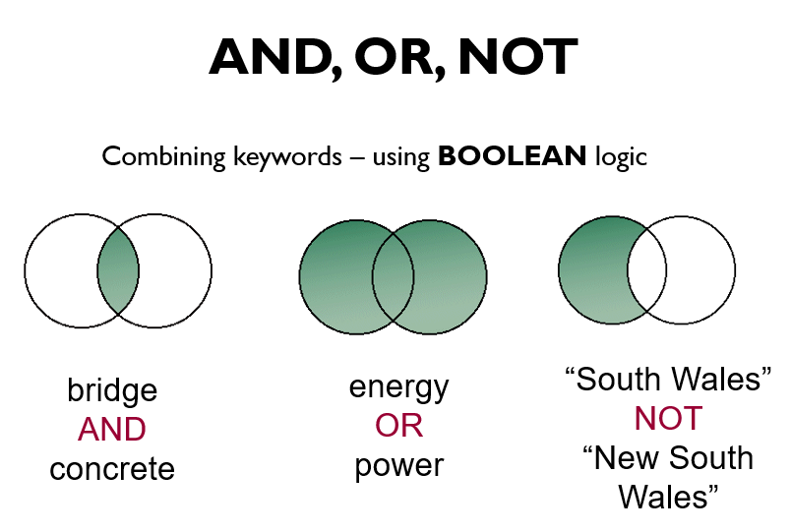

Slide 31
Quotation marks for a phrase
“gravitational waves”
Combining keywords
(vibration OR oscillation) AND pendulum
Truncation
detect* = detects, detector(s), detection, detected
Refine your search
By date, subject etc to narrow your results to those which are most relevant

Slide 32
Exercise 4 follow-up: Highly recommended search tool: Scopus
Demo search on Scopus
Demo search on LibrarySearch
Look at:
Refining search
Reordering results
Accessing full-text
Notes:
Limits results to items in PDF format with a list of references
Set up Google Scholar to find CU full text
Full Text @ Cardiff links from own laptop via Settings – Library links
[PDF] arxiv.org links also appear – open access
Less curated & less sophisticated than a database like Scopus, but simple to use & effective

Slide 33

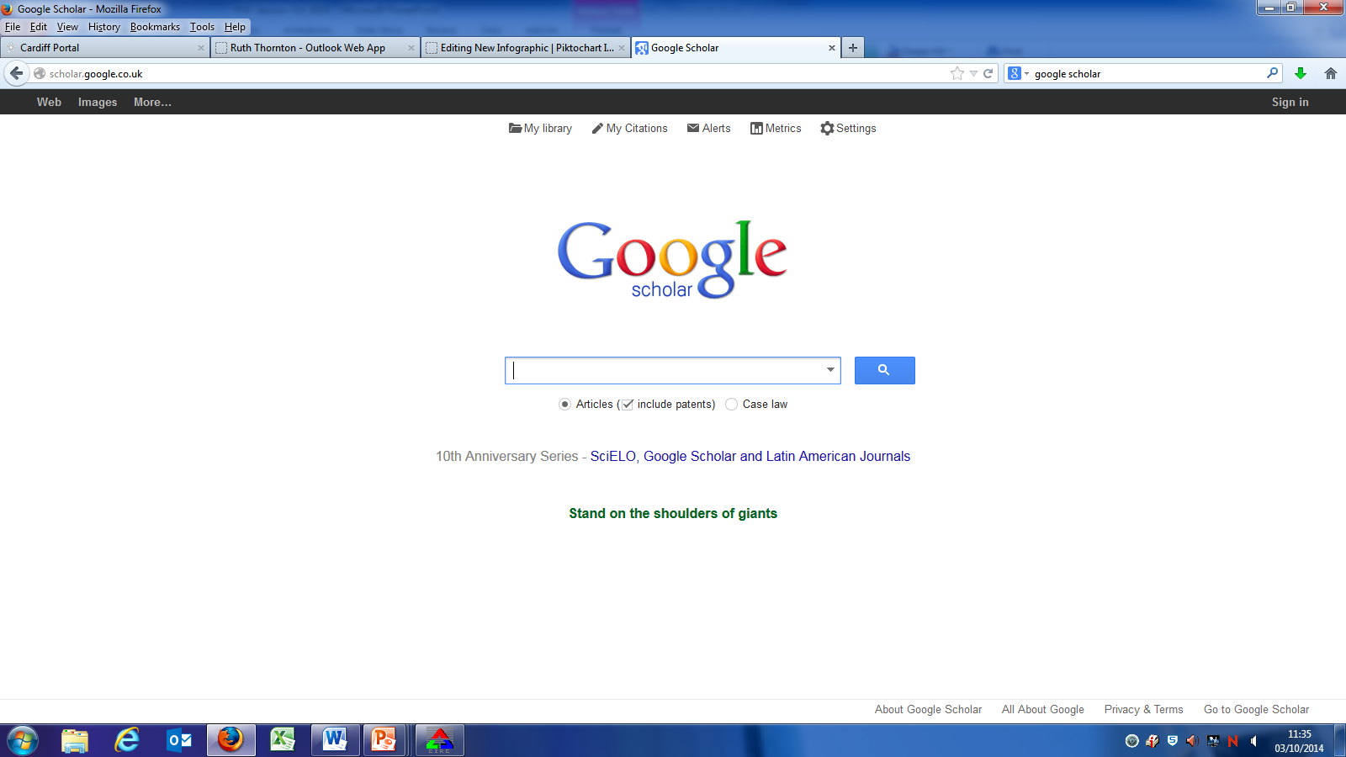


Accessing papers as a member of Cardiff University
Request inter-library loans for any important articles to which we do not subscribe
Set up Google Scholar to link to CU subscribed full-text on your own laptop
Always login to the intranet first to authenticate yourself as a CU student (particularly important off-campus)
Install Lean Library, a browser extension that works with our CU library systems to give you access to the books and resources we provide when you are searching online

Slide 34
Exercise 5 follow-up: Additional things to try with search tools
Demo on Scopus:
Saving useful articles
Setting up alerts
Save articles which look useful and email them to yourself or use reference management software (more on this in a moment)
Devised a good search strategy? Got good results?
Set up an alert so the database emails you with new matches
Or save the search strategy to re-run in future
Sometimes you have to register a free account with the database to use this functionality
Notes:
Limits results to items in PDF format with a list of references
Set up Google Scholar to find CU full text
Full Text @ Cardiff links from own laptop via Settings – Library links
[PDF] arxiv.org links also appear – open access
Less curated & less sophisticated than a database like Scopus, but simple to use & effective

Slide 35
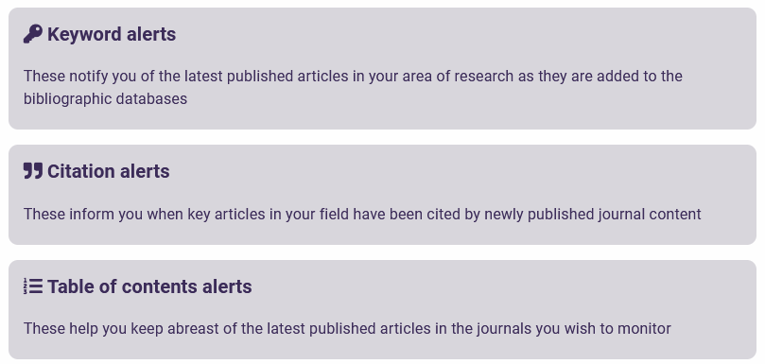
Types of alerts

Slide 36
3. How do I keep track of what I’ve found and avoid plagiarism?

Slide 37

Note-taking
Avoid writing down too many direct quotes
Write notes in your own words, this helps with understanding
Make a note of where ideas and quotes have come from (including page numbers)

Slide 38
Scholarship is a conversation
As a student, you will contribute to the ongoing scholarly conversation just as Professors do
By citing & referencing, you acknowledge other voices in the conversation
You will be able to illustrate things like a change in the scholarly perspective over time or the contribution a particular source has made to the conversation
“ ”
“ ”
“ ”

Slide 39
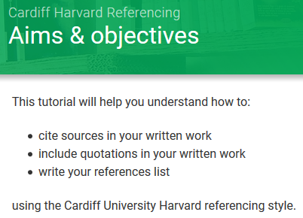
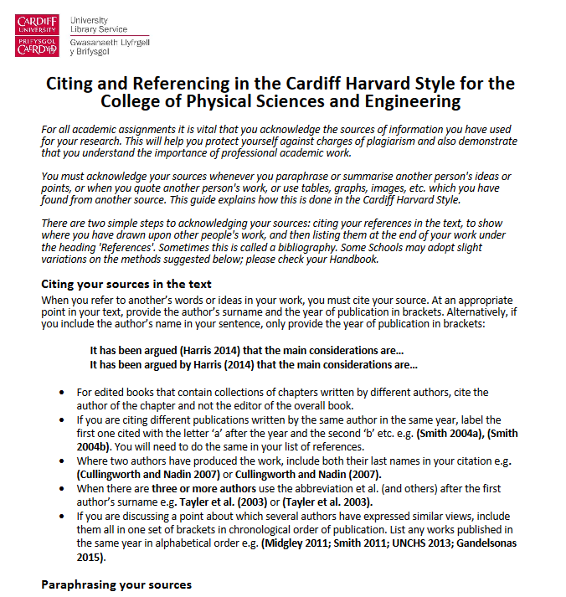
Citing and referencing
Lots of resources on the intranet, eg tutorial, examples https://intranet.cardiff.ac.uk/students/study/study-skills/academic-writing-communication-and-referencing
Bit.ly/pseharvard2
PDF guide to citing and referencing in the Cardiff Harvard Style for students in the PSE College:
Physics and astronomy information resources - Student intranet - Cardiff University
click on the link on the right hand side of the page to access the PDF guide

Slide 40

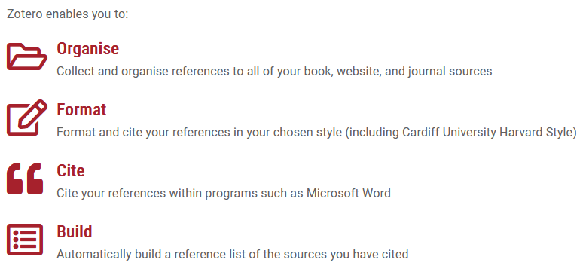
Zotero reference management software
See tutorials on the Zotero intranet pages
Notes:
Keep track:
Ensuring your search is thorough
Citing your sources
Avoiding repetition of tasks
Added links in LC to:
Choosing Quality Sources
Reference Management pages

Slide 41
Literature searching: summary
Engage with the academic literature
Start with a seminal paper and follow up citations
When searching, consider use of keywords and how to refine your search
Your use of the literature will change and deepen as your project goes on

Slide 42
Further help
You can get in touch with your Subject Librarian (me!) any time:
via email (EmertonJ@cardiff.ac.uk)
via Microsoft Teams chat (start a new chat and search for Jessica Emerton)
via Trevithick Library help desk
Worksheet and slides from today will be added to Learning Central
Supplementary online tutorial:
https://bit.ly/PHYSXlibrary2022

