Slide 1
Airport Hub Optimization
Allison McMahon and Isabella McCoy
4/28/2026
1
1

Slide 2
Background Information
Hub and Spoke Model
Southwest Holiday Meltdown
Airline network where passengers are routed through a central "hub" airport to connect to various "spoke" destinations.
Massive operational failure exacerbated by crew scheduling technology, staffing issues, and point-to-point network.
2
2

Slide 3
16,647
$1.2 Billion
$140 Million
Flights canceled Dec 21st-Dec 30th
Reported financial loss
Fines from US Department of Transportation
3
3

Slide 4
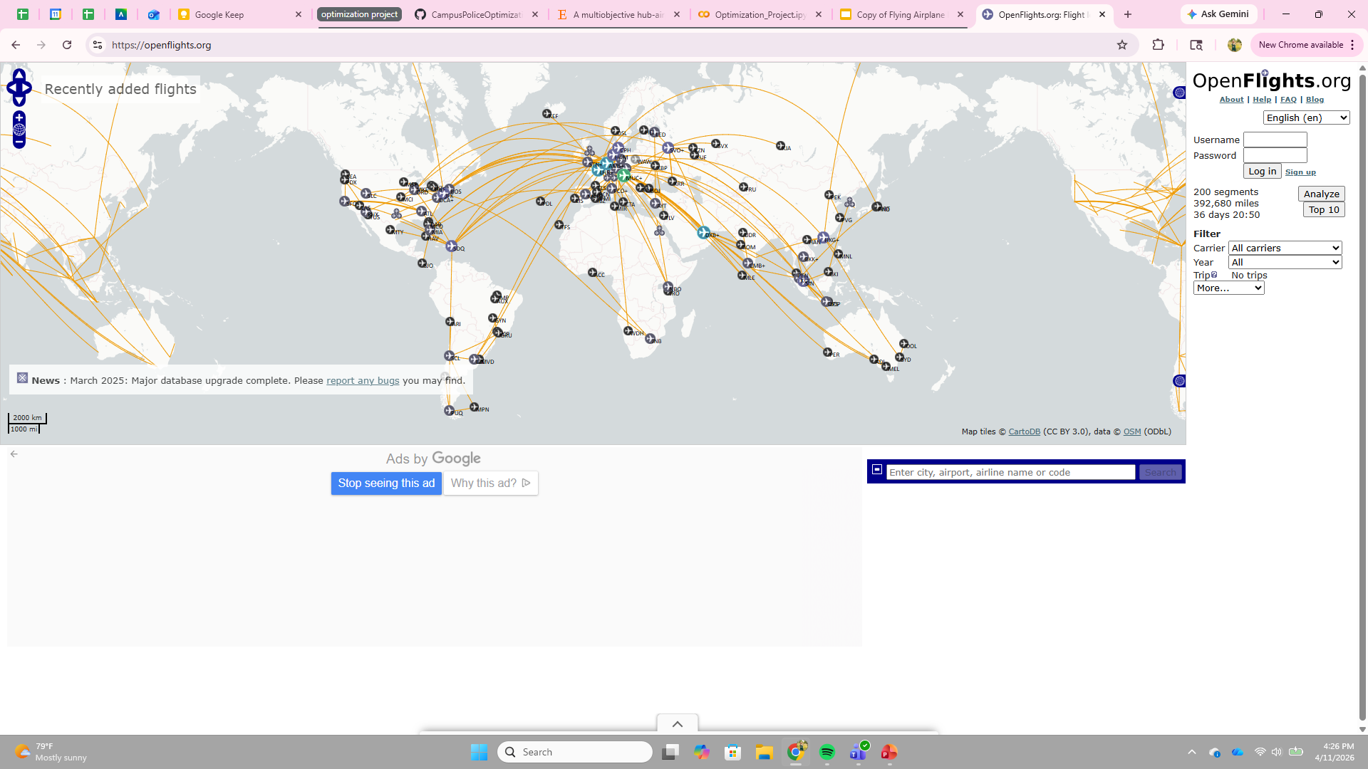

The Data
Two data sets from OpenFlights.org (routes and airports)
The airline routes dataset is used to measure how “busy” each airport is and estimate the demand between airports.
The airport dataset shows the geographic points of the airport and is used to calculate the distances.
4
4

Slide 5
Model Formulation
Goal: Minimize the total weighted travel distance between airports and their assigned hubs, where weights reflect airport activity.
Constraints:
Select exactly 5 hubs.
Each airport is assigned to exactly one hub.
Airports can only be assigned to selected hubs.
The purpose is to design an efficient hub-and-spoke network that reduces total travel distance while prioritizing high-travel airports as hubs. This does not mean that the highest-travel airports will automatically be chosen as hubs.
5
5

Slide 6
Model Limitations
Simplified Demand Approximation
Distance-Only Cost Measure
No Capacity or Operational Constraints
Demand is estimated using route activity not passenger data, which may not be fully reflective of true traffic patterns.
The model minimizes geographic distance but does not account for cost, flight frequency, or airlines operational constraints.
Airports are assumed to handle unlimited traffic; congestion, runway limits, and sheduling are not considered.
12
6

Slide 7
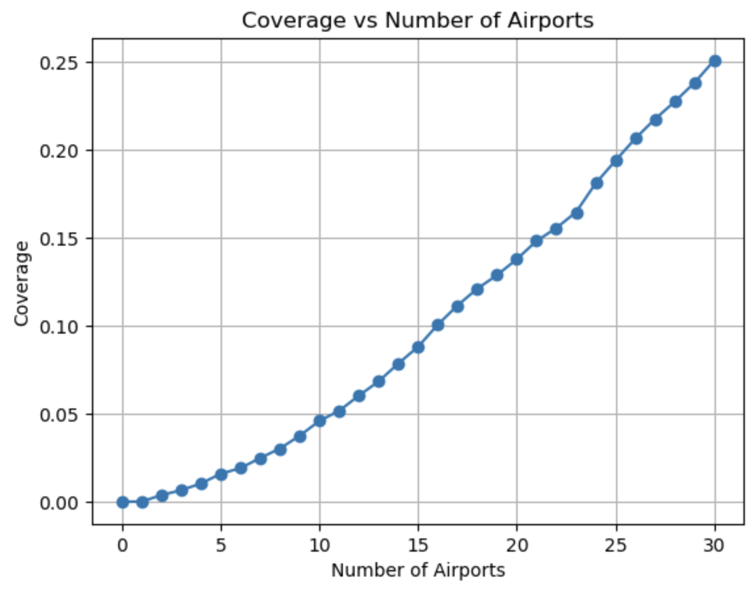
Route Coverage
To test our model, we seek to cover 25% of routes in our dataset.
Coverage means that both the departure and destination airports will be included in our final index of airports (nodes).
At 25% coverage, our index has 30 airports.
This will give us a model that is easy to test and can be scaled later.
5
7

Slide 8
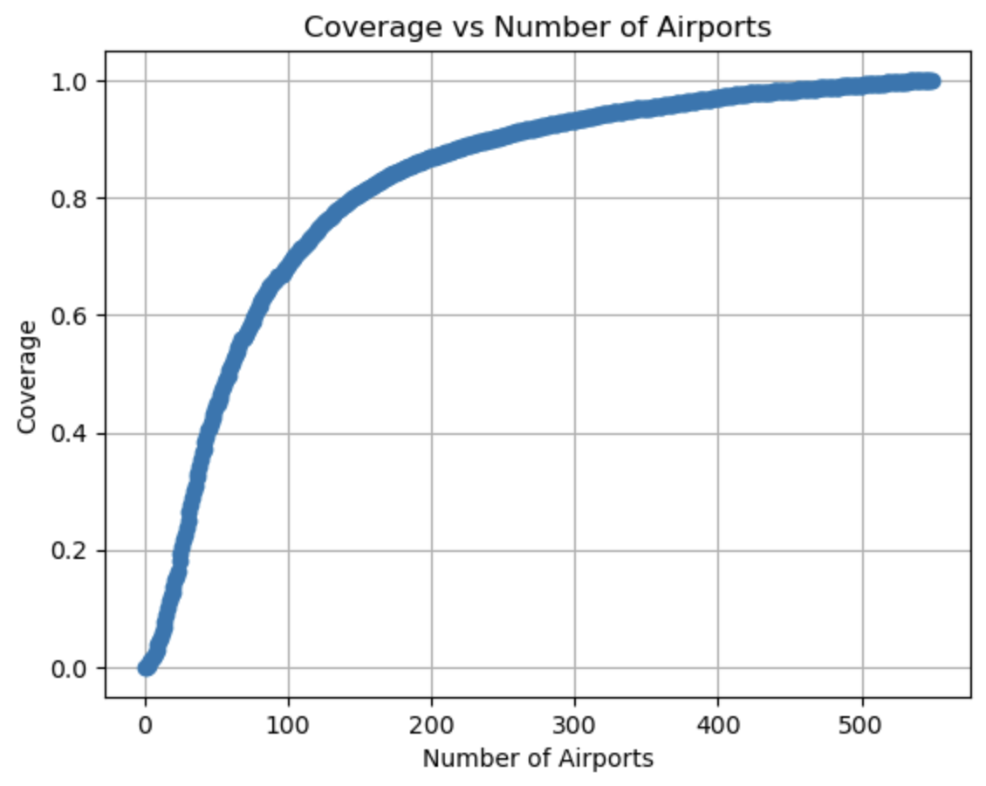
Route Coverage
100% coverage requires using all 549 unique airports in the routes dataset.
However, this graph demonstrates that the steepest gains in coverage come from the top 100 airports, with lesser gains coming from the next 100, and further diminishing returns after this point.
For example, 80% coverage occurs at 146 airports.
6
8

Slide 9
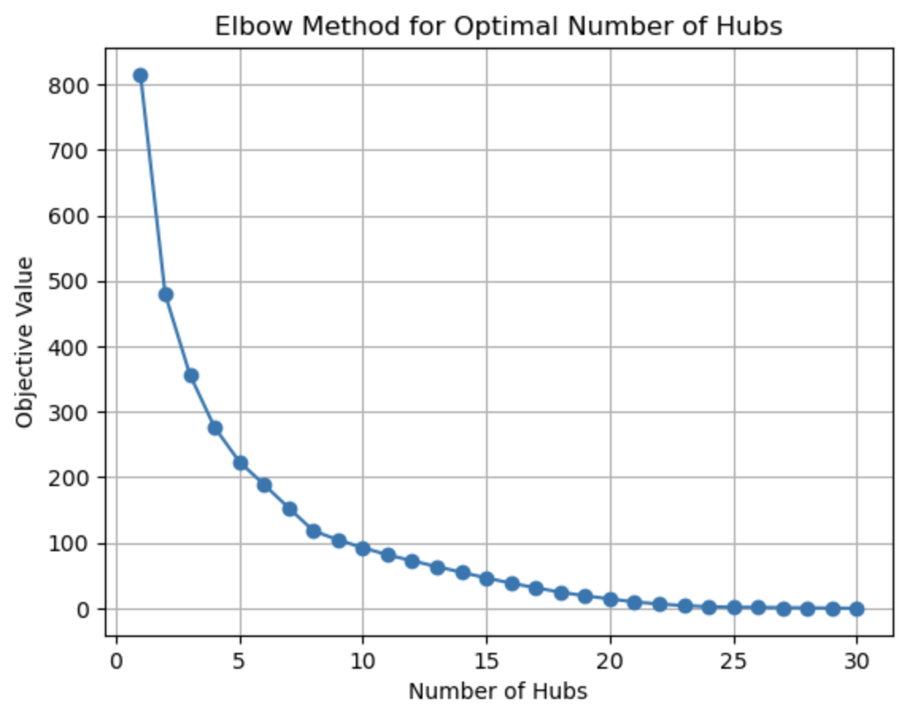
Ideal Number of Hubs
In order to choose an ideal number of airports to serve as hubs, we solved the model from 1 hub to n (number of airports determined by the desired route coverage) hubs.
In this model, n=30, and we used the elbow method to find that diminishing returns occurred after around 5 hubs.
9
7

Slide 10
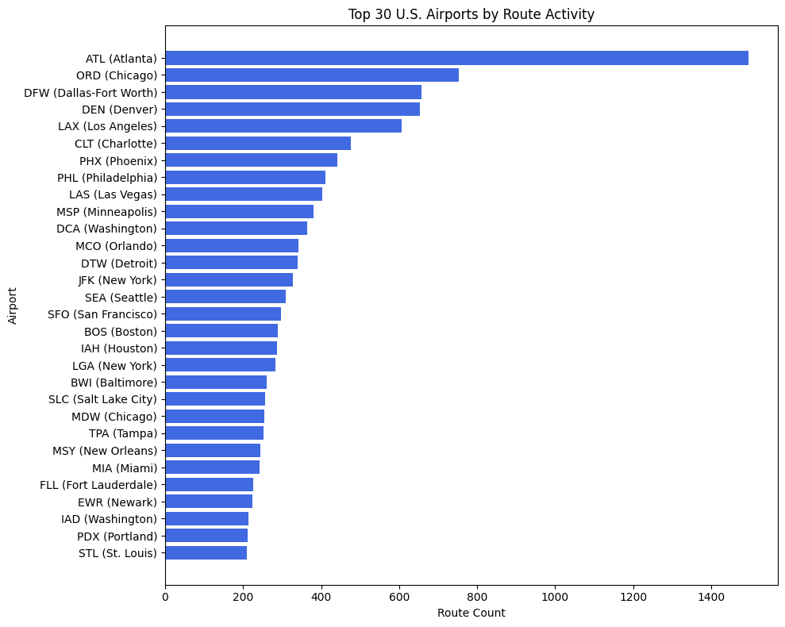
Top 30 Airports by Route Activity
Airports ranked by total route connections, used as a proxy for airport activity.
These airports form the candidate set for hub selection.
Identifies the most connected and influential airports in the network.
9
10

Slide 11
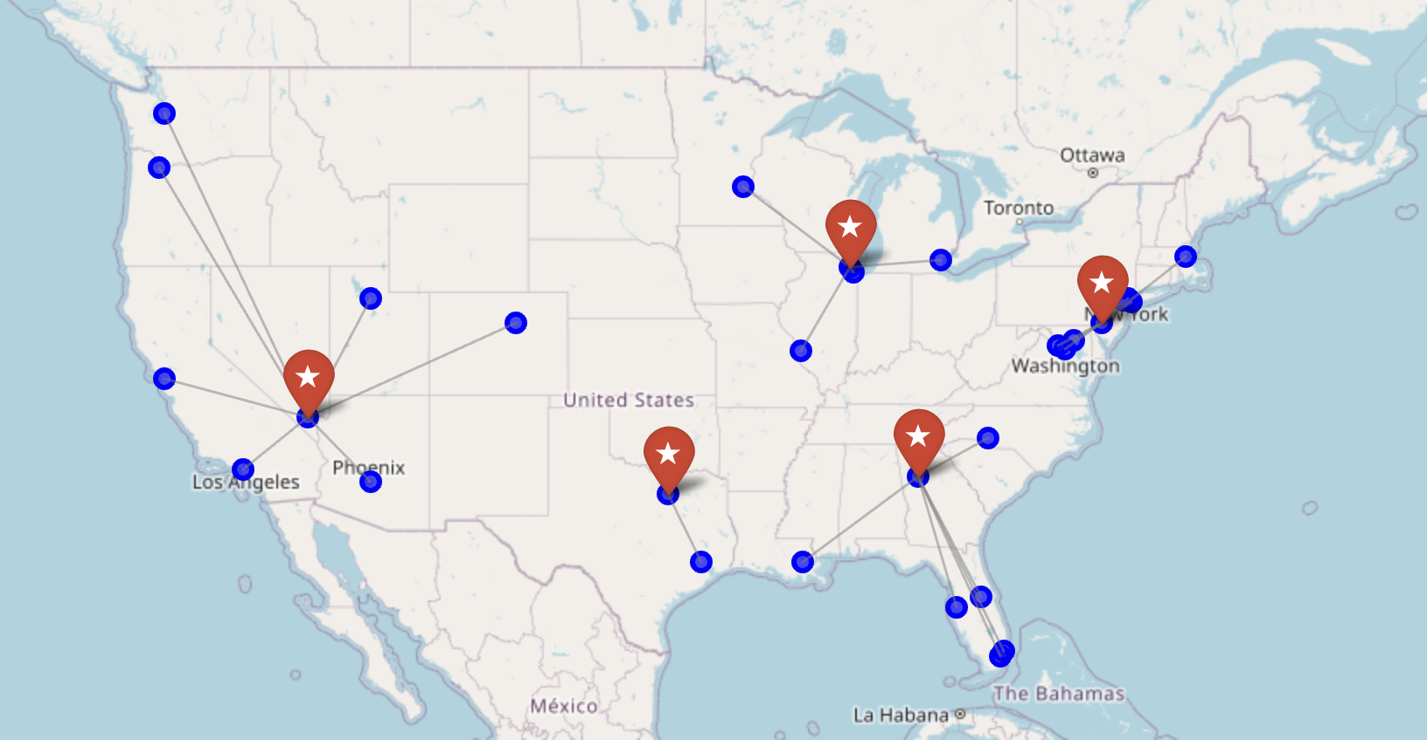
Hub and Spoke Map
11

Slide 12
Key Takeaways
Hub Selection Impacts Efficiency
Non-Obvious Solutions
Adaptable and Scalable
Strategic hub placement significantly reduces total network travel distance.
The model identifies hubs that may not be intuitive but improve overall network performance.
The framework can be adjusted for different hub counts, datasets, and real-world applications.
12

Slide 13
Thank You
13

