Slide 1
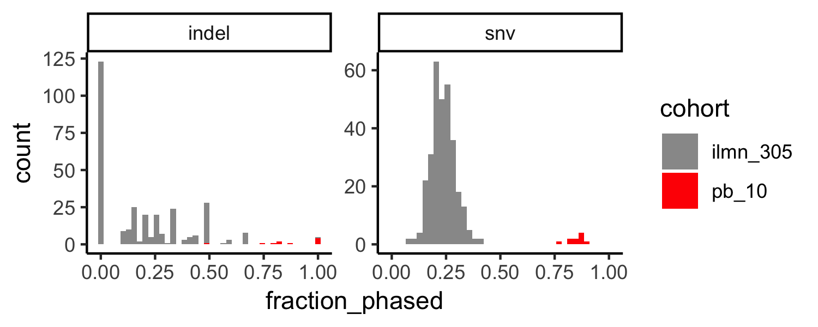
(a)
(b)
Cohort |  | Mom | Dad | Unphased | Fraction phased
PacBio (N=10) | SNV | 138 | 445 | 105 | 0.85
 | Indel | 11 | 37 | 10 | 0.83
Illumina (N=305) | SNV | 1,217 | 3,945 | 16,860 | 0.23
 | Indel | 82 | 224 | 1,229 | 0.20
Cohort
Trios/bin
Illumina (N=305)
PacBio (N=10)
Fraction of de novo variants phased
Figure 1. The fraction of de novo variants (DNVs) phased with Illumina short-read or PacBio long-read sequencing through read-pair tracing. (a) The total number of SNVs and Indels phased in each cohort. (b) Histograms of the fraction of de novo indels (left panel) or SNVs (right panel) phased with Illumina short-read (grey) or PacBio long-read (red) sequencing.

Slide 2
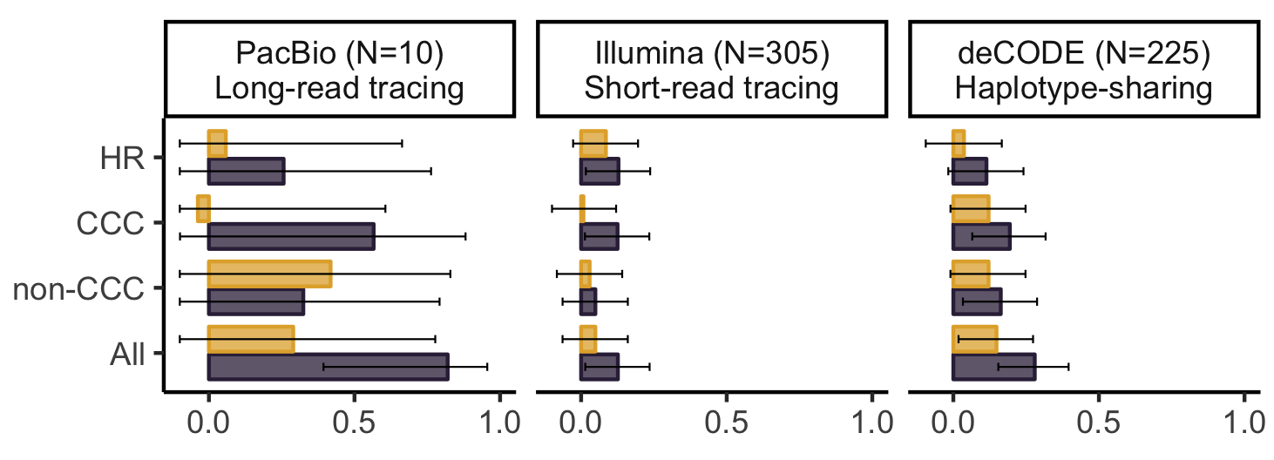
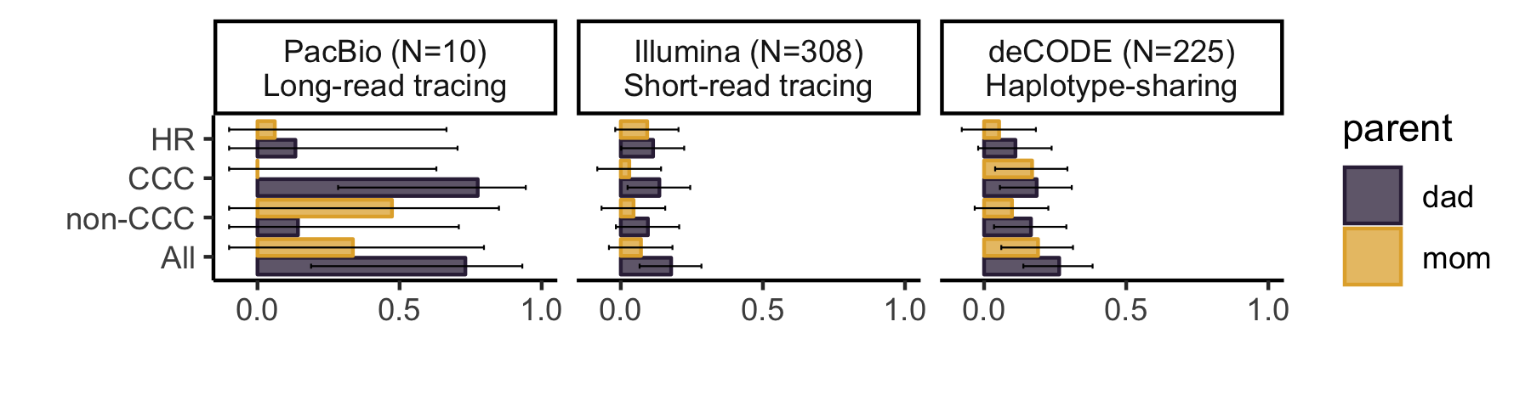
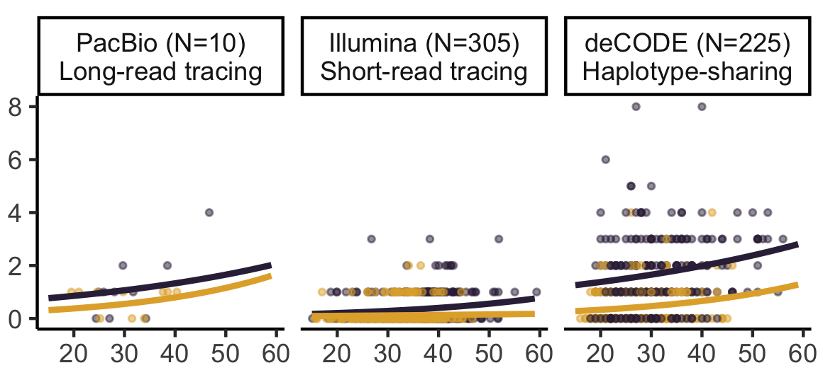
(a)
Mother
Father
Spearman’s correlation coefficient
(b)
Meta-analysis P
(c)
 | Mother | Father
HR | 0.51 | 0.033
CCC | 0.45 | 7.1x10⁻³
Non-CCC | 0.16 | 0.054
All | 0.092 | 4.6x10⁻⁷
CCC indels/trio
Parental age at conception
Figure 2. Correlation between parental age and indel classes across three phasing methods. (a) Spearman’s correlation coefficient and 95% confidence intervals between maternal or paternal age at conception and three indel classes for three methods. (b) Fisher’s method meta-analysis of correlation p-values shows a significant correlation between paternal age and CCC indels. (c) Scatter plots illustrating the correlation between age at conception and the number of CCC indels, fitted with mixed effects Poisson regression (Supplemental Figure 2 for HR, non-CCC, and all indel scatter plots). HR=homopolymer run, CCC=change in copy count (excluding HRs), non-CCC=indels not classified as HR or CCC

Slide 3
Supplemental

Slide 4
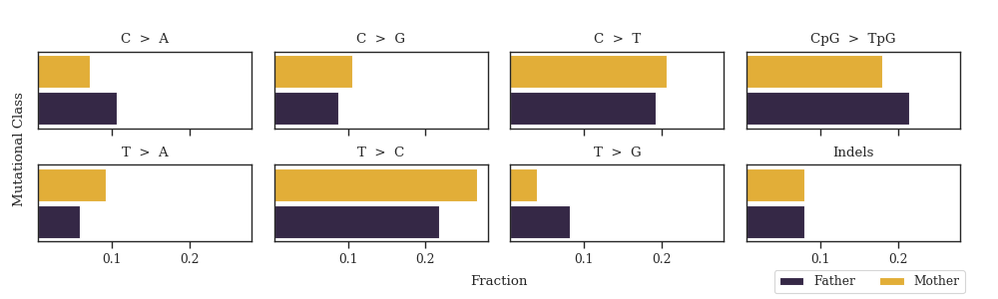
Supplemental Figure 1. Replication of previous de novo SNV patterns with long-read phasing by read-pair tracing. (a) Fraction of de novo variants in major classes phased to each parent. (b) Correlations between de novo variants in each class and parental age.

Slide 5
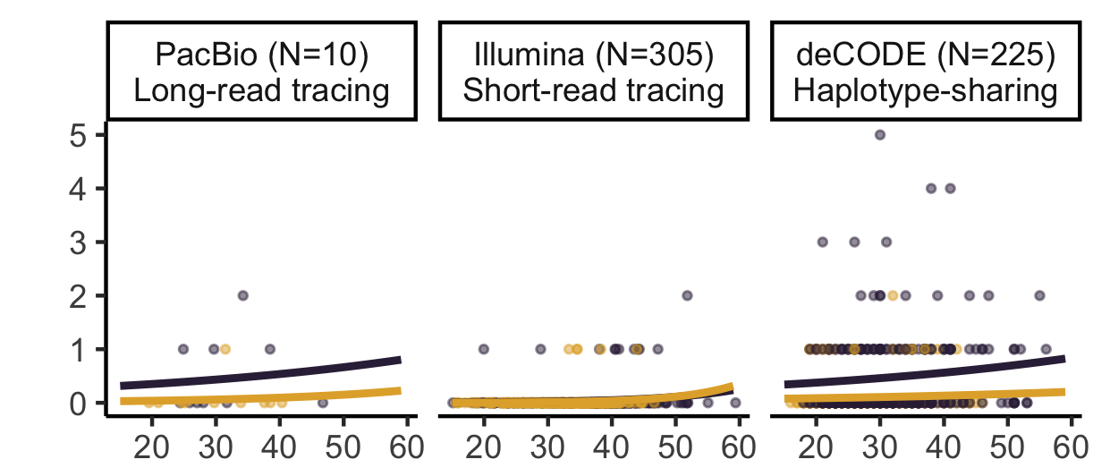
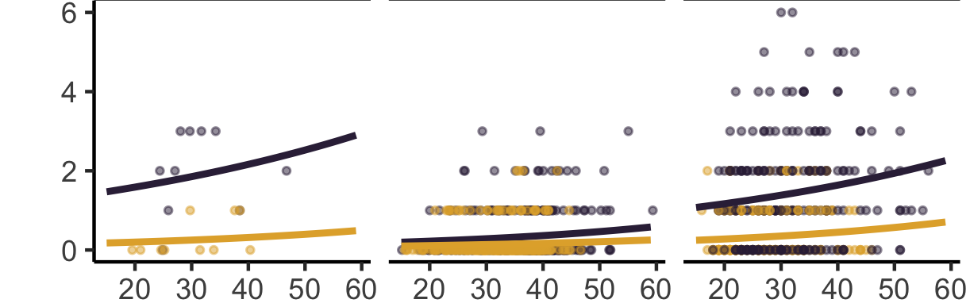
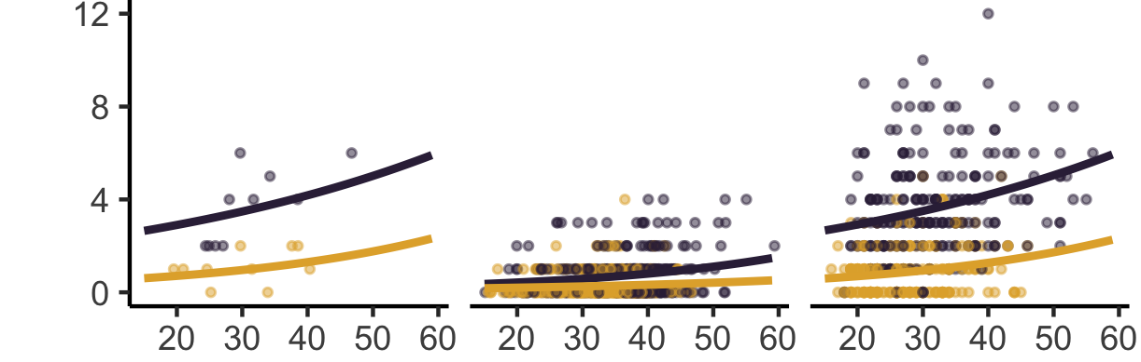
HR
Non-CCC
Indels per trio
Mother
Father
All
Parental age at conception
Supplemental Figure 2. Number of HR, non-CCC, or all indels per trio (y-axis) as a function of parental age (x-axis).

Slide 6
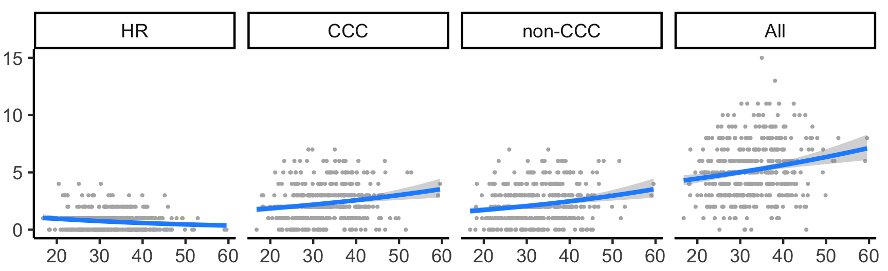
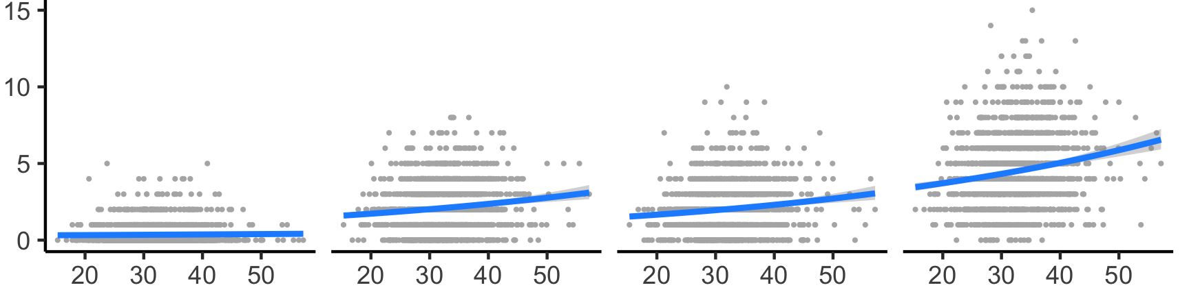
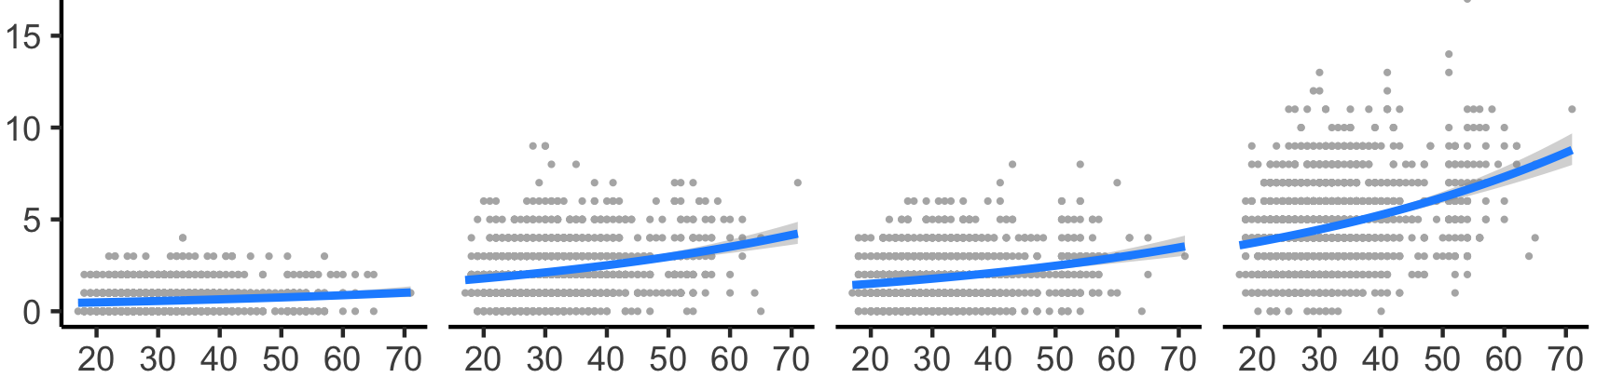
PCGC
(n=441)
Meta-analysis P
 | Mother | Father
HR | 0.11 | 0.14
CCC | 0.61 | 1.9x10⁻⁹
Non-CCC | 0.14 | 2.8x10⁻⁷
All | 0.04 | 1.4x10⁻¹⁴
Indels per trio
SFARI
(n=1,627)
deCODE
(n=1,323)
Father’s age at conception
Supplemental Figure 3. Correlation between father’s age at conception and number of unphased indels per trio. Trios without phasing information reveal correlations consistent with a pronounced paternal age effect in both CCCs and non-CCCs, in contrast to phased de novo indels where only CCCs where significantly correlated. P-values were obtained from multiple regression coefficients and meta-analyzed with Fisher’s method.

Slide 7
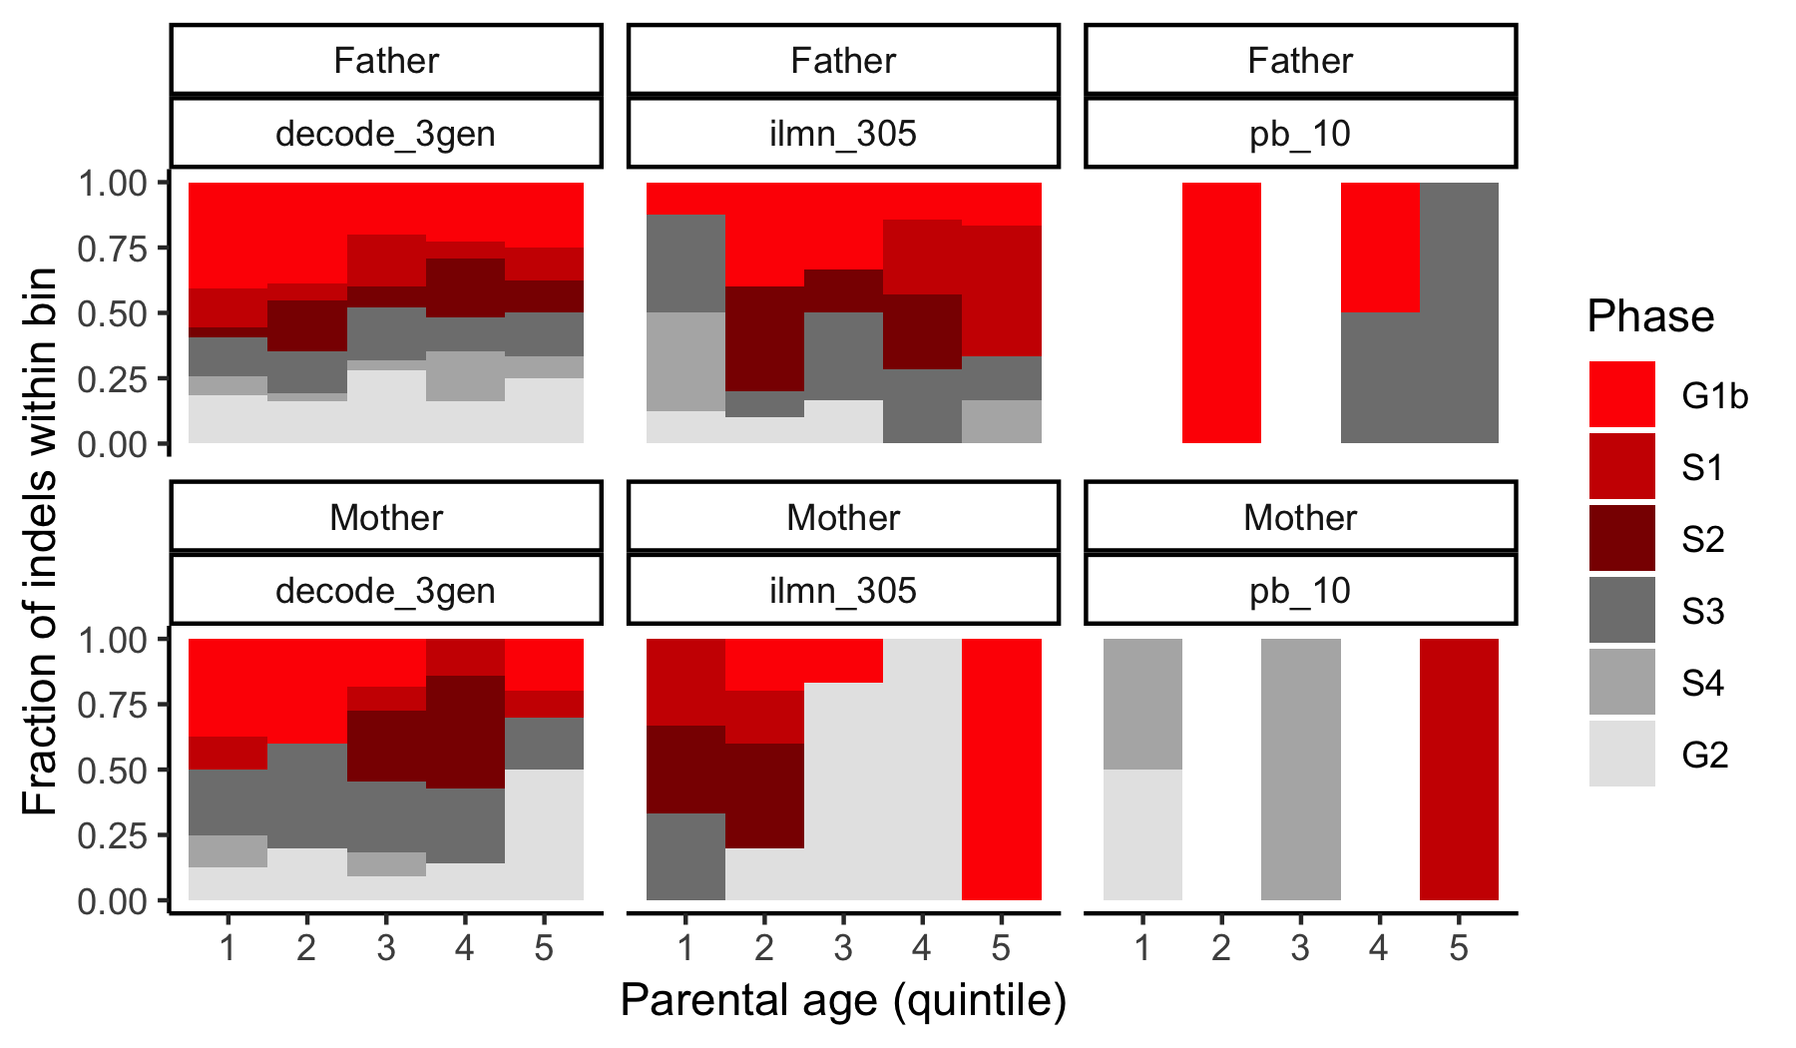
Supplemental Figure 4. No association between number of de novo CCC indels and replication timing in embryonic stem cells. Parental ages were binned into quintiles and (1=youngest, 5=oldest). Within each bin, the fraction of de novo CCC indels falling in each of six replication time points (colors) was plotted. There was no increase in the fraction of de novo CCC indels in early-replicating regions (i.e., G1b, S1) with increasing paternal age.

