Slide 1
Afiniti Intern Projects
January 2020
Allison Serio
Sabrina Romero

Slide 2
Client-Server Chat using Socket Programming in C++
Notes:
Sabrina

Slide 3
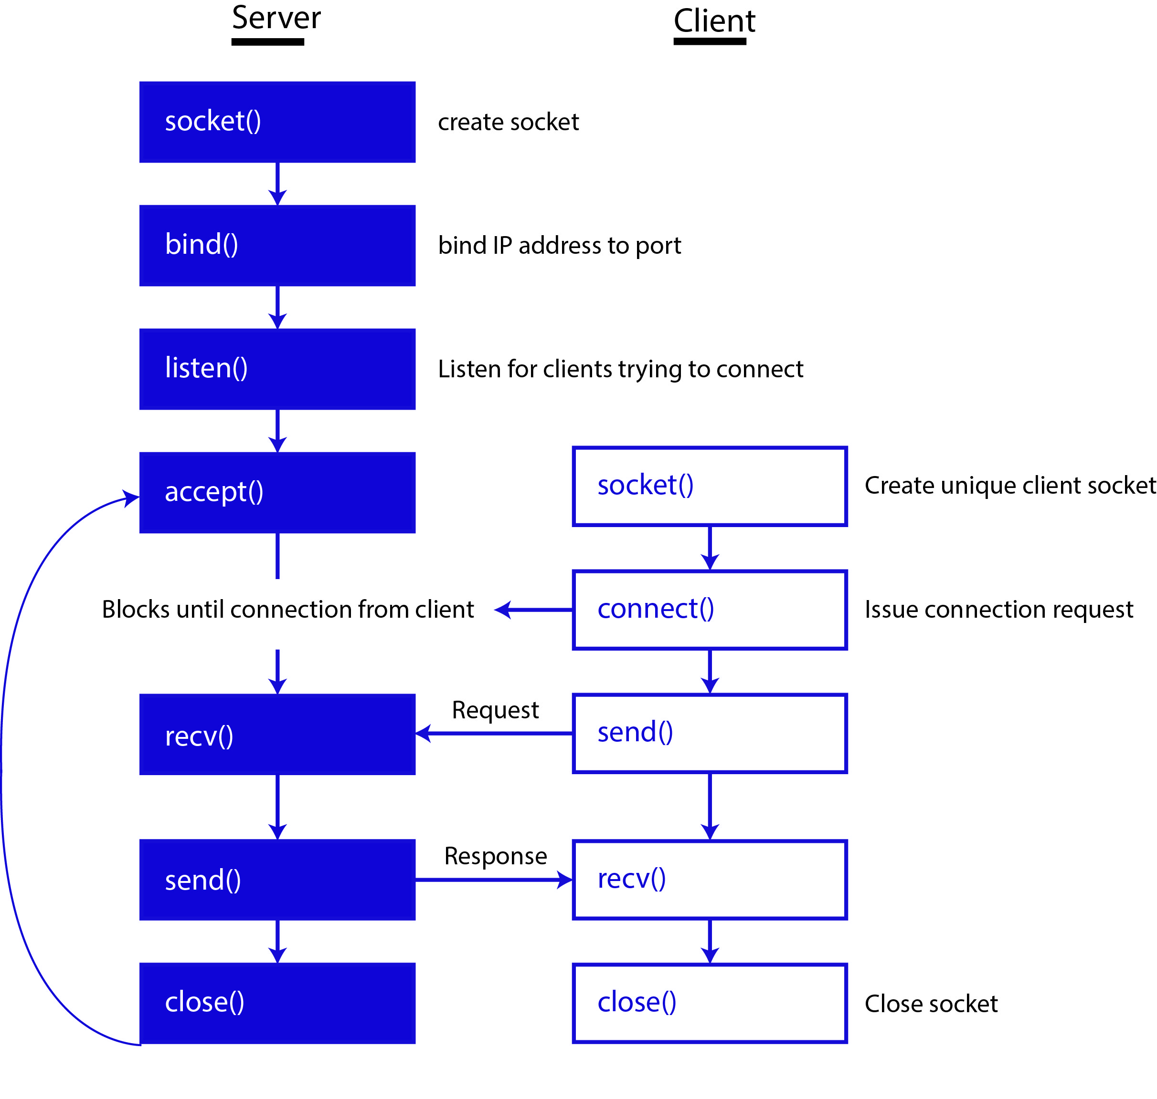
Notes:
Allison
binding problems with IP because of VM

Slide 4


Slide 5
Sentiment Analysis
Notes:
Allison

Slide 6
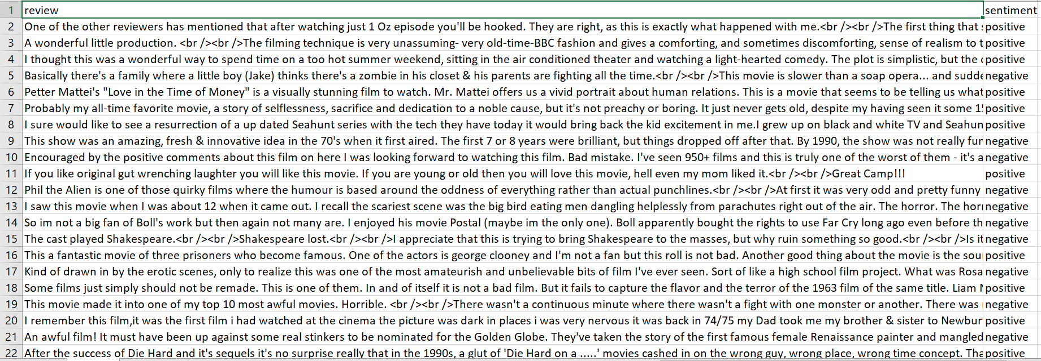
Data Processing
IMDB dataset of 50k movie reviews
Notes:
Allison
-subset
-numbers and characters that are not letters

Slide 7
Modifications
remove tags
remove brackets
remove special characters
remove stopwords
stem words
Notes:
Allison
-reducing the size of the vocabulary

Slide 8
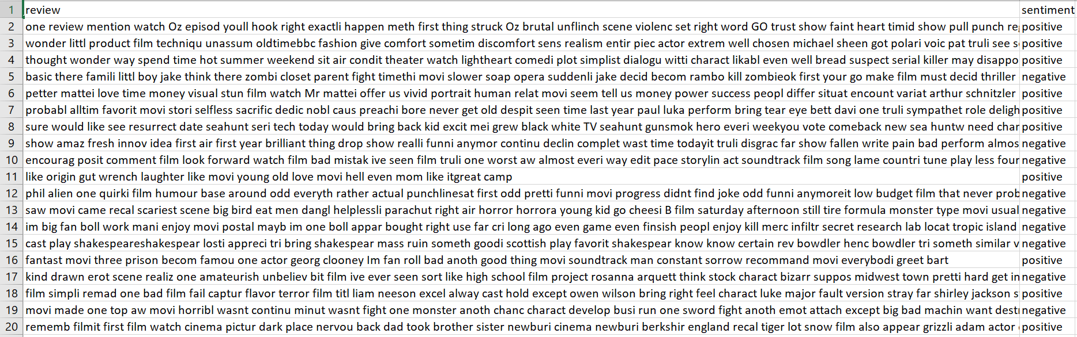
Filtered Dataset
Notes:
Allison

Slide 9
Converting text to numbers
Bag of Words Model
go,
back,
to,
Mississippi,
Alabama,
South,
Carolina,
Georgia,
Louisiana
Go back to Mississippi,
go back to Alabama,
go back to South Carolina,
go back to Georgia,
go back to Louisiana.
Notes:
Sabrina

Slide 10
Converting text to numbers
Bag of Words Model
Go back to South Carolina
[go, back, to, Mississippi, Alabama, South, Carolina, Georgia, Louisiana]
[ 1 , 1 , 1 , 0 , 0 , 1 , 1 , 0 , 0 ]
Notes:
Sabrina

Slide 11

Using scikit-learn library in Python
CountVectorizer
build vocabulary of known words
encode new documents using that vocabulary
integer count for the number of times each word appeared in the document.
Notes:
Sabrina

Slide 12

Using scikit-learn library in Python
TfidfVectorizer
Term Frequency: how often a word appears within a document.
Inverse Document Frequency: Downscales words that appear often across documents.
.
Highlights the words that are frequent in a document but not across documents.
Notes:
Sabrina

Slide 13

Results in the dataset
Notes:
Sabrina

Slide 14
Classification Models
Neural Network
Support Vector Machine
Logistic Regression
Notes:
Allison
nn not terminating but has score
svm svc model not terminating for rbf

Slide 15
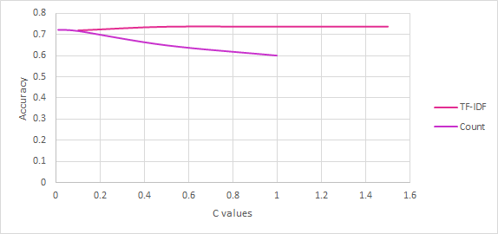
Logistic Regression Results
Notes:
Sabrina

Slide 16
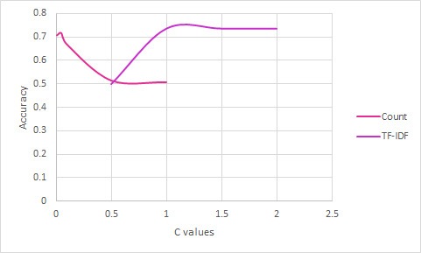
SVM Results
Notes:
Sabrina

Slide 17
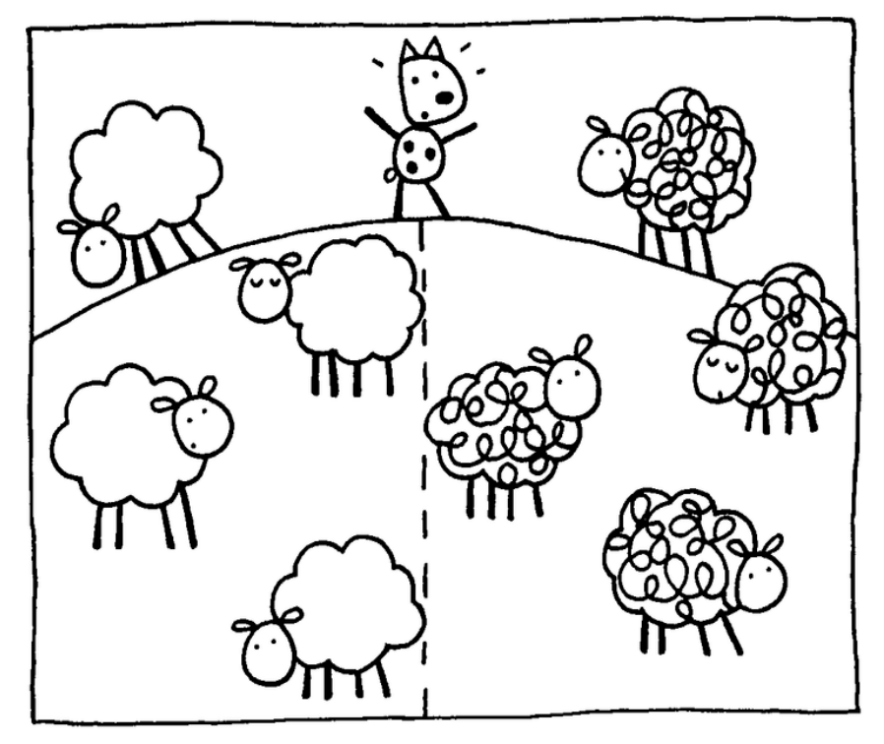
Best Model
Accuracy: 73.72%
Support Vector Machine
TF-IDF Vectorizer
C value: 1.5
Notes:
Allison

Slide 18
Linux on Android
Notes:
Sabrina

Slide 19



Solutions
Magisk Manager
Supersu
Termux + AnLinux
Notes:
Sabrina

Slide 20


Magisk Manager
Flash Magisk ZIP File through TWRP
Install ADB and Fastboot in PC
Enable USB debugging
Enable developer options
adb reboot bootloader
Enable OEM unlocking
fastboot flash recovery twrp-version.img
Notes:
Sabrina

Slide 21
Supersu
Rooting solution without bootloader
Download Supersu app on android emulator
Download recovery flash zip on host machine and extract files
Allow emulator to write to system files in host terminal
emulator.exe -avd {emulator name} -writable-system
adb root && adb remount
Notes:
Allison

Slide 22
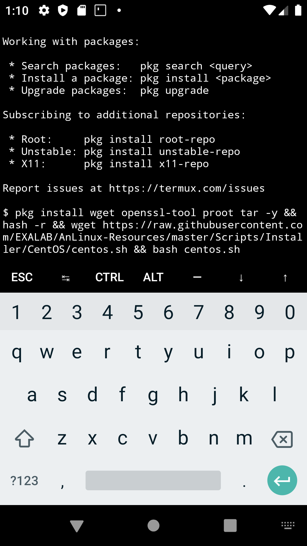
Termux + AnLinux
Termux: Android terminal emulator and Linux environment app
-Limited distro packages
-Bootleg packages error
Anlinux: Requires Termux
-Supports many Linux distro
-Desktop environment with vnc server
Notes:
Allison

Slide 23
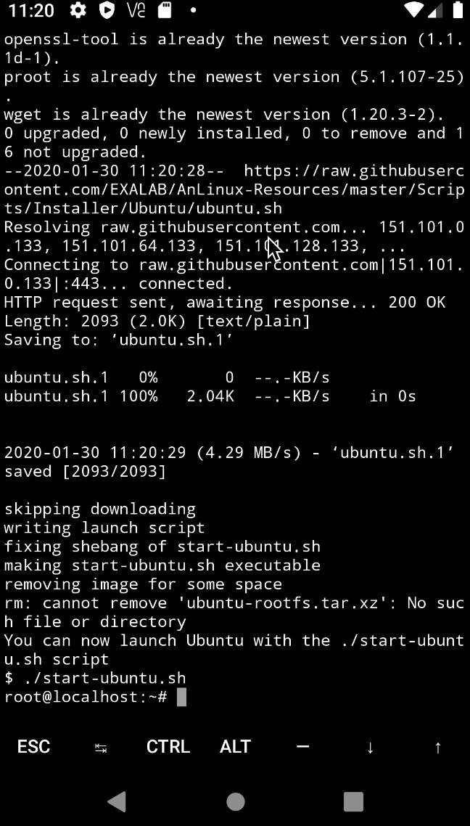
Termux + AnLinux
Notes:
Allison

Slide 24
Resources
https://android.stackexchange.com/questions/171442/root-android-virtual-device-with-android-7-1-1
https://www.kaggle.com/lakshmi25npathi/imdb-dataset-of-50k-movie-reviews
https://wiki.termux.com/wiki/Graphical_Environment
https://github.com/laBruji/Sentiment-Analysis

