Slide 1
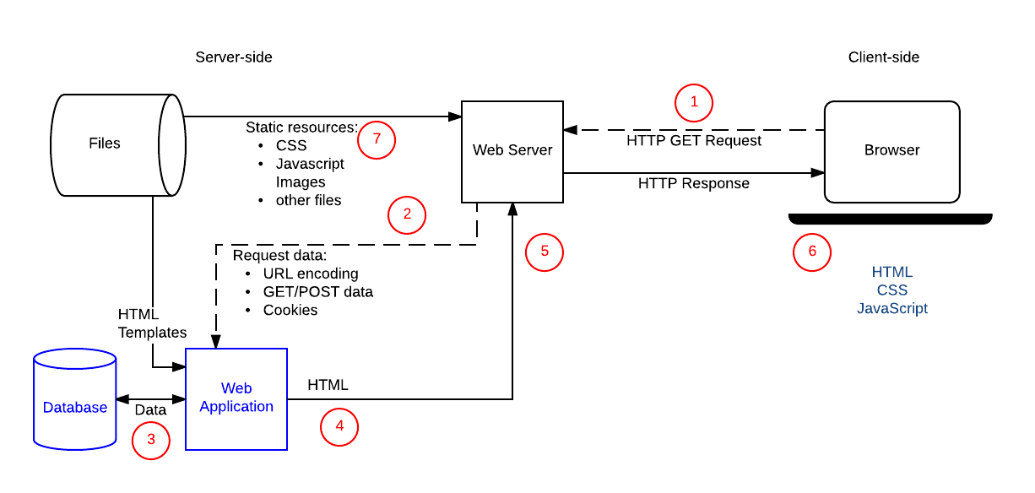
Anatomy of a Client/Server Web Application

Slide 2
Website Architectures
Backend heavy application
More processing done server-side
Allows for more customized responses
Steady, relatively slower page load times
Single Page application
More processing done client-side using javascript
Speedy, dynamic web pages
Higher upfront page loading costs but faster performance afterwards
REST API used for interactions with backend

Slide 3
Creating a Simple Backend Heavy Web App
Install and run web server (Apache, nginx, python)
Create directory structure (folders for js, css, html)
Create files (.html, .css, .js, .pngs)
Create index.html
Use php for backend code

Slide 4
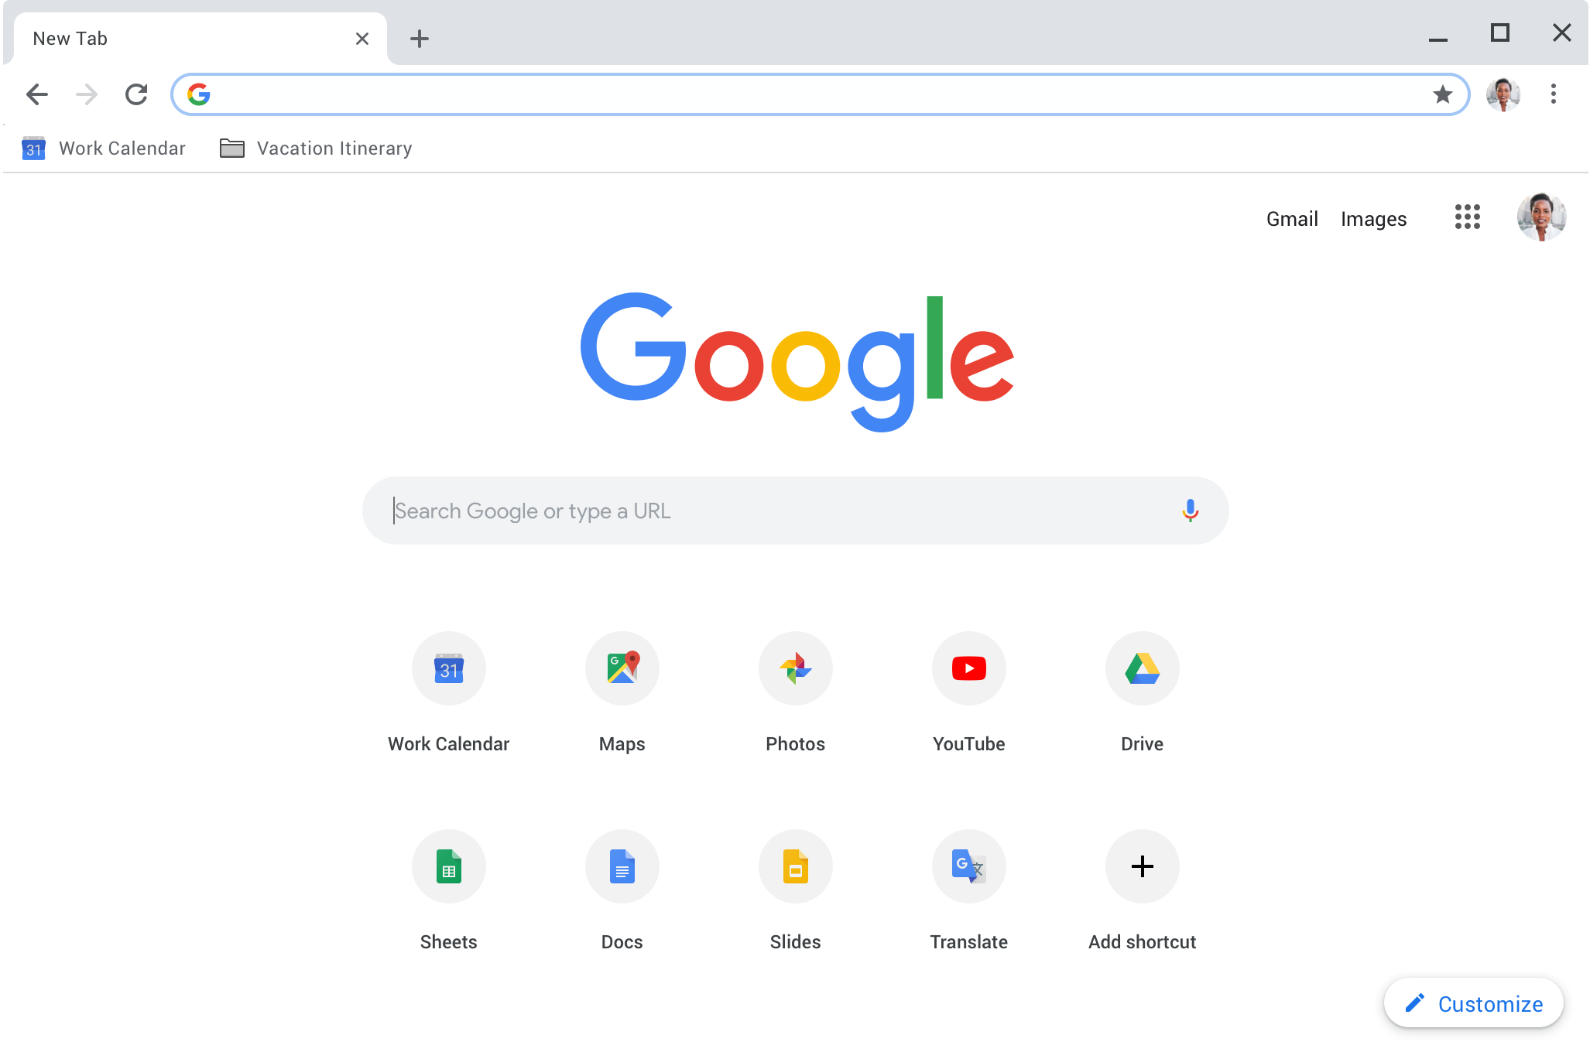

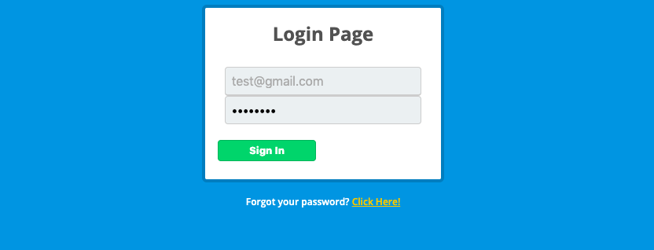
Breakdown of a Web Request
www.synprint.com/ece303/project1/
HTTP GET
text/html
HTTP 200 OK
<form method="post" action="main.php">
<h1>Login Page</h1>
….
text/css
body{
font-family: 'Open Sans', sans-serif;
background:#3498db;
…..
HTTP 200 OK
application/javascript
HTTP 200 OK
$(document).ready(function(){
$('.box').hide().fadeIn(1000);

Slide 5
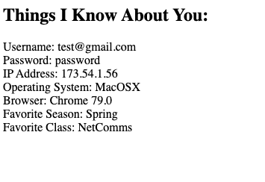
Breakdown of a Web Request (cont’d)
HTTP POST
PHP Backend Code
text/html
<html><head></head><dbody onload="saveCookie()"><h2>Things I Know About You:</h2>Username: test@gmail.com<br>Password: password<br>IP Address: 173.54.1.56<br>Operating System: MacOSX<br>Browser: Chrome 79.0<br>Favorite Season: Spring<br>Favorite Class: NetComms<br><script>function saveCookie () { document.cookie = "secret=1aedb8d9dc4751e229a335e371db8058";}</script></body></html>
HTTP 200 OK

Slide 6
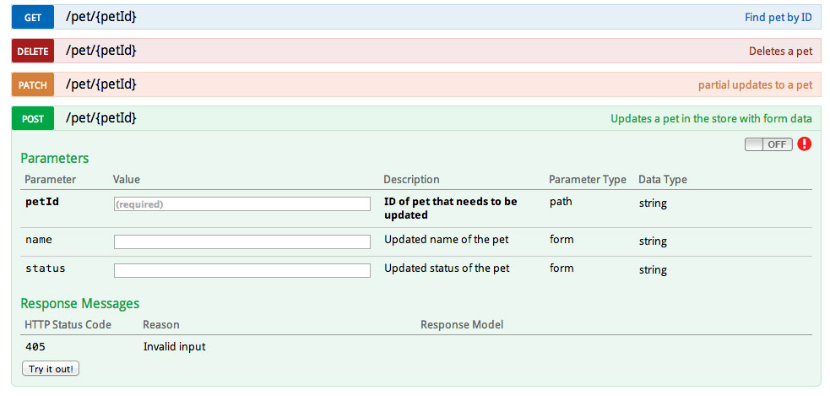
REST API
REST (Representational State Transfer) is a web services API (Application Programming Interface)
REST APIs are based on URIs (Uniform Resource Identifier, of which a URL is a specific type) and the HTTP protocol, and use JSON for a data format
REST APIs can be simple to build and scale
Example API Documentation
Learn by example: Let’s create a simple API

Slide 7
Web Clients
Web browser – graphical user interface for interacting with web apps
Chrome
Firefox
Safari
Headless Browsers – command line interface for testing web apps (including javascript engine)
Selenium
SlimerJS
WebDriver
Command line tools – command line interface for interacting with web apps (typically no javascript engine)
Curl
Wget
HTTPie
Programming Libraries – most modern languages have web client libraries
Python http.client
Golang net/http
Java httpclient

Slide 8




Application Protocol Analysis
Baseline Testing
Server-side Testing
Normal Traffic
Client Spoofing
Observe and record baseline network traffic
Spoofed client sends custom traffic to the server
Discover weaknesses in access control, application protocol, input validation of the server
Example Vulnerability: Able to login as any facebook user
Client-side Testing
Man-in-the-middle Testing
Server Spoofing
Man-in-the-middle Attack
Spoofed server sends custom traffic to client
Discover weaknesses in authentication, encryption, privacy, and confidentiality of the client
Example Vulnerability: Able to retrieve user’s address book
Proxy that spoofs both client and server to manipulate existing traffic
Discover weaknesses in authentication, encryption, integrity, privacy, and confidentiality of the client/server connection
Example Vulnerability: Able to modify user’s facebook post
Notes:
May require more than one slide

Slide 9
Cooper Password Reset Website Example
You need to fully understand a protocol before you can exploit it
Hackers know the applications sometimes better than the software developer
Let’s perform an SQL Injection attack to retrieve more information than we should have access to

