Slide 1
Internet Protocol Stack
5- application: supporting network applications
4- transport: process-process data transfer
3- network: routing of datagrams from source to destination
2- link: data transfer between neighboring network elements
1- physical: bits “on the wire”
5 - Application Layer - HTTPS
Twitter App
Twitter Server
4 - Transport Layer - TCP
iOS
3 - Network Layer - IP
Redhat Linux
2- Link Layer - Ethernet
2- Link Layer - Ethernet
2- Link Layer - Ethernet
2- Link Layer - Ethernet
Switch
Router
802.11 (Wi-Fi)
Fiber Optic
Cat5
Cat5
Dell Server
iPhone XR
1 - Physical Layer
1 - Physical Layer
1 - Physical Layer
1 - Physical Layer

Slide 2
Transport Layer

Slide 3
Transport Layer
Overview
Sockets, Ports, IP Addresses
Multiplexing and Demultiplexing
UDP (User Datagram Protocol)
TCP (Transmission Control Protocol)
Connection Management
Reliable Data Transfer
Flow Control
Congestion Control

Slide 4
Transport Layer Overview
Book Definition: provide logical communication between app processes running on different hosts
Wikipedia: provide host-to-host communication services for applications such as connection-oriented communication, reliability, flow control, and multiplexing.
My Definition: provides options on how you would like your data to be delivered

Slide 5
Definitions
IP Address – Layer 3 logical endpoint that identifies the device/host
Port – Layer 4 logical endpoint that identifies an application running on a host
Socket – logical connection endpoint that is defined by an IP address and port

Slide 6









Transport Layer Analogy
Destination IP Address
1512 Raymound Blvd
Suite 400
New York, NY
Destination Port
Postcard
UDP
Mail Envelope
Certified Mail
Destination
Socket
Delivery
Notification
Source IP Address
14 Southbrook Ter
Unit #45
Parsippany, NJ
Package
Source Port
Source
Socket
TCP ACK
TCP
(Guaranteed Delivery)

Slide 7


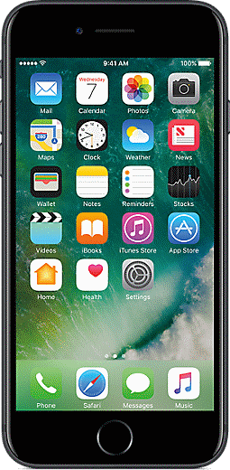

Transport Layer Single Client and Server
What about multiple connections? Transport Layer is designed to handle multiple connections - next slide…
The Instagram application process creates a socket and sends data through it
The data is sent over the network to the server
The Instagram server process is listening on a socket
5-Application
4-Transport
3-Network
2-Link
1-Physical
5-Application
4-Transport
3-Network
2-Link
1-Physical
Client Socket
IP: 192.168.0.1
Port: 12341
Server Socket
IP: 12.14.40.11
Port: 80
Internet
Instagram App
Instagram Web Server

Slide 8
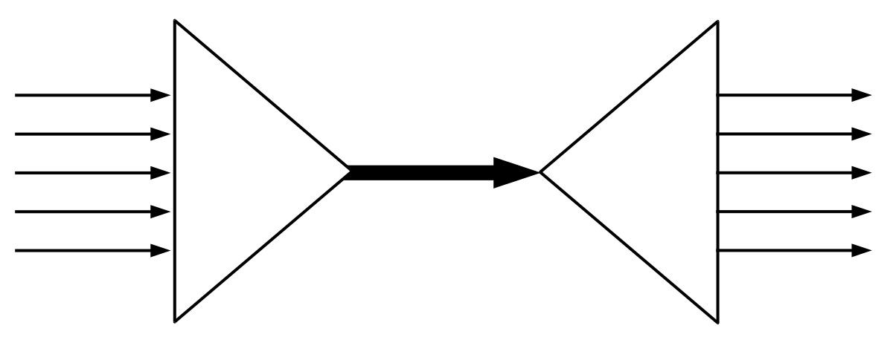
Definitions
MUX and DEMUX – architecture that allows a host to manage multiple data connections
Multiplexing
Wikipedia: method by which multiple analog or digital signals are combined into one signal over a shared medium
De-multiplexing
Splitting of a single signal into multiple signals
sometimes referred to as inverse multiplexing
MUX
DEMUX

Slide 9



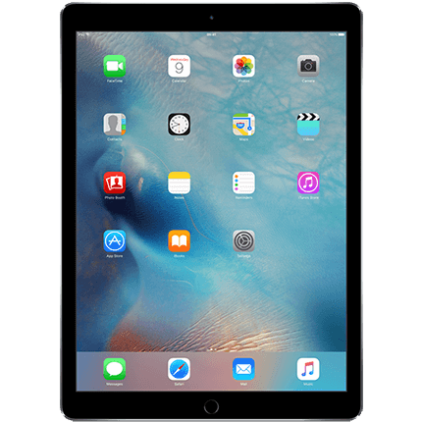

Transport Layer Multiple Clients and Servers
MUX
DEMUX
Socket
Packet
Instagram and SSH Server
5-Application
4-Transport
3-Network
2-Link
1-Physical
Applications have child processes. These processes can send and receive data on sockets. Sockets are associated with port numbers. The Transport layer manages distribution of traffic to the appropriate ports and ultimately to the appropriate application.
5-Application
4-Transport
3-Network
2-Link
1-Physical
Internet
Twitter Server
WhatsApp Server

Slide 10
Why DEMUX?
How does a server receive data from multiple clients through a single physical interface?
The Transport Layer handles this by creating sockets and assigning port numbers to distinguish multiple traffic streams.
An application, such as Apache, can have multiple child processes, each of which has their own socket. This allows a single application to handle multiple data connections.
Port 80
Layer 5 – Application
Multiple Apps
Layer 4 – Transport
Single-to-Multi
Layer 3 – Network
Single Network Interface
Layer 2 - Link Layer
Single Link
Layer 1 – Physical Layer
Single Physical Interface
Port 80
Port 22
IP Address
But how does the server MXU or distinguish between 2 inbound clients to Port 80?

Slide 11


Why MUX?
How do multiple apps all send data through a single physical interface?
The Transport Layer handles this by creating a TCP/IP.
These port numbers are generated randomly at the start of a new connection (between 1024 and 65535)
This randomness reduces the risk of collision at the destination server
Layer 5 – Application
Multiple Apps
Layer 4 – Transport
Multi-to-Single
Layer 3 – Network
Single Network Interface
Layer 2 - Link Layer
Single Link
Layer 1 – Physical Layer
Single Physical Interface
Port 18120
Port 45910
Port 22152
IP Address
How does randomness reduce collision?
Is there another way this can be done that isn’t random?

Slide 12
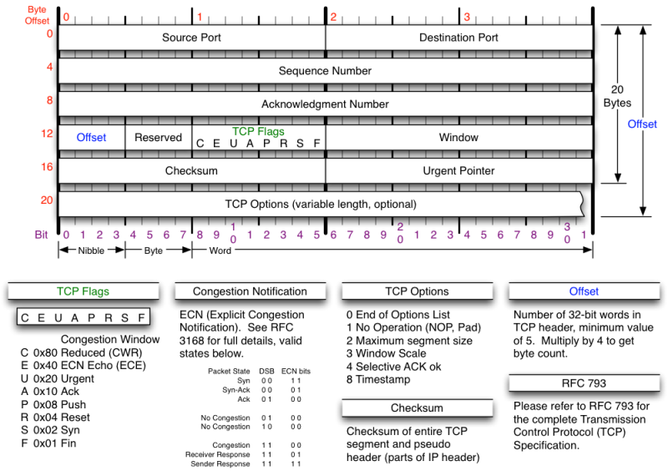
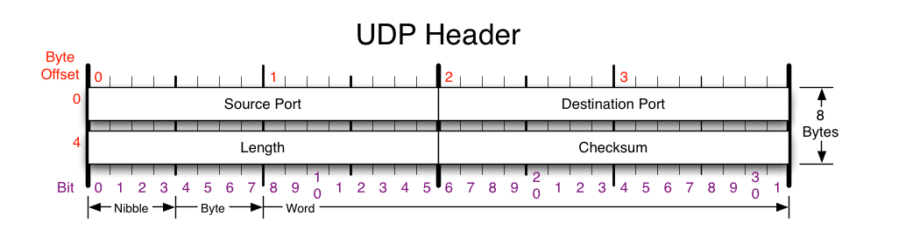
UDP vs TCP
TCP Header
TCP and UDP use different identifiers to determine distinct connections
TCP Sockets are identified by
Source IP Address (Layer 3)
Source Port (Layer 4)
Destination IP Address (Layer 3)
Destination Port (Layer 4)
UDP Sockets are identified by
Destination IP Address (Layer 3)
Destination Port (Layer 4)

Slide 13
Port Numbers
Scanning for Open Ports
If you have access to the host, you can run:
netstat -atup
If you are remote, you can use:
nmap
netcat or nc
Well-Known Port Numbers [0-1023]
Other port numbers [1024-65535]
TCP Ports You Should Know
20, 21 – FTP (File Transfer Protocol)
22 – SSH (Secure Shell)
23 – Telnet
25 – SMTP (Simple Mail Transfer Protocol)
80 – HTTP (HyperText Transfer Protocol)
443 – HTTPS (HTTP with Secure Sockets Layer)
8080 – HTTP-alt
UDP Ports You Should Know
53 – DNS (Domain Name System)

Slide 14
Questions

Slide 15
UDP

Slide 16
UDP: User Datagram Protocol [RFC 768]
“no frills,” “bare bones” Internet transport protocol
“best effort” service, UDP segments may be:
lost
delivered out of order to app
connectionless:
no handshaking between UDP sender, receiver
each UDP segment handled independently of others
Why is there a UDP?
no connection establishment (which can add delay)
simple: no connection state at sender, receiver
small segment header
no congestion control: UDP can blast away as fast as desired

Slide 17
UDP: more
often used for streaming multimedia apps
loss tolerant
rate sensitive
other UDP uses
DNS
SNMP
reliable transfer over UDP: add reliability at application layer
application-specific error recovery!
32 bits
Length, in
bytes of UDP
segment,
including
header
source port #
dest port #
length
checksum
Application
data
(message)
UDP segment format

Slide 18
TCP

Slide 19
TCP: Overview RFCs: 793, 1122, 1323, 2018, 2581
point-to-point:
one sender, one receiver
reliable, in-order byte steam:
no “message boundaries”
pipelined:
TCP congestion and flow control set window size
send & receive buffers
full duplex data:
bi-directional data flow in same connection
MSS: maximum segment size
connection-oriented:
handshaking (exchange of control msgs) init’s sender, receiver state before data exchange
flow controlled:
sender will not overwhelm receiver

Slide 20
Connection
Management
Flow Control

Slide 21
TCP segment structure
32 bits
URG: urgent data
(generally not used)
counting
by bytes
of data
(not segments!)
source port #
dest port #
sequence number
ACK: ACK #
valid
acknowledgement number
head
len
not
used
U
Receive window
A
P
R
S
PSH: push data now
(generally not used)
F
# bytes
rcvr willing
to accept
checksum
Urg data pointer
RST, SYN, FIN:
connection estab
(setup, teardown
commands)
Options (variable length)
application
data
(variable length)
Internet
checksum
(as in UDP)

Slide 22
TCP seq. #’s and ACKs
Seq. #’s:
byte stream “number” of first byte in segment’s data
ACKs:
seq # of next byte expected from other side
cumulative ACK
Q: how receiver handles out-of-order segments
A: TCP spec doesn’t say, - up to implementer
Host A
Host B
User
types
‘C’
Seq=42, ACK=79, data = ‘C’
host ACKs
receipt of
‘C’, echoes
back ‘C’
Seq=79, ACK=43, data = ‘C’
host ACKs
receipt
of echoed
‘C’
Seq=43, ACK=80
time
simple telnet scenario

Slide 23
TCP Connection Management
Recall: TCP sender, receiver establish “connection” before exchanging data segments
initialize TCP variables:
seq. #s
buffers, flow control info (e.g. RcvWindow)
client: connection initiator
Socket clientSocket = new Socket("hostname","port number");
server: contacted by client
Socket connectionSocket = welcomeSocket.accept();
Three way handshake:
Step 1: client host sends TCP SYN segment to server
specifies initial seq #
no data
Step 2: server host receives SYN, replies with SYNACK segment
server allocates buffers
specifies server initial seq. #
Step 3: client receives SYNACK, replies with ACK segment, which may contain data

Slide 24
TCP Connection Management (cont.)
Closing a connection:
client closes socket: clientSocket.close();
Step 1: client end system sends TCP FIN control segment to server
Step 2: server receives FIN, replies with ACK. Closes connection, sends FIN.
client
server
close
FIN
ACK
close
FIN
ACK
timed wait
closed

Slide 25
TCP Connection Management (cont.)
Step 3: client receives FIN, replies with ACK.
Enters “timed wait” - will respond with ACK to received FINs
Step 4: server, receives ACK. Connection closed.
Note: with small modification, can handle simultaneous FINs.
client
server
closing
FIN
ACK
closing
FIN
ACK
timed wait
closed
closed

Slide 26
Questions

Slide 27
Flow Control

Slide 28
TCP Flow Control
TCP Header: Window Size (Receive Window)
flow control
sender won’t overflow
receiver’s buffer by
transmitting too much,
too fast
receive side of TCP connection has a receive buffer:
(currently)
unused buffer
space
speed-matching service: matching send rate to receiving application’s drain rate
IP
datagrams
TCP data
(in buffer)
application
process
app process may be slow at reading from buffer

Slide 29
TCP Flow control: how it works
TCP Header: Window Size (Receive Window)
(currently)
unused buffer
space
receiver: advertises unused buffer space by including rwnd value in segment header
sender: limits # of unACKed bytes to rwnd
guarantees receiver’s buffer doesn’t overflow
IP
datagrams
TCP data
(in buffer)
application
process
rwnd
RcvBuffer
(suppose TCP receiver discards out-of-order segments)
unused buffer space:
= rwnd
= RcvBuffer-[LastByteRcvd - LastByteRead]

Slide 30
Congestion Control

Slide 31
Principles of Congestion Control
Congestion:
informally: “too many sources sending too much data too fast for network to handle”
different from flow control!
manifestations:
lost packets (buffer overflow at routers)
long delays (queueing in router buffers)
a top-10 problem!

Slide 32
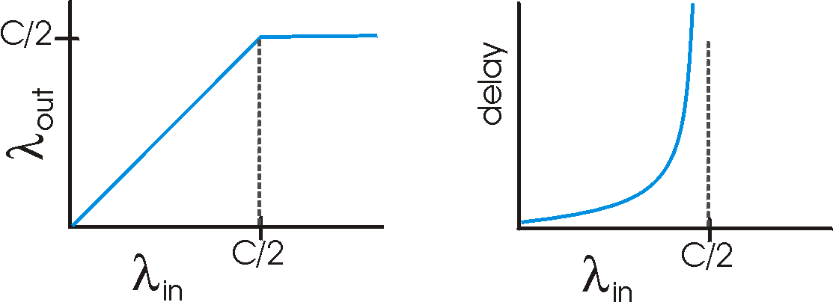
Causes/costs of congestion: scenario 1
two senders, two receivers
one router, infinite buffers
no retransmission
Host A
λ_{in} : original data
λ_{out}
Host B
unlimited shared output link buffers
large delays when congested
maximum achievable throughput

Slide 33
Causes/costs of congestion: scenario 2
one router, finite buffers
sender retransmission of lost packet
Host A
λ_{in} : original data
λ_{out}
λ'_{in} : original data, plus retransmitted data
Host B
finite shared output link buffers

Slide 34
Causes/costs of congestion: scenario 2
λ
λ
always: (goodput)
“perfect” retransmission only when loss:
retransmission of delayed (not lost) packet makes larger (than perfect case) for same
=
in
out
λ
>
λ
in
out
λ
in
λ
out
R/2
R/2
R/2
R/3
λ_{out}
λ_{out}
λ_{out}
R/4
λ_{in}
R/2
λ_{in}
R/2
λ_{in}
R/2
a.
b.
c.
“costs” of congestion:
more work (retrans) for given “goodput”
unneeded retransmissions: link carries multiple copies of pkt

Slide 35
Causes/costs of congestion: scenario 3
λ
four senders
multihop paths
timeout/retransmit
Q: what happens as and increase ?
λ
in
in
Host A
λ_{in} : original data
λ_{out}
λ'_{in} : original data, plus retransmitted data
finite shared output link buffers
Host B

Slide 36
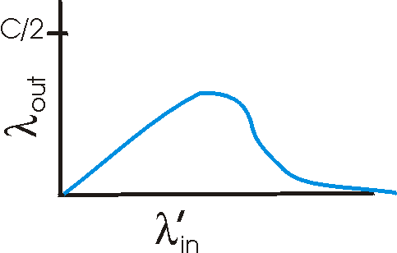
Causes/costs of congestion: scenario 3
Host A
λ_{out}
Host B
another “cost” of congestion:
when packet dropped, any “upstream transmission capacity used for that packet was wasted!

Slide 37
Approaches towards congestion control
two broad approaches towards congestion control:
end-end congestion control:
no explicit feedback from network
congestion inferred from end-system observed loss, delay
approach taken by TCP
network-assisted congestion control:
routers provide feedback to end systems
single bit indicating congestion (SNA, DECbit, TCP/IP ECN, ATM)
explicit rate sender should send at

Slide 38
Case study: ATM ABR congestion control
ABR: available bit rate:
“elastic service”
if sender’s path “underloaded”:
sender should use available bandwidth
if sender’s path congested:
sender throttled to minimum guaranteed rate
RM (resource management) cells:
sent by sender, interspersed with data cells
bits in RM cell set by switches (“network-assisted”)
NI bit: no increase in rate (mild congestion)
CI bit: congestion indication
RM cells returned to sender by receiver, with bits intact

Slide 39
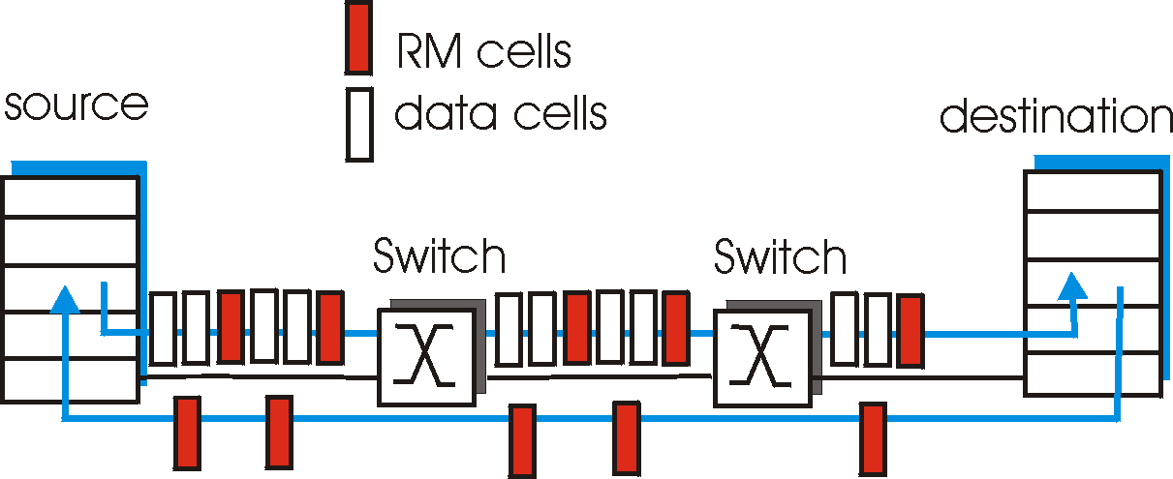
Case study: ATM ABR congestion control
two-byte ER (explicit rate) field in RM cell
congested switch may lower ER value in cell
sender’ send rate thus maximum supportable rate on path
EFCI bit in data cells: set to 1 in congested switch
if data cell preceding RM cell has EFCI set, sender sets CI bit in returned RM cell

Slide 40
Question

