Slide 1

Chapter 2 Application Layer
A note on the use of these ppt slides:
We’re making these slides freely available to all (faculty, students, readers). They’re in PowerPoint form so you can add, modify, and delete slides (including this one) and slide content to suit your needs. They obviously represent a lot of work on our part. In return for use, we only ask the following:
If you use these slides (e.g., in a class) in substantially unaltered form, that you mention their source (after all, we’d like people to use our book!)
If you post any slides in substantially unaltered form on a www site, that you note that they are adapted from (or perhaps identical to) our slides, and note our copyright of this material.
Thanks and enjoy! JFK/KWR
All material copyright 1996-2009
J.F Kurose and K.W. Ross, All Rights Reserved
Computer Networking: A Top Down Approach, 5th edition. Jim Kurose, Keith Ross Addison-Wesley, April 2009.

Slide 2
Chapter 2: Application layer
2.1 Principles of network applications
2.2 Web and HTTP
2.3 FTP
2.4 Electronic Mail
SMTP, POP3, IMAP
2.5 DNS
2.6 P2P applications
2.7 Socket programming with UDP
2.8 Socket programming with TCP

Slide 3












Creating a network app
application
transport
network
data link
physical
write programs that
run on (different) end systems
communicate over network
e.g., web server software communicates with browser software
No need to write software for network-core devices
Network-core devices do not run user applications
applications on end systems allows for rapid app development, propagation
application
transport
network
data link
physical
application
transport
network
data link
physical

Slide 4
Chapter 2: Application layer
2.1 Principles of network applications
2.2 Web and HTTP
2.3 FTP
2.4 Electronic Mail
SMTP, POP3, IMAP
2.5 DNS
2.6 P2P applications
2.7 Socket programming with UDP
2.8 Socket programming with TCP

Slide 5
Application architectures
Client-server
Including data centers / cloud computing
Peer-to-peer (P2P)
Hybrid of client-server and P2P

Slide 6
Client-server architecture
server:
always-on host
permanent IP address
server farms for scaling
Feel like I should add the word cloud here
clients:
communicate with server
may be intermittently connected
may have dynamic IP addresses
do not communicate directly with each other
client/server

Slide 7
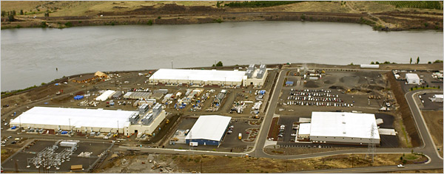
Google Data Centers
Estimated cost of data center: $600M
Google spent $2.4B in 2007 on new data centers
Each data center uses 50-100 megawatts of power

Slide 8
Pure P2P architecture
no always-on server
arbitrary end systems directly communicate
peers are intermittently connected and change IP addresses
Examples?
Highly scalable but difficult to manage
peer-peer

Slide 9
Hybrid of client-server and P2P
Video Chats
voice-over-IP P2P application
centralized server: finding address of remote party:
client-client connection: direct (not through server)
Instant messaging
chatting between two users is P2P
centralized service: client presence detection/location
user registers its IP address with central server when it comes online
user contacts central server to find IP addresses of buddies

Slide 10
Processes communicating
Process: program running within a host.
within same host, two processes communicate using inter-process communication (defined by OS).
processes in different hosts communicate by exchanging messages
Client process: process that initiates communication
Server process: process that waits to be contacted
Note: applications with P2P architectures have client processes & server processes

Slide 11

Sockets
process sends/receives messages to/from its socket
socket analogous to door
sending process shoves message out door
sending process relies on transport infrastructure on other side of door which brings message to socket at receiving process
host or
server
host or
server
controlled by
app developer
process
process
socket
socket
TCP with
buffers,
variables
TCP with
buffers,
variables
Internet
controlled
by OS
API: (1) choice of transport protocol; (2) ability to fix a few parameters (lots more on this later)

Slide 12
Addressing processes
Q: does IP address of host on which process runs suffice for identifying the process?
A: No, many processes can be running on same
Identifier includes both IP address and port numbers associated with process on host.
Example port numbers:
HTTP server: 80
Mail server: 25
to receive messages, process must have identifier
host device has unique 32-bit IP address
Exercise: use ipconfig from command prompt to get your IP address (Windows)
Screw windows, ifconfig that

Slide 13
App-layer protocol defines
Types of messages exchanged,
e.g., request, response
Message syntax:
what fields in messages & how fields are delineated
Message semantics
meaning of information in fields
Rules for when and how processes send & respond to messages
Public-domain protocols:
defined in RFCs
allows for interoperability
e.g., HTTP, SMTP, BitTorrent
Proprietary protocols:
e.g., Skype, ppstream

Slide 14
What transport service does an app need?
Data loss
some apps (e.g., audio) can tolerate some loss
other apps (e.g., file transfer, telnet) require 100% reliable data transfer
Throughput
some apps (e.g., multimedia) require minimum amount of throughput to be “effective”
other apps (“elastic apps”) make use of whatever throughput they get
Security
Encryption, data integrity, …
Timing
some apps (e.g., Internet telephony, interactive games) require low delay to be “effective”

Slide 15
Transport service requirements of common apps
Application
file transfer
e-mail
Web documents
real-time audio/video
stored audio/video
interactive games
instant messaging
Data loss
no loss
no loss
no loss
loss-tolerant
loss-tolerant
loss-tolerant
no loss
Throughput
elastic
elastic
elastic
audio: 5kbps-1Mbps
video:10kbps-5Mbps
same as above
few kbps up
elastic
Time Sensitive
no
no
no
yes, 100’s msec
yes, few secs
yes, 100’s msec
yes and no

Slide 16
Internet transport protocols services
TCP service:
connection-oriented: setup required between client and server processes
reliable transport between sending and receiving process
flow control: sender won’t overwhelm receiver
congestion control: throttle sender when network overloaded
does not provide: timing, minimum throughput guarantees, security
UDP service:
unreliable data transfer between sending and receiving process
does not provide: connection setup, reliability, flow control, congestion control, timing, throughput guarantee, or security
Q: why bother? Why is there a UDP?

Slide 17
Internet apps: application, transport protocols
Application
layer protocol
SMTP [RFC 2821]
Telnet [RFC 854]
HTTP [RFC 2616]
FTP [RFC 959]
HTTP (eg Youtube), RTP [RFC 1889]
SIP, RTP, proprietary
(e.g., Skype)
Underlying
transport protocol
TCP
TCP
TCP
TCP
TCP or UDP
typically UDP
Application
e-mail
remote terminal access
Web
file transfer
streaming multimedia
Internet telephony

Slide 18
Chapter 2: Application layer
2.1 Principles of network applications
2.2 Web and HTTP
2.3 FTP
2.4 Electronic Mail
SMTP, POP3, IMAP
2.5 DNS
2.6 P2P applications
2.7 Socket programming with UDP
2.8 Socket programming with TCP

Slide 19
Web and HTTP
First some jargon
Web page consists of objects
Object can be HTML file, JPEG image, Java applet, audio file,…
Web page consists of base HTML-file which includes several referenced objects
Each object is addressable by a URL
Example URL:
www.cooper.edu/eeDept/tobyAfricaShirt.gif
host name
path name

Slide 20

HTTP overview
HTTP: hypertext transfer protocol
Web’s application layer protocol
client/server model
client: browser that requests, receives, “displays” Web objects
server: Web server sends objects in response to requests
HTTP request
PC running
Explorer
HTTP response
HTTP request
Server
running
Apache Web
server
HTTP response
Mac running
Navigator

Slide 21
HTTP overview (continued)
Uses TCP:
client initiates TCP connection (creates socket) to server, port 80
server accepts TCP connection from client
HTTP messages (application-layer protocol messages) exchanged between browser (HTTP client) and Web server (HTTP server)
TCP connection closed
HTTP is “stateless”
server maintains no information about past client requests
aside
Protocols that maintain “state” are complex!
past history (state) must be maintained
if server/client crashes, their views of “state” may be inconsistent, must be reconciled

Slide 22
HTTP connections
Nonpersistent HTTP
At most one object is sent over a TCP connection.
Persistent HTTP
Multiple objects can be sent over single TCP connection between client and server.

Slide 23
Nonpersistent HTTP
(contains text,
references to 10
jpeg images)
Suppose user enters URL www.cooper.edu/eeDept/freddy/BLAH.html
1a. HTTP client initiates TCP connection to HTTP server (process) at www.cooper.edu on port 80
1b. HTTP server at host www.someSchool.edu waiting for TCP connection at port 80. “accepts” connection, notifying client
2. HTTP client sends HTTP request message (containing URL) into TCP connection socket. Message indicates that client wants object eeDept/freddy/BLAH.html
3. HTTP server receives request message, forms response message containing requested object, and sends message into its socket
time

Slide 24
Nonpersistent HTTP (cont.)
4. HTTP server closes TCP connection.
5. HTTP client receives response message containing html file, displays html. Parsing html file, finds 10 referenced jpeg objects
time
6. Steps 1-5 repeated for each of 10 jpeg objects

Slide 25
Non-Persistent HTTP: Response time
Definition of RTT: time for a small packet to travel from client to server and back.
Response time:
one RTT to initiate TCP connection
one RTT for HTTP request and first few bytes of HTTP response to return
file transmission time
total = 2RTT+transmit time
initiate TCP
connection
RTT
request
file
RTT
time to
transmit
file
file
received
time
time

Slide 26
Persistent HTTP
Nonpersistent HTTP issues:
requires 2 RTTs per object
OS overhead for each TCP connection
browsers often open parallel TCP connections to fetch referenced objects
Persistent HTTP
server leaves connection open after sending response
subsequent HTTP messages between same client/server sent over open connection
client sends requests as soon as it encounters a referenced object
as little as one RTT for all the referenced objects

Slide 27
HTTP request message
two types of HTTP messages: request, response
HTTP request message:
ASCII (human-readable format)
request line
(GET, POST,
HEAD commands)
GET /somedir/page.html HTTP/1.1
Host: www.someschool.edu
User-agent: Mozilla/4.0
Connection: close
Accept-language:fr
(extra carriage return, line feed)
header
lines
Carriage return,
line feed
indicates end
of message

Slide 28
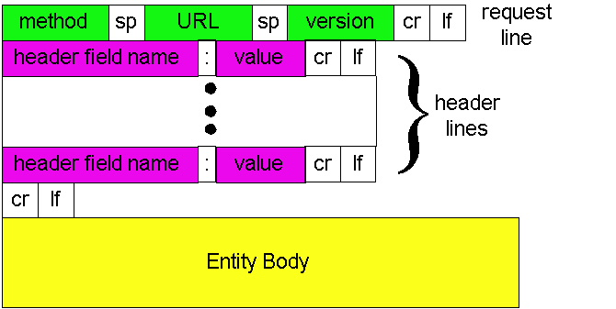
HTTP request message: general format

Slide 29
Uploading form input
Post method:
Web page often includes form input
Input is uploaded to server in entity body
URL method:
Uses GET method
Input is uploaded in URL field of request line:
www.somesite.com/animalsearch?monkeys&banana

Slide 30
Method types
HTTP/1.0
GET
POST
HEAD
asks server to leave requested object out of response
HTTP/1.1
GET, POST, HEAD
PUT
uploads file in entity body to path specified in URL field
DELETE
deletes file specified in the URL field

Slide 31
HTTP response message
status line
(protocol
status code
status phrase)
HTTP/1.1 200 OK
Connection close
Date: Thu, 06 Aug 1998 12:00:15 GMT
Server: Apache/1.3.0 (Unix)
Last-Modified: Mon, 22 Jun 1998 …...
Content-Length: 6821
Content-Type: text/html
data data data data data ...
header
lines
data, e.g.,
requested
HTML file

Slide 32
HTTP response status codes
In first line in server->client response message.
A few sample codes:
200 OK
request succeeded, requested object later in this message
301 Moved Permanently
requested object moved, new location specified later in this message (Location:)
400 Bad Request
request message not understood by server
404 Not Found
requested document not found on this server
505 HTTP Version Not Supported

Slide 33
Trying out HTTP (client side) for yourself
1. Telnet to your favorite Web server:
telnet cis.poly.edu 80
Opens TCP connection to port 80
(default HTTP server port) at cis.poly.edu.
Anything typed in sent
to port 80 at cis.poly.edu
2. Type in a GET HTTP request:
GET /~ross/ HTTP/1.1
Host: cis.poly.edu
By typing this in (hit carriage
return twice), you send
this minimal (but complete)
GET request to HTTP server
3. Look at response message sent by HTTP server!

Slide 34
User-server state: cookies
Example:
Susan always access Internet always from PC
visits specific e-commerce site for first time
when initial HTTP requests arrives at site, site creates:
unique ID
entry in backend database for ID
Many major Web sites use cookies
Four components:
1) cookie header line of HTTP response message
2) cookie header line in HTTP request message
3) cookie file kept on user’s host, managed by user’s browser
4) back-end database at Web site

Slide 35
Cookies: keeping “state” (cont.)
client
server
ebay 8734
usual http request msg
Amazon server
creates ID
1678 for user
cookie file
usual http response
Set-cookie: 1678
create
entry
ebay 8734
amazon 1678
usual http request msg
cookie: 1678
cookie-
specific
action
access
one week later:
usual http response msg
backend
database
access
ebay 8734
amazon 1678
usual http request msg
cookie: 1678
cookie-
spectific
action
usual http response msg

Slide 36
Cookies (continued)
aside
What cookies can bring:
authorization
shopping carts
recommendations
user session state (Web e-mail)
Cookies and privacy:
cookies permit sites to learn a lot about you
you may supply name and e-mail to sites
How to keep “state”:
protocol endpoints: maintain state at sender/receiver over multiple transactions
cookies: http messages carry state

Slide 37



Web caches (proxy server)
Goal: satisfy client request without involving origin server
user sets browser: Web accesses via cache
browser sends all HTTP requests to cache
object in cache: cache returns object
else cache requests object from origin server, then returns object to client
origin
server
Proxy
server
HTTP request
HTTP request
client
HTTP response
HTTP response
HTTP request
HTTP response
client
origin
server

Slide 38
More about Web caching
cache acts as both client and server
typically cache is installed by ISP (university, company, residential ISP)
Why Web caching?
reduce response time for client request
reduce traffic on an institution’s access link.
Internet dense with caches: enables “poor” content providers to effectively deliver content (but so does P2P file sharing)

Slide 39
Caching example
origin
servers
Assumptions
average object size = 1,000,000 bits
avg. request rate from institution’s browsers to origin servers = 15/sec
delay from institutional router to any origin server and back to router = 2 sec
Consequences
utilization on LAN = 15%
utilization on access link = 100%
total delay = Internet delay + access delay + LAN delay
= 2 sec + minutes + milliseconds
public
Internet
15 Mbps
access link
institutional
network
100 Mbps LAN
institutional
cache

Slide 40
Caching example (cont)
origin
servers
possible solution
increase bandwidth of access link to, say, 100 Mbps
consequence
utilization on LAN = 15%
utilization on access link = 15%
Total delay = Internet delay + access delay + LAN delay
= 2 sec + msecs + msecs
often a costly upgrade
public
Internet
100 Mbps
access link
institutional
network
100 Mbps LAN
institutional
cache

Slide 41
Caching example (cont)
origin
servers
possible solution: install cache
suppose hit rate is 0.4
consequence
40% requests will be satisfied almost immediately
60% requests satisfied by origin server
utilization of access link reduced to 60%, resulting in negligible delays (say 10 msec)
total avg delay = Internet delay + access delay + LAN delay = .6*(2.01) secs + .4*milliseconds < 1.4 secs
public
Internet
15 Mbps
access link
institutional
network
100 Mbps LAN
institutional
cache

Slide 42
Conditional GET
cache
server
Goal: don’t send object if cache has up-to-date cached version
cache: specify date of cached copy in HTTP request
If-modified-since: <date>
server: response contains no object if cached copy is up-to-date:
HTTP/1.0 304 Not Modified
HTTP request msg
If-modified-since: <date>
object
not
modified
HTTP response
HTTP/1.0
304 Not Modified
HTTP request msg
If-modified-since: <date>
object
modified
HTTP response
HTTP/1.0 200 OK
<data>

Slide 43
Chapter 2: Application layer
2.1 Principles of network applications
2.2 Web and HTTP
2.3 FTP
2.4 Electronic Mail
SMTP, POP3, IMAP
2.5 DNS
2.6 P2P applications
2.7 Socket programming with UDP
2.8 Socket programming with TCP

Slide 44

FTP: the file transfer protocol
FTP
user
interface
FTP
client
file transfer
FTP
server
user
at host
remote file
system
local file
system
transfer file to/from remote host
client/server model
client: side that initiates transfer (either to/from remote)
server: remote host
ftp: RFC 959
ftp server: port 21

Slide 45
FTP: separate control, data connections
TCP control connection
port 21
FTP client contacts FTP server at port 21, TCP is transport protocol
client authorized over control connection
client browses remote directory by sending commands over control connection.
when server receives file transfer command, server opens 2nd TCP connection (for file) to client
after transferring one file, server closes data connection.
FTP
client
TCP data connection
port 20
FTP
server
server opens another TCP data connection to transfer another file.
control connection: “out of band”
FTP server maintains “state”: current directory, earlier authentication

Slide 46
FTP commands, responses
Sample commands:
sent as ASCII text over control channel
USER username
PASS password
LIST return list of file in current directory
RETR filename retrieves (gets) file
STOR filename stores (puts) file onto remote host
Sample return codes
status code and phrase (as in HTTP)
331 Username OK, password required
125 data connection already open; transfer starting
425 Can’t open data connection
452 Error writing file

Slide 47
Chapter 2: Application layer
2.1 Principles of network applications
2.2 Web and HTTP
2.3 FTP
2.4 Electronic Mail
SMTP, POP3, IMAP
2.5 DNS
2.6 P2P applications
2.7 Socket programming with UDP
2.8 Socket programming with TCP

Slide 48
Electronic Mail
outgoing
message queue
user mailbox
Three major components:
user agents
mail servers
simple mail transfer protocol: SMTP
User Agent
a.k.a. “mail reader”
composing, editing, reading mail messages
e.g., Eudora, Outlook, elm, Mozilla Thunderbird
outgoing, incoming messages stored on server
user
agent
mail
server
user
agent
SMTP
mail
server
user
agent
SMTP
SMTP
mail
server
user
agent
user
agent
user
agent

Slide 49
Electronic Mail: mail servers
Mail Servers
mailbox contains incoming messages for user
message queue of outgoing (to be sent) mail messages
SMTP protocol between mail servers to send email messages
client: sending mail server
“server”: receiving mail server
user
agent
mail
server
user
agent
SMTP
mail
server
user
agent
SMTP
SMTP
mail
server
user
agent
user
agent
user
agent

Slide 50
Electronic Mail: SMTP [RFC 2821]
uses TCP to reliably transfer email message from client to server, port 25
direct transfer: sending server to receiving server
three phases of transfer
handshaking (greeting)
transfer of messages
closure
command/response interaction
commands: ASCII text
response: status code and phrase
messages must be in 7-bit ASCII

Slide 51

Scenario: Alice sends message to Bob
1) Alice uses UA to compose message and “to” bob@someschool.edu
2) Alice’s UA sends message to her mail server; message placed in message queue
3) Client side of SMTP opens TCP connection with Bob’s mail server
4) SMTP client sends Alice’s message over the TCP connection
5) Bob’s mail server places the message in Bob’s mailbox
6) Bob invokes his user agent to read message
1
mail
server
mail
server
user
agent
user
agent
2
3
6
4
5

Slide 52
Sample SMTP interaction
S: 220 hamburger.edu
C: HELO crepes.fr
S: 250 Hello crepes.fr, pleased to meet you
C: MAIL FROM: <alice@crepes.fr>
S: 250 alice@crepes.fr... Sender ok
C: RCPT TO: <bob@hamburger.edu>
S: 250 bob@hamburger.edu ... Recipient ok
C: DATA
S: 354 Enter mail, end with "." on a line by itself
C: Do you like ketchup?
C: How about pickles?
C: .
S: 250 Message accepted for delivery
C: QUIT
S: 221 hamburger.edu closing connection

Slide 53
Try SMTP interaction for yourself:
telnet servername 25
see 220 reply from server
enter HELO, MAIL FROM, RCPT TO, DATA, QUIT commands
above lets you send email without using email client (reader)

Slide 54
SMTP: final words
SMTP uses persistent connections
SMTP requires message (header & body) to be in 7-bit ASCII
SMTP server uses CRLF.CRLF to determine end of message
Comparison with HTTP:
HTTP: pull
SMTP: push
both have ASCII command/response interaction, status codes
HTTP: each object encapsulated in its own response msg
SMTP: multiple objects sent in multipart msg

Slide 55
Mail message format
SMTP: protocol for exchanging email msgs
RFC 822: standard for text message format:
header lines, e.g.,
To:
From:
Subject:
different from SMTP commands!
body
the “message”, ASCII characters only
header
blank
line
body

Slide 56
Mail access protocols
SMTP
SMTP
access
protocol
user
agent
user
agent
sender’s mail
server
receiver’s mail
server
SMTP: delivery/storage to receiver’s server
Mail access protocol: retrieval from server
POP: Post Office Protocol [RFC 1939]
authorization (agent <-->server) and download
IMAP: Internet Mail Access Protocol [RFC 1730]
more features (more complex)
manipulation of stored msgs on server
HTTP: gmail, Hotmail, Yahoo! Mail, etc.

Slide 57
POP3 protocol
S: +OK POP3 server ready
C: user bob
S: +OK
C: pass hungry
S: +OK user successfully logged on
authorization phase
client commands:
user: declare username
pass: password
server responses
+OK
-ERR
transaction phase, client:
list: list message numbers
retr: retrieve message by number
dele: delete
quit
C: list
S: 1 498
S: 2 912
S: .
C: retr 1
S: <message 1 contents>
S: .
C: dele 1
C: retr 2
S: <message 1 contents>
S: .
C: dele 2
C: quit
S: +OK POP3 server signing off

Slide 58
POP3 (more) and IMAP
More about POP3
Previous example uses “download and delete” mode.
Bob cannot re-read e-mail if he changes client
“Download-and-keep”: copies of messages on different clients
POP3 is stateless across sessions
IMAP
Keep all messages in one place: the server
Allows user to organize messages in folders
IMAP keeps user state across sessions:
names of folders and mappings between message IDs and folder name

Slide 59
Chapter 2: Application layer
2.1 Principles of network applications
2.2 Web and HTTP
2.3 FTP
2.4 Electronic Mail
SMTP, POP3, IMAP
2.5 DNS
2.6 P2P applications
2.7 Socket programming with UDP
2.8 Socket programming with TCP

Slide 60
DNS: Domain Name System
People: many identifiers:
SSN, name, passport #
Internet hosts, routers:
IP address (32 bit) - used for addressing datagrams
“name”, e.g., ww.yahoo.com - used by humans
Q: map between IP addresses and name ?
Domain Name System:
distributed database implemented in hierarchy of many name servers
application-layer protocol host, routers, name servers to communicate to resolve names (address/name translation)
note: core Internet function, implemented as application-layer protocol
complexity at network’s “edge”

Slide 61
DNS
DNS services
hostname to IP address translation
host aliasing
Canonical, alias names
mail server aliasing
load distribution
replicated Web servers: set of IP addresses for one canonical name
Why not centralize DNS?
single point of failure
traffic volume
distant centralized database
maintenance
doesn’t scale!

Slide 62
Distributed, Hierarchical Database
Root DNS Servers
com DNS servers
org DNS servers
edu DNS servers
yahoo.com
DNS servers
pbs.org
DNS servers
poly.edu
DNS servers
umass.edu
DNS servers
amazon.com
DNS servers
Client wants IP for www.amazon.com; 1st approx:
client queries a root server to find com DNS server
client queries com DNS server to get amazon.com DNS server
client queries amazon.com DNS server to get IP address for www.amazon.com

Slide 63
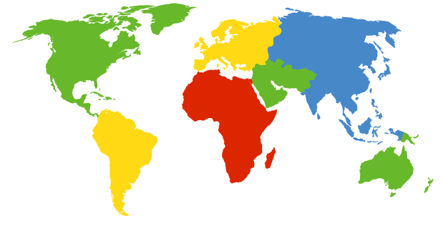
DNS: Root name servers
contacted by local name server that can not resolve name
root name server:
contacts authoritative name server if name mapping not known
gets mapping
returns mapping to local name server
a Verisign, Dulles, VA
c Cogent, Herndon, VA (also LA)
d U Maryland College Park, MD
g US DoD Vienna, VA
h ARL Aberdeen, MD
j Verisign, ( 21 locations)
k RIPE London (also 16 other locations)
i Autonomica, Stockholm (plus 28 other locations)
e NASA Mt View, CA
f Internet Software C. Palo Alto, CA (and 36 other locations)
m WIDE Tokyo (also Seoul, Paris, SF)
13 root name servers worldwide
b USC-ISI Marina del Rey, CA
l ICANN Los Angeles, CA

Slide 64
TLD and Authoritative Servers
Top-level domain (TLD) servers:
responsible for com, org, net, edu, etc, and all top-level country domains uk, fr, ca, jp.
Network Solutions maintains servers for com TLD
Educause for edu TLD
Authoritative DNS servers:
organization’s DNS servers, providing authoritative hostname to IP mappings for organization’s servers (e.g., Web, mail).
can be maintained by organization or service provider

Slide 65
Local Name Server
does not strictly belong to hierarchy
each ISP (residential ISP, company, university) has one.
also called “default name server”
when host makes DNS query, query is sent to its local DNS server
acts as proxy, forwards query into hierarchy

Slide 66

DNS name resolution example
root DNS server
2
Host at cis.poly.edu wants IP address for gaia.cs.umass.edu
3
TLD DNS server
4
5
iterated query:
contacted server replies with name of server to contact
“I don’t know this name, but ask this server”
local DNS server
dns.poly.edu
7
6
1
8
authoritative DNS server
dns.cs.umass.edu
requesting host
cis.poly.edu
gaia.cs.umass.edu

Slide 67
DNS name resolution example
root DNS server
recursive query:
puts burden of name resolution on contacted name server
heavy load?
2
3
7
6
TLD DNS server
local DNS server
dns.poly.edu
5
4
1
8
authoritative DNS server
dns.cs.umass.edu
requesting host
cis.poly.edu
gaia.cs.umass.edu

Slide 68
DNS: caching and updating records
once (any) name server learns mapping, it caches mapping
cache entries timeout (disappear) after some time
TLD servers typically cached in local name servers
Thus root name servers not often visited
update/notify mechanisms under design by IETF
RFC 2136
http://www.ietf.org/html.charters/dnsind-charter.html

Slide 69
DNS records
DNS: distributed db storing resource records (RR)
RR format: (name, value, type, ttl)
Type=A
name is hostname
value is IP address
Type=CNAME
name is alias name for some “canonical” (the real) name
www.ibm.com is really
servereast.backup2.ibm.com
value is canonical name
Type=NS
name is domain (e.g. foo.com)
value is hostname of authoritative name server for this domain
Type=MX
value is name of mailserver associated with name

Slide 70
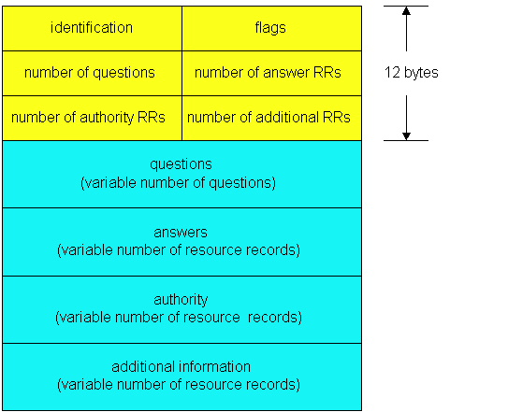
DNS protocol, messages
DNS protocol : query and reply messages, both with same message format
msg header
identification: 16 bit # for query, reply to query uses same #
flags:
query or reply
recursion desired
recursion available
reply is authoritative

Slide 71
DNS protocol, messages
Name, type fields
for a query
RRs in response
to query
records for
authoritative servers
additional “helpful”
info that may be used

Slide 72
Inserting records into DNS
example: new startup “Network Utopia”
register name networkuptopia.com at DNS registrar (e.g., Network Solutions)
provide names, IP addresses of authoritative name server (primary and secondary)
registrar inserts two RRs into com TLD server:
(networkutopia.com, dns1.networkutopia.com, NS)
(dns1.networkutopia.com, 212.212.212.1, A)
create authoritative server Type A record for www.networkuptopia.com; Type MX record for networkutopia.com
How do people get IP address of your Web site?

Slide 73
Chapter 2: Application layer
2.1 Principles of network applications
2.2 Web and HTTP
2.3 FTP
2.4 Electronic Mail
SMTP, POP3, IMAP
2.5 DNS
2.6 P2P applications
2.7 Socket programming with UDP
2.8 Socket programming with TCP

Slide 74
Pure P2P architecture
no always-on server
arbitrary end systems directly communicate
peers are intermittently connected and change IP addresses
Three topics:
File distribution
Searching for information
Case Study: Skype
peer-peer

Slide 75


File Distribution: Server-Client vs P2P
Question : How much time to distribute file from one server to N peers?
u_{s}: server upload bandwidth
Server
u_{i}: peer i upload bandwidth
u₁
d₁
u₂
u_{s}
d₂
d_{i}: peer i download bandwidth
File, size F
d_{N}
Network (with
abundant bandwidth)
u_{N}

Slide 76


File distribution time: server-client
Server
server sequentially sends N copies:
NF/u_{s} time
client i takes F/d_{i} time to download
F
u₁
d₁
u₂
u_{s}
d₂
d_{N}
Network (with
abundant bandwidth)
u_{N}
Time to distribute F
to N clients using
client/server approach
= d_{cs} = max { NF/u_{s}, F/min(d_{i}) }
i
increases linearly in N
(for large N)

Slide 77
File distribution time: P2P
Server
server must send one copy: F/u_{s} time
client i takes F/d_{i} time to download
NF bits must be downloaded (aggregate)
F
u₁
d₁
u₂
u_{s}
d₂
d_{N}
Network (with
abundant bandwidth)
u_{N}
fastest possible upload rate: u_{s} + Σu_{i}
d_{P2P} = max { F/u_{s}, F/min(d_{i}) , NF/(u_{s} + Σu_{i}) }
i

Slide 78
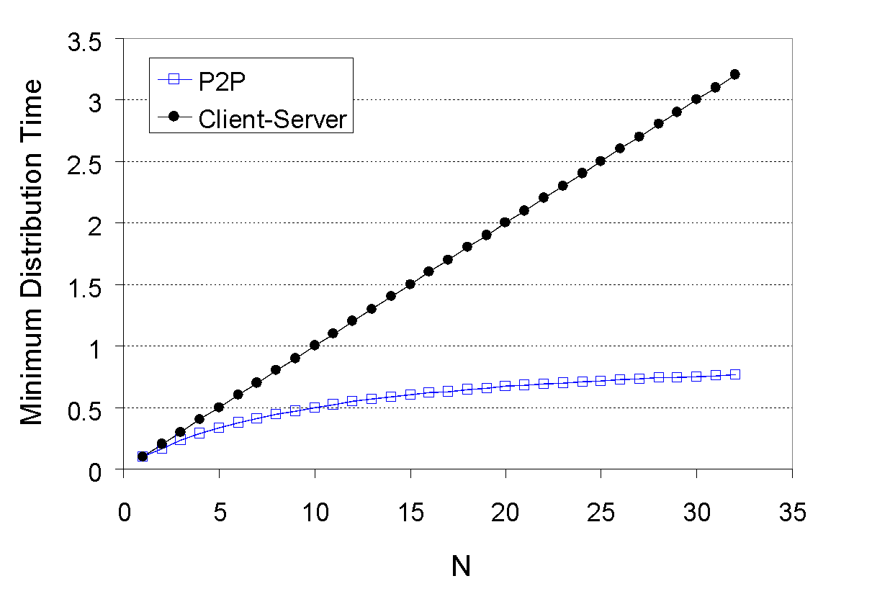
Server-client vs. P2P: example
Client upload rate = u, F/u = 1 hour, u_{s} = 10u, d_{min} ≥ u_{s}

Slide 79


File distribution: BitTorrent
P2P file distribution
tracker: tracks peers
participating in torrent
torrent: group of
peers exchanging
chunks of a file
obtain list
of peers
trading
chunks
peer

Slide 80



BitTorrent (1)
file divided into 256KB chunks.
peer joining torrent:
has no chunks, but will accumulate them over time
registers with tracker to get list of peers, connects to subset of peers (“neighbors”)
while downloading, peer uploads chunks to other peers.
peers may come and go
once peer has entire file, it may (selfishly) leave or (altruistically) remain

Slide 81
BitTorrent (2)
Sending Chunks: tit-for-tat
Alice sends chunks to four neighbors currently sending her chunks at the highest rate
re-evaluate top 4 every 10 secs
every 30 secs: randomly select another peer, starts sending chunks
newly chosen peer may join top 4
“optimistically unchoke”
Pulling Chunks
at any given time, different peers have different subsets of file chunks
periodically, a peer (Alice) asks each neighbor for list of chunks that they have.
Alice sends requests for her missing chunks
rarest first

Slide 82
BitTorrent: Tit-for-tat
(1) Alice “optimistically unchokes” Bob
(2) Alice becomes one of Bob’s top-four providers; Bob reciprocates
(3) Bob becomes one of Alice’s top-four providers
With higher upload rate, can find better trading
partners & get file faster!

Slide 83
Distributed Hash Table (DHT)
DHT = distributed P2P database
Database has (key, value) pairs;
key: ss number; value: human name
key: content type; value: IP address
Peers query DB with key
DB returns values that match the key
Peers can also insert (key, value) peers

Slide 84
DHT Identifiers
Assign integer identifier to each peer in range [0,2^{n}-1].
Each identifier can be represented by n bits.
Require each key to be an integer in same range.
To get integer keys, hash original key.
eg, key = h(“Led Zeppelin IV”)
This is why they call it a distributed “hash” table

Slide 85
How to assign keys to peers?
Central issue:
Assigning (key, value) pairs to peers.
Rule: assign key to the peer that has the closest ID.
Convention in lecture: closest is the immediate successor of the key.
Ex: n=4; peers: 1,3,4,5,8,10,12,14;
key = 13, then successor peer = 14
key = 15, then successor peer = 1

Slide 86
Circular DHT (1)
1
3
15
4
12
5
10
8
Each peer only aware of immediate successor and predecessor.
“Overlay network”

Slide 87
Circle DHT (2)
O(N) messages
on avg to resolve
query, when there
are N peers
0001
Who’s resp
for key 1110 ?
I am
0011
1111
1110
1110
0100
1110
1100
1110
0101
1110
Define closest as closest successor
1110
1010
1000

Slide 88
Circular DHT with Shortcuts
1
Who’s resp
for key 1110?
3
15
4
12
5
10
8
Each peer keeps track of IP addresses of predecessor, successor, short cuts.
Reduced from 6 to 2 messages.
Possible to design shortcuts so O(log N) neighbors, O(log N) messages in query

Slide 89
Peer Churn
1
To handle peer churn, require
each peer to know the IP address
of its two successors.
Each peer periodically pings its two successors to see if they are still alive.
3
15
4
12
5
10
8
Peer 5 abruptly leaves
Peer 4 detects; makes 8 its immediate successor; asks 8 who its immediate successor is; makes 8’s immediate successor its second successor.
What if peer 13 wants to join?

Slide 90



P2P Case study: Skype
Skype clients (SC)
inherently P2P: pairs of users communicate.
proprietary application-layer protocol (inferred via reverse engineering)
hierarchical overlay with SNs
Index maps usernames to IP addresses; distributed over SNs
Skype
login server
Supernode
(SN)

Slide 91
Peers as relays
Problem when both Alice and Bob are behind “NATs”.
NAT prevents an outside peer from initiating a call to insider peer
Solution:
Using Alice’s and Bob’s SNs, Relay is chosen
Each peer initiates session with relay.
Peers can now communicate through NATs via relay

Slide 92
Chapter 2: Summary
Most importantly: learned about protocols
typical request/reply message exchange:
client requests info or service
server responds with data, status code
message formats:
headers: fields giving info about data
data: info being communicated
Important themes:
control vs. data msgs
in-band, out-of-band
centralized vs. decentralized
stateless vs. stateful
reliable vs. unreliable msg transfer
“complexity at network edge”

