Slide 1
ECE264: Data Structures and Algorithms II (DSA 2)
Program #2 Sample Run Explained

Slide 2
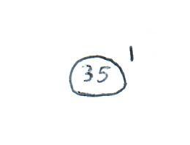
Insert string one (1), value 35
$ ./useHeap.exe
Choose a capacity for the binary heap: 500
Options:
1 - Insert a new item into the binary heap
2 - Set the key of a specified item
3 - Delete a specified item
4 - Perform a deleteMin
5 - Quit
Choose an option: 1
Enter an id string (to insert): string one
Enter an associated integer key: 35
Call to 'insert' returned: 0

Slide 3
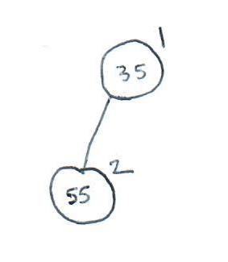
Insert string two (2), value 55
Options:
1 - Insert a new item into the binary heap
2 - Set the key of a specified item
3 - Delete a specified item
4 - Perform a deleteMin
5 - Quit
Choose an option: 1
Enter an id string (to insert): string two
Enter an associated integer key: 55
Call to 'insert' returned: 0

Slide 4
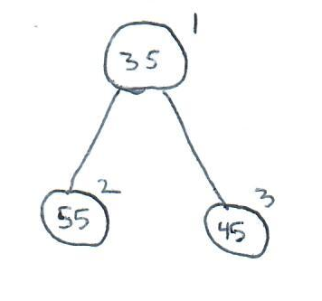
Insert string three (3), value 45
Options:
1 - Insert a new item into the binary heap
2 - Set the key of a specified item
3 - Delete a specified item
4 - Perform a deleteMin
5 - Quit
Choose an option: 1
Enter an id string (to insert): string three
Enter an associated integer key: 45
Call to 'insert' returned: 0

Slide 5
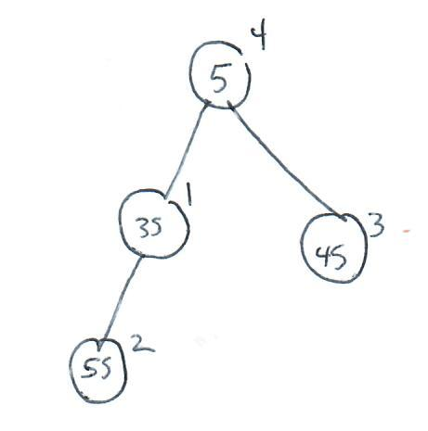
Insert string four (4), value 5
Options:
1 - Insert a new item into the binary heap
2 - Set the key of a specified item
3 - Delete a specified item
4 - Perform a deleteMin
5 - Quit
Choose an option: 1
Enter an id string (to insert): string four
Enter an associated integer key: 5
Call to 'insert' returned: 0

Slide 6
Insert string two (2), value 10
Options:
1 - Insert a new item into the binary heap
2 - Set the key of a specified item
3 - Delete a specified item
4 - Perform a deleteMin
5 - Quit
Choose an option: 1
Enter an id string (to insert): string two
Enter an associated integer key: 10
Call to 'insert' returned: 2

Slide 7
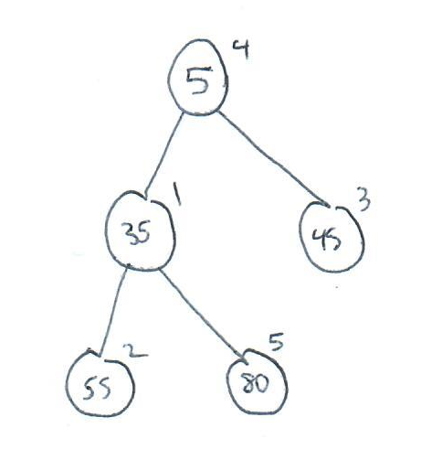
Insert string five (5), value 80
Options:
1 - Insert a new item into the binary heap
2 - Set the key of a specified item
3 - Delete a specified item
4 - Perform a deleteMin
5 - Quit
Choose an option: 1
Enter an id string (to insert): string five
Enter an associated integer key: 80
Call to 'insert' returned: 0

Slide 8
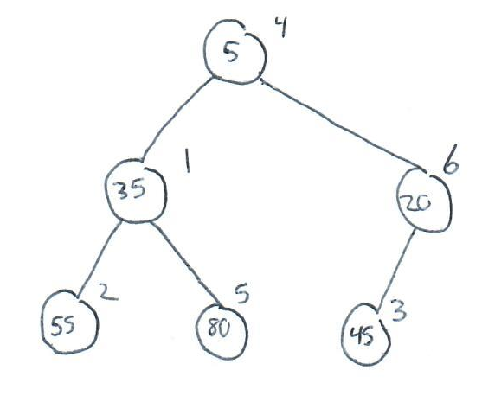
Insert string six (6), value 20
Options:
1 - Insert a new item into the binary heap
2 - Set the key of a specified item
3 - Delete a specified item
4 - Perform a deleteMin
5 - Quit
Choose an option: 1
Enter an id string (to insert): string six
Enter an associated integer key: 20
Call to 'insert' returned: 0

Slide 9
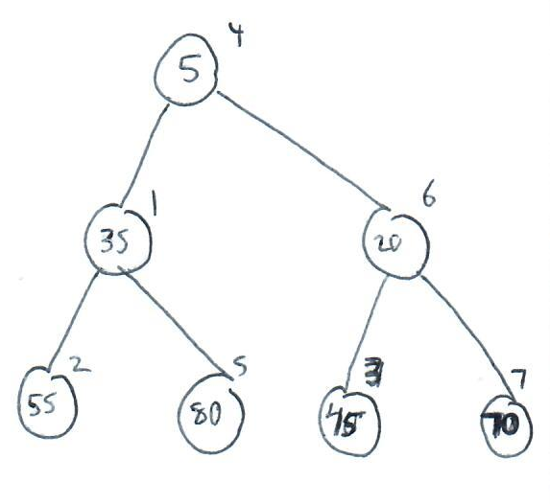
Insert string seven (7), value 70
Options:
1 - Insert a new item into the binary heap
2 - Set the key of a specified item
3 - Delete a specified item
4 - Perform a deleteMin
5 - Quit
Choose an option: 1
Enter an id string (to insert): string seven
Enter an associated integer key: 70
Call to 'insert' returned: 0

Slide 10
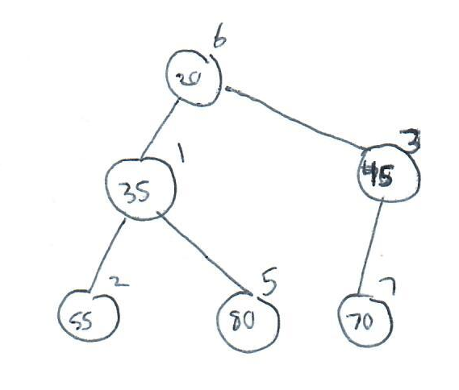
Perform deleteMin
Options:
1 - Insert a new item into the binary heap
2 - Set the key of a specified item
3 - Delete a specified item
4 - Perform a deleteMin
5 - Quit
Choose an option: 4
Call to 'deleteMin' returned: 0
Deleted item with string id "string four" and key 5

Slide 11
Delete string four (4)
Options:
1 - Insert a new item into the binary heap
2 - Set the key of a specified item
3 - Delete a specified item
4 - Perform a deleteMin
5 - Quit
Choose an option: 3
Enter an id string (to delete): string four
Call to 'delete' returned: 1

Slide 12
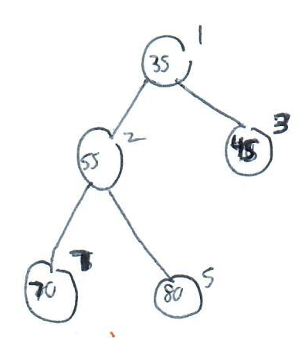
Perform deleteMin
Options:
1 - Insert a new item into the binary heap
2 - Set the key of a specified item
3 - Delete a specified item
4 - Perform a deleteMin
5 - Quit
Choose an option: 4
Call to 'deleteMin' returned: 0
Deleted item with string id "string six" and key 20

Slide 13
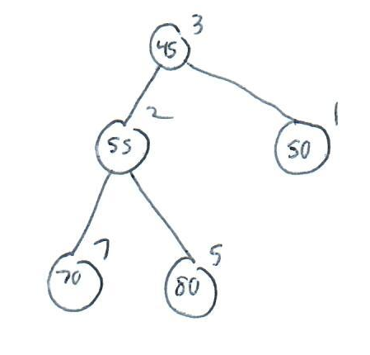
Set key string one (1), value 50
Options:
1 - Insert a new item into the binary heap
2 - Set the key of a specified item
3 - Delete a specified item
4 - Perform a deleteMin
5 - Quit
Choose an option: 2
Enter an id string (to change its key): string one
Enter an associated integer key: 50
Call to 'setKey' returned: 0

Slide 14
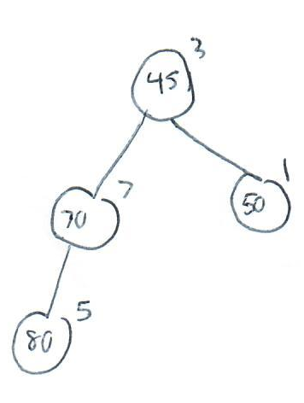
Delete string two (2)
Options:
1 - Insert a new item into the binary heap
2 - Set the key of a specified item
3 - Delete a specified item
4 - Perform a deleteMin
5 - Quit
Choose an option: 3
Enter an id string (to delete): string two
Call to 'delete' returned: 0
Deleted item with string id "string two" and key 55

Slide 15
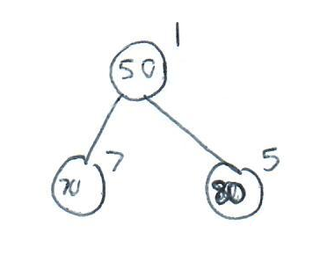
Perform deleteMin
Options:
1 - Insert a new item into the binary heap
2 - Set the key of a specified item
3 - Delete a specified item
4 - Perform a deleteMin
5 - Quit
Choose an option: 4
Call to 'deleteMin' returned: 0
Deleted item with string id "string three" and key 45

Slide 16
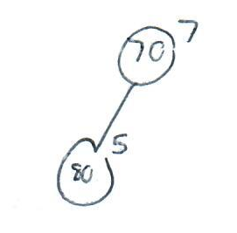
Perform deleteMin
Options:
1 - Insert a new item into the binary heap
2 - Set the key of a specified item
3 - Delete a specified item
4 - Perform a deleteMin
5 - Quit
Choose an option: 4
Call to 'deleteMin' returned: 0
Deleted item with string id "string one" and key 50

Slide 17
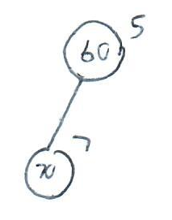
Set key string five (5), value 60
Options:
1 - Insert a new item into the binary heap
2 - Set the key of a specified item
3 - Delete a specified item
4 - Perform a deleteMin
5 - Quit
Choose an option: 2
Enter an id string (to change its key): string five
Enter an associated integer key: 60
Call to 'setKey' returned: 0

Slide 18
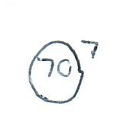
Perform deleteMin
Options:
1 - Insert a new item into the binary heap
2 - Set the key of a specified item
3 - Delete a specified item
4 - Perform a deleteMin
5 - Quit
Choose an option: 4
Call to 'deleteMin' returned: 0
Deleted item with string id "string five" and key 60

Slide 19
Perform deleteMin
Options:
1 - Insert a new item into the binary heap
2 - Set the key of a specified item
3 - Delete a specified item
4 - Perform a deleteMin
5 - Quit
Choose an option: 4
Call to 'deleteMin' returned: 0
Deleted item with string id "string seven" and key 70

Slide 20
Perform deleteMin
Options:
1 - Insert a new item into the binary heap
2 - Set the key of a specified item
3 - Delete a specified item
4 - Perform a deleteMin
5 - Quit
Choose an option: 4
Call to 'deleteMin' returned: 1

Slide 21
Quit
Options:
1 - Insert a new item into the binary heap
2 - Set the key of a specified item
3 - Delete a specified item
4 - Perform a deleteMin
5 - Quit
Choose an option: 5
Goodbye!

