Slide 1
ECE469: Artificial Intelligence
Advanced Search

Slide 2
Informed Search
Out last topic covered uninformed search strategies
With those strategies, an agent could distinguish goal states from non-goal states
However, it could not determine how close a non-goal state is to a goal state
An informed search strategy is one that uses problem-specific knowledge beyond the definition of the problem itself
One key component of these algorithms is a heuristic function
h(n) = the estimated cost of the cheapest path from the state at node n to a goal state

Slide 3
Best-first Search Revisited
In our previous topic, we covered a general best-first search algorithm
Best-first search starts with only the initial state on the frontier
Best-first search decides which node to expand next based on an evaluation function, f(n)
In the general pseudo-code, a priority queue is used, so nodes with the smallest value, according to f(n), would be expanded
We saw that best-first search could be used to implement different uninformed search strategies:
For uniform-cost search, the evaluation function is the path cost
For breadth-first search (BFS), the evaluation function is the node’s depth
For depth-first search (DFS), the evaluation function is the negative of the node’s depth
In practice, BFS and DFS are typically implemented differently

Slide 4
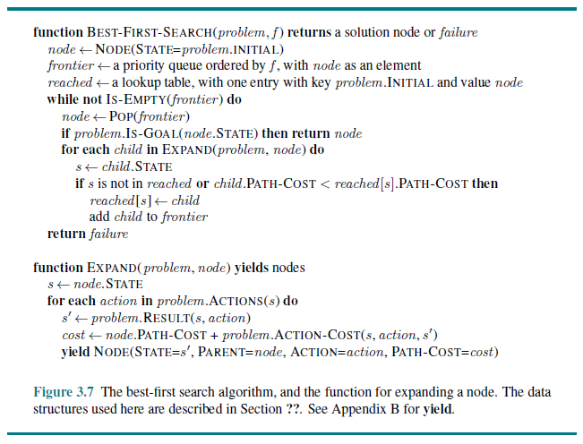
Best-first Search Pseudo-code Revisited

Slide 5
Greedy Best-first Search
Greedy best-first search (an example of a greedy algorithm) tries to expand the node closest to a goal
This can be achieved by using the heuristic function as the evaluation function; i.e., f(n) = h(n)
Using the pseudo-code from our last topic, this would carry out a greedy graph search
If a repeated state is detected with a lower path cost than before, we replace the node in the frontier with the new node
We will look at an example related to the Romania map problem
The heuristic we will use for this problem is straight-line distance
Note that the algorithm does not find the best solution for this case

Slide 6
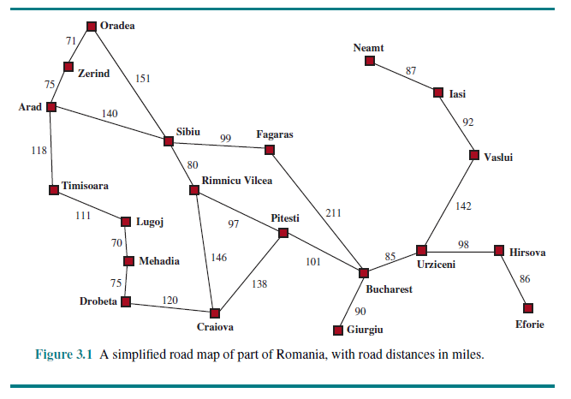
The Romania Map Problem Revisited

Slide 7
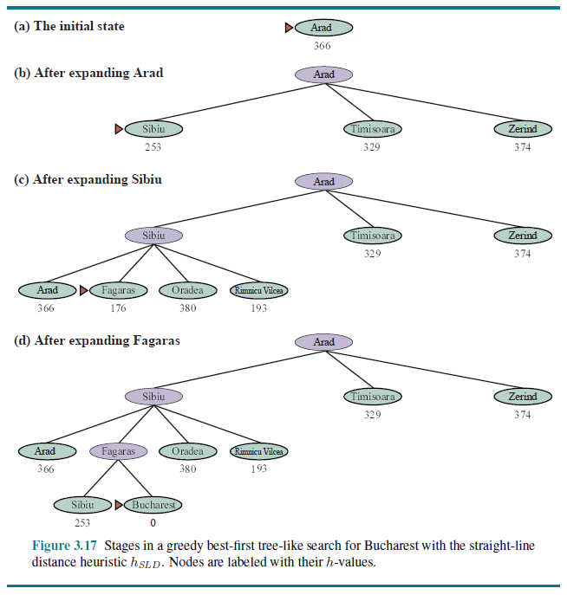
Greedy Best-first Search Example

Slide 8
Properties of Greedy Best-first Search
Greedy best-first search is clearly not optimal
The tree-search version is not complete (it can oscillate back and forth between two states forever)
The graph search version is complete for finite spaces
The worst-case time and space complexity for the graph version is O(|V|)
However, it can be much faster for some problems with a good heuristic

Slide 9
A* Search
A* search (sometimes just called A*) evaluates a node by combining g(n), the path cost to reach the node, and the heuristic, h(n)
More specifically, f(n) = g(n) + h(n)
Remember that:
g(n) is an exact measure of the path cost from the initial state to the current node (which contains the current state)
h(n) is an estimate of the remaining cost to any goal node
Therefore, we can view f(n) as an estimated cost of the best path from the initial state, through the current node, to any goal node
A* is complete as long as every action has a cost that is greater than some positive ε and the state space either has a solution or is finite
Provided that h(n) satisfies certain conditions, A* is optimal

Slide 10
Admissible Heuristics
An admissible heuristic is one that never overestimates the cost to reach a goal; such a heuristic may be optimistic
A tree search version of A* is optimal if h(n) is an admissible heuristic
A graph search version of A* is optimal with an admissible heuristic as long as repeated paths to a state with better costs are not discarded
Example: Using straight-line distance for the Romania map example is admissible

Slide 11
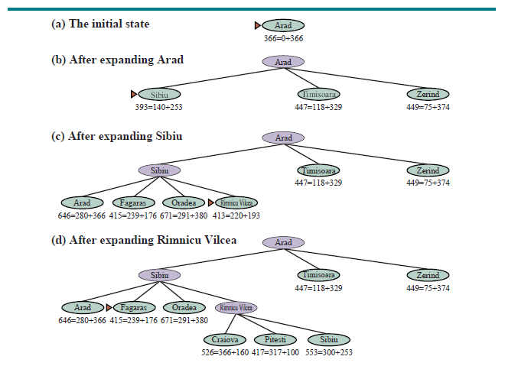
A* Applied to the Romania Map Problem

Slide 12
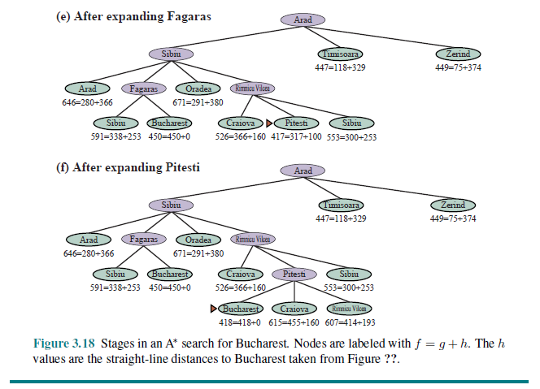
A* Applied to the Romania Map Problem (cont.)

Slide 13
Proving Optimality of A*
There is a simple proof that A* is optimal if h(n) is admissible:
Suppose that a suboptimal goal node G2 appears on the frontier, and let the cost of the optimal solution be C*; then f(G2) = g(G2) + h(G2) = g(G2) + 0 > C*
Next consider a frontier node, n, that is on an optimal path to a solution; we know that f(n) = g(n) + h(n) <= C* if h(n) is admissible
Then f(n) < f(G2) and node n will be expanded before node G2, leading to another node on the frontier that is on an optimal solution path
The proof breaks down if repeated stated with better path costs are discarded (tree search and our version of graph search don’t do that)
The 4th Edition of the textbook shows an indirect proof of optimality

Slide 14
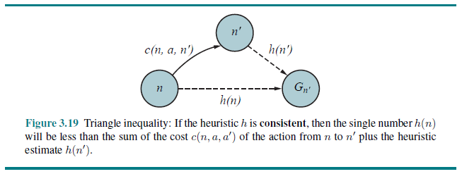
Consistent Heuristics
A heuristic, h(n), is consistent if for every node n and successor n' generated by action a, it is the case that h(n) <= c(n, a, n') + h(n’)
This is a form of the triangle inequality
Consistent heuristics are always admissible

Slide 15
A* versus Uniform-cost Search
The heuristic h(n)=0 is both admissible and consistent
If A* is applied with this heuristic, this gives us f(n) = g(n) + h(n) = g(n)
A* with this heuristic is equivalent to uniform-cost search!
More accurate heuristics will lead to a goal node using less time and memory

Slide 16
Contours
The f-costs along any path explored by A* with a consistent heuristic are monotonic (i.e., non-decreasing), assuming positive action costs:
Suppose n' is a successor of n; then g(n') = g(n) + c(n, a, n') for some a
Also, by definition, f(n') = g(n') + h(n') = g(n) + c(n, a, n') + h(n')
If h(n) is consistent, this leads to f(n') >= g(n) + h(n) = f(n)
We can draw contours in the state space, i.e., curves within which all nodes have values of f(n) less than or equal to some constant
A* expands all nodes on one contour before expanding any nodes on a contour representing higher values of f(n)
Therefore, the first time that a state is expanded represents an optimal path to that state

Slide 17
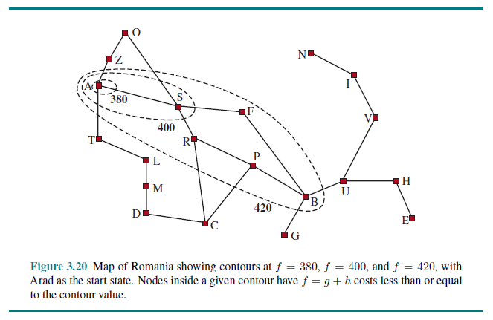
Contours for the Romania Map Problem

Slide 18
Properties of A*
A* expands all nodes with f(n) < C* (the cost of the optimal path to a goal node)
A* expands some nodes on the “goal contour”
A* expands no nodes with f(n) > C*
A* is optimally efficient; no other optimal algorithm is guaranteed to expand fewer nodes
Still, A* is not the answer to all searching needs
The number of nodes within the goal contour can be exponential with respect to the length of the solution
All generated nodes are kept in memory (as with all graph search algorithms)
Because of this, A* usually runs out of memory before time

Slide 19
Simplified Memory-bounded A*
The book discusses several potential methods of dealing with this issue
We will focus on simplified memory-bounded A* (SMA*)
SMA* proceeds like A*, but if memory is full and a new node is generated, it drops the worst leaf node
However, the parent of the node remembers that the node has been dropped, and remembers its f-value
The node may be regenerated if, later in the algorithm, all other alternatives seem worse
SMA* is complete if there is a reachable solution, and optimal if there is a reachable optimal solution
The book calls SMA* “a fairly robust choice for finding optimal solutions” under certain conditions
However, “memory limitations can make a problem intractable from the point of view of computation time” and “the only way out is to drop the optimality requirement”

Slide 20
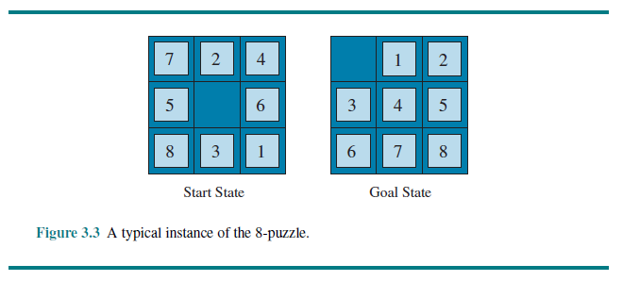
The 8-puzzle Revisited

Slide 21
The 8-puzzle Statistics
Here are some statistics about the 8-puzzle:
The average branching factor is about 3
The average depth to an optimal solution is about 22
This could lead to 3²² ≈ 3.1 * 10¹⁰ nodes for an exhaustive search
Keeping track of repeated states could cut down by factor of about 170,000, because only 9!/2 = 181,440 distinct states are reachable
For the 8-puzzle, all distinct, reachable states could be kept in memory
For the 15-puzzle and 24-puzzle, however, there are about 10¹³ and 10²⁵ reachable distinct states, respectively

Slide 22
Heuristics for the 8-puzzle
To use A* for the 8-puzzle, we need a heuristic that never overestimates the number of steps to the goal
Two candidates are:
h₁ = # of misplaced tiles
h₂ = the sum of horizontal and vertical distances of tiles from their goal positions (this is called the city-block distance, a.k.a. the Manhattan distance)
Note that both of these are clearly admissible heuristics
Furthermore, h₂ dominates h₁, meaning h₂ >= h₁ always; this translates directly into efficiency
All nodes expanded by A* with h₂ will also be expanded with h₁, except possibly for some nodes with f(n) = C*
Other nodes might be expanded as well

Slide 23
Evaluating Heuristics
One way to evaluate a heuristic for A* is by noting the number of nodes generated, N, for inputs with different solution depths, d
A related way is to use a metric known as effective branching factor, b*
This is the branching factor that a uniform tree of depth d would need in order to contain N nodes: N = 1 + b* + (b*)² + … + (b*)^{d}

Slide 24
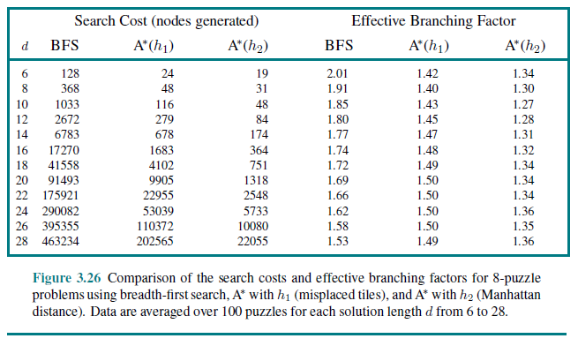
Evaluating Heuristics for the 8-puzzle

Slide 25
Generating Heuristics from Relaxed Problems
One method of generating an admissible heuristic is to use the cost of the solution to a relaxed problem
A relaxed problem is a modification of the original problem with fewer restrictions on the actions
Because the derived heuristic is the exact cost for the relaxed problem, it must obey the triangle inequality and is therefore consistent
Some examples for the 8-puzzle include:
A tile can move from square A to square B if A is adjacent to B; this leads to h₂, since each tile can walk directly to its final position
A tile can move from square A to square B; this leads to h₁ since each tile can jump directly to its final position
A tile can move form square A to square B if B is blank; this leads to Gaschnig's heuristic; it is at least as accurate as h₁, but can be more or less accurate than h₂

Slide 26
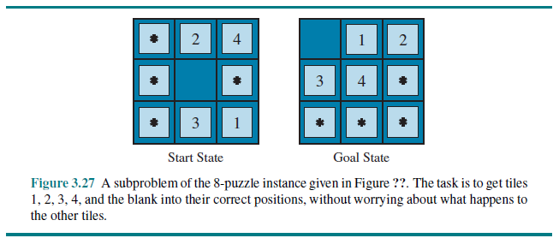
Generating Heuristics from Subproblems
Admissible heuristics can also be derived from the solution cost of a subproblem
Casually speaking a subproblem is a piece of the original problem that needs to be solved
An example for the 8-puzzle:

Slide 27
Pattern Databases
A pattern database stores the exact solution costs for every possible subproblem of a problem
For example, for the 8-puzzle, a pattern database might store the cost of every possible configuration of four tiles and the blank
The cost of solving the subproblem is an admissible, consistent heuristic
By using disjoint pattern databases, the agent might be able to sum the costs of subproblems; however, one needs to be careful
For the 8-puzzle, if one database considers only tiles 1-4, and another considers tiles 5-8, the sum would not lead to an admissible heuristic
However, if we only store the number of moves involving the four considered tiles, it works, leading to a very useful heuristic for the 8-puzzle

Slide 28
Using Multiple Heuristics
Suppose, for some given problem, you have m admissible heuristics, h₁(n), h₂(n), …, h_{m}(n)
If none of the heuristics clearly dominates the others, you can obtain the “best of all worlds” by taking the max
That is: h(n) = max{h₁(n), h₂(n), …, h_{m}(n)}

Slide 29
Local Search
So far, a solution to a problem has been the path to the goal
For many problems, the path to the goal is irrelevant (e.g., the 8-queens problem)
Local search algorithms operate using only a single current state, and they generally move only to neighbors of the current state
One advantage of local search algorithms is that they use very little memory
They are often useful for optimization problems aimed at finding the best state according to an objective function
It is useful to consider the state-space landscape
Each location has an elevation defined by the objective function
The agent's goal is to find the global maximum or the global minimum
Problems include local maxima or minima, flat local maxima or minima, and shoulders

Slide 30
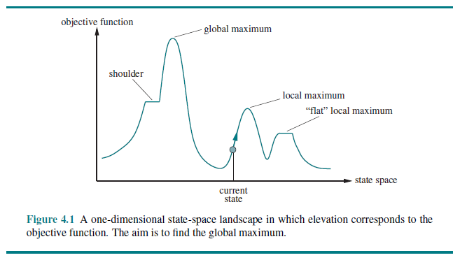
State-space Landscape Example

Slide 31
The 8-queens Problem Revisited
Recall that our goal in the 8-queens problem is to place 8 queens on a chess board such that none of them attack each other
In our last topic, we considered an incremental formulation, in which we placed one queen on the board at a time
Now, we will consider a complete-state formulation
That is, we will place 8-queens on the board right away, and that configuration will constitute the current state
We will apply a local search algorithm to attempt to solve the problem

Slide 32
Hill Climbing
Hill climbing (a.k.a. greedy local search) replaces the current node with its best neighbor
When no neighbor is better than the current state, the search is finished
We will apply hill-climbing to the 8-queens problem
As previously mentioned, we will consider a complete-state formulation
Using our knowledge of the problem, we can start by randomly placing one queen in each column
At each step, we will allow movements of any queen to any other square in the same column; therefore, each current state has 56 successors
The “best neighbor” is the state which has the smallest number of pairs of queens attacking each other
Optionally, if no move improves the situation, we can allow sideways moves, which may allow us to escape from a shoulder

Slide 33
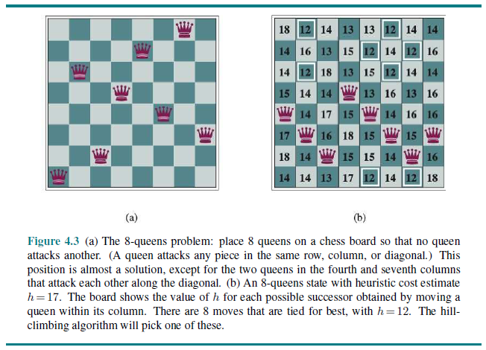
Hill Climbing for 8-queens Problem Example

Slide 34
Hill Climbing for 8-queens Problem Results
When hill climbing is applied to the 8-queens problem without sideways moves:
There is only about a 14% chance of success (i.e., it gets stuck about 86% of the time)
When there is a success, it takes an average of 4 moves
When it gets stuck, it takes an average of 3 moves
When hill climbing is applied to the 8-queens problem, and up to 100 sideways moves are allowed:
There is about a 94% chance of success (i.e., it gets stuck about 6% of the time)
When there is a success, it takes an average of 21 moves
When it gets stuck, it takes an average of 64 moves

Slide 35
Random-restart Hill Climbing
Of course, we want an algorithm that can solve the 8-queens problem every time
We can virtually guarantee this with random-restart hill climbing
The approach is simple; apply hill climbing (with or without sideways moves); if it gets stuck, start over!
If a single hill climbing search has a probability p of success, then the expected number of restarts is 1/p – 1
The expected number of steps is the cost of a successful iteration plus 1/p – 1 = (1-p)/p times the cost of a failure
The expected number of steps for the 8-queens problem is approximately 25 if up to 100 sideways moves are allowed and 22 moves if they are not
According to our textbook (4th edition), this solution can find a solution for up to three million queens in seconds (the 3rd edition said less than one minute)!

Slide 36
Other Variations of Hill Climbing
Stochastic hill climbing chooses at random from among the uphill moves
The probabilities can vary with the steepness of the moves
This usually converges slower than typical (steepest ascent) hill climbing, but it can find better solutions for some landscapes
First-choice hill climbing implements stochastic hill climbing by generating successors at random until one is better than current state
This may be a good strategy when a state has many successors (e.g., thousands)
It can get stuck at a local maximum
Either of these strategies can be combined with random restarts

Slide 37
Other Variations of Local Search
Random walk will eventually find a goal under certain assumptions (i.e., it doesn’t get stuck), but it is extremely inefficient
Simulated annealing combines aspects of hill climbing and random walk
From the current state, the agent picks a random move
If the move improves the situation, the agent accepts it no matter what
If not, the agent accepts it with a probability that decreases with the badness of the move and with time
A local beam search keeps track of k states rather than just one
If any successor is a goal state, it halts
Otherwise, it selects the k-best successors from the complete list
A stochastic beam search is a variation of local beam search that chooses the k successors randomly with probabilities proportional to their values

Slide 38
Genetic Algorithms
A genetic algorithm is one type of evolutionary algorithm that is motivated by the concept of natural selection
Successor states are generated by combining two parent states
Genetic algorithms start with set of K randomly generated states, called the initial population
Each state in the population is an individual, represented as a string over a finite alphabet
Individuals are evaluated with a fitness function; the probability of selecting a state for reproduction is proportional to its fitness score
Randomly chosen crossover points are used to combine states to generate successors in the next generation, and random mutations are allowed
Iterations generating new generations of the population continue until some stopping criterion is met, or for a set number of iterations

Slide 39
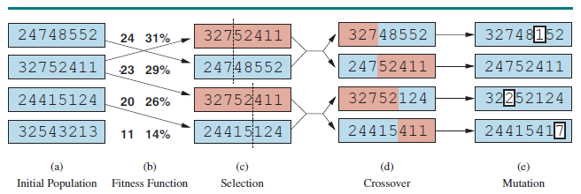
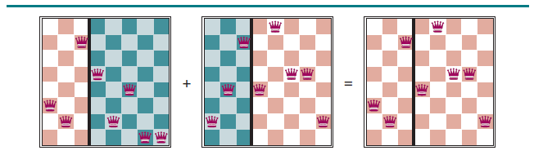
Genetic Algorithm Example

Slide 40
Continuous State Spaces
In a continuous state space, a state might have infinitely many successors (i.e., the agent may have infinite applicable actions
The textbook points out that there is a vast literature devoted to this type of problem, and that they are providing only a very brief introduction
Example: Place three new airports in Romania such that sum of the squared distances from each city to the closest airport is minimized
We will briefly consider a local search with a complete state formulation to solve this problem
One way to avoid continuous state spaces is to discretize the state space; then we can apply any of the local search algorithms already described
Other methods use the gradient of the landscape; the gradient gives the direction and magnitude of the steepest slope from the current point

Slide 41
Online Search Problems
So far, we have examined offline search algorithms; the agents compute complete solutions and then execute them without recourse to percepts
An online search problem can only be solved by an agent executing actions
Online search is necessary for exploration problems in which states and/or actions are unknown; e.g., a robot exploring a new space
Sometimes the cost we're interested in is the cost of the path the agent actually follows; compared to the cost of the actual shortest path, this gives the competitive ratio
In practice, we are often assuming safely explorable spaces (i.e., the goal is reachable from every reachable state); otherwise, there can be dead ends
If actions are reversible, it is possible to perform an online DFS
The competitive ratio can be arbitrarily bad; e.g., if the goal is next to the initial state but the agent goes off on a long excursion; an online version of IDS solves this problem
Hill climbing can be an online search; it is not very useful in its simplest form because of local maxima, and random restarts, of course, cannot be used with an online search

