Slide 1
ECE469: Artificial Intelligence
Intelligent Agents

Slide 2
Agents
Book: “An agent is anything that can be viewed as perceiving its environment through sensors and acting upon that environment through actuators”
A percept is an agent's perceptual inputs at any given instant
A percept sequence is the complete history of percepts
An agent's behavior can be described by an agent function mapping the percept sequence to an action
An agent program implements the agent function

Slide 3
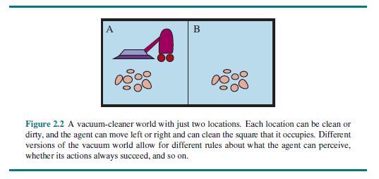
The Vacuum-cleaner World

Slide 4
Rational Agents
Book: “A rational agent is one that does the right thing”
A performance measure is used to evaluate agents
It is better to design a performance measure according to what you want in an environment rather than how you think an agent should behave
What is rational at a given instant depends on four things:
The performance measure
The agent's prior knowledge of the environment
The percept sequence
The allowable actions
Definition of a rational agent:
“For each possible percept sequence, a rational agent should select an action that is expected to maximize its performance measure, given the evidence provided by the percept sequence and whatever built-in knowledge the agent has.”

Slide 5
Task Environments
According to the textbook, task environments “are essentially the problems to which rational agents are the solutions”
A task environment includes the performance measure, the environment, the agent's actuators, and the agent's sensors (PEAS)
The book uses an automated taxi driver as an example of a complex agent and discusses its task environment

Slide 6
Categorizing Task Environments
Fully observable versus partially observable
Deterministic versus stochastic (or strategic)
Episodic versus sequential
Static versus dynamic (or semidynamic)
Discrete versus continuous
Single-agent versus multi-agent
Known versus unknown

Slide 7
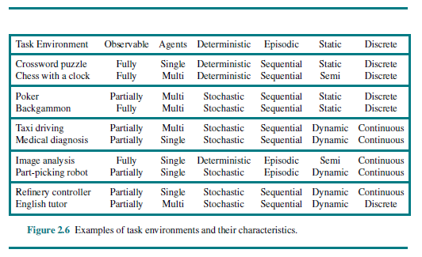
Examples of Task Environments

Slide 8
Types of agents
Types of agents:
Simple reflex agents
Model-based reflex agents
Goal-based agents
Utility-based agents
Agents can either use hard-coded rules to make decisions, or they can learn the rules

Slide 9
Agent Representations
Types of agent representations (related to expressivity or complexity):
Atomic representations
Factored representations
Structured representations
A more expressive representation can capture everything that a less expressive one can plus more
We can also distinguish between localist representations and a distributed representations

