Slide 1
ECE469: Artificial Intelligence
Bayesian Learning

Slide 2
Relevant Previous Topics
We have seen that AI agents often use probability theory to deal with uncertainty
Probabilities represent degrees of belief (at least, that is the interpretation we have been using)
Bayesian networks allow us to graphically represent dependencies between random variables describing the world
There are implicit independence and conditional independence assumptions
We have also been introduced to concepts related to machine learning
We talked more specifically about supervised machine learning and classification
We will see that Bayesian learning, and related learning methods, combines elements from all these topics

Slide 3
Bayesian Learning
Agents handle uncertainty using probability, but often in AI contexts, they must learn the probabilities from experience
Using our prior terminology, we start with prior probabilities (a.k.a. unconditional probabilities or priors)
In a machine learning context, these probabilities might refer to the likelihood of various hypotheses that may be true about the agent’s world
We will be considering scenarios in which we collect data that provides evidence that might change our degrees of belief (i.e., the probabilities)
One goal of Bayesian learning is to update the conditional probabilities (a.k.a. posterior probabilities) of the hypotheses given the evidence
Another goal of Bayesian learning is to make predictions about future data given the evidence

Slide 4
Candy!
A running example throughout this topic involves boxes of candy
The candies come in two flavors: cherry (which the textbook considers good) and lime (with the textbook considers bad)
The candy comes in large packages with different proportions of cherry vs. lime pieces
The pieces are not labeled, and you don’t know what flavor a piece of candy will have until you open it
For now, we will assume that there are five possible proportions, which we can consider hypotheses (we will generalize this later):
h₁: 100% cherry (the best!) 10% of the packages have this proportion
h₂: 75% cherry + 25% lime 20% of the packages have this proportion
h₃: 50% cherry + 50% lime 40% of the packages have this proportion
h₄: 25% cherry + 75% lime 20% of the packages have this proportion
h₅: 100% lime (the worst!) 10% of the packages have this proportion
We will assume that the packages are very large, so that as we select and unwrap candies, the change in the proportion is negligible, and we will ignore it

Slide 5
Updating Probabilities and Making Predictions
As we collect data, we can apply Bayes’ rule (a.k.a. Bayes’ law or Bayes’ theorem) to update the probabilities of hypotheses as follows:
P(h_{i} | d) = α P(d | h_{i}) P(h_{i})
Key quantities in this equation are the hypothesis prior, P(h_{i}), and the likelihood of the data under each hypothesis, P(d | h_{i})
Also, d represents the observed values for all the observed data, perhaps involving multiple observations
Also recall that α is a normalization constant; in this case, 1 / P(d)
We can use the updated probabilities of all possible hypotheses to make predictions about some random variable, X, as follows:
P(X | d) = ∑_{i} P(X | h_{i}) P(h_{i} | d)
Recall that the boldfaced Ps represent probability distributions, while the non-bold Ps represent single probabilities
Note that we are taking a weighted average of predictions made by each possibly hypothesis (weighted according to the hypotheses’ probabilities)

Slide 6
The I.I.D. Assumption
In our candy example, we are assuming that the packages are very large
More specifically, we will basically assume that the proportion of cherry and lime candies in the package will not change over time
More formally, we will assume the observations we make over time are independently and identically distributed (i.i.d.)
For the candy example, we can express this as: P(d | h_{i}) = ∏_{j} P(d_{j} | h_{i})
Here, i is the index of a single hypothesis and j is the index of a single observation
According to our assumptions, as we open candies, the chances of seeing a cherry or lime do not change over time; each event is independent of the others
We note here that this is not actually true, but it may be approximately correct if the package is very large (or if we appropriately pick candies with replacement)
Of course, our beliefs as to what sort of box we have will clearly change over time

Slide 7
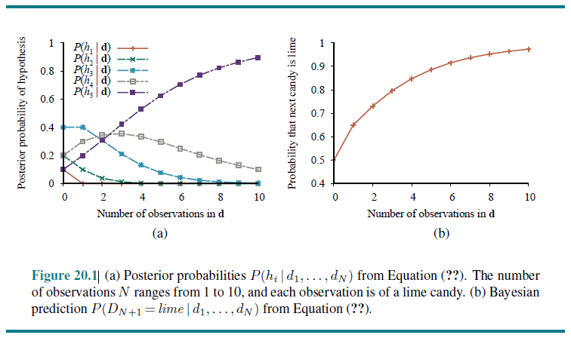
Bayesian Learning Example

Slide 8
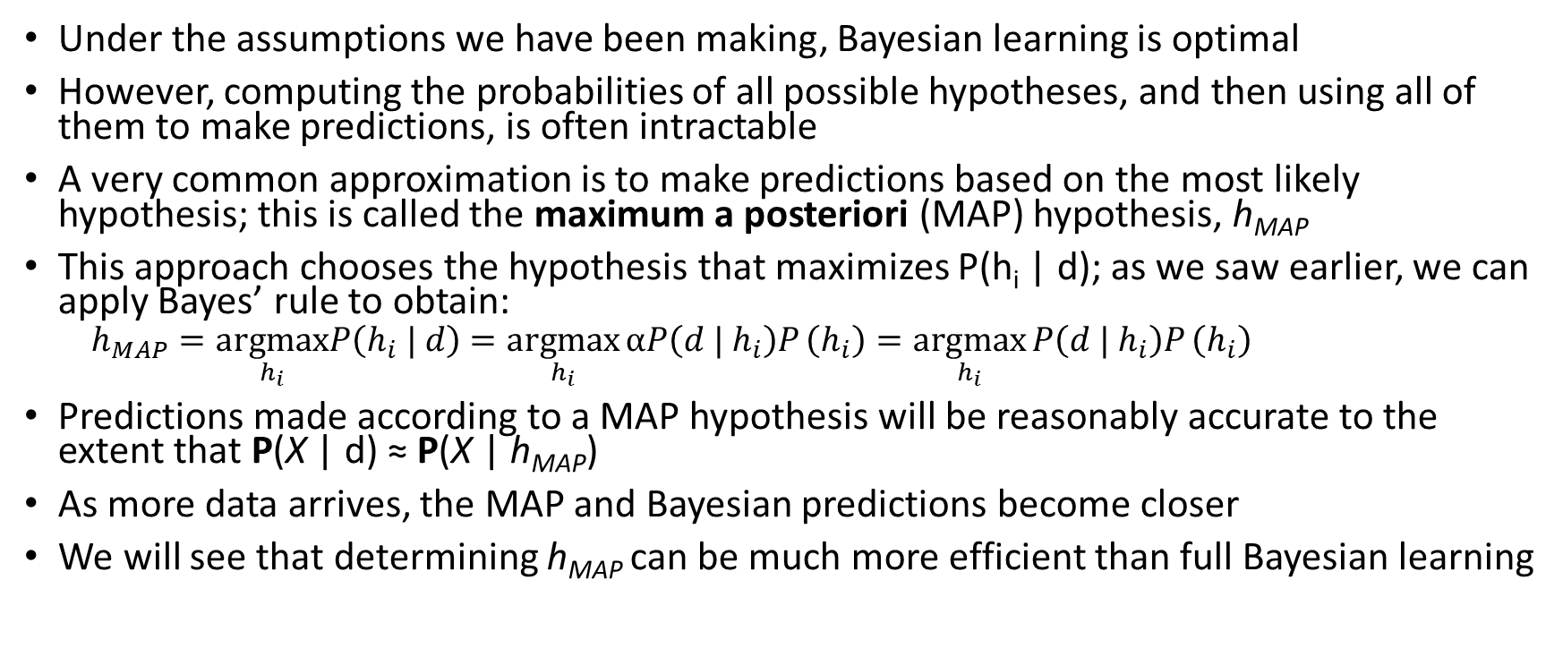
MAP Learning
Under the assumptions we have been making, Bayesian learning is optimal
However, computing the probabilities of all possible hypotheses, and then using all of them to make predictions, is often intractable
A very common approximation is to make predictions based on the most likely hypothesis; this is called the maximum a posteriori (MAP) hypothesis, h_{MAP}
This approach chooses the hypothesis that maximizes P(h_{i} | d); as we saw earlier, we can apply Bayes’ rule to obtain:
$$h_{MAP}=\underset{h_{i}}{argmax}P\left(h_{i} | d\right)=\underset{h_{i}}{argmax}{αP\left(d | h_{i}\right)P}\left(h_{i}\right)=\underset{h_{i}}{argmax}{P\left(d | h_{i}\right)P}\left(h_{i}\right)$$
Predictions made according to a MAP hypothesis will be reasonably accurate to the extent that P(X | d) ≈ P(X | h_{MAP})
As more data arrives, the MAP and Bayesian predictions become closer
We will see that determining h_{MAP} can be much more efficient than full Bayesian learning

Slide 9
The Importance of the Prior
According to the book, in both Bayesian and MAP learning, the hypothesis prior plays, P(h_{i}), “plays an important role”
I would argue that this is often, but not always, the case; e.g., I have worked on categorization problems for which the prior almost never changes the prediction
As with all forms of machine learning, if the hypothesis space is too expressive, this can lead to overfitting, a concept we have previously encountered that can affect all ML methods
Bayesian and MAP learning can use the prior to penalize complexity; typically, complex hypothesis have lower probabilities because there are more of them
We are, in a sense, choosing the simplest hypothesis to explain the data; this is once again related to Ockham’s razor
Another relevant insight is that choosing h_{MAP} to maximize P(d | h_{i}) * P(h_{i}) is equivalent to minimizing –log₂P(d | h_{i}) – log₂P(h_{i})
This is the number of bits, according to information theory, needed to specify the hypothesis and the data given the hypothesis (related to the concept of entropy we saw in our previous topic)
Therefore, MAP learning chooses the hypothesis providing the maximum compression of the data

Slide 10
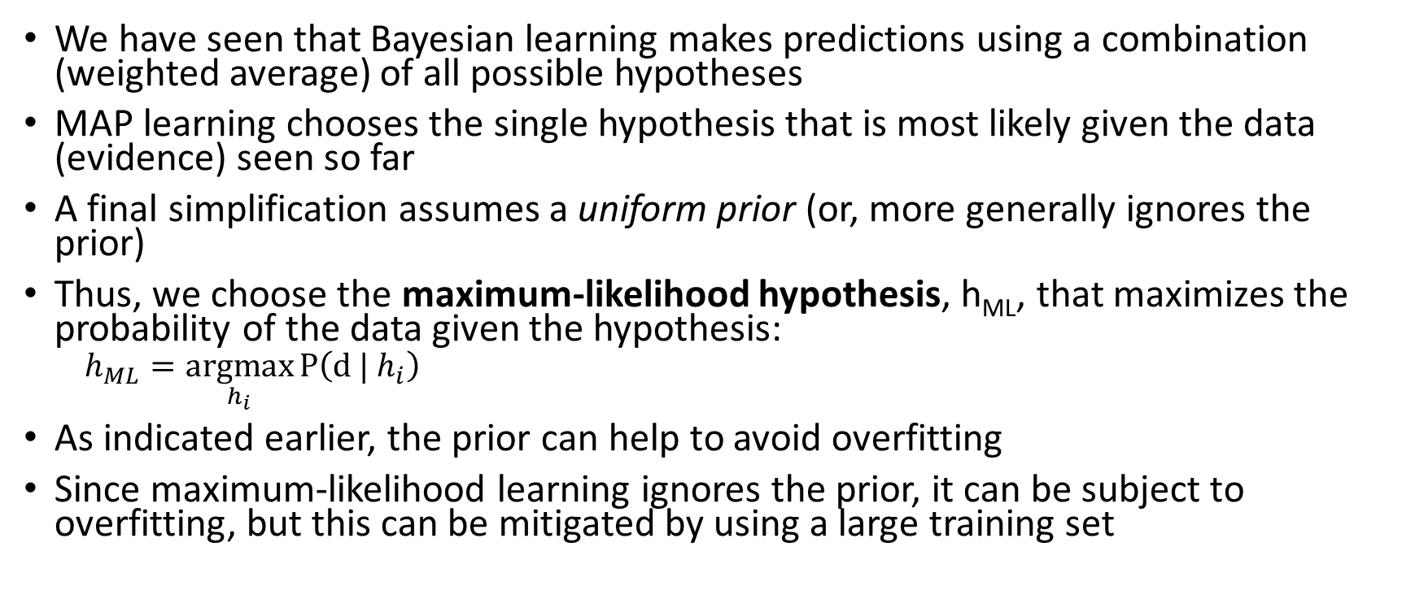
Maximum-likelihood Learning
We have seen that Bayesian learning makes predictions using a combination (weighted average) of all possible hypotheses
MAP learning chooses the single hypothesis that is most likely given the data (evidence) seen so far
A final simplification assumes a uniform prior (or, more generally ignores the prior)
Thus, we choose the maximum-likelihood hypothesis, h_{ML}, that maximizes the probability of the data given the hypothesis:
$$h_{ML}=\underset{h_{i}}{argmax}{P\left(d | h_{i}\right)}$$
As indicated earlier, the prior can help to avoid overfitting
Since maximum-likelihood learning ignores the prior, it can be subject to overfitting, but this can be mitigated by using a large training set

Slide 11
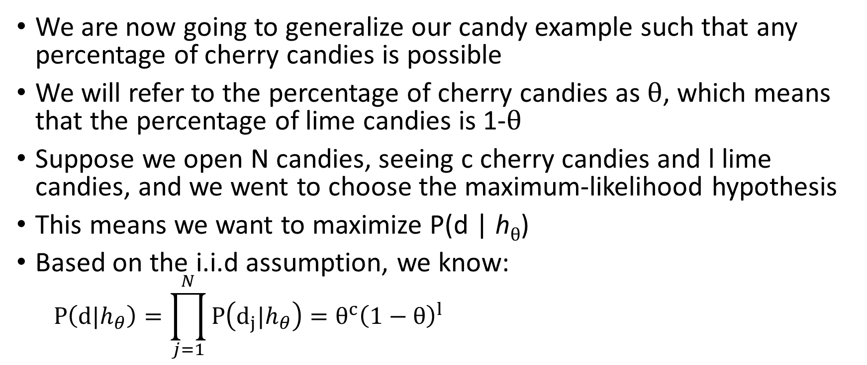
Maximum-likelihood Learning Example
We are now going to generalize our candy example such that any percentage of cherry candies is possible
We will refer to the percentage of cherry candies as $θ$, which means that the percentage of lime candies is 1-$θ$
Suppose we open N candies, seeing c cherry candies and l lime candies, and we went to choose the maximum-likelihood hypothesis
This means we want to maximize P(d | h$θ$)
Based on the i.i.d assumption, we know:
$$P\left(d|h_{θ}\right)=\prod_{j=1}^{N}{P\left(d_{j}|h_{θ}\right)=θ^{c}{\left(1−θ\right)}^{l}}$$

Slide 12
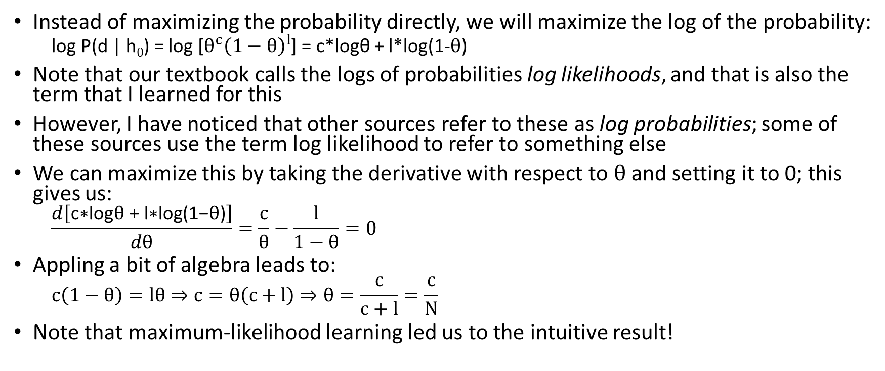
Solving for h_{ML} Example
Instead of maximizing the probability directly, we will maximize the log of the probability:
log P(d | h$θ$) = log [$θ^{c}{\left(1−θ\right)}^{l}$] = c*logθ + l*log(1-$θ$)
Note that our textbook calls the logs of probabilities log likelihoods, and that is also the term that I learned for this
However, I have noticed that other sources refer to these as log probabilities; some of these sources use the term log likelihood to refer to something else
We can maximize this by taking the derivative with respect to $θ$ and setting it to 0; this gives us:
$$\frac{d\left[\text{c}\text{∗}\text{log}\text{θ}\text{ + }\text{l}\text{∗}\text{log}\text{(1−}\text{θ}\text{)}\right]}{dθ}=\frac{c}{θ}−\frac{l}{1−θ}=0$$
Appling a bit of algebra leads to:
$$c\left(1−θ\right)=lθ⇒c=θ\left(c+l\right)⇒θ=\frac{c}{c+l}=\frac{c}{N}$$
Note that maximum-likelihood learning led us to the intuitive result!

Slide 13
General Bayesian Learning Approach
A general approach for maximum-likelihood parameter learning is:
Write an expression for the likelihood of the data as a function of the parameters (we will soon see that this also works when there is more than one parameter)
Take the derivative of the log probability with respect to each parameter
Set the derivatives to 0 and solve (this is often the trickiest step, and it may require optimization techniques)
When the data set is small, unobserved types of events are assigned the probability 0 by the maximum-likelihood hypothesis
Various tricks are available to avoid this problem
For example, we can initialize the count of each event to 1 instead of 0
This is actually a simple type of smoothing
We will mention this notion again during our unit on natural language processing

Slide 14
Expanded Candy Example
We are now going to expand our world
In addition to dealing with two flavors of candy (cherry and lime), we will also deal with two types of wrappers (red and green)
Each flavor has a certain probability of being wrapped in a red wrapper as opposed to a green wrapper
We see the wrappers, which might give non-definite hints about the flavors, but in terms of causality, the flavor influences the wrapper
In our original candy example, we had only one parameter to predict based on evidence
In this expanded example, we will see that there are three parameters to predict based on evidence

Slide 15
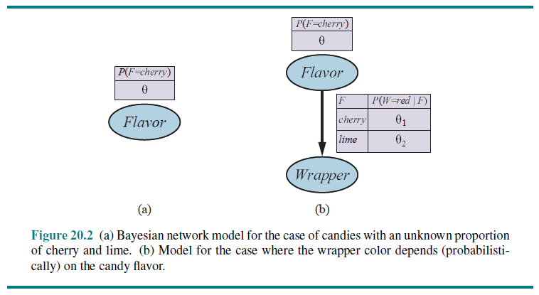
Bayesian Networks for Both Candy Examples

Slide 16
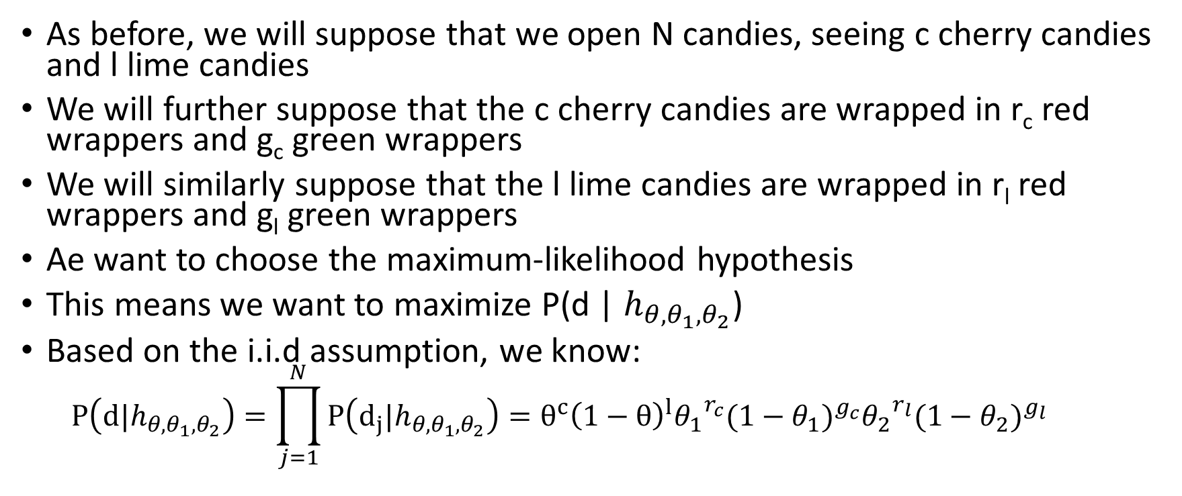
New Maximum-likelihood Learning Example
As before, we will suppose that we open N candies, seeing c cherry candies and l lime candies
We will further suppose that the c cherry candies are wrapped in r_{c} red wrappers and g_{c} green wrappers
We will similarly suppose that the l lime candies are wrapped in r_{l} red wrappers and g_{l} green wrappers
Ae want to choose the maximum-likelihood hypothesis
This means we want to maximize P(d | $h_{θ,θ_{1},θ_{2}}$)
Based on the i.i.d assumption, we know:
$$P\left(d|h_{θ,θ_{1},θ_{2}}\right)=\prod_{j=1}^{N}{P\left(d_{j}|h_{θ,θ_{1},θ_{2}}\right)=θ^{c}{\left(1−θ\right)}^{l}{θ_{1}}^{r_{c}}{{(1−θ}_{1})}^{g_{c}}{θ_{2}}^{r_{l}}(1−{θ_{2})}^{g_{l}}}$$

Slide 17
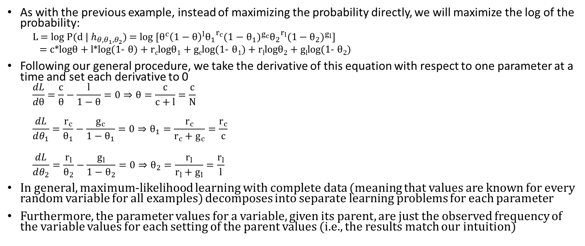
Solving for Three Parameters Example
As with the previous example, instead of maximizing the probability directly, we will maximize the log of the probability:
L = log P(d | $h_{θ,θ_{1},θ_{2}}$) = log [$θ^{c}{\left(1−θ\right)}^{l}{θ_{1}}^{r_{c}}{{(1−θ}_{1})}^{g_{c}}{θ_{2}}^{r_{l}}(1−{θ_{2})}^{g_{l}}$]
= c*logθ + l*log(1- $θ$) + r_{c}logθ₁ + g_{c}log(1- $θ$₁) + r_{l}logθ₂ + g_{l}log(1- θ₂)
Following our general procedure, we take the derivative of this equation with respect to one parameter at a time and set each derivative to 0
$$\frac{dL}{dθ}=\frac{c}{θ}−\frac{l}{1−θ}=0⇒θ=\frac{c}{c+l}=\frac{c}{N}$$
$$\frac{dL}{dθ_{1}}=\frac{r_{c}}{θ_{1}}−\frac{g_{c}}{1−θ_{1}}=0⇒θ_{1}=\frac{r_{c}}{r_{c}+g_{c}}=\frac{r_{c}}{c}$$
$$\frac{dL}{dθ_{2}}=\frac{r_{l}}{θ_{2}}−\frac{g_{l}}{1−θ_{2}}=0⇒θ_{2}=\frac{r_{l}}{r_{l}+g_{l}}=\frac{r_{l}}{l}$$
In general, maximum-likelihood learning with complete data (meaning that values are known for every random variable for all examples) decomposes into separate learning problems for each parameter
Furthermore, the parameter values for a variable, given its parent, are just the observed frequency of the variable values for each setting of the parent values (i.e., the results match our intuition)

Slide 18
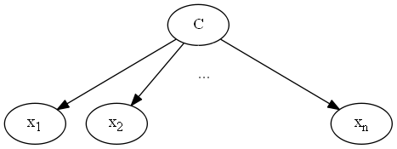
Naïve Bayes
We will now return to the naïve Bayes method of categorization, briefly discussed at the end of our topic on probability
We will use the naïve Bayes method to predict a class, or category, given the values of evidence variables
The method relies on Bayes’ rule and assumes the evidence variables are conditionally independent of each other given the category (this is not always true in practice, and this is why the method is called “naïve”)
With this assumption, we have:
P(C | x₁, …, x_{n}) = αP(C)∏_{i}P(x_{i} | C)
The terms P(x_{i} | C) and P(C) can be estimated based on a training set using maximum-likelihood learning; we can either use simple ratios, or employ a smoothing technique
Our textbook states that naïve Bayes is “probably the most common Bayesian network model used in machine learning”
Here is the Bayesian network matching the assumptions of the method:

Slide 19
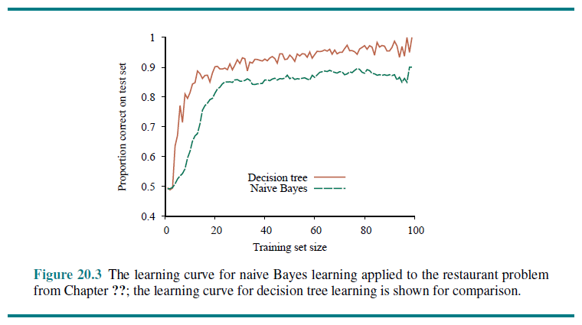
Superimposed Learning Curves

Slide 20
Notes about the Naïve Bayes Method
For the restaurant problem, decision trees seem to perform better than naïve Bayes, but for many other problems, the opposite will be the case
When we are dealing with a Boolean category (such as WillWait), we are really comparing the probability of true to the probability of false
Naïve Bayes can also be simply applied for classification involving mutually exclusive, exhaustive categories
We have the option of scaling the probabilities to add up to one, thus obtaining the predicted probability of each possible category
In practice, I have found that the actual probabilities are often not very accurate
If we don’t care about the probabilities, and we only care about choosing the most likely category, we can ignore the normalization constant entirely
The naïve Bayes method easily handles missing or noisy data

Slide 21
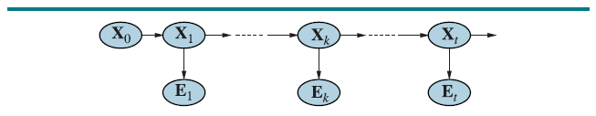
Hidden Markov Models Revisited
We have seen that Hidden Markov Models (HMMs) can be viewed as dynamic Bayesian networks:
The Xs are hidden variables representing states that are not directly observed; the transitions between them are governed by transition probabilities, a.k.a. output probabilities
The Es are evidence variables representing values that we observe; their values are governed by emission probabilities
We have seen that HMMs can be used to represent various sorts of sequences
One common task HMMs are used for is to predict a sequence of hidden states given a sequence of observations (e.g., for speech recognition or POS tagging); the Viterbi algorithm can be used for this

Slide 22
Training an HMM Revisited
We previously said that adjusting the parameters of the HMM given a training set can be very simple of much more difficult
This depends on the type of training data we are dealing with
We now know that these are examples of supervised machine learning or unsupervised machine learning
For the supervised case, the training data indicates the values of both the hidden variables and the evidence variables
The learned probabilities are simply ratios; this is an example of maximum-likelihood learning
If the training data only includes the values for sequences of evidence variables, we can use an algorithm called the Baum-Welch algorithm
The Baum-Welch algorithm is an instance of the more general expectation maximization (EM) algorithm, another probabilistic learning algorithm which we will not discuss in detail
Roughly speaking, we iterate back and forth between an E step and an M step
The E-step computes the probability of the training sequences given the current parameters of the HMM
The M-step re-estimates the parameters of the HMM to make these probabilities more likely

Slide 23
Clustering
Another task that can make use of the EM algorithm of unsupervised clustering (or just clustering)
My description of clustering: You have a dataset, and you want to divide it into groups such that the data points within each group are similar to each other
Note that the categories are not specified in advance, and the data is not labeled
Clustering often presumes that the data are generated from a mixture distribution with k components; each component is a distribution in its own right
We will briefly look at an example using a mixture of Gaussians; the parameters are:
w_{i} = P(c=i) (the weight of each component)
u_{i} (the mean of each component)
∑_{i} (the covariance of each component)
When the EM algorithm is used for clustering:
The parameters of the model (in this case, a mixture of Gaussians) are randomly initialized
The E-step computes the likelihood of the data according to the current parameters of the model
The-M step computers re-estimates the parameters to make the data more likely

Slide 24
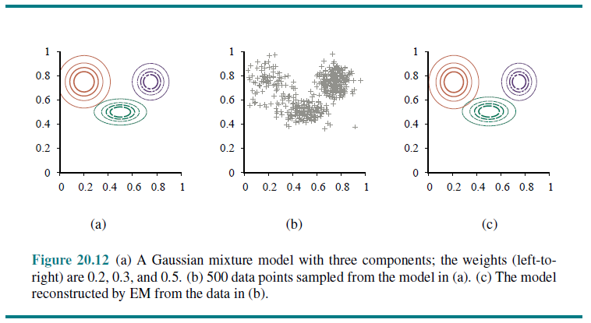
Clustering Example

