Slide 1
ECE469: Artificial Intelligence
Bayesian Networks

Slide 2
Bayesian Networks
In our previous topic, we learned that a full joint probability distribution specifies probabilities for all combinations of all random variables used to describe the world
If all the random variables are discrete with finite domains, this can be specified by a table
We have also seen that independence and conditional independence assumptions can greatly reduce the number of probabilities that need to be specified for the full joint distribution
A data structure called a Bayesian network (a.k.a. belief network, decision network, or Bayesian net) can be used to graphically represent dependencies among variables
A Bayesian network is a directed graph such that:
Each node corresponds to a random variable
If there is an arrow (a.k.a. link) from X to Y, X is said to be a parent of Y; a node may have more than one parent
The graph has no directed cycles; hence it is a directed acyclic graph (DAG)
Each node X_{i} has a conditional probability distribution P(X_{i} | Parents(X_{i})) that quantifies the effect of the parents on the node
There are typical implicit assumptions related to the links (we will discuss these shortly)

Slide 3
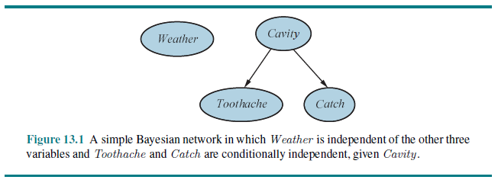
Bayesian Network Simple Example

Slide 4
Conditional Probability Tables
More complex Bayesian networks may include conditional probability tables (CPTs)
Each row of a CPT contains the conditional probability of the node for a conditioning case
Each conditional case represents a possible combination of values for the parents of the current nodes
CPTs are only appropriate when the associated random variables are discrete with finite domains
Note that the number of values in each row can be one less than the number of values in the random variable’s domain
Therefore, each row in a CPT for a Boolean random variables only needs to specify a single value

Slide 5
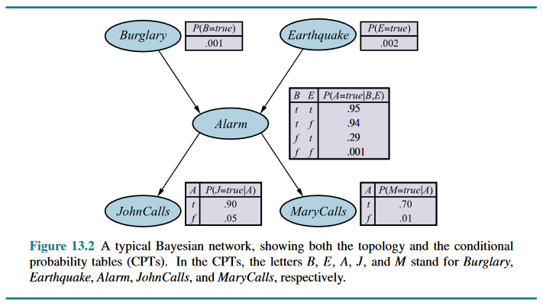
Bayesian Network Example with CPTs

Slide 6
Causal Links
For both examples we have seen so far, the links are assumed to be direct, causal links and all such links are present
This implies that each node is conditionally independent of its predecessors given its parents
Constructing the Bayesian network in this way is generally the responsibility of an expert with knowledge of the domain
For example, consider adding the MaryCalls node last in the previous example; it is dependent on all previous nodes, but only directly influenced by Alarm
A Bayesian network constructed this way (containing all direct, causal links) is also called a causal network, a.k.a. a causal graph
Such graphs are important in the field of causal inference
Various assumptions about causality which are built into these Bayesian networks; e.g., John and Mary won’t notice the earthquake and decide not to call

Slide 7
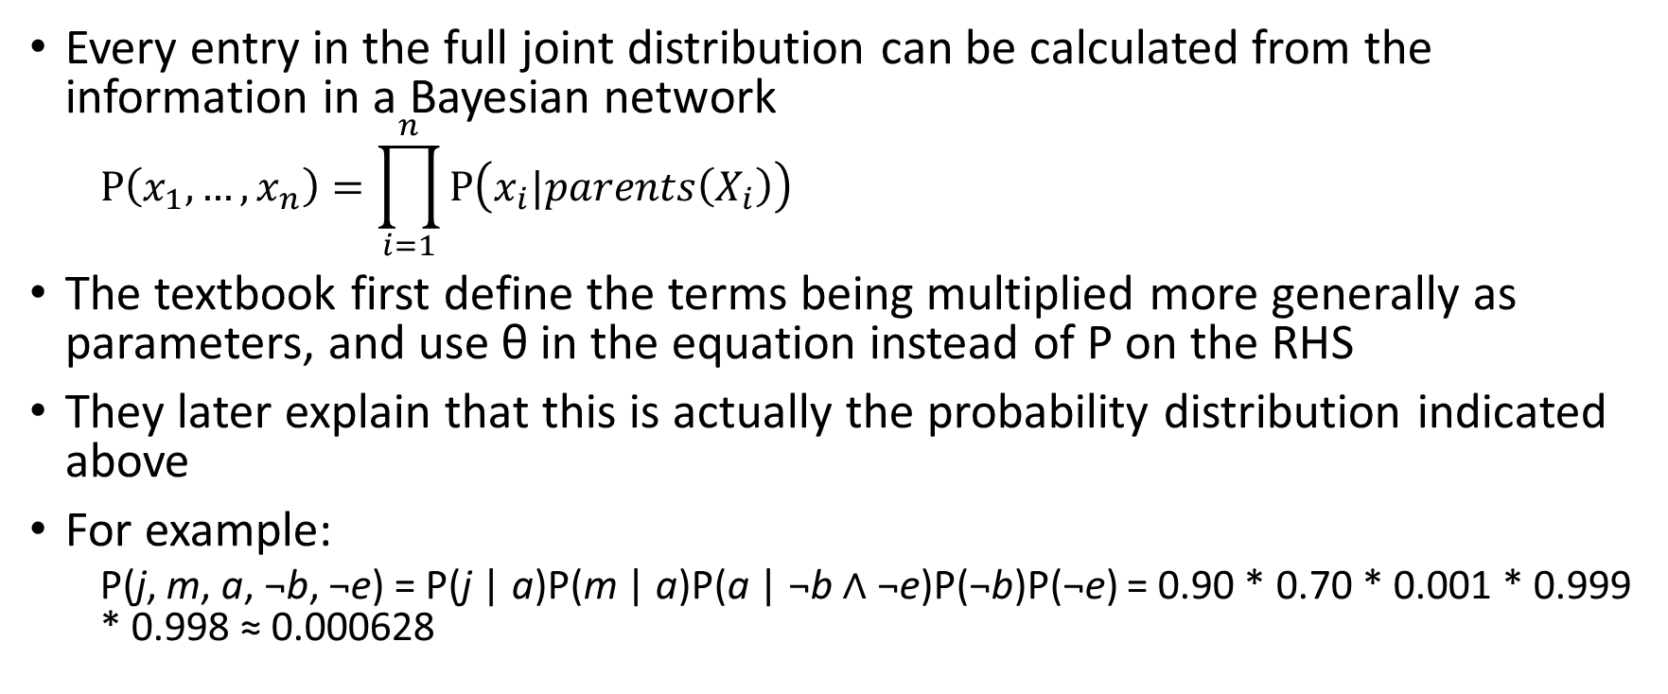
Calculating Probabilities using Bayesian Nets
Every entry in the full joint distribution can be calculated from the information in a Bayesian network
$$P\left(x_{1},…,x_{n}\right)=\prod_{i=1}^{n}{P\left(x_{i}|parents\left(X_{i}\right)\right)}$$
The textbook first define the terms being multiplied more generally as parameters, and use θ in the equation instead of P on the RHS
They later explain that this is actually the probability distribution indicated above
For example:
P(j, m, a, ¬b, ¬e) = P(j | a)P(m | a)P(a | ¬b $∧$ ¬e)P(¬b)P(¬e) = 0.90 * 0.70 * 0.001 * 0.999 * 0.998 ≈ 0.000628

Slide 8
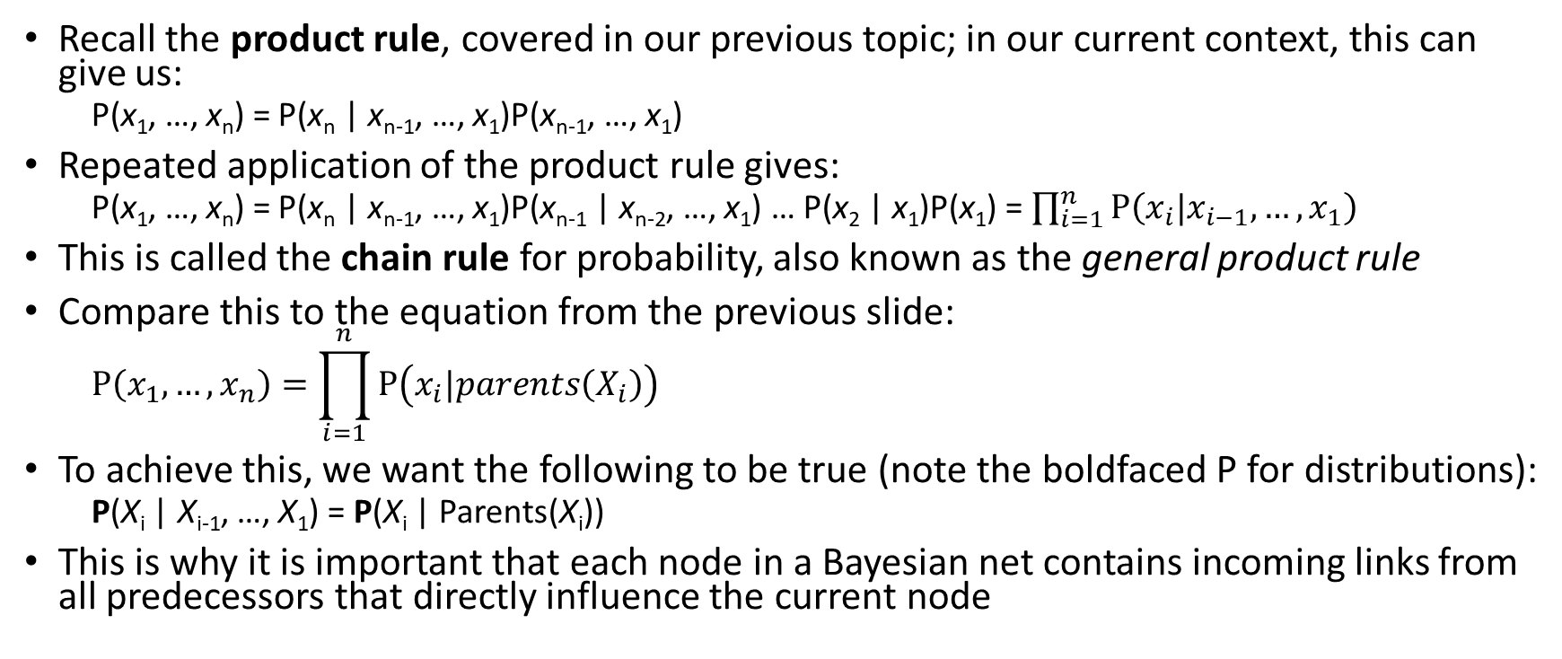
Chain Rule for Probability
Recall the product rule, covered in our previous topic; in our current context, this can give us:
P(x₁, …, x_{n}) = P(x_{n} | x_{n-1}, …, x₁)P(x_{n-1}, …, x₁)
Repeated application of the product rule gives:
P(x₁, …, x_{n}) = P(x_{n} | x_{n-1}, …, x₁)P(x_{n-1} | x_{n-2}, …, x₁) … P(x₂ | x₁)P(x₁) = $\prod_{i=1}^{n}{P\left(x_{i}|x_{i−1},…,x_{1}\right)}$
This is called the chain rule for probability, also known as the general product rule
Compare this to the equation from the previous slide:
$$P\left(x_{1},…,x_{n}\right)=\prod_{i=1}^{n}{P\left(x_{i}|parents\left(X_{i}\right)\right)}$$
To achieve this, we want the following to be true (note the boldfaced P for distributions):
P(X_{i} | X_{i-1}, …, X₁) = P(X_{i} | Parents(X_{i}))
This is why it is important that each node in a Bayesian net contains incoming links from all predecessors that directly influence the current node

Slide 9
Constructing a Bayesian Network
A Bayesian net is an example of a sparse (i.e., locally structured) system
When choosing an order to add nodes (which represent random variables), one possibility is:
First add nodes representing the root causes
Then add the variables that those nodes influence, then the variables that the newer nodes influence, etc.
Repeat this process until you reach leaves which have no direct influence on anything else
It can be helpful to number the nodes using a topological sort
If the links are not causal, the process can still work, but causal graphs will be more compact and more intuitive

Slide 10
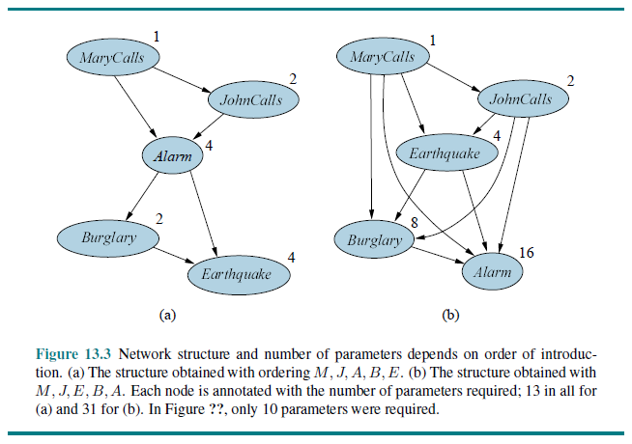
Bayesian Nets with Non-causal Links Examples

Slide 11
Compact Bayesian Networks
A Bayesian network is a complete and non-redundant representation of a domain
Additionally, a Bayesian net is often far more compact than the full joint probability distribution
For example, consider a Bayesian network with n Boolean variables that are each directly influenced by at most k others
The complete Bayesian network (including n CPTs) is specified with n * 2^{k} numbers
In contrast, the full joint distribution requires 2^{n} (or 2^{n} - 1) numbers
If n = 30 and k = 5, this requires 960 numbers compared to over 1 billion
It might be a good idea to drop tenuous relationships; this weighs compactness vs. accuracy
For example, John or Mary may not call if they sense an earthquake and assume it caused the alarm

Slide 12
Independence Assumptions in a Bayesian Net
We have already seen one conditional independence assumption implicitly indicated in a Bayesian network
Namely, each node is conditionally independent of its predecessors given its parents
There are also other conditional independence relationships indicated by a Bayesian network (see the next slide for a graphical representation)
A node (X) is conditionally independent of all its non-descendants (e.g., the Zs) given its parents (the Us, shown in purple on the left)
I add: the Zs are not the only non-descendants, they are the parents of the Ys; others include most siblings, some of their descendants, ancestors of the parents, etc.
Example: JohnCalls is independent of Burglary, Earthquake, and MaryCalls given Alarm
A node (X) is conditionally independent of all other nodes given its parents (the Us), its children (the Ys), and its children's parents (the Zs)
These nodes are collectively referred to as the node's Markov blanket (shown in purple on the right)
E.g., Burglary is independent of JohnCalls and MaryCalls given Alarm and Earthquake

Slide 13
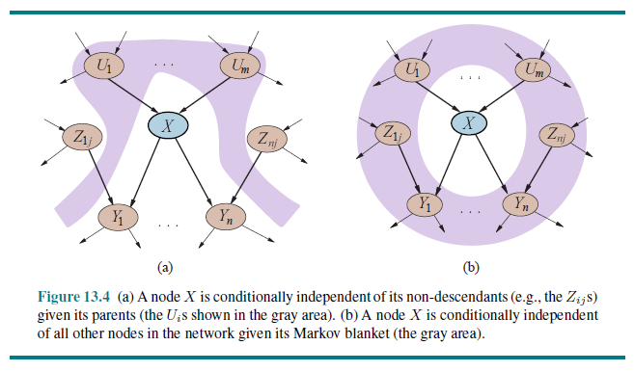
Independence Assumptions Graphically

Slide 14
Canonical Distributions
Filling in a CPT for a node still requires O(2^{k}) numbers, perhaps requiring a lot of data to obtain good estimates
Often, some relationships are describable by a canonical distribution; in this case, a complete table can be specified by naming a standard pattern and supplying a much smaller number of parameters
The simplest example involves deterministic nodes, for which there is no uncertainty
For example, NorthAmerican is a disjunction of parent nodes Canadian, US, and Mexican
Uncertain relationships can sometimes be characterized by noisy logical relationships; an example is the noisy-OR relation
For example, consider Fever as a child of Cold, Flu, and Malaria
A logical OR (a disjunction) would say that Fever is true if and only if Cold, Flue, or Malaria is true; a noisy-OR allows for uncertainty; Fever is false if and only of all of its true parents are inhibited
One assumption so far is that all possible causes are listed as parents; leak nodes can be added to cover miscellaneous causes
Another assumption is that the inhibition of each parent is independent
Deterministic relations often require a constant number of parameters; noisy relationships in which a node depends on k parents can often be described using O(k) parameters; a typical CPT requires O(2^{k}) parameters

Slide 15
Continuous Random Variables
Many real-world problems involve continuous random variables
One way to handle them in a Bayesian net involves discretization, but this often results in loss of accuracy and very large CPTs
Another solution is to use standard families of probability density functions specified by some finite number of parameters
A hybrid Bayesian network contains both discrete and continuous random variables, which requires additional types of distributions
Consider an example with Cost under both Subsidy and Harvest, and with Buys under Cost; Subsidy is Boolean, Harvest and Cost are continuous, Buys is Boolean
Of course, there can also be non-Boolean discrete random variables
The textbook shows examples of distributions for continuous random variables and hybrid networks, but we will skip these details

Slide 16
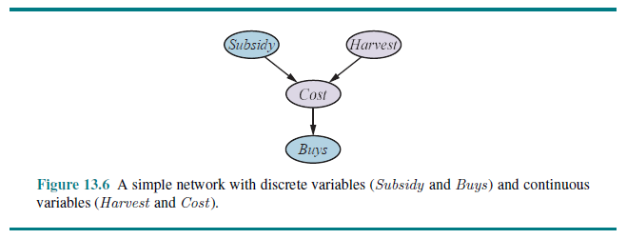
Hybrid Bayesian Network Example

Slide 17
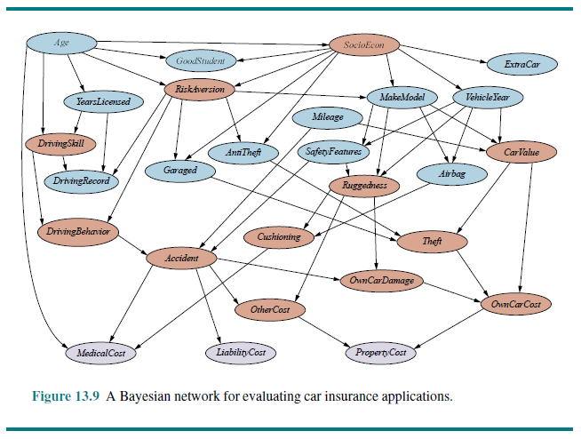
More Complex Bayesian Network Example

Slide 18
Exact Inference in Bayesian Networks
Book: "The basic task for any probabilistic inference system is to compute the posterior probability distribution for a set of query variables, given some observed event"
An observed event refers to the assignment of values to a set of evidence variables
Notation:
X will denote a query variable (a single random variable for simplicity)
E denotes the set of evidence variables E₁, …, E_{m}; e is a particular observed event
Y denotes the non-evidence, non-query variables Y₁, …, Y_{l} (a.k.a. hidden variables)
A query asks for the posterior probability distribution P(X | e) (note the boldfaced P)
When we compute the values of the probability distribution exactly, that is an example of exact inference
We will discuss how to perform exact inference using Bayesian networks

Slide 19
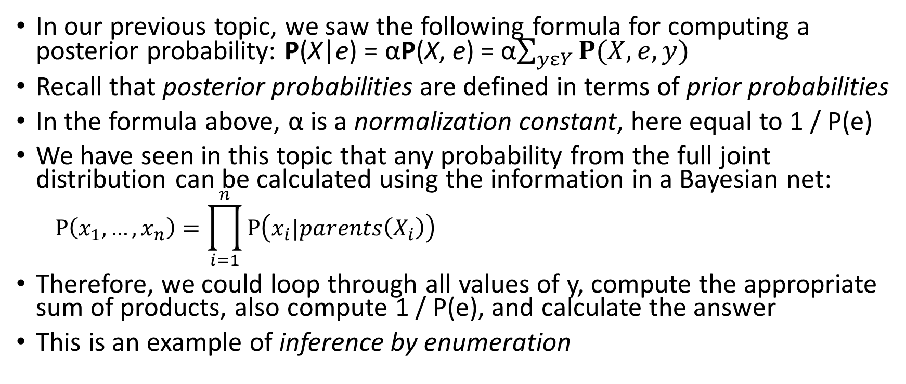
Inference by Enumeration
In our previous topic, we saw the following formula for computing a posterior probability: P(X|e) = αP(X, e) = α$\sum_{yεY}{P(X,e,y)}$
Recall that posterior probabilities are defined in terms of prior probabilities
In the formula above, α is a normalization constant, here equal to 1 / P(e)
We have seen in this topic that any probability from the full joint distribution can be calculated using the information in a Bayesian net:
$$P\left(x_{1},…,x_{n}\right)=\prod_{i=1}^{n}{P\left(x_{i}|parents\left(X_{i}\right)\right)}$$
Therefore, we could loop through all values of y, compute the appropriate sum of products, also compute 1 / P(e), and calculate the answer
This is an example of inference by enumeration

Slide 20
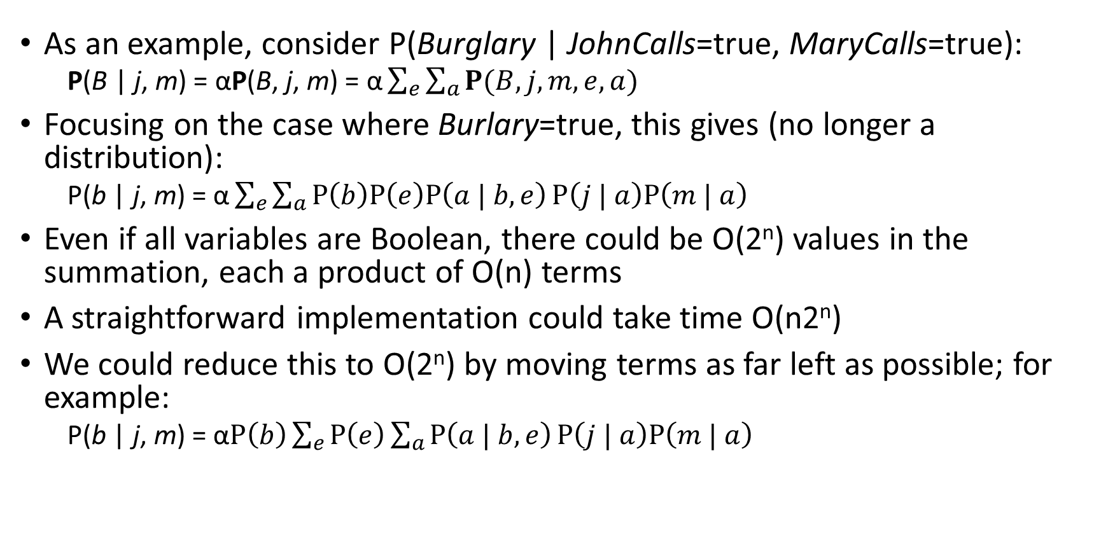
Inference by Enumeration Example
As an example, consider P(Burglary | JohnCalls=true, MaryCalls=true):
P(B | j, m) = αP(B, j, m) = $\text{α}\sum_{e}{\sum_{a}{P(B, j, m, e, a)}}$
Focusing on the case where Burlary=true, this gives (no longer a distribution):
P(b | j, m) = $\text{α}\sum_{e}{\sum_{a}{P\left(b\right)P\left(e\right)P\left(a | b, e\right)}}P\left(j | a\right)P\left(m | a\right)$
Even if all variables are Boolean, there could be O(2^{n}) values in the summation, each a product of O(n) terms
A straightforward implementation could take time O(n2^{n})
We could reduce this to O(2^{n}) by moving terms as far left as possible; for example:
P(b | j, m) = $\text{α}P\left(b\right)\sum_{e}{P\left(e\right)\sum_{a}{P\left(a | b, e\right)}}P\left(j | a\right)P\left(m | a\right)$

Slide 21
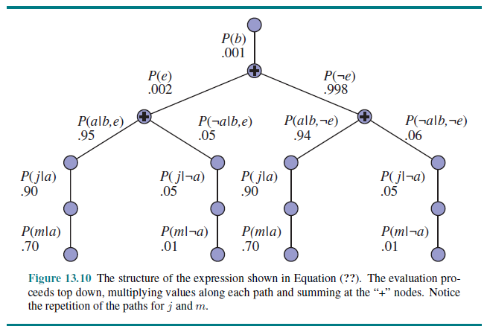
Example Expression Structure

Slide 22
Avoiding Repeated Expressions
An algorithm using depth-first recursion to compute such a tree requires only O(n) space but (2^{n}) time
Note that there are wasteful computations involving repeated subexpressions
The enumeration algorithm can be improved by eliminating repeated calculations
The idea: save results for later use; this is a form of dynamic programming
There are several variations of this approach; the book covers one such method called the variable elimination algorithm
Expressions are evaluated from right to left (or bottom-up in the figure)
The textbook steps through a long example, but we will not cover the details

Slide 23
Complexity of Exact Inference
The burglary network has a nice property: There is at most one undirected path between any two nodes in network
This is an example of a singly connected network, or a polytree
For singly connected networks, the time and space complexity of exact inference, using a method such as variable elimination, is linear with respect to the size of the network
Size is defined as the number of CPT entries
If the number of parents of a node is bounded by a constant, k, the complexity is also linear in the number of nodes (because 2^{k} can be technically considered a constant)
The network from earlier related to car insurance applications is an example of a multiply connected network
For multiply connected networks, variable elimination can have exponential time and space complexity (even if the number of parents per node is bounded)
There are methods of converting some multiply connected networks to polytrees, but only at the expense of growing the size of the CPTs exponentially
Ultimately, the problem of exact inference in a Bayesian network is NP-hard

Slide 24
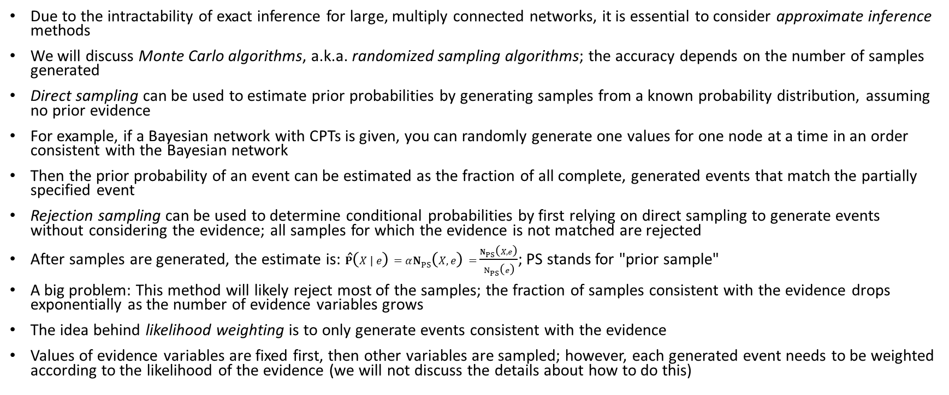
Approximate Inference for Bayesian Networks
Due to the intractability of exact inference for large, multiply connected networks, it is essential to consider approximate inference methods
We will discuss Monte Carlo algorithms, a.k.a. randomized sampling algorithms; the accuracy depends on the number of samples generated
Direct sampling can be used to estimate prior probabilities by generating samples from a known probability distribution, assuming no prior evidence
For example, if a Bayesian network with CPTs is given, you can randomly generate one values for one node at a time in an order consistent with the Bayesian network
Then the prior probability of an event can be estimated as the fraction of all complete, generated events that match the partially specified event
Rejection sampling can be used to determine conditional probabilities by first relying on direct sampling to generate events without considering the evidence; all samples for which the evidence is not matched are rejected
After samples are generated, the estimate is: $\hat{P}\left(X | e\right)=αN_{PS}\left(X, e\right)=\frac{N_{PS}\left(X, e\right)}{N_{PS}\left(e\right)}$; PS stands for "prior sample"
A big problem: This method will likely reject most of the samples; the fraction of samples consistent with the evidence drops exponentially as the number of evidence variables grows
The idea behind likelihood weighting is to only generate events consistent with the evidence
Values of evidence variables are fixed first, then other variables are sampled; however, each generated event needs to be weighted according to the likelihood of the evidence (we will not discuss the details about how to do this)

