Slide 1
ECE469: Artificial Intelligence
Conventional
Computational Linguistics

Slide 2
Natural Language Processing (recap)
Natural language processing (NLP) is a subfield of artificial intelligence (AI) that deals with the processing of text specified using natural languages
Natural languages are languages that are spoken by (or written by or otherwise used by) people; e.g. English, French, Japanese, etc.
This is as opposed to formal languages, such as first-order logic or programming languages
In our course, our unit on NLP is divided into three topics; I am calling them:
"Conventional Statistical Natural Language Processing" – This will cover statistical NLP approaches that dominated the field until around 2013
"Conventional Computational Linguistics" – This covers natural languages, in general, and approaches to processing natural languages that consider linguistics
"Deep Learning and NLP" – This covers modern approaches to NLP
Some sources define computational linguistics to be synonymous with NLP in general
I use the term to refer to the aspects of NLP which related to linguistics, which is the scientific study of natural languages

Slide 3
Disciplines Related to Natural Languages
Linguistics:
How do words form phrases and sentences? What are the rules, and how can these rules be expressed? What constrains the meaning of a sentence?
This field relies on both intuition and mathematical models (e.g., grammars)
Psycholinguistics (a subfield of psychology; the study of the mental aspects of language):
How do people identify the structure of sentences? How are the meanings of words identified? When does understanding take place?
This field relies on experiments with humans and statistical analysis of observations
Philosophy:
What is meaning and how do words and sentences acquire it? How do words identify objects in the world?
This field relies on intuition, hypothetical thought experiments, and mathematical models (e.g., logic)
Natural language processing and computational linguistics:
How can language be used to accomplish specific tasks? How can the structure of a sentence be identified algorithmically? How can knowledge and meaning be represented?
The tools of this field include data structures, algorithms, ML, and AI techniques

Slide 4
Why is NLP Hard? (recap)
Humans have an uncanny ability to learn a language (at least when they are very young)
However, in my opinion, we are very far from having computers that appear to understand (or perhaps actually understand) human languages
During our last topic, we explored the question of why NLP is hard by considering the sentence, "I made her duck“
Now, we will consider a famous example from NLP history: "Time flies like an arrow."
According to Steven Pinker in "The Language Instinct", this was the first sentence input to one of the first-ever implemented parsers
Supposedly, the implementers were surprised when the parser output five parses
All were valid, and they related to five different possible meanings of the sentence

Slide 5
"Time flies like an arrow." (five meanings)
Possible meaning #1: Time proceeds as quickly as an arrow proceeds (probably the intended meaning)

Slide 6
"Time flies like an arrow." (five meanings)
Possible meaning #1: Time proceeds as quickly as an arrow proceeds (probably the intended meaning)
Possible meaning #2: Measure the speed of flies in the same way that you measure the speed of an arrow

Slide 7
"Time flies like an arrow." (five meanings)
Possible meaning #1: Time proceeds as quickly as an arrow proceeds (probably the intended meaning)
Possible meaning #2: Measure the speed of flies in the same way that you measure the speed of an arrow
Possible meaning #3: Measure the speed of flies in the same way that an arrow measures the speed of flies

Slide 8
"Time flies like an arrow." (five meanings)
Possible meaning #1: Time proceeds as quickly as an arrow proceeds (probably the intended meaning)
Possible meaning #2: Measure the speed of flies in the same way that you measure the speed of an arrow
Possible meaning #3: Measure the speed of flies in the same way that an arrow measures the speed of flies
Possible meaning #4: Measure the speed of flies that resemble an arrow

Slide 9
"Time flies like an arrow." (five meanings)
Possible meaning #1: Time proceeds as quickly as an arrow proceeds (probably the intended meaning)
Possible meaning #2: Measure the speed of flies in the same way that you measure the speed of an arrow
Possible meaning #3: Measure the speed of flies in the same way that an arrow measures the speed of flies
Possible meaning #4: Measure the speed of flies that resemble an arrow
Possible meaning #5: Flies of a particular kind, "time flies", are fond of an arrow

Slide 10
"Time flies like an arrow." (five meanings)
Possible meaning #1: Time proceeds as quickly as an arrow proceeds (probably the intended meaning)
Possible meaning #2: Measure the speed of flies in the same way that you measure the speed of an arrow
Possible meaning #3: Measure the speed of flies in the same way that an arrow measures the speed of flies
Possible meaning #4: Measure the speed of flies that resemble an arrow
Possible meaning #5: Flies of a particular kind, "time flies", are fond of an arrow; if you don’t like this one, consider "Fruit flies like an apple."

Slide 11
The Turing Test
A common belief espoused by our textbook: What sets humans apart from other animals is that we use language
There may be a very strong relation between natural language and intelligence (although I have come to think that the correlation might be overemphasized)
Recall that the Turing Test challenges us to create a program that can fool an expert into thinking it is a person by engaging in conversation (we will talk more about this in our final topic)
The Loebner prize offers a $100,000 bounty for the first program to pass the Turing test; an annual contest generally awards a much smaller amount to the best entry each year
Note that even simple techniques at communicating with a user can perform somewhat impressively, if the user sticks to limited domains and/or does not investigate deeply
For example, ELIZA, a program created at MIT by Joseph Weizenbaum in the mid-1960s, used simple pattern-matching techniques to imitate the responses of a Rogerian psychotherapist
Some modern, deep-learning-based systems can impressively generate stories or articles after being trained on large corpora of English
However, in my opinion, we are far from having any program that can pass the Turing test

Slide 12
Necessary Knowledge for Communication
There are several types of knowledge that human rely on when engaging in complex conversation
Phonetics and phonology – knowledge about linguistic sounds (such knowledge is necessary for speech production and speech recognition if the conversation is verbal)
Morphology – knowledge about the meaningful components of words (we need to recognize tense, when words are plural, etc.)
Syntax – knowledge about the structural relationships between words, such as how words combine to form phrases and sentences
Semantics - knowledge of meaning (this applies to individual words, as well as to sentences)
Pragmatics – knowledge of meaning taking into account context and the intentions of the speaker (e.g., is the speaker stating a fact, asking a question, making a request, etc.)
Discourse – knowledge about linguistic units larger than a single sentence or utterance
Real-world knowledge (a.k.a. common-sense knowledge) – knowledge about the world that typical people know; we need to constantly rely on, and update, this knowledge
For the rest of this topic, we will focus on syntax and (to a lesser degree) semantics

Slide 13
Grammar
A grammar (a.k.a. a formal grammar) is a finite set of rules that specifies a language (either a formal language or a natural language)
The rules of a grammar define the syntax of the language
Formal languages such as C++ or first-order logic have strict mathematical definitions (i.e., defined grammars); natural languages do not
A formal language is defined as a (possibly infinite) set of strings
Each string is a concatenation of terminal symbols (a.k.a. terminals, tokens, or words)
The grammar defines how the terminal symbols are allowed to combine to form longer strings
A question naturally arises: Can we model a natural language as a formal language?
Linguists strive to figure out grammars for natural languages
Note that most modern linguists would say that grammars for natural languages should be descriptive as opposed to prescriptive

Slide 14
Phrase Structure Grammars
Until recently, most attempts at modeling grammars of natural languages have been based on the idea of phrase structure
The fundamental idea of phrase structure grammars, a.k.a. constituency grammars, is that a group of words may behave as a single unit called a phrase or constituent
The phrases can be classified into different syntactic categories (e.g., noun phrase, verb phrase, sentence, etc.)
Until recently, such grammars have dominated both linguistics and computational linguistics
In recent years, dependency parsing has become a popular alternative
Before specifying a grammar, you need to choose a grammar formalism, which represents the type or class of formal grammar that can be defined
The grammar formalism determines what sorts of syntactic rules can be expressed by the grammar; different formalisms have different expressive power or generative capacity

Slide 15
The Chomsky Hierarchy
The Chomsky hierarchy defines four types of formal grammars that are useful for various tasks; namely:
Unrestricted grammars (type 0)
Context-sensitive grammars (type 1)
Context-free grammars (type 2)
Regular grammars (type 3)
These are numbered from the most powerful / least restrictive (type 0) to the least powerful / most restrictive (type 3)
It is often useful (simpler and more efficient) to use the most restrictive type of grammar that suits your purpose
For example, regular grammars are generally powerful enough to specify rules for tokenization, and they are often used for this purpose
It has been well established that the syntax of natural languages cannot be defined by regular grammars
It has long been debated whether context-free grammars (CFGs) are capable of defining natural languages
It has been shown that a few constructs in some languages (but not English) are not context free
However, CFGs have been the most common formalism used by linguists to represent grammar
CFGs are also popular for expressing the syntax rules of computer programming languages

Slide 16
Context-free Grammars
When a CFG is used to represent a natural language, the names of syntactic categories (phrases) and parts of speech are nonterminal symbols (or nonterminals)
As mentioned earlier, a language (formal or natural) is a concatenation of terminal symbols
For natural languages, the terminal symbols typically represent words, but in some cases, they can represent parts of words, punctuation, etc.
CFGs define nonterminals using rewrite rules (a.k.a. productions)
Example: S → NP VP; the arrow can be read as, "can have the form of"
CFGs require that every rule has a single nonterminal symbol on the left-hand side
The right-hand is unconstrained (that is, it may consist of a sequence of zero or more nonterminal symbols and terminal symbols)
As previously mentioned, linguists have attempted to use CFGs to express the rules for natural languages, although it is believed that some natural languages include constructions that are not context-free
CFGs are also popular for expressing the syntax rules of computer programming languages
Every CFG also defines one nonterminal to be the start symbol; for natural languages, this is typically S, representing a sentence

Slide 17
The Wumpus World
The wumpus world is a game that can easily be implemented as a computer program
Some rules that define the wumpus world are:
You are moving around a rectangular grid of rooms
One room contains the wumpus (a giant beast that moves around and wants to kill you) and one room contains a pot of gold
You can move one square at a time; up, down, left, or right
Some rooms contain bottomless pits that trap anyone who enters (except the wumpus)
If you are one room away from a bottomless pit, you will feel a breeze
If you step into the square with the wumpus, and the wumpus is alive, you die a miserable death
If you are one square away from the wumpus, you will smell it
You have a single arrow that can be shot in one direction; it will travel to the end of the grid; this can be used to kill the wumpus
Your goal is to find the gold

Slide 18
Lexicons
A grammar needs to include all the allowable terminal symbols
For a natural language, this often takes the form of a lexicon, which is a list of the allowable words in the language
Often a lexicon will also list the syntactic category of each word
Such categories include nouns, pronouns, names, verbs, adjectives, adverbs, articles, prepositions, conjunctions, etc.
We have seen in our previous topic that these categories are often called parts of speech (POS)

Slide 19
Probabilistic Context Free Grammars
The formalism we will use to express grammars is actually an extension of a CFG called a probabilistic context-free grammar (PCFG)
Every rule will have an associated number, indicating the frequency of the right-hand side given the left-hand side
Recall that the left-hand side will always be a single nonterminal representing a type of phrase or a part of speech
It is typical to consider these frequencies to be probabilities, representing the likelihood that a phrase or POS is formed a certain way
The probabilities of all the valid right-hand sides for any nonterminal will sum to 1
Example: S → NP VP [0.90]
As with a regular CFG, this rule tells us that a sentence can have the form of a noun phrase followed by a verb phrase
In a PCFG, the rule additionally tells us that 90% of sentences have this form

Slide 20
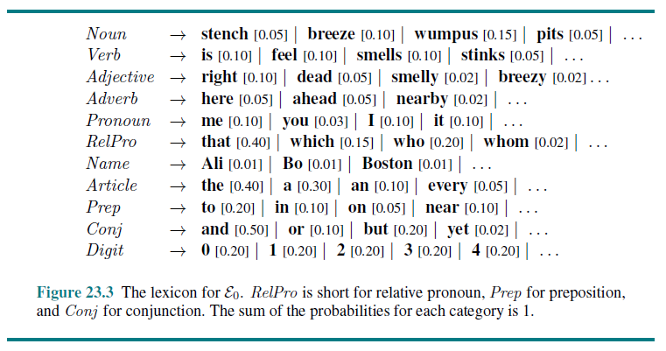
Lexicon Example

Slide 21
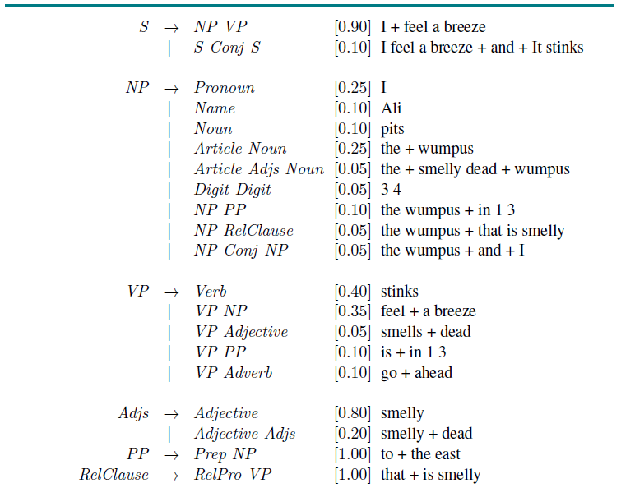
Grammar Example

Slide 22
Notes About the Example Grammar
Note that we don't need to separate the lexicon and grammar
The lexicon is represented as a CFG, and it can be included as part of the main grammar
The types of phrases recognized are sentence (S), noun phrase (NP), verb phrase (VP), list of adjectives (Adjs), prepositional phrase (PP), and relative clause (RelClause)
The start symbol for this grammar is S
That’s not explicitly stated here, but it is often assumed for a natural language grammar
It is also common to make the start symbol the left-hand side of the first rule
The vertical bars in the rules can be read as "or"
This is not formally part of the CFG formalism, so this is really an understood shorthand for multiple rules
For example, what looks like a single rule S → NP VP | S Conj S really represents two separate rules S → NP VP and S → S Conj S
This grammar both over-generates (e.g., it allows "I smells pits wumpus Boston") and under-generates (e.g., it does not allow "I think the wumpus is smelly")

Slide 23
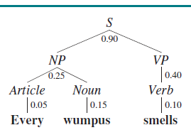
Parse trees
A parse tree shows how a string can form a sentence according to a grammar
Terminals (i.e., words) are represented by leaves and nonterminals (phrases) are represented by internal nodes
Generally, parse trees are specified for sentences, in which case the root of the tree is labeled with S
If such a parse tree exists, then the input string is accepted by the grammar
To the right, we see an example of a parse tree for the sentence "Every wumpus smells“
If the PCFG were used to randomly generate a parse tree, the probability that this particular parse tree would result is:
0.9 * 0.25 * 0.05 * .015 * 0.4 * 0.10 = 0.0000675
In this case, this is also the probability that the particular sentence would result
That is because this is the only valid parse tree for the sentence (i.e., the sentence is syntactically unambiguous)
We can also indicate this parse tree with text as follows:
[S [NP [Article every] [Noun wumpus]][VP [Verb smells]]]

Slide 24
Parsing
Our textbook defines parsing as "the process of analyzing a string of words to uncover its phrase structure, according to the rules of a grammar"
Parsing can be viewed as the process of searching for a parse tree
Top-down parsing starts with the S symbol and searches for a tree with the words as its leaves
Bottom-up parsing starts with the words and searches for a tree with root S
Both types of searches can be inefficient; repeating calculations involving substrings can lead to exponential explosion
Top-down parsers can generate nodes that cannot be latched to words, and bottom-up parsers can generate partial parses of the words that cannot appear in any sentence
Top-down parsing can also run into infinite loops with left-recursive rules (e.g., VP → VP NP)
Consider these two sentences that have the first 10 words in common:
"Have the students in section 2 of Computer Science 101 take the exam."
"Have the students in section 2 of Computer Science 101 taken the exam?"
If a left-to-right algorithm guesses wrong for the first word, it will have to backtrack
This type of backtracking is inevitable to some degree, but we do not want to have to reanalyze every intermediate phrases

Slide 25
Chart Parsing
Chart parsers store the results for substrings in a data structure known as a chart
This is example of dynamic programming
For example, in the previous case, once it is known that "the students in section 2 of Computer Science 101" is a valid NP, this will not need to be reanalyzed
The book describes one chart parsing algorithm known as the CYK algorithm, a.k.a. the CKY algorithm (named after its inventors, Cocke, Younger, and Kasami)
We are not going to cover the details of the algorithm in this course
CYK has space complexity O(n²m) and time complexity O(n³m), where n is the number of words in the sentence and m is the number of nonterminal symbols in the grammar
Technically speaking, a chart parser is really a recognizer and not a parser
You can expand the algorithm to determine all the valid parses, but if so, you cannot avoid exponential time in the worst case
This is because some ambiguous sentences can have exponentially many valid parse trees

Slide 26
Treebanks
The grammar rules of a CFG and the probabilities (and rules) of a PCFG can be learned if an appropriate manually tagged corpus, a.k.a. a treebank, is available
The Penn Treebank is probably the best-known treebank
Documents from various sources containing over 3 million words in total have been manually annotated with parts of speech (for words) and parse trees (for sentences)
Without a treebank, learning the grammar rules and their probabilities is very difficult
It is still possible to some extent using a variation of the expectation maximization algorithm, assuming that the parts of speech and types of phrases are known
We won’t discuss the details, but there are several drawbacks: it is slow; there are generally many low-probability, unusual rules; and ultimately, the results are usually not very good
Then again, an annotated treebank will also lead to some unusual rules
E.g., one rule based on the Penn treebank is: VP → VBP PP PP PP PP PP ADVP PP
The sentence that led to this rule is: "This mostly happens because we go from football in the fall to lifting in the winter to football again in the spring."

Slide 27
Lexicalized PCFGs
There is a lot that the grammar so far is not handling
For example, one general sort of problem is that it is not true that one NP is equal to any other regardless of context
In reality, it is much more common, for example, to "eat a banana" than it is to "eat a bandanna", but these are recognized as equally likely by our PCFG
The head of a phrase is the most important word in the phrase (linguistically speaking)
For example, the head of a verb phrase is the main verb, and the head of a noun phrase is the main noun (but heads are not always this obvious)
One way to handle this problem is to use a lexicalized PCFG, a form of augmented grammar in which the probabilities for a rule can depend on the relationships between head words
One obvious problem with this approach is the need to have probability estimates for all possible pairs of verbs and nouns for a rule like this
In practice, this is not possible based on a treebank, so you often need to use some sort of smoothing technique when no evidence is available

Slide 28
Lexicalized PCFG Example (from book)
VP(v) → Verb(v) NP(n) [P₁(v,n)]
VP(v) → Verb(v) [P₂(v)]
NP(n) → Article(a) Adjs(j) Noun(n) [P₃(n,a)]
NP(n) → NP(n) Conjunction(c) NP(m) [P₄(n,c,m)]
Verb(ate) → ate [0.002]
Noun(banana) → banana [0.0007]

Slide 29
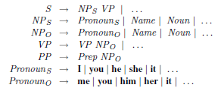
Case Agreement
One specific problem with the grammar so far is that it does not handle case agreement
For example, certain pronouns (e.g., "I", "we", etc.) can only be subjects
Others (e.g., "me", "us", etc.) can only be objects
The partial grammar to the right shows how this can be handled with a non-augmented grammar
However, there are various other types of agreement that also need to be handled
E.g., subject-verb agreement states that the subject and verb must agree in number
To handle all such cases with normal productions would cause exponential growth of the grammar

Slide 30
Augmented Grammars
An alternative is to rely on a more general augmented grammar
We can augment nonterminal symbols with additional parameters, or variables, in addition to the string argument and head
Example: NP (case) → Pronoun (case)
This means that a noun phrase can have the form of a pronoun, and the case of the NP is the same as the case of the Pronoun
We will see how such augmentations can be used to handle case agreement, subject-verb agreement, and head words
The probabilities are not shown for this example (so this is a snippet of an augmented CFG)
We could add probabilities to make it an augmented PCFG

Slide 31
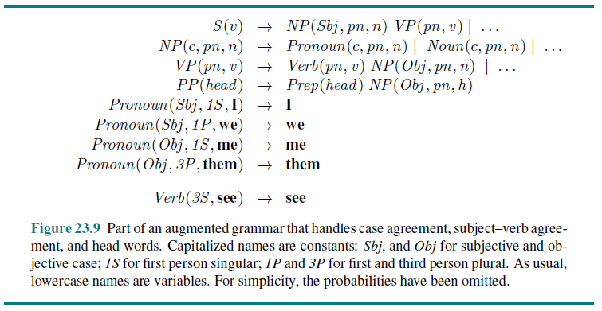
Augmented Grammar Example

Slide 32
Semantic Interpretation
Moving on to semantics, augmented grammars can also be used to generate semantic interpretations of expressions
This roughly refers to the extraction of the meaning of grammatical expressions
To start off with an example simpler than a natural language, we will look at a grammar for arithmetic expressions augmented with semantics
We will then look at a sample parse tree for an expression according to the grammar
When it comes to semantic interpretation of natural language text, our textbook and much of the NLP community interpret this as associating a first-order logic (FOL) expression with a phrase
Although we have not covered FOL formally, recall that we had a brief introduction to it early in our topic on probability (discussing its shortcomings to deal with the dental domain)
An English example: "Ali loves Bo" can be represented as the FOL expression Loves(Ali, Bo)
We will look at a small grammar that can generate four English sentences and a sample parse tree for one of those sentences
The particular notation being used in the grammar is called λ-notation, which was introduced in the textbook's chapter on FOL; we will not discuss the details

Slide 33
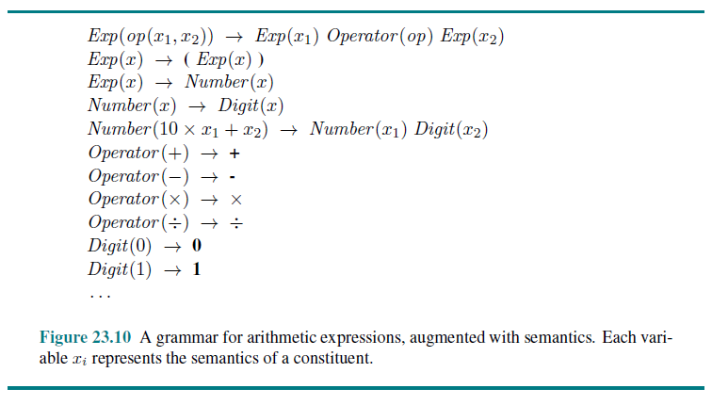
Grammar for Arithmetic Expressions

Slide 34
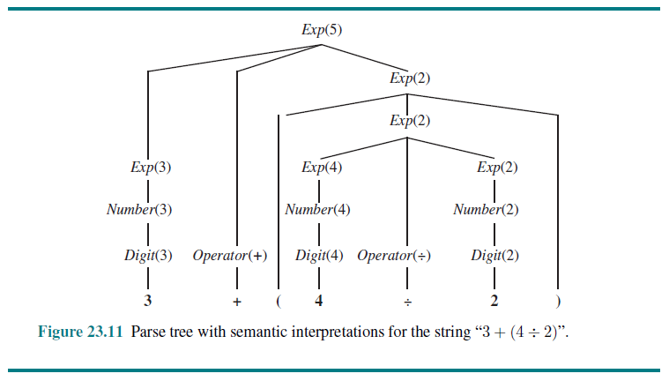
Parse Tree with Semantic Interpretation

Slide 35
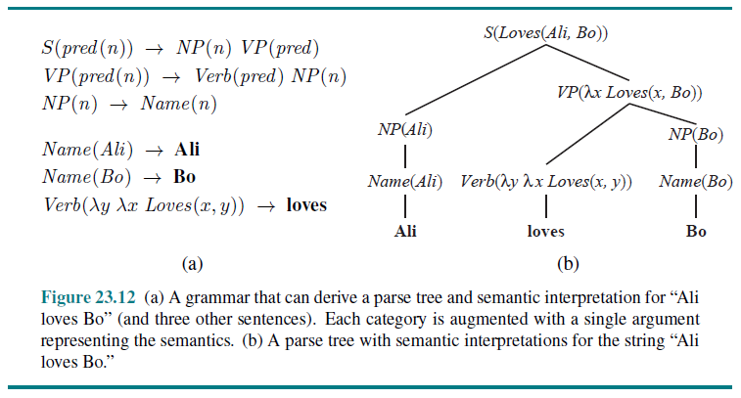
English Grammar for Semantic Interpretation

Slide 36
It’s Complicated
There are many additional complications related to semantic interpretation; we will just consider a few
Representing precise times or complex temporal relationship is very difficult
Even dealing with tense is unwieldy; for example, using what are sometimes referred to as event variables:
"Ali loves Bo" could be represented as E₁∈Loves(Ali,Bo)^During(Now,Extent(E₁))
"Ali loved Bo" could be represented as E₂∈Loves(Ali,Bo)^After(Now,Extent(E₂))
Now consider an example of quantification, such as "Every agent feels a breeze"; there are two reasonable interpretations:
∀a a∈Agents ⇒ ∋b b∈Breezes ^ Feel(a,b)
∋b b∈Breezes ^ ∀a a∈Agents ⇒ Feel(a,b)
I personally consider either interpretation to be reasonable there, but sometimes, one seems to be the clearly intended meaning; consider my two examples:
"Every student has a user ID"
"Every machine learning system agrees on a classification"
We already saw when we discussed probability that FOL does not provide any reasonable way to deal with uncertainty
A more philosophical issue is that understand an FOL expression, we need to understand the meanings of the individual terms (such as Loves, After, Ali, Breezes, etc.)

Slide 37
Pragmatics, Discourse, Real-World Knowledge
We still need to complete the interpretation by adding context-dependent information concerning the current situation
This is called pragmatic interpretation
One obvious need for pragmatic info is to resolve meaning of indexicals, which are phrases that refer directly to the current situation
Example: "I am in Boston today"; the meaning of "I" and "today" depends on who is speaking and when
Discourse refers to meaning taking into account multiple sentences or utterances
Resolving pronouns is an example of reference resolution, and this often spans sentences; consider my two examples:
"The customer called the waiter. He asked for his check."
"The customer called the waiter. He came to take their order."
Real-world knowledge is also extremely important (I think this was demonstrated in the previous examples, and will be again in our next examples)

Slide 38
Ambiguity
The book gives examples of "examples taken from newspaper headlines" (it is unclear to me if they are real); here are a few:
"Squad helps dog bite victim"
"Helicopter powered by human flies"
"Portable toilet bombed; police have nothing to go on"
Again, I claim that these demonstrate the importance of real-world knowledge
We understand the intended meanings because the alternatives are preposterous, not due to syntactic clues
Ambiguity in natural language is extremely common!
Book (3rd Edition): "…almost every utterance is highly ambiguous, even though the alternative interpretations might not be apparent to a native speaker"
Book (4th Edition): "…almost every sentence is ambiguous, with multiple parses (even hundreds), even when the single preferred parse is the only one that native speakers notice"

Slide 39
Types of Ambiguity
A funny example from the 4th Edition of the textbook is related to a Groucho Marx joke
First, they give the sentence "Outside of a dog, a book is a person's best friend."
Then, they follow it up with "Inside of a dog it's too dark to read."
This example involves lexical ambiguity; some words (such as "outside") have more than one meaning
Syntactic ambiguity (a.k.a. structural ambiguity) can occur without lexical ambiguity
For example: "I smelled a wumpus in 2, 2"; it is unclear if the PP modifies "smelled" or "a wumpus"; this also leads to semantic ambiguity
Semantic ambiguity can occur without lexical ambiguity or syntactic ambiguity
An example from the 2nd Edition of the textbook is the title: "Attack of the Cat People"; in other instances, "cat people" are people who love cats
Sometimes there is ambiguity between literal and figurative interpretations of a sentence (and it is a pet peeve of mine that "literally" is often used figuratively!)
Figures of speech are surprisingly common in everyday speech; one case is metonymy in which one object stands for another; e.g., "Chrysler announced a new model"
Other complications include metaphors, similes, analogies, etc.

Slide 40
Disambiguation
Disambiguation refers to the determination of the intended meaning of an utterance or sentence
To disambiguate natural language, you need to consider four models of knowledge:
The world model indicates the likelihood that a proposition occurs in the world)
The mental world indicates the likelihood that the speaker would form the intent to express the fact given that it occurs
The language model indicates the likelihood that a certain string would be chosen to express the content, given that the speaker already has the intention to express it
The acoustic model indicates, for spoken communication, the likelihood that the sequence of sounds would be generated given that a string was chosen
Final funny example: A politician says, "I am not a crook."; a crook can also be a hooked shepherd's staff
I would argue that it is solely due to the mental model that we understand the (likely) intended meaning of this sentence

