Slide 1
ECE469: Artificial Intelligence
Decision Trees

Slide 2
Supervised Learning Recap
In our last topic, we defined the task of supervised learning, which is one form of machine learning (ML), as follows:
Given a training set of N examples of input/output pairs (x₁, y₁) … (x_{N}, y_{N}), where each y_{i} was generated by an unknown function y=f(x_{i}), discover a function h that approximates f
We will typically assume that the output is a single variable, which we can refer to as a label
When the domain of the output variable is a finite, discrete set, this is an example of classification, a.k.a. categorization
Any hypothesis that agrees with the known data (the training examples) is said to be consistent
A good hypothesis will generalize well (i.e., it will predict unseen examples correctly)
We said that the specific method selected limits the hypothesis space; that is, the method determines which hypotheses are potentially contained within the space that we are searching
When choosing a method, there is often a tradeoff between the expressiveness of the hypothesis space and the complexity of finding a simple, consistent hypothesis within the space

Slide 3
Machine Learning Example
Toward the end of our last topic, we introduced a machine learning problem (an example of categorization) that will serve as a running example through this topic and our next topic
The problem involves the decision as to whether or not to wait at a restaurant
The output is a Boolean variable that we'll call WillWait
We will base the prediction (about whether WillWait is true of false) on ten attributes (i.e., features), all of which are discrete (and with binning, all have small, finite domains):
Alternate – Is there a suitable alternative restaurant nearby?
Bar – Is there a comfortable bar area to wait in?
Fri/Sat – Is it a Friday or Saturday?
Hungry – Are we hungry?
Patrons - How many people are in the restaurant? (None, Some, or Full)
Price - $, $$, or $$$
Raining – Is it raining outside?
Reservation – Whether or not a reservation was made
Type – The kind of restaurant (French, Italian, Thai, or burger)
WaitEstimate – The wait estimated by the host (0-10 minutes, 10-30, 30-60, >60)

Slide 4
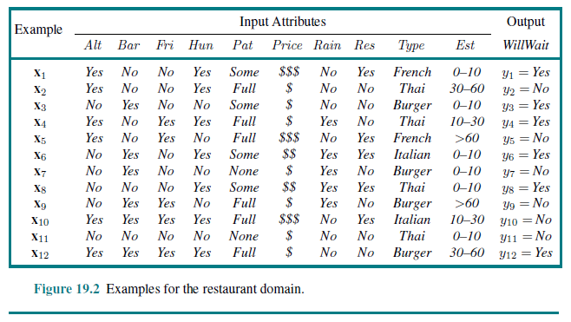
Example Training Set

Slide 5
Decision Trees
A decision tree takes as input a situation described by a set of attributes (features) with values and returns a decision (a predicted output value)
The input and output values can be discrete or continuous
For now we will concentrate on Boolean classification (i.e., there are two possible output values) from discrete input
We can view this as classifying each example as true (a positive example) or false (a negative example)
A decision tree performs a sequence of tests
A decision tree can be represented as a tree in which:
Internal nodes of the tree correspond to tests
Branches (links) represent the possible outcomes of tests
Leaves indicate decisions (outputs)
Book (3rd Ed.): “Decision tree induction is one of the simplest and yet most successful forms of machine learning”

Slide 6
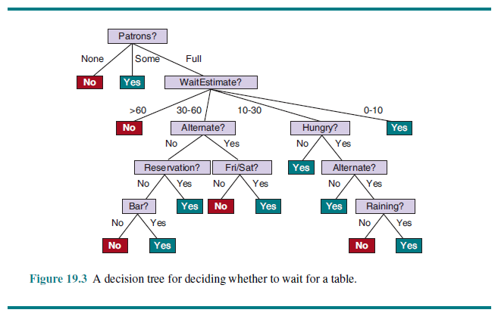
(Actual?) Decision Tree for Restaurant Task

Slide 7
Expressivity of Decision Trees
Decision trees are fully expressive within the class of propositional languages
This does not mean that they are Turing-complete
Any Boolean function can be represented by having each row in the truth table for the function correspond to a path in the tree
However, this would yield an exponentially large tree
In practice, decision trees are good for some kinds of functions but bad for others
Examples of functions for which decision trees are bad include:
The parity function (1 if and only if an even number of the inputs are 1)
A majority function (1 if and only if more than half of the inputs are 1)
As we discussed in our last topic, no machine learning method is good at all possible ML tasks according to the no free lunch theorem

Slide 8
Learning a Decision Tree from Examples
As previously discussed, an example for a decision tree consists of a vector of input attributes, x, and a single output value, y
The complete set of available examples for learning is the training set
Assuming that there are no contradictory examples, it would be trivial to create a decision tree that is consistent (i.e., is correct for all the examples)
A trivial tree just memorizes the observations; it is not extracting any patterns; it is not able to extrapolate or generalize
Applying Ockham's razor, we should try to find smallest consistent tree, but this is an intractable problem
With some simple heuristics, we can do a good job

Slide 9
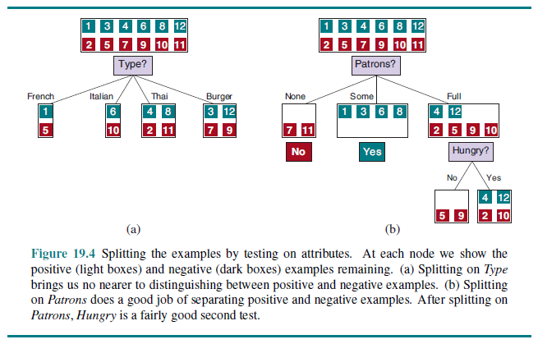
Choosing Attributes Example

Slide 10
Learning a Decision Tree Recursively
After an attribute is applied, each possible outcome leads to a new decision tree learning problem for each subset of examples with a particular value of the just-used attribute
As demonstrated on the previous slide, for the restaurant example, Patrons is a good first choice; after Patrons, Hungry is a pretty good second choice
For each new node, there are four cases to consider:
If all remaining examples are positive or negative, we are done; answer Yes or No
If both positive and negative examples remain, and there are remaining attributes to choose from, choose the best attribute to split the remaining examples; this is the recursive case
If both positive and negative examples remain, but there are no attributes left, it means that there was inconsistent input; we can return the majority classification at this node
If there are no examples left, it means that no such example has been observed; we can return a value based on the majority classification at the empty node's parent
Inconsistent input could be caused by noise, by a nondeterministic domain, or because the available attributes do not provide enough information to fully describe the situation

Slide 11
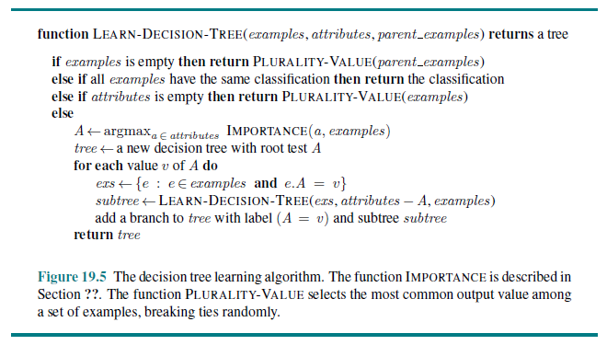
Decision Tree Learning Pseudo-code

Slide 12
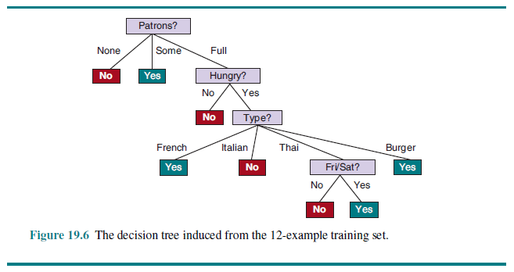
Learned Decision Tree Example

Slide 13
Inspecting the Learned Decision Tree
This tree is clearly different from the “real” tree, but it agrees with all the training examples, and it is simpler than the original tree
In general, with all machine learning methods, you should not expect the learned hypothesis to match the real function exactly
The book points out that the application has “detected an interesting and previously unsuspected pattern: SR will wait for Thai food on weekends”
The learned tree we have examined is bound to make mistakes
For example, it has never seen a case with a zero- to ten-minute wait for a full restaurant, and WaitEstimate is not used at all in the generated tree!
With more examples, we would expect to induce a tree that is more similar to the original tree

Slide 14
How to Choose Attributes
Decision tree learning aims to approximately minimize the depth of the final tree
It does this by selecting an attribute at each stage that goes as for as possible toward providing an exact classification
This is an example of a greedy algorithm as well as a divide-and-conquer algorithm
A perfect attribute divides the remaining examples into sets such that within each set, all examples are positive or negative (or, more generally, all belong to a single category)
One suitable measure of goodness for an attribute is the expected amount of information provided by the attribute
We are using the term in a strict mathematical sense
Information theory measures information content in terms of bits of entropy
The term “bits” here is similar to the term “bits” we are used to, but we will see it is a more general term in information theory, and a fractional number of bits is possible
The book defines entropy as “a measure of the uncertainty of a random variable”

Slide 15
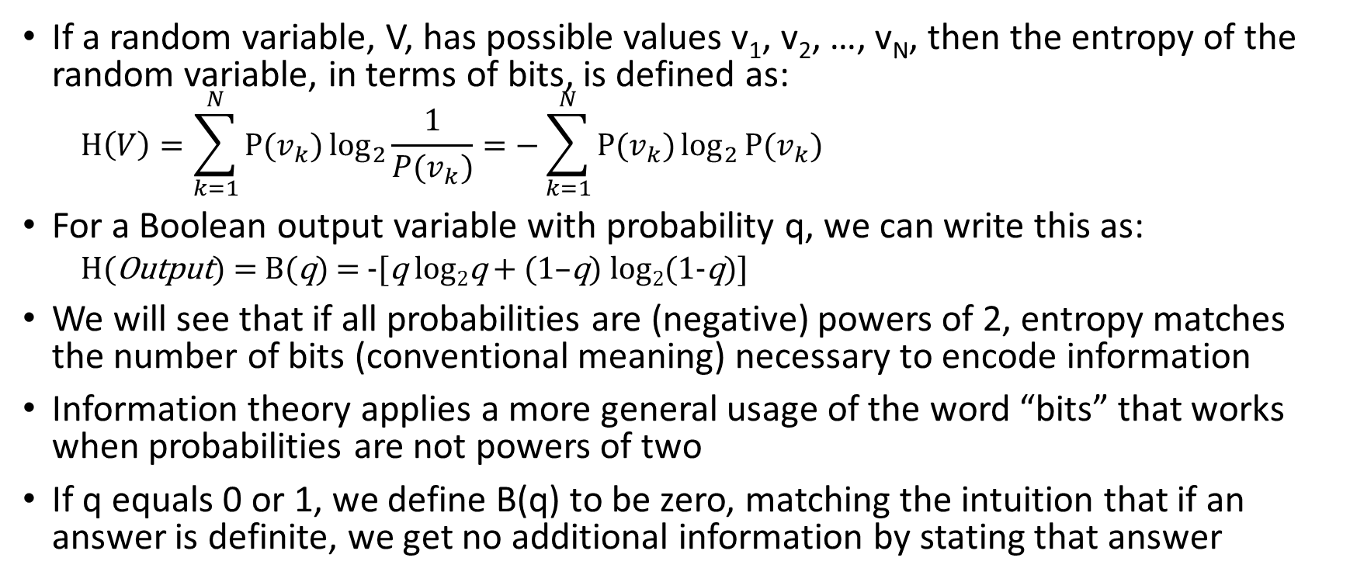
Entropy
If a random variable, V, has possible values v₁, v₂, …, v_{N}, then the entropy of the random variable, in terms of bits, is defined as:
$$H\left(V\right)=\sum_{k=1}^{N}{P(v_{k})\log_{2}{\frac{1}{P(v_{k})}}}=−\sum_{k=1}^{N}{P(v_{k})\log_{2}{P(v_{k})}}$$
For a Boolean output variable with probability q, we can write this as:
H(Output) = B(q) = -[q log₂q + (1–q) log₂(1-q)]
We will see that if all probabilities are (negative) powers of 2, entropy matches the number of bits (conventional meaning) necessary to encode information
Information theory applies a more general usage of the word “bits” that works when probabilities are not powers of two
If q equals 0 or 1, we define B(q) to be zero, matching the intuition that if an answer is definite, we get no additional information by stating that answer

Slide 16
Textbook’s Examples of Entropy
Assume we are dealing with a fair coin, and Fair will have the value of heads or tails, each with probability ½; then the entropy of Fair is:
H(Fair) = B(0.5) = -(0.5log₂0.5 + 0.5log₂0.5) = 1 bit
Assume we are dealing with a fair four-sided die, and Die4 has four possible values, each with probability ¼; then the entropy of Die4 is:
H(Die4) = -(0.25log₂0.25 + 0.25log₂0.25 + 0.25log₂0.25 + 0.25log₂0.25) = 2 bits
Now consider a loaded coin with a 99% probability of heads and a 1% probability of tails; the entropy of Loaded (representing the result) is:
H(Loaded) = B(0.99) = -(0.99log₂0.99 + 0.01log₂0.01) ≈ 0.08 bits

Slide 17
Encryption Example (not in book)
Suppose we are encrypting a document with four distinct characters; arbitrarily let’s assume they are ‘a’, ‘b’, ‘c’, and ‘d’
First let’s assume that each distinct character is equally frequent throughout the document
Let a random variable, C₁, represent the value of the character if one is chosen at random from the document
This would lead to an entropy identical to the fair four-sided die example; that is, H(C₁) = 2 bits
This is also equal to the number of bits needed to represent each character if each distinct character uses a fixed representation
Now let’s assume that 50% of the characters are ‘a’, 25% of the characters are ‘b’, 12.5% of the characters are ‘c’, and 12.5% of the characters are ‘d’
Let a random variable, C₂, represent the value of the character if one is chosen at random from the document
H(C₂) = -(0.5 log₂0.5 + 0.25log₂0.25 + 0.125log₂0.125 + 0.125log₂0.125) = 0.5(1) + 0.25(2) +0.125(3) + 0.125(3) = 1.75 bits
This is also equal to the average number of bits needed to represent each character if Huffman coding is used to compress the document
For example, Huffman coding may lead to ‘a’ being represented as 0, ‘b’ being represented as 10, ‘c’ being represented as 110, and ‘d’ being represented as 111
The formula matches this; 50% of the characters use 1 bit; 25% of the characters use two bits; 12.5% of the characters use three bits; and another 12.5 of the characters also use three bits

Slide 18
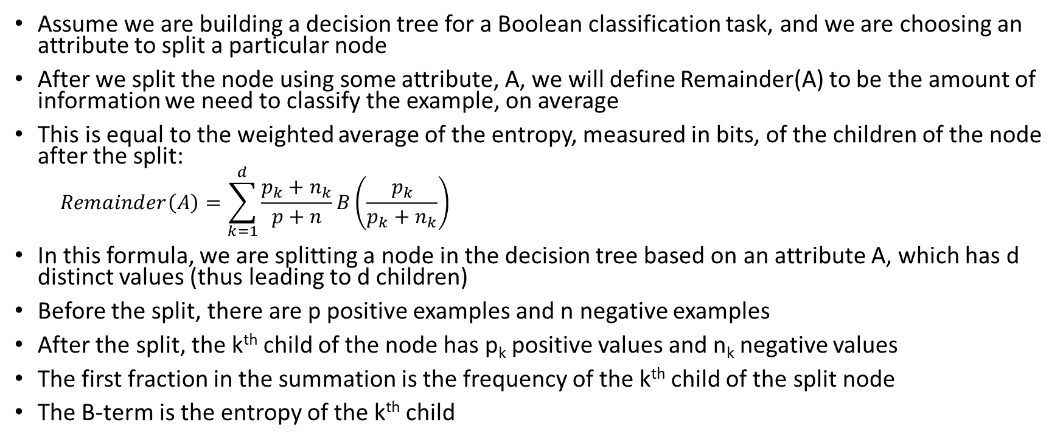
Splitting a Node in a Decision Tree
Assume we are building a decision tree for a Boolean classification task, and we are choosing an attribute to split a particular node
After we split the node using some attribute, A, we will define Remainder(A) to be the amount of information we need to classify the example, on average
This is equal to the weighted average of the entropy, measured in bits, of the children of the node after the split:
$$Remainder\left(A\right)=\sum_{k=1}^{d}{\frac{p_{k}+n_{k}}{p+n}B\left(\frac{p_{k}}{p_{k}+n_{k}}\right)}$$
In this formula, we are splitting a node in the decision tree based on an attribute A, which has d distinct values (thus leading to d children)
Before the split, there are p positive examples and n negative examples
After the split, the k^{th} child of the node has p_{k} positive values and n_{k} negative values
The first fraction in the summation is the frequency of the k^{th} child of the split node
The B-term is the entropy of the k^{th} child

Slide 19
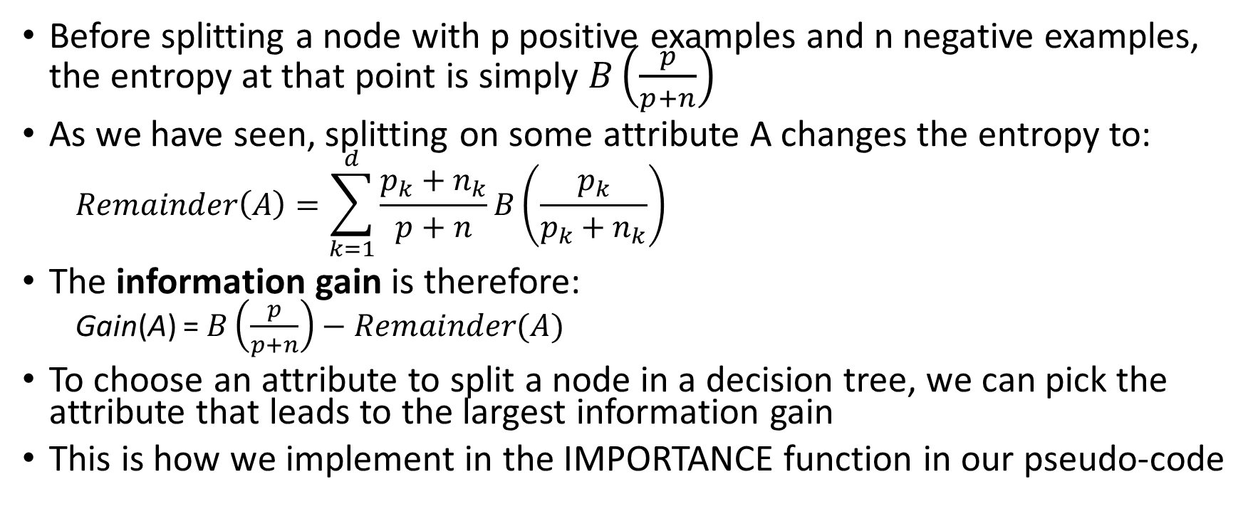
Information Gain
Before splitting a node with p positive examples and n negative examples, the entropy at that point is simply $B\left(\frac{p}{p+n}\right)$
As we have seen, splitting on some attribute A changes the entropy to:
$$Remainder\left(A\right)=\sum_{k=1}^{d}{\frac{p_{k}+n_{k}}{p+n}B\left(\frac{p_{k}}{p_{k}+n_{k}}\right)}$$
The information gain is therefore:
Gain(A) = $B\left(\frac{p}{p+n}\right)−Remainder(A)$
To choose an attribute to split a node in a decision tree, we can pick the attribute that leads to the largest information gain
This is how we implement in the IMPORTANCE function in our pseudo-code

Slide 20
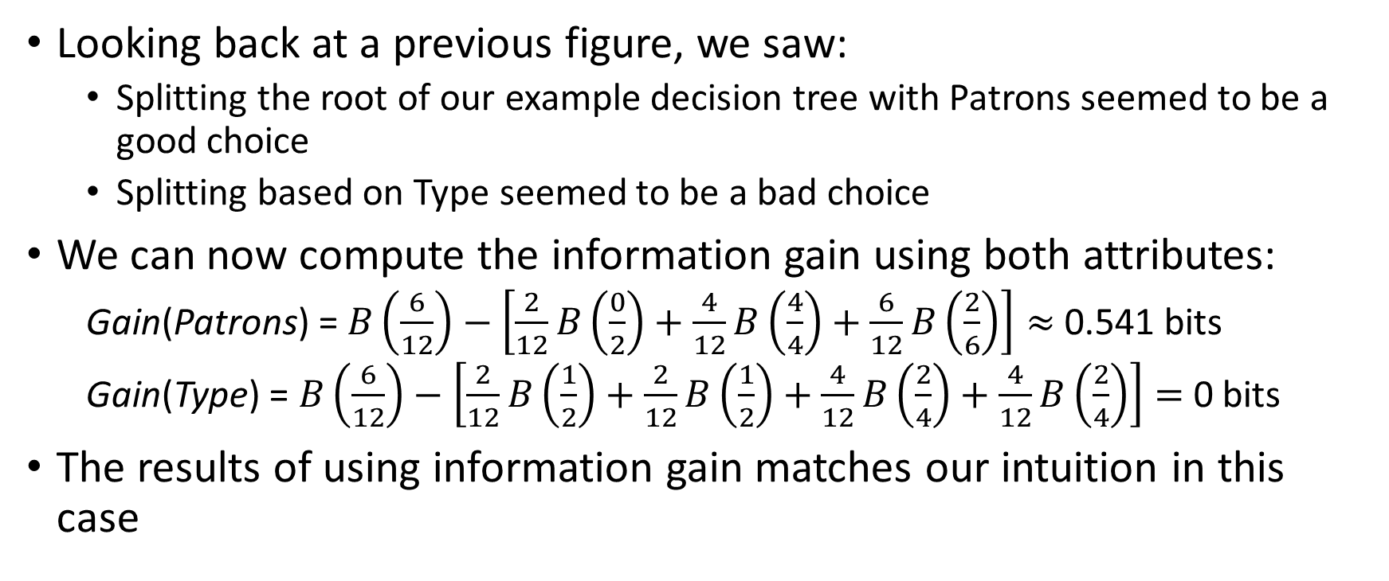
Information Gain Example
Looking back at a previous figure, we saw:
Splitting the root of our example decision tree with Patrons seemed to be a good choice
Splitting based on Type seemed to be a bad choice
We can now compute the information gain using both attributes:
Gain(Patrons) = $B\left(\frac{6}{12}\right)−\left[\frac{2}{12}B\left(\frac{0}{2}\right)+\frac{4}{12}B\left(\frac{4}{4}\right)+\frac{6}{12}B\left(\frac{2}{6}\right)\right]≈$ 0.541 bits
Gain(Type) = $B\left(\frac{6}{12}\right)−\left[\frac{2}{12}B\left(\frac{1}{2}\right)+\frac{2}{12}B\left(\frac{1}{2}\right)+\frac{4}{12}B\left(\frac{2}{4}\right)+\frac{4}{12}B\left(\frac{2}{4}\right)\right]=$ 0 bits
The results of using information gain matches our intuition in this case

Slide 21
Evaluating Decision Trees
As with all machine learning algorithms, we should evaluate our trained decision tree using a test set
We really should not look at the test set until the training of the system is complete, or else we will get an overestimate of accuracy
It is also possible to use a validation set or cross-validation to help decide which attributes to use, how to bin attribute values, etc.
We can also use the validation set to tune hyperparameters; there are a couple related to decision tree pruning, which we will discuss shortly
It is sometimes interesting to examine how the size of the training set effects the accuracy of a system
This can be visualized with a learning curve

Slide 22
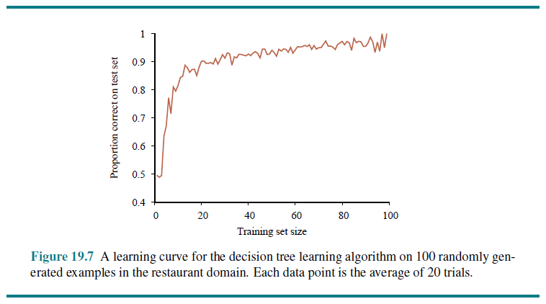
Learning Curve Example

Slide 23
Decision Tree Pruning
In our previous topic, we have learned that highly expressive machine learning algorithms may be subject to overfitting
This is true of decision trees when we use many attributes or attributes with a large number of distinct values
This can be partially combatted by increasing the size of the training set, but that is not always an option
Another technique to combat overfitting is called decision tree pruning
This involves applying significance tests to determine if the information gain obtained by applying attributes is statistically significant
We generate the entire tree before pruning, because there are cases where no single attribute leads to significant gain, but multiple attributes do
Trees constructed with this type of pruning often perform significantly better than trees constructed without pruning, especially if the data contains a lot of noise
An additional benefit is that the pruned trees are often much smaller and easier to understand

Slide 24
Additional Complications for Decision Trees
Missing data: Sometimes, not all attribute values are known for an example
This can be a problem for both learning and classification
Some machine learning algorithms can handle this better than others
Continuous- or multi-valued attributes: These include attributes with many distinct values (e.g., ExactTime or Height)
Information gain can give an inappropriate measure of usefulness
Binning values into groups based on split points can be useful, but that is harder when the values don’t have a clear ordering (e.g., RestaurantName)
Continuous-valued output attributes
This requires a regression tree
Each leaf indicates a linear function of a subset of numerical attributes rather than a single value

Slide 25
Ensemble Learning
The idea of ensemble learning is to select a collection, or ensemble, of hypotheses and to combine their predictions
Predictions can be combined by averaging, voting, or by another machine learning method
Ensemble methods related to decision trees include:
Bagging generates K training sets by sampling from the original training set with replacement, and learning a decision tree based on each
Random forests additionally randomizes the allowable attributes to ensure that more diverse trees are created
Boosting creates a sequence of decision stumps (decision trees with only one level) that are individually weak but make good predictions when combined appropriately
In recent years, ensembles of neural networks have become common, and they such ensembles often top the leaderboards for many ML tasks

