Slide 1
ECE469: Artificial Intelligence
Games

Slide 2
Games
Environments with competitive agents give rise to adversarial search problems
While these could, in theory, involve "real-world skirmishes", we will focus on games
Game theory, a branch of economics, typically views any multi-agent environment where the impact of agents on each other is significant as a game
Many games studied in AI are deterministic, turn-taking, two-player, zero-sum games of perfect information
We will focus mainly on this type of game, but others will be discussed a bit near the end
Although "deterministic" is listed here, according to earlier definitions that we covered, the task environment is strategic
The term "perfect information" implies that the task environment is fully observable
Zero-sum means that what is good for one player is equally bad for the other, and vice versa

Slide 3
Defining a Game
A game can be formally defined as a search problem with the following components:
S₀: The initial state; e.g., the board position at the start of the game
TO-MOVE(s): A function that specifies whose turn it is at the given state
ACTIONS(s): A function that returns the legal moves given a state
RESULT(s, a): The transition model which defines the result of the specified move when applied at a specified state
IS-TERMINAL(s): A terminal test, which determines if the game is over (final states for which the function is true are terminal states)
UTILITY(s, p): A utility function (a.k.a. objective function or payoff function), which gives a numeric value for terminal states with respect to the specified player
For chess, the utility function might assign +1, -1, or 0 for a win, a loss, or a draw, respectively (or 1, 0, or 0.5, but that does not fit the zero-sum term well)
For backgammon, values might range from +192 to -192

Slide 4
Game Trees
The initial state, legal moves (actions), and transition model define the game tree
When depicting game trees, we will be calling the two players MAX and MIN (we will typically assume that MAX moves first)
For a game like Tic-Tac-Toe, the game tree has fewer than 9! = 362,880 terminal nodes, and only 5,478 distinct states
For a game like chess, on the other hand, there would be over 10⁴⁰ nodes
In some sources (including earlier editions of the AI book), when both players take a turn, that is considered one move, or two half-moves
Each half-move is also known as a ply (this term is unambiguous)
In other sources, when either player takes a turn, that is a move

Slide 5
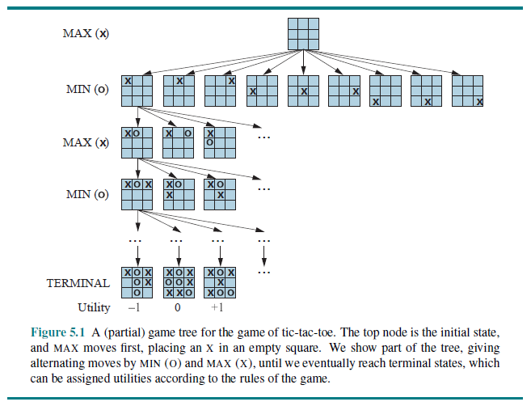
Example Game Tree: Tic-Tac-Toe

Slide 6
Minimax Values
In a "normal" search problem, the solution is a sequence of moves (actions) leading to goal state
In a game, your opponent (MIN, assuming you are MAX) has something to say about it!
MAX must find a contingent strategy; an optimal strategy will lead to outcomes as least as good as any other when playing an infallible opponent
The optimal strategy can be determined by calculating the minimax value of each node:
MINIMAX (s) =
UTILITY(s) if IS-TERMINAL(s); i.e., if s is a terminal state
max_{aεACTIONS(s)} MINIMAX(RESULT(s, a)) if TO-MOVE(s) = MAX
min_{aεACTIONS(s)} MINIMAX(RESULT(s, a)) if TO-MOVE(s) = MIN
The minimax decision using this function maximizes the worst-case scenario
The opponent may not make the move you expect, but if not, you will do at least as well as you predicted based on a minimax search

Slide 7
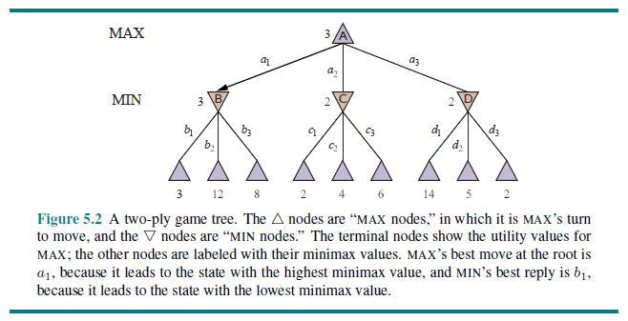
Minimax Values Example

Slide 8
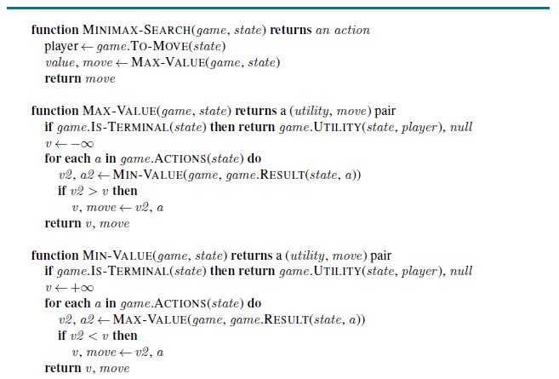
Minimax Search Pseudo-code

Slide 9
Minimax Search Complexity
This algorithm, as we have covered it so far, performs a complete DFS of the game tree
Assume the maximum depth of the game tree is m and there are b legal moves per state
Then the time complexity is O(b^{m})
The space requirement is O(b * m) if all or actions or successors are generated at once
The space complexity can be reduced to O(m) if one action or successor is generated at a time

Slide 10
Minimax with More Than Two Players
In a game with more than two players, each node includes a vector of values (e.g., <v_{a}, v_{b}, v_{c}> for a three-player game)
In a two-player, zero-sum game, the two-element vector can be reduced to one value because the two values will always be opposites
This extended version of minimax no longer maximizes the worst-case scenario
The truth is that general multi-player games are often much more complex than two-player games
For example, deals and alliances are made (and sometimes broken)

Slide 11
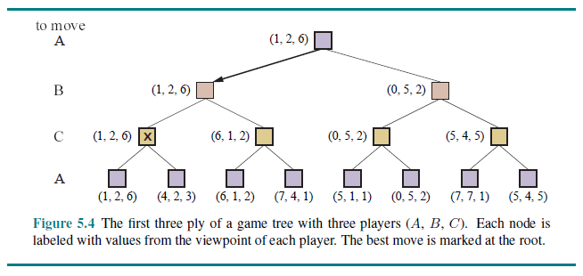
Three-player Minimax Values Example

Slide 12
Alpha-Beta Pruning
A major problem with minimax search as describes so far is that the number of game states is exponential w.r.t. the number of moves
A search using alpha-beta pruning returns exactly the same move as a minimax search
However, it does not consider, or even generate, the majority of the nodes in the search tree in most cases
To implement this strategy, two new search parameters need to be added:
α (alpha) = the value of the best choice for MAX (i.e., the highest value) along the current path so far
β (beta) = the value of the best choice for MIN (i.e., the lowest value) along the current path so far
With these changes, the search is known as alpha-beta search, a.k.a. minimax search with alpha-beta pruning

Slide 13
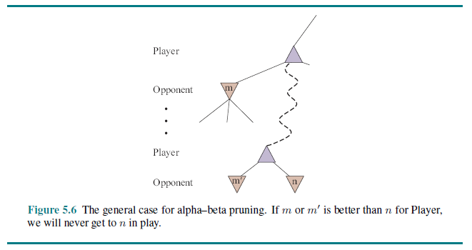
Alpha-Beta Explanation

Slide 14
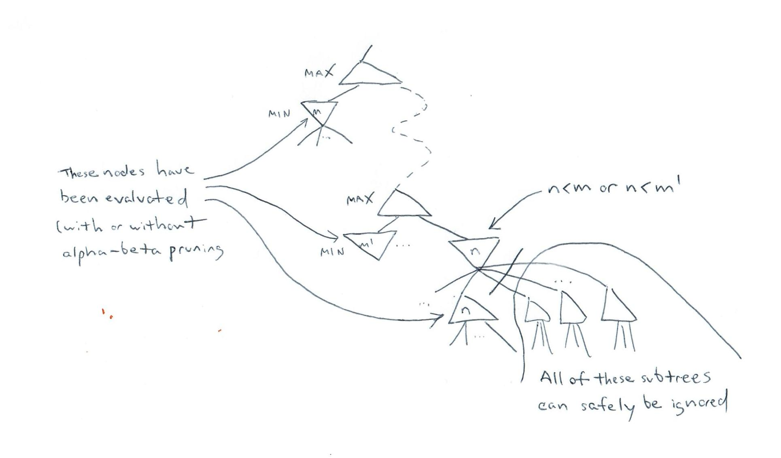
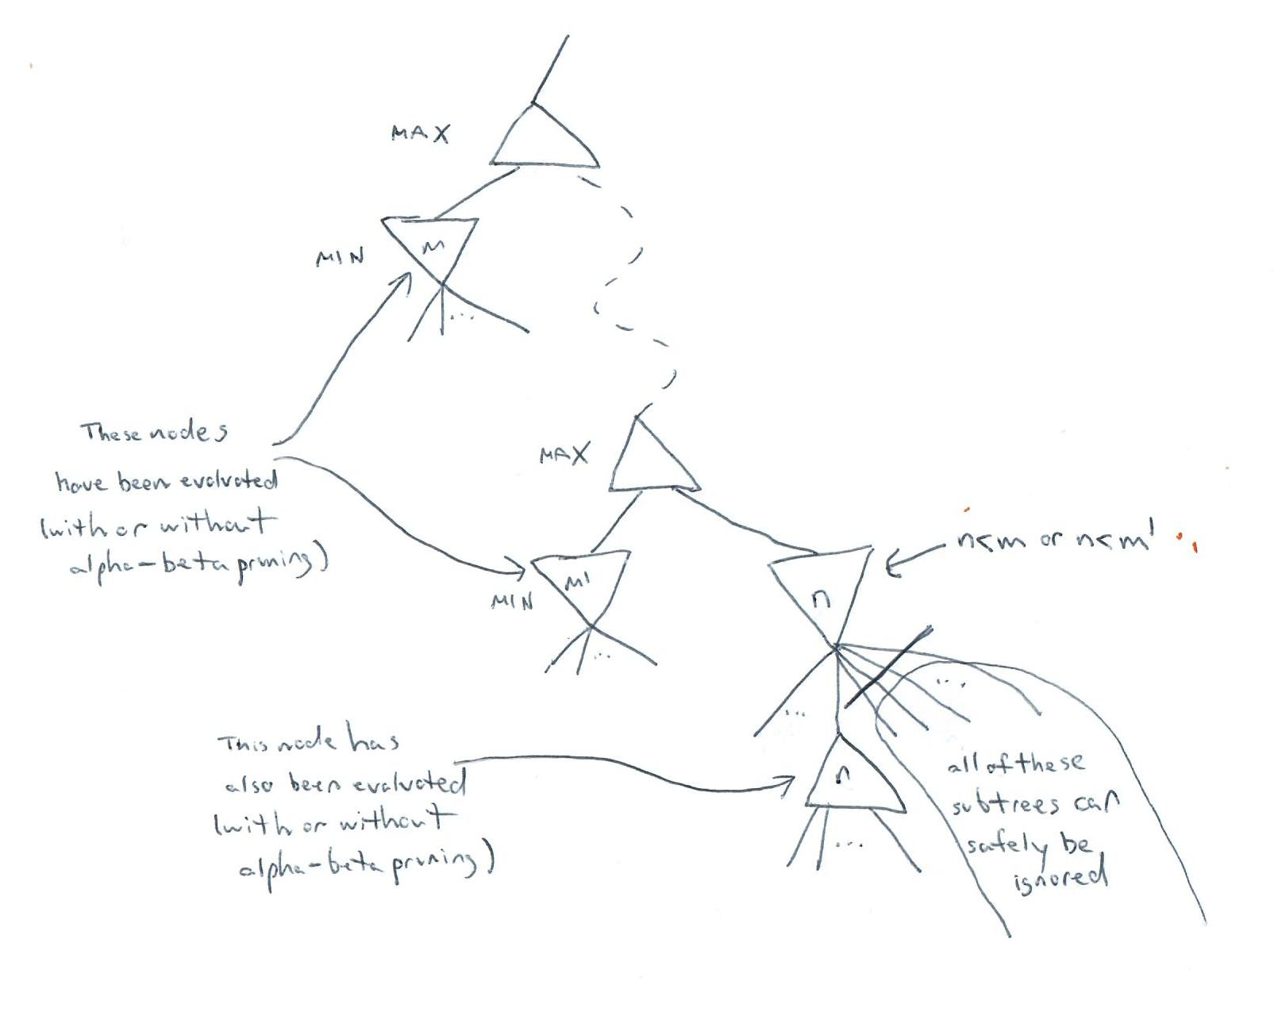
Alpha-Beta Explanation Augmented

Slide 15
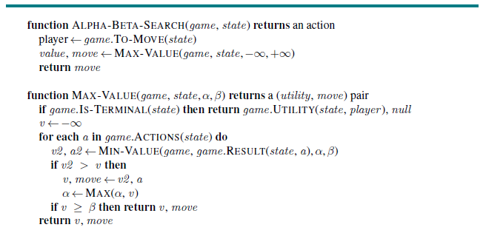
Alpha-Beta Pseudo-code (part 1)

Slide 16
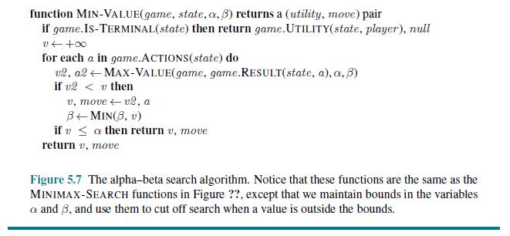
Alpha-Beta Pseudo-code (part 2)

Slide 17
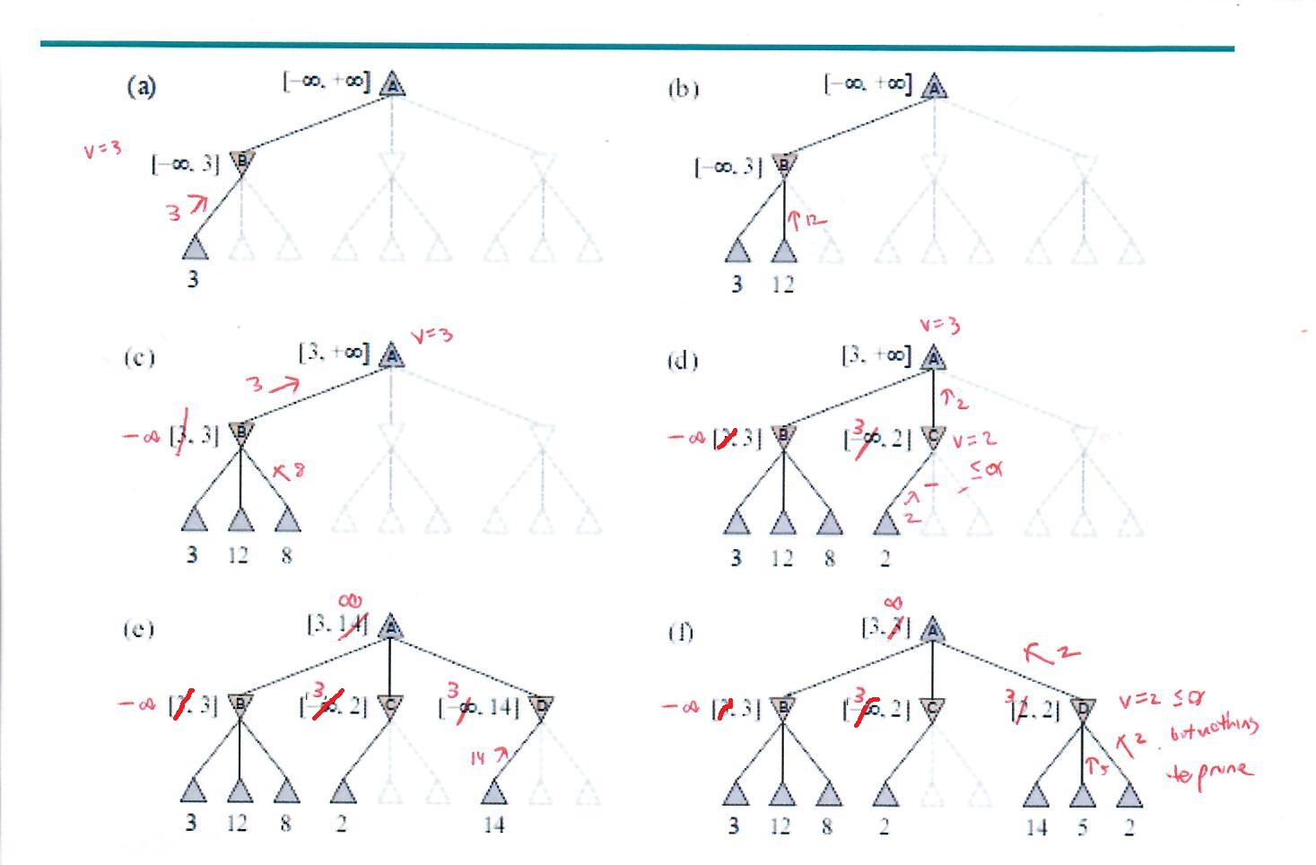
Alpha-Beta Example (corrected)

Slide 18
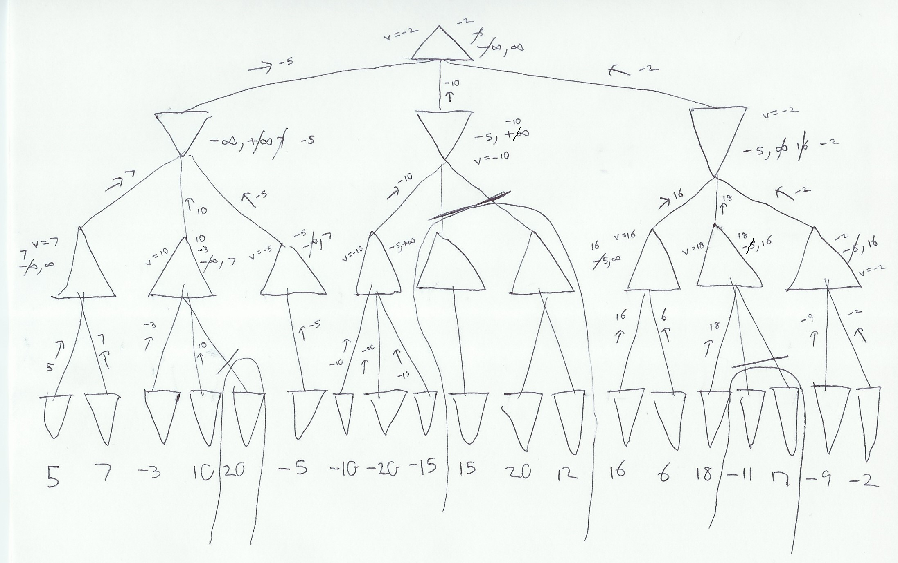
Alpha-Beta My Example

Slide 19
Combining Recursive Functions
When implementing minimax search with or without alpha-beta pruning, the two recursive functions can be combined into one recursive function
With a straight-forward implementation, this requires an extra parameter indicating whose turn it is
Alternatively, when implementing alpha-beta search, some people like to always consider the current player (at all depths of the recursion) to be the MAX player
Some sources call this variation of the implementation negamax; this is not discussed in the textbook, but you can find pseudo-code for this on-line easily
When implementing the search this way, with each recursive call, -α gets passed to β and -β gets passed to α; also, the result of each recursive call gets negated
The code for negamax is more compact, but probably more confusing and arguably more difficult to debug
Whichever way you implement the strategy, the efficiency should be approximately the same and the results should be exactly the same

Slide 20
Ordering Moves
The order in which moves are searched influences the effectiveness of alpha-beta pruning
If moves were searched in perfect order (which is obviously impossible), for typical games, the number of nodes examined would be cut from O(b^{m}) to approximately O(b^{m/2})
If successors are searched in random order, the exponent is effectively cut by about 25%
If the AI agent has a specific time limit for each move, this means that it can search twice as deep in the tree for the perfect case, and 4/3 as deep in the random case
In general, as we search deeper in the tree, a much higher percentage of nodes are pruned (in fact, a very high majority of nodes will be pruned in most cases)
For chess, reasonably simply ordering schemes can get you close to the theoretical limit; e.g., try captures first, then threats, then forward moves, then backwards moves
Dynamic move-ordering schemes can also bring us close to the theoretical limit
For example, if iterative deepening is used to search the game tree, we can use the evaluations from one stage to determine the order of moves searched at the start of the next stage

Slide 21
Transposition Tables
Transpositions are different permutations of moves that lead to the same position
In games, this often leads to checking the same state over and over again
A hash table of positions evaluated up to a certain depth (with their evaluations) is called a transposition table
This allows you to avoid evaluating the same state more than once
Because game trees are exponentially big, you usually can't store all the evaluated states
Strategies exist to choose which nodes to keep and which to discard
According to the textbook, transposition tables can have a dramatic effect, sometimes as much as doubling the reachable depth in chess

Slide 22
Searching Exponentially Big Game Trees
In real game-playing applications, we must avoid requiring minimax or alpha-beta search to search all the way to terminal nodes
The terminal test is replaced by a cutoff test and the utility function is replaced by an evaluation function (a.k.a. a heuristic function)
The cutoff test can just check to see if the search has reached some specified depth
When a time-limit is required instead of a depth-limit, iterative deepening can be used
When the time-limit is about to be up, the recursion unwinds
When this happens, the program should choose the move determined by the deepest completed search

Slide 23
Evaluation Functions
The evaluation function ideally should:
order terminal states in the same order as the utility function (this is crucial)
order other states based on the “chances of winning”
be fast!
Conventional evaluation functions compute numeric contributions for various manually constructed features and combine them for a total value
Some evaluations functions use a weighted linear function and can be expressed as:
EVAL(s) = w₁f₁(s) + w₂f₂(s) + … + w_{n}f_{n}(s) = ∑_{i=1..N} w_{i}f_{i}(s)
For example, for chess:
The f-values might be the number of various types of pieces in chess
The w-values could be the value of the piece (1 for pawn, 3 for bishop, etc.)
In addition to material value, more advanced chess heuristics would include features related to concepts such as pawn structure, king safety, etc.
In reality, the features are not always independent, so non-linear evaluation functions can sometimes work better

Slide 24
Creating Evaluation Functions
Conventionally, the choice of features for an evaluation function is based on expert knowledge
Weights can either be manually set or empirically determined
Modern programs for various games sometimes learn the features as well as the weights
When applied to terminal states, the evaluation function should evaluate to some multiple of the defined utility of the state
Definite wins for MAX should get the highest weight; definite losses for MAX should get the lowest weight (the negation of the highest weight); draws should be evaluated as 0
The evaluation function must be zero-sum
If you apply the evaluation function from the opposite player’s point of view, the result should be the negated value of the current player’s point of view
This means that if you, for example, add one point for every one of the current player’s pawns in a chess game, you must also subtract one point for every one of the other player’s pawns
As much as I tend to emphasize this, I have seen many students get it wrong; your programs will not play well if you don’t get this right

Slide 25
Implementing Alpha-Beta Search
When implementing the updated (i.e., with a depth cutoff) alpha-beta search, a few things in the pseudo-code need to change:
You need an additional parameter indicating the current depth of the search, and each recursive call should pass the current depth plus one
Replace IS-TERMINAL(state) with IS-CUTOFF(state, depth); note that actual terminal states also count as a cutoff
Replace UTILITY(state, player) with EVAL(state, player)
Really, UTILITY and EVAL can do without the “player” parameter and always use MAX’s perspective
You could use a fixed depth limit as the cutoff, but it is better to use iterate deepening, which is necessary if there is a time limit
When the time runs out, remember to select the move determined by deepest completed search

Slide 26
Quiescent Search
Positions that are quiescent are unlikely to exhibit wild swings in value in the near future
A quiescent search expands non-quiescent positions until quiescent positions are found
This can be implemented by modifying IS-CUTOFF to return false for non-quiescent positions
For example, in chess, positions in which a capture of the queen is possible would be non-quiescent, and should be expanded further

Slide 27
The Horizon Effect
The horizon effect is more difficult to eliminate
This occurs when serious damage is ultimately unavoidable, but it can be temporarily avoided by pushing the outcome beyond the search depth
We will look at a couple of examples from chess
In the first, the program may think it is ahead, even though it is doomed to lose
In the second, the program may make poor moves to avoid losing a bishop, even though it is inevitable
As hardware improvements lead to deeper searches, the horizon effect occurs less often

Slide 28
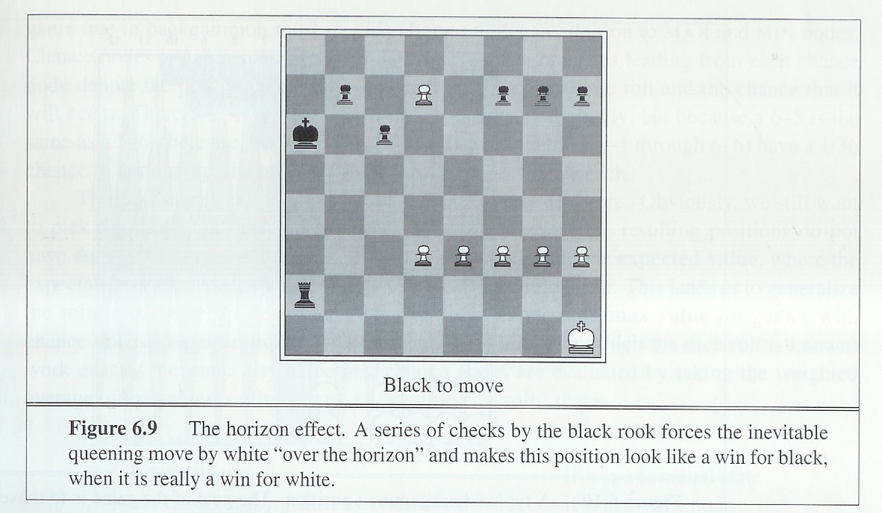
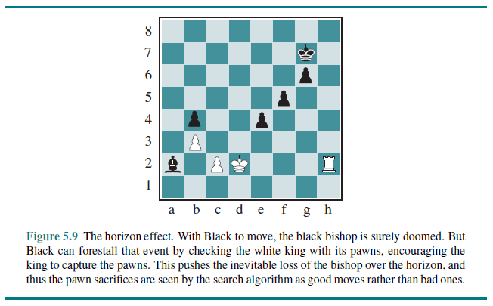
Horizon Effect Examples
Example from 2nd Edition
Example from 3rd and 4th Editions

Slide 29
Other Potential Improvements
A singular extension is a move that is “clearly better” than all others in a given position
Some programs allow the search to extend below the depth limit when singular extensions are recognized; this can help mitigate the horizon effect
Some programs use forward pruning to prune moves that seem clearly bad, although this can be dangerous
It is sometimes safe to prune one of two symmetrical moves
I add: In an extreme case, if there is only one legal move, performing an alpha-beta search is irrelevant and wasteful
Many existing game-playing programs use databases of common opening and endgame positions; thus, early and late in the game, no search occurs

Slide 30
Stochastic Games
Stochastic games (which include random elements) are more difficult to deal with compared to deterministic (really strategic) games
For example, in backgammon you don't know what the legal moves will be because it depends on dice; there is no standard search tree
To handle this, we must generalize the minimax value to an expectiminimax value:
EXPECTIMINIMAX(n) =
UTILITY(n) if TERMINAL-TEST(s)
max_{a} EXPECTIMINIMAX(RESULT(s, a)) if TO-MOVE(s) = MAX
min_{a} EXPECTIMINIMAX(RESULT(s, a)) if TO-MOVE(s) = MIN
∑_{r} P(r) * EXPECTIMINIMAX(RESULT(s, r)) if TO-MOVE(s) = CHANCE
In the final bullet, r represents a possible dice roll or some other chance event
The nodes in the game tree related to the chance events are called chance nodes

Slide 31
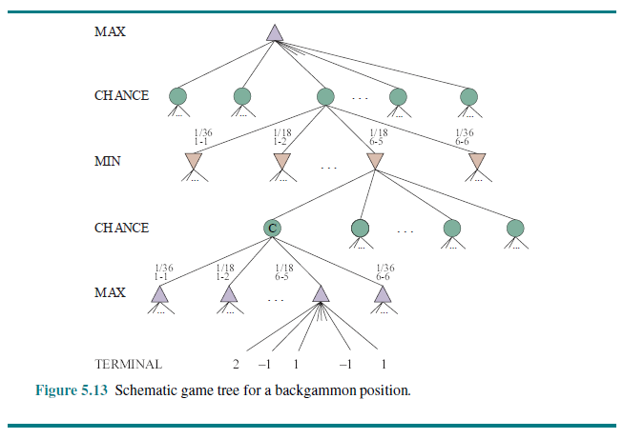
Example Game Tree for Backgammon

Slide 32
Properties of Expectiminimax
The expectiminimax value is an expected value of a position if the opponent plays perfectly
With expectiminimax search, we are no longer maximizing the worst-case scenario
As with regular minimax search, we can search to some specified depth limit and use an evaluation function
There is also an extension of alpha-beta pruning that can be used (under certain assumptions)
Now, however, we must be more careful with the evaluation function
The value assigned to a position should be a positive linear transformation of the probability of winning
Before, only the ranking order of positions mattered
The time complexity changes from O(b^{m}) to O(b^{m}n^{m}) where n is number of distinct random events
This makes a huge difference in the number of moves that we can look ahead
Nonetheless, expectiminimax search with a complex, manually constructed evaluation function can compete with top humans at backgammon

Slide 33
Partially Observable Games
As part of a discussion of partially observable games, the text discusses Kriegspiel
This is a variation of chess where players only see their own pieces, but a referee sees the entire board and only allows legal moves
Players can propose moves on their turn until a legal move is found
We are skipping the details, but one notion that reappears is that of belief states
The book also discusses card games (e.g., bridge, hearts, and some forms of poker) in which cards are dealt randomly at the beginning of each game or hand
In games such as these, and in Kriegspiel, it is often strategic to give away as little information as possible
At times, this requires acting randomly in order to be unpredictable
The book also mentions the notion of bluffing in poker

Slide 34
Monte Carlo Tree Search (basic)
Methods involving Monte Carlo tree search (MCTS) have led to huge successes for certain games in recent years
One example is Go; two factors of Go which hinder alpha-beta search are:
There is a large branching factor (it is 361 at the start of the game)
It is difficult to come up with a good evaluation function
A basic MCTS strategy could just randomly play a bunch of games from the current position, starting from every possible move
These random games would be examples of simulations (a.k.a. playouts or rollouts)
The move that leads to the most wins could then be selected (so no heuristic would be used)
This might lead to good moves against opponents who play randomly, but it does not generally lead to good moves against strong players for complex games

Slide 35
Monte Carlo Tree Search (better)
It is better to rely on a playout policy, that bias moves toward good ones
Early attempts at using MCTC for Go involved manually created playout policies, but recent attempts have used deep neural networks and reinforcement learning to learn playout policies
The playout policy does not always start at the root of the search tree (the root represents the current position in the game at which the program needs to make a choice)
Instead, a selection policy is used to choose which node to expand; this can combine two factors:
We want to ensure exploration of states that have had few playouts so far
We want to ensure exploitation of states that have done well in past playouts
Selection starts at the root of the search tree and makes its way down to a leaf node; then an expansion step generates a new child of the leaf node (or multiple children can be generated)
For each new node that is generated, a full simulation is performed starting at that node according to the playout policy; these moves are not recorded in the search tree
At the end of each simulation, based on the result, a back-propagation step updates the statistics associated with nodes on the path from the root to the selected node

Slide 36
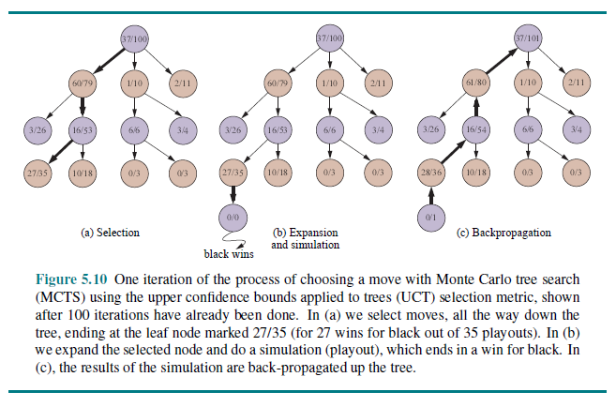
Example of MCTS (one iteration)

Slide 37
The State of AI Chess
Deep Blue (the program that beat the world champion Garry Kasparov in chess in 1997) used an iterative-deepening alpha-beta search with a transposition table
The search would generate extensions beyond the depth limit for interesting lines of forcing/forced moves
The program routinely searched to a depth of 14 plies, but in some cases up to 40
The evaluation function used 8,000 features (weights were learned by analyzing master games)
There was an opening book of 4,000 positions, a database of 700,000 grandmaster games, and a large database of solved endgames including all positions with five pieces of less
The program ran on a chip specifically designed for Deep Blue
Over the next two decades, algorithmic improvements led to increasingly good chess programs
In late 2017, using techniques similar to those used for AlphaGo (to be mentioned soon), including Monte Carlo tree search, deep learning, and reinforcement learning, another major breakthrough occurred
A system named AlphaZero, developed by Google's DeepMind subsidiary, after learning for one day, played the previously top-ranked chess program in 100 games; it won 28 and drew the rest!
The 4th edition of the textbook states that the top chess programs today “far exceed human players”

Slide 38
The State of AI Checkers
Chinook, developed at the University of Alberta in Canada, lost to Marion Tinsley in checkers (a.k.a. English draughts) in 1990
Tinsley had been the checkers world champion for over 40 years, losing only 3 games in all that time
He won the match 20.5 – 18.5, including two losses to Chinook
In a 1994 rematch, Tinsley had to withdraw for health reasons, and Chinook became the official world champion
In 2007, the same team that created Chinook weakly solved the game of checkers!
The 4th edition of the textbook says it took "18 CPU-years of alpha-beta search to solve the game"
Chinook now plays perfectly, combining an alpha-beta search and a database of 39 trillion endgame positions
A "reduced" version of the game can be played on-line

Slide 39
The State of Othello
A computer beat the world champion in Othello (a.k.a. Reversi) 6-0 in 1997
The textbook says that since this time, programs have played at a “superhuman level”
The search space is smaller than chess, and evaluation functions are simpler to create

Slide 40
The State of Backgammon
As mentioned earlier, backgammon includes random events (in this case, rolling the dice)
Since 1995, TD-Gammon, the top program in backgammon, played at around the level of top humans
The program uses expectiminimax search, looking ahead only two or three moves due to the chance nodes
The evaluation function was manually learned using neural networks and self play
The textbook says that the success of TD-Gammon changed the wisdom of top players about certain aspects of the game

Slide 41
The State of Bridge
Aspects that make bridge a tough game include imperfect information and randomness
Additionally, the first part of the game, called bidding, requires strategies involving communication between teams of two players
Some of the top AI programs for bridge include GIB, and more recently, Jack and Wbrdige5; all use Monte Carlo tree search
As far back as 1998, GIB was able to beat some of the world's top humans (not all) in a par contest, which involves just hand playing, not bidding
Bridge programs still cannot compete with the top humans when it comes to bidding

Slide 42
The State of Scrabble
Two complications of Scrabble are:
The task environment is partially observable (you don't know your opponent's tiles)
The game is stochastic (due to randomly choosing tiles)
At an amateur level, part of becoming a good Scrabble player involves memorizing words; but at the expert level, we can assume that virtually all words are known
It is simple to write a program that can quickly determines the highest scoring moves
However, any good Scrabble player knows there are many other strategies involved
In 2006, the program QUACKLE defeated the former world champion, David Boys, 3 to 2 in a match
It is not clear to me that the best AI scrabble systems are better than the best humans, but they are probably at least about even

Slide 43
The State of Go
Not long ago, Go was often mentioned as a popular game that AI hasn’t cracked yet
Through 2015, the best Go programs played at an advanced amateur level
In 2016, AlphaGo, developed by Google's DeepMind subsidiary, beat one of the world’s top human Go players in a match (4 games to 1)
AlphaGo combines Monte Carlo Tree Search, reinforcement learning, and deep neural networks
A later version of the program, called AlphaGo Zero, is considered even far superior to AlphaGo
The program has since been generalized to one called AlphaZero (mentioned earlier), which can play multiple games including chess
A successor to AlphaZero, named MuZero, uses similar techniques to AlphaZero, but learns without even knowing the rules!
MuZero not only plays chess and Go and super advanced levels, but also PacMan and lots of Atari games!

Slide 44
The State of Poker
Factors that make poker difficult include imperfect information, randomness, and bluffing (which is more important in no-limit games compared to limit games)
AI poker has been researched for decades by the Computer Poker Research Group at the University of Alberta (part of the group that developed Chinook and weakly solved checkers)
Until recently, they focused on limit poker (specifically, heads-up limit Texas Hold ‘Em), which constrains betting to fixed increments
A decade ago, their system was about as good as the best humans in limit poker
In 2008, in a competition against six top human limit players, their program Polaris achieved 3 wins with 2 losses and one draw
In 2017, their program DeepStack, trained with reinforcement learning and deep neural networks, beat professional players in heads-up no-limit Texas Hold ‘Em
In 2019, Pluribus, developed by Facebook's AI lab, also trained using reinforcement learning, beat professional human players in no-limit Texas Hold 'Em games with six players

