Slide 1
ECE469: Artificial Intelligence
Hidden Markov Models

Slide 2
Markov ___________
We will be considering stochastic processes in which the values of random variables change over time according to their probability distributions
The Markov property holds if the conditional probability distributions for future states of random variables, given the current state and all past states, depends only on the current state
A Markov process is a stochastic process that has the Markov property
Some sources such as our textbook refer to this more specifically as a first-order Markov process
With a more general n^{th}-order Markov process, the probability distribution for each state depends on the n previous states
With a (regular) Markov model, the Markov assumption states that the system being modeled is a Markov process
Let X be a random variable, and at every time unit t, the state (or value) of X is X_{t}; using our textbook's notation, we then have: P(X_{t} | X_{0:t-1}) = P(X_{t} | X_{t-1})
This is called a transition model for first-order Markov processes; the sequence of random values described by such a model is known as a Markov chain

Slide 3
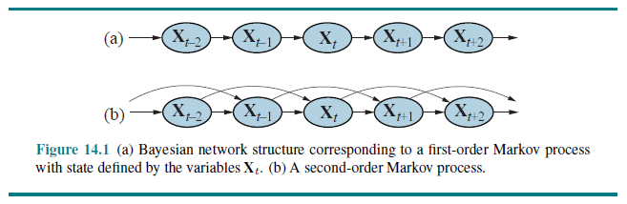
Dynamic Bayesian Networks
A dynamic Bayesian network is Bayesian network in which the nodes represent random variables at different time steps
Although the term “time steps” is commonly used, really, the nodes can refer to steps of more general sequences
All directed links in such a Bayesian network will flow forward in time (or, more generally, forward in the sequence)
Markov processes can easily be represented by dynamic Bayesian networks:

Slide 4
Hidden Markov Models
A hidden Markov model (HMM) is used when the states of X cannot be observed directly
However, there are observable evidence variables that are dependent on the states
We assume that the conditional probability distribution of each evidence variable depends only on the current state: P(E_{t} | X_{0:t}, E_{1:t-1}) = P(E_{t} | X_{t})
This is called a sensor model, because it can be used to explain how sensors work
The sensors can be represented by the observable evidence variables that depend on the current state
Two other assumptions when using HMMs are:
The states are discrete
The various probability distributions do not change over time (this is called the stationarity assumption)
We also need to specify P(X₀), the prior probability distribution for the initial state of X
With our model, we can compute all entries from the complete joint probability distribution: P(X₀, ..., X_{t}, E₁, ..., E_{t}) = P(X₀)∏_{1...t}[P(X_{i} | X_{i-1}) P(E_{i} | X_{i})]

Slide 5
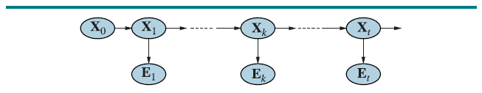
HMMs as Dynamic Bayesian Networks
HMMs can easily be represented as dynamic Bayesian networks:
Note: In many sources, there would also be an E₀, which I personally think makes more sense in most cases
However, I will follow our textbook's convention and assume there is no evidence variable at the initial state

Slide 6
Applications of HMMs
Some (of the many) applications of hidden Markov models include:
Speech recognition: The states represent the intended phonemes, and the evidence variables represent the acoustical representation of the sound
Optical character recognition: The states represent the strokes of a pen, and the evidence variables represent a combination of location and pressure
Machine translation: The states represent the tokens (e.g., words) in the destination language, and the evidence represents the tokens in the source language
Part-of-speech tagging: The states represent intended parts of speech, and the evidence represents words
Gesture recognition: E.g., we have had senior project groups attempt automatic sign language recognition based on readings from flex sensors on a glove
Many applications in bioinformatics and genomics, including gene finding and the analysis of DNA or protein sequences
Note that for some of these applications, time is replaced by position in a sequence

Slide 7
Problems Solved by HMMs
We will discuss three types of problems that can be solved using an HMM:
Determine the probability of a particular output sequence (i.e., a sequence of values for the evidence variables) given the parameters of the HMM, λ
Determine the most likely sequence of hidden states given an output sequence and the parameters of an HMM
Adjust the parameters of an HMM, given an output sequence or a set of output sequences (i.e., a training set), to make the output more likely
This algorithms we will cover for the first two tasks are both examples of dynamic programming algorithms
The third task is an example of a machine learning task; we will only discuss this briefly in relation to HMMs

Slide 8
Computing Probabilities of Output Sequences
Note that there can be an exponential number of sequences of hidden states that lead to a particular output sequence, so a brute force approach to this calculation is intractable
The forward algorithm first computes the probability of being in each possible state at each time, and then computes the probability of each evidence value
First, we will define a quantity known as a forward probability: α_{t}(i) = P(E_{1:t}, X_{t} = s_{i} | λ)
This is equal to the probability of seeing all of the observations so far up until time t, and being in some specific state, s_{i}, given the parameters of the HMM
We can then apply the following steps:
Initialization: α₀(i) = P(X₀=s_{i})
Induction: α_{t}(j) = [∑_{i=1:N} α_{t-1}(i) * P(X_{t}=s_{j} | X_{t-1} = s_{i})] P(E_{t} | X_{t} = s_{j})
Termination: P(O | λ) = ∑_{i=1:N} α_{T}(i)
The time complexity is O(T * N²), where N is the number of possible states
This is because we loop both i and j from 1 to N and t from 1 to T during induction

Slide 9
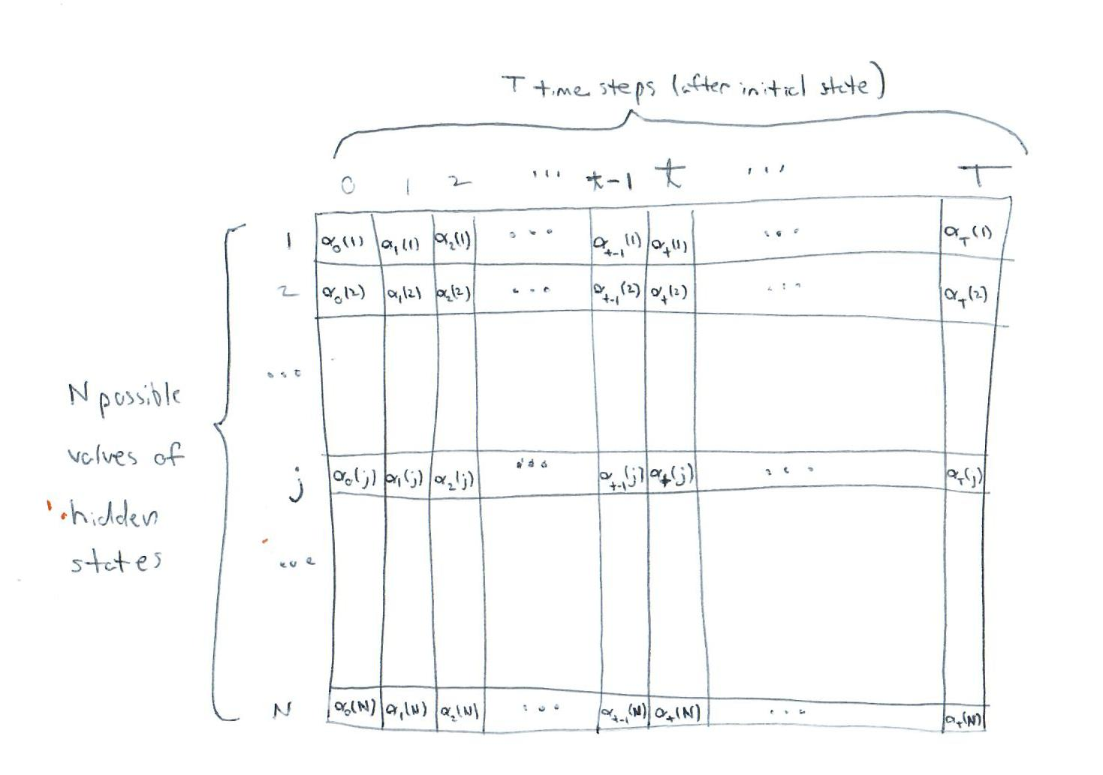
Matrix to Store All Alpha Values

Slide 10
Determining the Most Likely Hidden States
Typically, you learn the parameters of the HMM first (we’ll briefly discuss this next)
Then, you apply the trained HMM to future examples to predict the values of the hidden states given sequences of observed data; this is an example of a sequence labelling task
For example, for speech recognition, you feed the HMM sequences of audio samples for training, and then you can predict the phonemes represented by later audio samples
The prediction of hidden states is typically performed using the Viterbi algorithm
Earlier, we defined the forward probability, α_{t}(i), as the probability of seeing the observations so far up until time t, and being in some specific state, s_{i}, given the parameters of the HMM
Now, we will define δ_{t}(i) as the probability of the most likely path (a.k.a. the Viterbi path) for the observations so far up until time t, and ending at state s_{i}, given the parameters of the HMM:
The procedure is very similar to the forward algorithm:
Initialization (same as α): δ₀(i) = P(X₀=s_{i})
Induction (we are replacing a summation with a max): δ_{t}(j) = max_{i=1:N} [δ_{t-1}(i) * P(X_{t}=s_{j} | X_{t-1}=s_{i})] P(E_{t} | X_{t}=s_{j})
Termination (again replacing a summation with a max): P* = max_{i=1:N} δ_{T}(i)
P* is the probability of the single most likely path accounting for the observed evidence

Slide 11
Retrieving the Viterbi Path
Assuming we also want to be able to retrieve the Viterbi path, we need two additional variables
At the induction step, for t = 1:T, we add: ψ_{t}(j) = argmax_{i=1:n} [δ_{t-1}(i) * P(X_{t}=s_{j} | X_{t-1}=s_{i})] P(E_{t} | X_{t}=s_{j})
In other words, we are remembering the previous state that led to the maximum probability for each current state
At the termination step, we add: q*T = argmax_{i=1:n} δ_{T}(i)
In other words, we are remembering the most likely final state
We can then reconstruct the path by looping from T-1 down to 0 and calculating: q*_{t} = ψ_{t+1}(q*_{t+1})
In other words, as we iterate backwards, we keep track of the most likely state to account for the already determined next state
The final sequence denoted by the concatenation of q₀ through q_{T} represents the most likely path through hidden states given the observed evidence (i.e., it is the Viterbi path)
As with the forward algorithm, the time complexity of the Viterbi algorithm is O(T * N²)

Slide 12
Training an HMM
Adjusting the parameters of the HMM given a training set can be very simple of much more difficult, depending on the type of training data we are dealing with
If the training data includes labels for both hidden states and evidence variables, the transition probabilities are just simple ratios
We will discuss an example of a task where this is typical (part-of-speech tagging) during the unit of the course on natural language processing
If the training data only includes the values of evidence variables, we can use an algorithm called the Baum-Welch algorithm
The Baum-Welch algorithm is an instance of the more general expectation maximization (EM) algorithm
Roughly speaking, we iterate back and forth between an E step and an M step
The E-step computes the probabilities given the current parameters of the model
The M-step re-estimates the parameters of the model to make these probabilities more likely
We are not going to discuss the details of this algorithm, but we will discuss several other machine learning algorithms in the machine learning unit of our course

Slide 13
Other Sequence Labelling Models
For some tasks, using maximum entropy Markov models (MEMMs) can lead to better performance than HMMs
We won’t be discussing MEMMs in this course
More recently, various types of recurrent neural networks (RNNs) such as LSTMs may perform better than conventional approaches
Even more recently, transformers may perform better than LSTMs
We’ll talk a bit about RNNs including LSTMs and transformers during the unit on natural language processing

