Slide 1
ECE469: Artificial Intelligence
Machine Learning Concepts

Slide 2
Machine Learning
Early in the course, we discussed the term artificial intelligence (AI), and learned that there is no agreed upon definition for the term
One possibility: AI relates to getting computers, or more generally agents, to perform tasks that require intelligence (itself not well-defined) when humans attempt them
I think we can fairly say that one thing humans use intelligence for is learning
When an artificial agent such as a computer learns, we call that machine learning (ML)
When an agent learns, it improves its own ability to act in the future
Recall that an agent program implements an agent function that maps a percept sequence to an action
The goal of machine learning makes some sort of improvement to the agent program
The improvements, and the techniques used to make them, depend on multiple factors; for example:
What component of the agent is being improved?
What prior knowledge does the agent have?
What model of the world is the agent using?
What data is available to the agent?
What sort of feedback will the agent have access to as it acts?

Slide 3
Types of Learning
Supervised learning involves learning a function that maps inputs to outputs based on examples
Each example specifies one input and an output
If the outputs are discrete and have a finite domain, this is called classification or categorization, and each output can be called a label
If the outputs have an infinite domain (either discrete or continuous), this is called regression
Unsupervised learning involves learning patterns in the input when there are no output values; one example of such a task is clustering
Reinforcement learning means that the agent learns from reinforcements
The reinforcements can be thought of as rewards and punishments
The agent must decide which of its actions were most responsible and update its agent program appropriately
In semi-supervised learning, we are given a relatively small number of labeled examples in addition to a much larger collection of unlabeled examples

Slide 4
Supervised Learning
We are going to primarily cover techniques that fall into the category of supervised learning
The task of supervised learning can be defined as follows:
Given a training set of N examples of input/output pairs (x₁, y₁) … (x_{N}, y_{N}), where each y_{i} was generated by an unknown function y=f(x_{i}), discover a function, h, that approximates f
The function h is called a hypothesis
The set of all possible hypotheses is called the hypothesis space, H (this can be infinitely big)
The methods we cover assume that the input uses a factored representation
Recall that this is more complex than an atomic representation but less complex than a structured representation
This means that each input can be viewed as vectors of values
Each dimension of the input vector represents an attribute, variable, or feature
The outputs could theoretically be vectors, but more typically they are single values (we will usually assume this)
The domain of the output determines if we are dealing with classification or regression

Slide 5
Choosing a Hypothesis
Any hypothesis that agrees with the known data (the training examples) is said to be consistent
A good hypothesis will generalize well (i.e., it will predict unseen examples correctly)
To evaluate the accuracy of a hypothesis, we apply it to a test set of examples that are distinct from the training set
One method of choosing among consistent hypotheses is to rely on the principle known as Ockham's razor
Casually speaking, Ockham’s razor suggest that we prefer the simplest hypothesis
However, defining simplicity is not always obvious
In practice, the hypothesis learned by a modern machine learning algorithm will not necessarily be consistent with the training data

Slide 6
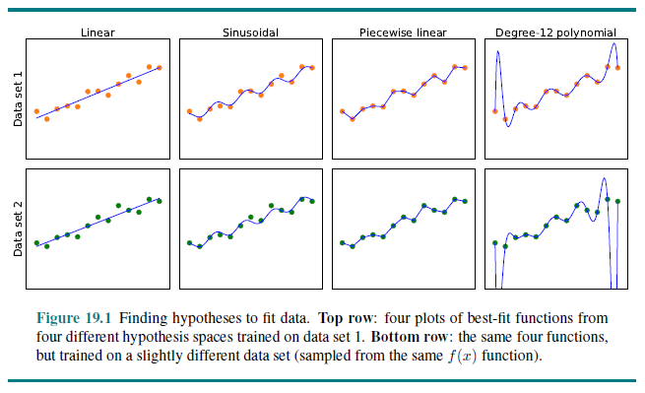
Choosing a Hypothesis Examples

Slide 7
Choosing a Machine Learning Method
A learning problem is realizable if the hypothesis space contains the true function
One possible approach: Let H be the class of all Turing machines (or all computer programs)
This does not take into account the complexity of learning
In general, there is a tradeoff between the expressiveness of the hypothesis space and the complexity of finding a simple, consistent hypothesis within the space
Additionally, choosing a hypothesis space that is too complex can lead to overfitting (this is clearly what happened in the fourth column of the previous figure)
When you choose a machine learning method (e.g., decision trees, Bayesian learning, neural networks, etc.), you are limiting the hypothesis space
You are further limiting the hypothesis space when you set certain hyperparameters
Examples of hyperparameters related to neural networks include the number and types of layers, the learning rate, the batch size, etc.
You are again limiting the hypothesis space when you choose which features to use to represent your data
Note that with conventional ML, feature selection was often a very important and time consuming
With modern deep learning approaches, you can sometimes use raw data

Slide 8
Training, Tuning, and Testing
We have discussed the notion of a training set, which includes examples of input/output pairs
We have also mentioned the notion of a test set, used to evaluate a final, trained system
This final evaluation typically involves some sort of accuracy metric or error rate that may depend on the specific application
We’ll see examples of metrics for various tasks that we discuss later
A third data set called a validation set, a.k.a. a development set or a tuning set, may be necessary to choose a model, to set hyperparameters, or to know when to stop training
Various models with multiple sets of hyperparameters can be trained on the training set and evaluated on the validation set
Models that iterate until convergence, such as neural networks, can use the validation set to minimize a loss function
The loss function may be different than the final metric that will be used to evaluate the system
In addition to accounting for loss, a more general cost function can add a regularization term that penalizes complexity; this helps to avoid overfitting
If the training set is small, k-fold cross validation can be used instead of a validation set
Only after training is fully complete, based on the training set and the validation set, should the trained system be applied to the test set

Slide 9
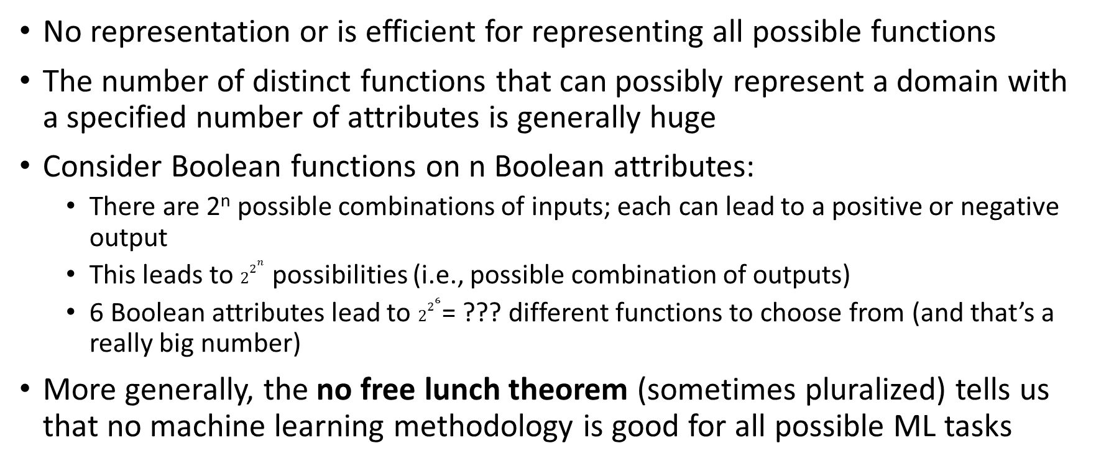
No Free Lunch
No representation or is efficient for representing all possible functions
The number of distinct functions that can possibly represent a domain with a specified number of attributes is generally huge
Consider Boolean functions on n Boolean attributes:
There are 2^{n} possible combinations of inputs; each can lead to a positive or negative output
This leads to $2^{2^{n}}$ possibilities (i.e., possible combination of outputs)
6 Boolean attributes lead to $2^{2^{6}}$= ??? different functions to choose from (and that’s a really big number)
More generally, the no free lunch theorem (sometimes pluralized) tells us that no machine learning methodology is good for all possible ML tasks

Slide 10
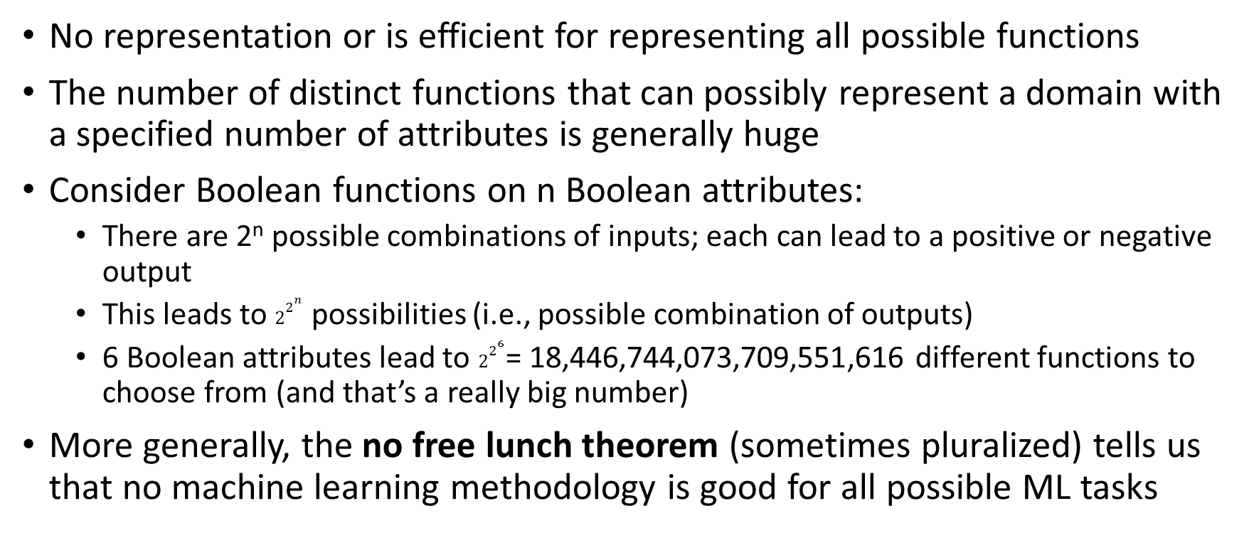
No Free Lunch
No representation or is efficient for representing all possible functions
The number of distinct functions that can possibly represent a domain with a specified number of attributes is generally huge
Consider Boolean functions on n Boolean attributes:
There are 2^{n} possible combinations of inputs; each can lead to a positive or negative output
This leads to $2^{2^{n}}$ possibilities (i.e., possible combination of outputs)
6 Boolean attributes lead to $2^{2^{6}}$= 18,446,744,073,709,551,616 different functions to choose from (and that’s a really big number)
More generally, the no free lunch theorem (sometimes pluralized) tells us that no machine learning methodology is good for all possible ML tasks

Slide 11
Publication Bias
Almost every published academic paper that describes a machine learning approach applied to some task reports positive results
The related notion of publication bias may indicate that the literature gives us an exaggerated notion of the goodness of at least some of these methods
The two main reasons for publication bias are:
Reviewers reviewing submissions for conferences or journals are more likely to accept those reporting positive results compared to those reporting negative results
Researchers who obtain positive results are more likely to attempt to publish their work compared to those who obtain negative results
If multiple researchers test the same method applied to some particular task, some may obtain positive results by chance; those that do are much more likely to have their results published!
This is not to suggest that anyone is doing something wrong intentionally, or that results were wrong due to an unintentional mistake (although either of these things might happen at times)
Personally, I think publication bias may be a big problem, not only in the field of machine learning, and it isn’t clear what can be done about it

Slide 12
Machine Learning Example
We will consider a simple, specific machine learning problem that will serve as a running example through our next two topics
The problem involves the decision as to whether or not to wait at a restaurant
The output is a Boolean variable that we'll call WillWait
We will base the prediction (about whether WillWait is true of false) on ten attributes (i.e., features), all of which are discrete (and with binning, all have small, finite domains):
Alternate – Is there a suitable alternative restaurant nearby?
Bar – Is there a comfortable bar area to wait in?
Fri/Sat – Is it a Friday or Saturday?
Hungry – Are we hungry?
Patrons - How many people are in the restaurant? (None, Some, or Full)
Price - $, $$, or $$$
Raining – Is it raining outside?
Reservation – Whether or not a reservation was made
Type – The kind of restaurant (French, Italian, Thai, or burger)
WaitEstimate – The wait estimated by the host (0-10 minutes, 10-30, 30-60, >60)

Slide 13
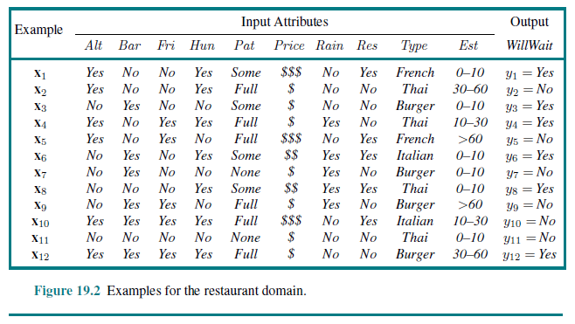
Example Training Set

