Slide 1
ECE469: Artificial Intelligence
Deep Learning and NLP

Slide 2
Conventional Statistical NLP
We previously learned that the vector space model was a popular approach in conventional, statistical natural language processing (NLP)
This implies that documents are represented as vectors of word weights
For example, the TF*IDF weighting scheme was very popular in the field for decades
Each dimension of the vector represents a word or token from the vocabulary
Tokens may be stemmed or lemmatized, but either way, two tokens are considered exact matches or completely different
A single token can be thought of as a one-hot vector

Slide 3
Word Embeddings
Many modern approaches rely heavily on word embeddings (a.k.a. word embedding vectors or word vectors)
This means that each word is represented by a learned numerical vector
To gain intuition as to why a vector of values might serve as a reasonable representation of a word, recall the notion of a term-document matrix, discussed during a previous topic
This is a matrix in which rows represent words and columns represent documents
In practice, we do not store the entire matrix, since it is sparse
Rather, for each term, we store an inverted index that maps the term to the documents in which it is contained
The inverted index can also include positions and/or term weights (such as TF*IDF)
It stands to reason that words with similar rows in the term-document matrix are likely to have similar meanings
The distributional hypothesis more generally predicts that words with similar semantic meaning will occur in similar contexts

Slide 4
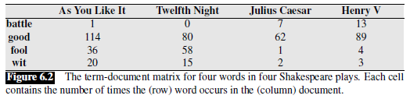
Term-document Matrix Example (from J&M)

Slide 5
Latent Semantic Analysis
The idea of representing words as vectors has a long history in NLP
For example, when I was a graduate student, latent semantic analysis (LSA) was popular
The technique would learn, based on a corpus, vectors that could be thought of as abstract "concepts" that are important to the corpus
All text-based sequences (including, for example, documents, queries, and single words) could then be represented as weighted sums of these concepts
Without getting into any details, LSA involved the use of singular value decomposition (SVD) applied to a matrix that is related to the term-document matrix
When LSA was used in the context of IR, the approach was known as latent semantic indexing
While interesting, my impression was that LSA did not seem to perform as well, empirically, as other approaches for IR or other NLP tasks such as text categorization

Slide 6
Modern Word Embeddings
Starting in around 2013, deep learning has transformed the field of NLP
Part of what made this possible was effective methods of learning useful word embeddings
As with some previous approaches, the idea is to create a d-dimensional vector, with a fixed d, to represent each word in a vocabulary
Typically, d is in the range of 50 to 500
The break-through approach to word embeddings was word2vec, and this is the approach we will discuss in this course (we will not cover most of the technical details)
More recent approaches, including one known as GloVe, may work better for many tasks
Some approaches learn embeddings for subwords or characters instead of words
Even more recently, contextual word embeddings such as those produced by BERT have led to state-of-the-art results for many NLP tasks
All these approaches involve pre-training using a large, unlabeled corpus; this is a form of unsupervised machine learning

Slide 7
Pre-word-embedding Neural Networks
Consider neural networks (NNs) applied to NLP tasks (such as text categorization) without word embeddings
A typical conventional approach was to have an input node for every word in the vocabulary
If the size of the vocabular were V, there would be V input nodes
The values of the inputs could be Boolean, word counts, or TF*IDF values
Of course, this was a bag-of-words approach; the order of the words in the input document does not affect the input to the neural network
Optionally, other input features could also be included

Slide 8
Problems with Pre-word-embedding NNs
There were a lot of weights between the inputs and the first hidden layer (this could lead to overfitting)
There is no simple way to incorporate word order into the methodology
Even Incorporating bigrams would blow up the number of input nodes
Two very similar words are represented by entirely different nodes
Of course, techniques such as stemming or lemmatization could be used
Still, any two tokens would be treated as being identical or totally different
It is my impression that, previous to word embeddings, NNs did not achieve state-of-the-art results for most (possible all) NLP tasks

Slide 9
Advantages of Word Embeddings for NNs
The number of input nodes is related to d, the dimension of the word embeddings
For different tasks and architectures, the input might be one word embedding at a time or a fixed number of word embeddings at a time
The input to feedforward neural networks, convolutional neural networks, or transformers might be word embeddings from one padded sentence
The input to recurrent neural networks is typically one word embedding at a time, and the words of a sentence are traversed in a sequence
Similar (but non-identical) words will have similar word embeddings

Slide 10
Word2vec
Really, word2vec includes two related methods for learning word embeddings
The principle behind both methods is related to the distributional hypothesis (mentioned earlier)
One method, called continuous bag-of-words (CBOW), learns embeddings useful to producing the current word in a text based on the surrounding context words
The other method, called the skip-gram method, learns embeddings useful to predict context words within a window of the current word
We will focus on the skip-gram method
Conceptually, either method can learn word embeddings by training a shallow neural network on an unlabeled corpus
In practice, more efficient techniques are used

Slide 11
The Skip-gram Model Learns Two Embeddings
The skip-gram method learns two embeddings for each word, w
One is called the target embedding, t
The other is called the context embedding, c
A target matrix, T, contains all the target embeddings
The i^{th} row of T is a 1 x d vector, t_{i}, for the i^{th} word of the vocabulary, V, where d is the dimension of the word embeddings
A context matrix, C, contains all the context embedding
The j^{th} column of C is a d x 1 vector, c_{j}, for the j^{th} word of the vocabulary, V

Slide 12
Learning the Skip-Gram Model Matrices
During training, we only consider context words within some small window of size L
The probability of seeing w_{j} in the context of w_{i} (i.e., within the window) can be denoted as P(w_{j} | w_{i})
This probability is related to the dot product of the target vector for w_{i} and the context vector for w_{j}; i.e., t_{i} ∙ c_{j}
During training:
The target embeddings of words are pushed closer to the context embeddings of words they appear close to (within the window)
The target embeddings of words are pushed away from other context embeddings
After training, it is possible to just keep the T matrix for the final embeddings
However, it is more common to sum, average, or concatenate the vectors

Slide 13
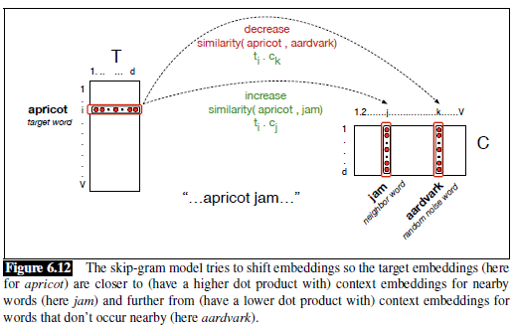
Word2vec Matrices Depiction (from J&M)

Slide 14
Word2vec Skim-gram Model as a NN
The word2vec skip-gram model can be implemented as a (simple) neural network (see the next slide, with a figure from an earlier draft of J&M)
The earlier draft of J&M called the target embedding the word embedding, and they referred to the target matrix, T, as the word matrix, W, but I think this is misleading
The input layer is a one hot vector (treated in the figure as a row vector)
Therefore, the hidden layer (also a row vector) contains one row of W (i.e., a single target/word embedding); there is no activation function applied at this layer
The input to the output layer is the dot product of the target embedding with every context embedding (stored in the columns of C)
If the output layer is a softmax layer, the dot products are converted to probability estimates
To train the network, each epoch could loop through every target word / context word pair, treating the probability of the context word as 1, and all others as 0
In practice, this is not how the model is implemented for efficiency reasons

Slide 15
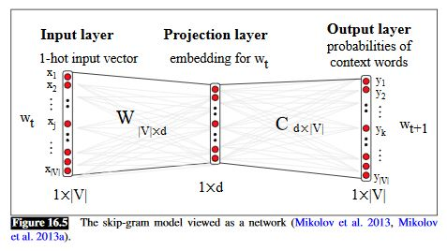
Word2vec as NN (from older draft of J&M)

Slide 16
Skip-gram with Negative Sampling
In practice, neural networks are not actually used to learn the word embeddings
Calculating the dot product of each center word with every word in the vocabular would be too expensive
Instead, skip-gram with negative sampling is used; we will only discuss this at a conceptual level
Basically, for each target word, the actual context words within the window size are used to push the target vector and context vectors closer to each other
Additionally, k words from the vocabulary are randomly chosen and assumed to be non-context words; their context vectors and the target vector are pushed further apart
Typical values of k range from 5 to 20, with smaller datasets requiring higher values of k to achieve good results
The k negative sampled words are typically chosen with probabilities proportional to their unigram frequencies raised to the power of 0.75
Learning word embeddings using the skip-gram method with negative sampling is much faster than training a neural network, and it produces embeddings that are about as useful

Slide 17
Embeddings for Word Similarity
We have learned that word2vec word embeddings have been learned for the purpose of predicting nearby words
However, they turn out to be useful for many other NLP-related tasks
One thing that word embeddings can simply be used for is to compute word-to-word similarity
We can simply compute the dot product between two embeddings
We can also look for the closest embeddings in the d-dimensional space to that of any particular specified word; for example:

Slide 18
Visualizing Word Embeddings
To help with visualization of word embeddings, the d-dimensional vectors can be mapped to two dimensions
One approach to do this is principal component analysis (PCA)
Today, a more popular method is known as t-SNE
These t-SNE plots can also help visualize differences between embeddings
In fact, differences between embeddings also seem to be meaningful!

Slide 19
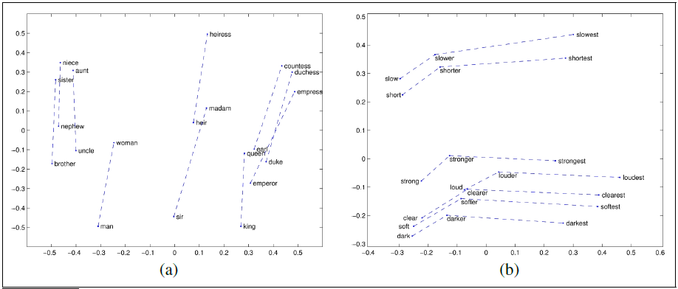
Visualizing Embeddings (t-SNE plot from J&M)

Slide 20
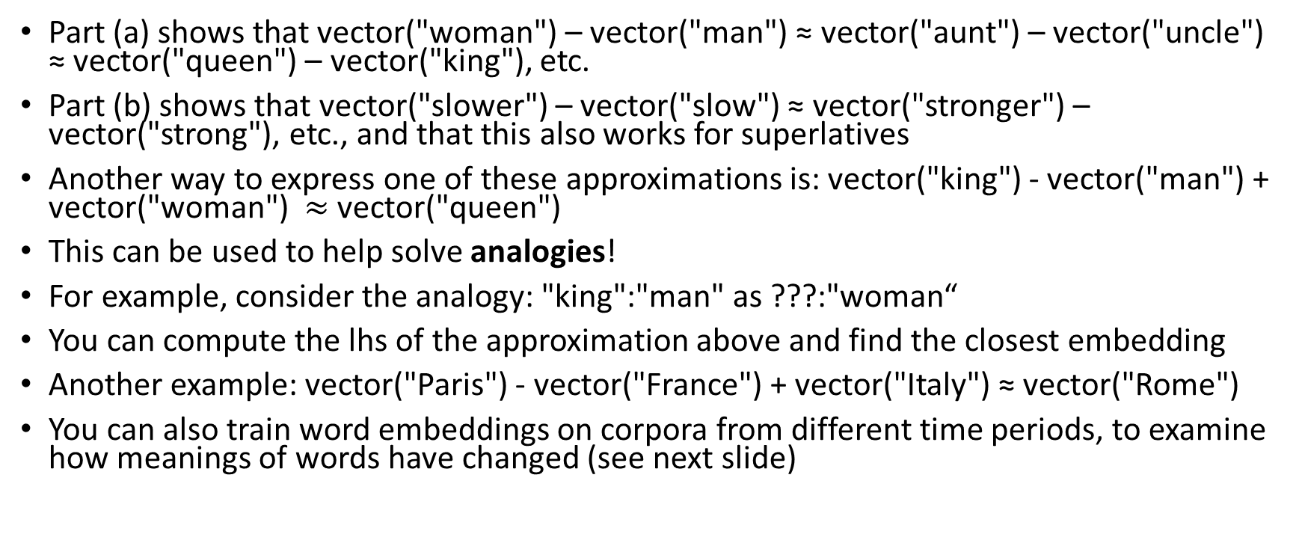
Differences Between Embeddings (examples)
Part (a) shows that vector("woman") – vector("man") ≈ vector("aunt") – vector("uncle") ≈ vector("queen") – vector("king"), etc.
Part (b) shows that vector("slower") – vector("slow") ≈ vector("stronger") – vector("strong"), etc., and that this also works for superlatives
Another way to express one of these approximations is: vector("king") - vector("man") + vector("woman") $≈$vector("queen")
This can be used to help solve analogies!
For example, consider the analogy: "king":"man" as ???:"woman“
You can compute the lhs of the approximation above and find the closest embedding
Another example: vector("Paris") - vector("France") + vector("Italy") ≈ vector("Rome")
You can also train word embeddings on corpora from different time periods, to examine how meanings of words have changed (see next slide)

Slide 21
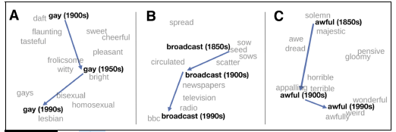
Historical Semantics and Embeddings (t-SNE)

Slide 22
Evaluating Word Embeddings
There are various ways to evaluate word embeddings
Word similarity scores can be correlated to human judgements of similarity
The embeddings can be evaluated with word analogy tasks
The embeddings can be used for other, more complex tasks, and the performance on those tasks can then be evaluated
This would be an example of extrinsic evaluation
Examples of tasks that rely on embeddings include sentence classification, machine translation, question answering, etc.

Slide 23
Using Word Embeddings with NNs
Word embeddings can now be used as inputs to various forms of NNs, including feedforward neural networks, convolutional neural networks, and recurrent neural networks (RNNs)
In this course, we will focus on recurrent neural networks, because these are unusually different from other neural networks, and have been used in NLP more than other fields
Until a few years ago, they also dominated the field for many NLP tasks
More recently, transformer-based architectures have performed even better for most of these tasks)
Depending on the task, either pre-trained word embeddings (e.g., from word2vec) can be used, or lower layers of the networks can learn task-specific and domain-specific embeddings
For some tasks, such as POS-tagging, each input word gets mapped to a predicted token (e.g., a POS tag or an IOB tag)
For other tasks, such as text categorization, a document or a sentence gets mapped to a category
For other tasks, such as machine translation, where we want to map an input sequence to an output sequence, an encoder-decoder model is used

Slide 24
Simple RNN
A recurrent neural network (RNN) "is any network that contains a cycle within its network connections"
We will start by covering simple recurrent networks, a.k.a. Elman networks or vanilla RNNs
A simple RNN has a single hidden layer, with outputs that lead back to its own inputs; the J&M textbook calls this a recurrent link
As with feedforward neural networks, layers can be implemented as vectors, and weights between layers can be implemented as matrices
The recurrent link can also be implemented as a matrix

Slide 25
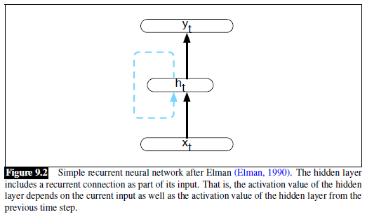
Simple RNN: Diagram

Slide 26
Simple RNN: Equations
The equations describing what happens at each time step are:
h_{t} = g(Uh_{t-1} + Wx_{t})
y_{t} = f(Vh_{t})
If the output layer is assumed to be a softmax layer, we can write:
y_{t} = softmax(Vh_{t})
Sometimes you will see additional terms in the parentheses representing bias weights; for example:
h_{t} = g(Uh_{t-1} + Wx_{t} + b_{h})
y_{t} = f(Vh_{t} + b_{y})

Slide 27
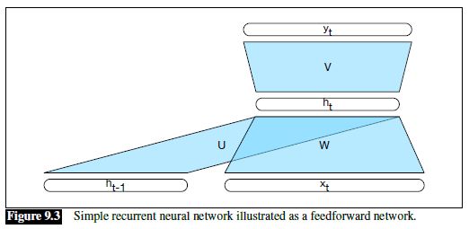
Simple RNN: Single Time Step

Slide 28
Simple RNN: Unrolling an RNN
It is common to depict an RNN as unrolled (e.g., see the next slide)
Basically, each time step (for some fixed number of time steps) is drawn separately
The number of depicted time steps shown in the unrolled network is arbitrary
When a simple RNN is applied to input, it keeps taking inputs until there are no more
Such a diagram helps intuit how forward inference in an RNN proceeds
The values at the hidden layers and output nodes are changing, but the U, W, and V matrices are not (they change during training, but not during forward inference)
As with feedforward neural networks, the network can be trained using stochastic gradient descent and backpropagation!
The matrices change multiple times during the backpropagation of a single example or batch; for RNNs, this is sometimes called backpropagation through time

Slide 29
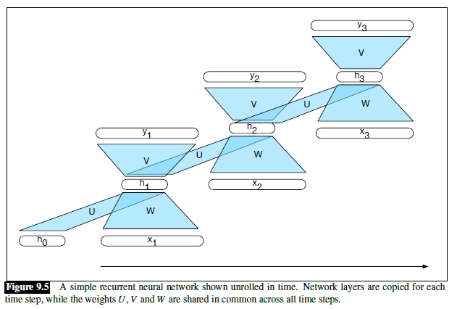
Simple RNN: Unrolled

Slide 30
Simple RNN: Sequence labelling
Sequence labeling refers to any task that involves categorizing every item in a sequence
One example is part-of-speech tagging (POS tagging)
See the next slide for a diagram of a simple RNN that can be used for POS tagging
The softmax layer is used to here pick the single most likely tag, given the current hidden state
The current hidden state, in turn, is based on the current word’s embedding and the previous hidden state
Recall that conventional approaches for POS tagging include hidden Markov models (HMMs) and maximum entropy Markov models (MEMMs)
In general, state-of-the-art deep learning POS taggers do a bit better than state-of-the-art MEMM POS taggers which do a bit better than state-of-the-art HMM POS taggers
State-of-the-art deep learning taggers do not use simple RNNs, but rather use variations of RNNs that we have not discussed yet

Slide 31
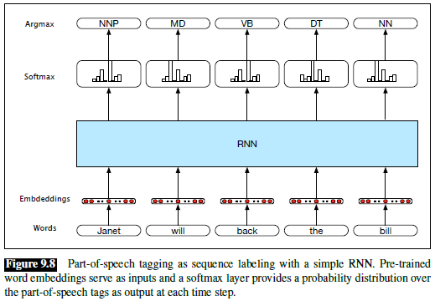
Simple RNN: POS tagging

Slide 32
Simple RNN: Text Categorization
Simple RNNs can be applied for text categorization (TC)
As with other tasks we have discussed, state-of-the-art RNN results involve variations of RNNs that we haven’t yet discussed
RNNs, in general, have mostly been successful for the categorization of short sequences of text, such as tweets or individual sentences
See the next slide for a diagram of a simple RNN that can be used for TC
When an RNN is applied for TC, a common approach is to have the final hidden state become the input to a feedforward neural network
It is common to think of the final hidden state as representing the meaning of the text
As with all neural networks we have looked at, the network can be trained end-to-end using stochastic gradient descent and backpropagation

Slide 33
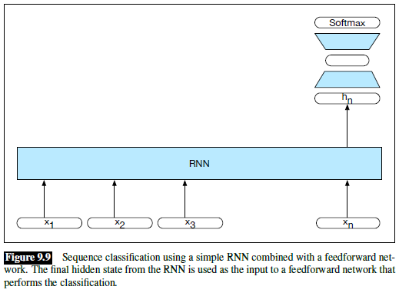
Simple RNN: TC Example Network

Slide 34
Stacked RNNs
A stacked RNN uses the hidden stated produced by one RNN as the inputs to the next
We can then refer to each RNN as a layer
The final RNN in the stack produces the final outputs for the stack
Stacks RNNs have outperformed single-layer RNNs for many tasks
The optimal number of RNN layers varies according to the task and the training set
Adding additional layers of RNNs can significantly increase the training time

Slide 35
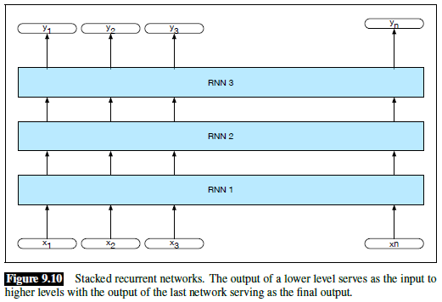
Stacked RNN Diagram

Slide 36
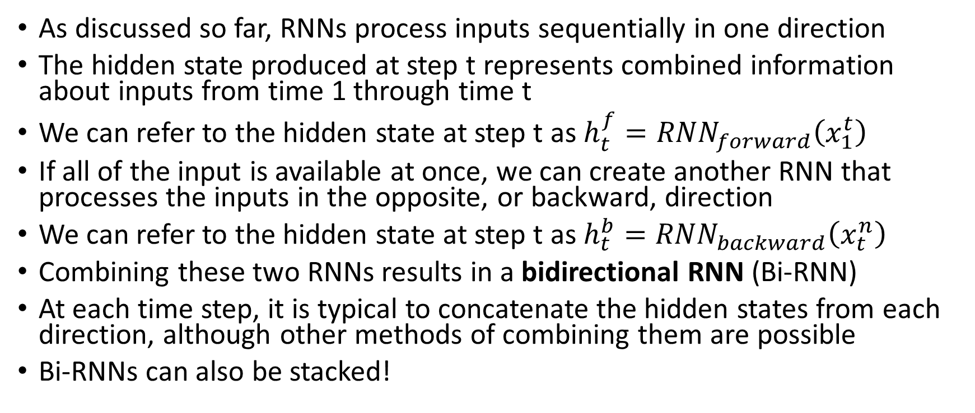
Bidirectional RNNs
As discussed so far, RNNs process inputs sequentially in one direction
The hidden state produced at step t represents combined information about inputs from time 1 through time t
We can refer to the hidden state at step t as $h_{t}^{f}={RNN}_{forward}\left(x_{1}^{t}\right)$
If all of the input is available at once, we can create another RNN that processes the inputs in the opposite, or backward, direction
We can refer to the hidden state at step t as $h_{t}^{b}={RNN}_{backward}\left(x_{t}^{n}\right)$
Combining these two RNNs results in a bidirectional RNN (Bi-RNN)
At each time step, it is typical to concatenate the hidden states from each direction, although other methods of combining them are possible
Bi-RNNs can also be stacked!

Slide 37
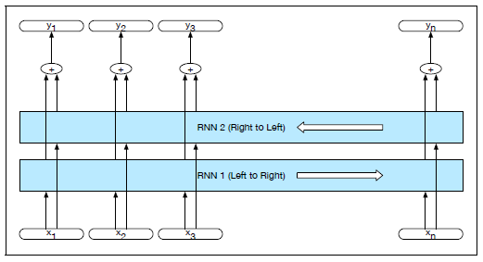
Bi-RNN for Sequence Labelling

Slide 38
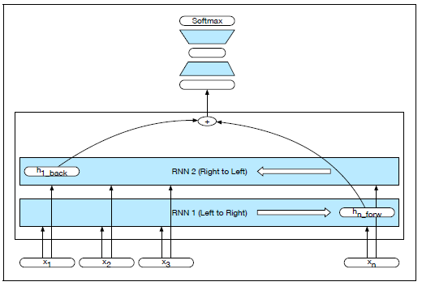
Bi-RNN for Text Categorization

Slide 39
The Vanishing Gradient Problem
During backpropagation, for each layer or time step that error is backpropagated, there is a multiplication taking place
Typically, these multiplications reduce the gradients; that is, the further back we go, the less significant layers or states seem to be
This leads to the vanishing gradient problem; it affects all deep neural network architectures (not just RNNs)
For other sorts of architectures (e.g., CNNs and feed-forward NNs), rectified linear units (ReLUs) mitigate the problem to an extent
However, ReLUs are not typically used for RNNs
There is a related problem known as the exploding gradient problem
That can be dealt with very simply, by just placing a cap on the gradients

Slide 40
Non-local Context
Without any solution to mitigate the vanishing gradient problem, only very local context winds up being significant
I have read that, for NLP tasks, hidden states in a simple RNN are only significantly influenced by the previous two or three words
Sometimes that is not enough
Consider: "The flights the airline was cancelling were full."
In order to know that "were" is the appropriate word, we need to recognize that the subject of the sentence, "flights", is plural
Note that the only other noun in between, "airline", is singular

Slide 41
Long Short-Term Memory Units
Long short-term memory (LSTM) networks provide one solution for mitigating the vanishing gradient problem
Often, the network or layer as a whole is just referred to as an LSTM
It is common to depict LSTMs graphically in terms of cells, also sometimes called units
Such depictions show the LSTM unrolled; the cell is the component of the architecture that repeats
We can also depict simple RNNs as cells, for a quick comparison
We will only discuss LSTMs briefly in this course

Slide 42
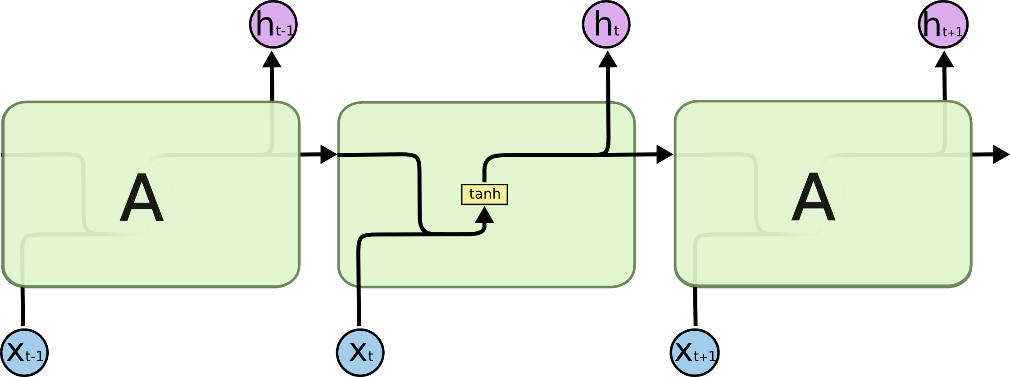
A Simple RNN Viewed in Terms of Cells
https://colah.github.io/posts/2015-08-Understanding-LSTMs

Slide 43

An LSTM Viewed in Terms of Cells
https://colah.github.io/posts/2015-08-Understanding-LSTMs

Slide 44
LSTM Cells
LSTM cells have two sets of values (which we can think of as vectors) that are passed between cells (really being passed as feedback between one time step and the next)
One set of values (the one on top in the figure) is typically referred to as the cell state
The other set of values is the cell's hidden state
A single LSTM cell/unit accepts as input the previous cell's state, the previous cell's hidden state, and the current input (which is also a vector)
The cell generates an updated cell state and an updated hidden state, which are passed to the next cell (really the same unit at the next time step)
The hidden state can also serve as the cell's output (i.e., it is visible outside the cell and can be used for classification, as input to a stacked LSTM layer, etc.)
Certain components of each cell are referred to as gates
The gates, along with the previous hidden state and the current input, help to determine which parts of the previous cell state to keep and/or forgot
As with other NN architectures that we have covered, we can learn the weights (i.e., train the LSTM) using stochastic gradient descent and backpropagation

Slide 45
Encoder Decoder Networks
Many NLP tasks involve mapping a sequence of text to another sequence of text
Examples include machine translation (MT), summarization, and (in some sense) question-answering (QA)
Encoder-decoder networks, also known as sequence-to-sequence (seq2seq) models are capable of this
The first portion of such a network is the encoder, which processes the input sequence, resulting in a context
The second part of a network, called the decoder, starts with the context and generates the output sequence
We will not discuss encoder-decoder networks in detail in this course

Slide 46
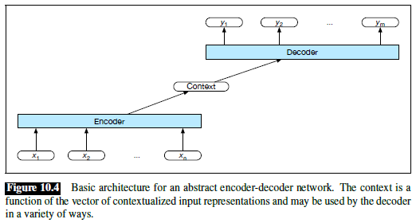
Basic Encoder-Decoder Network

Slide 47
Attention
One issue is that, as the output sequence is generated, the relative importance of different portions of the input sequence change
A very important concept known as attention can help to deal with this
Instead of having a static context vector, a different context vector is generated at each time step of the decoder
The next slide shows a graphical depiction of attention from the J&M textbook
Circa 2016, LSTMs with attention dominated the field of NLP
We will not discuss attention in detail in this course

Slide 48
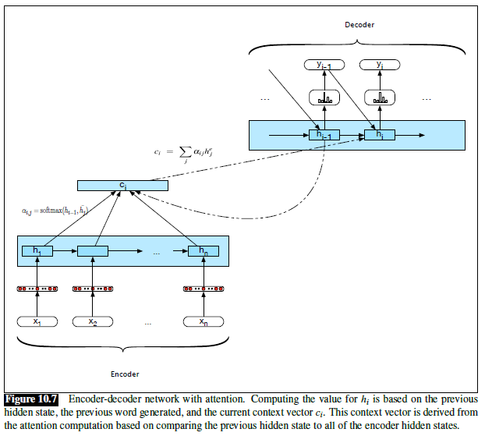
Attention: Graphical Depiction

Slide 49
Transformers
In December 2017, a paper titled "Attention is All You Need" was published by a group of researchers from Google
The paper introduces a new neural architecture called a Transformer, which does not rely on any recurrence or convolutions
A Transformer is another example of an encoder-decoder network
The encoder and decoder rely on stacked layers, and each layer has sub-layers
Some sublayers rely on a concept called self-attention
Other sublayers are pointwise, fully-connected, feed-forward NNs
The decoder also uses attention applied to the encoder output
Since the publication, variations of transformers have dominated the field of NLP
We will not discuss Transformers in detail in this course

