Slide 1
ECE469: Artificial Intelligence
Non-parametric Machine Learning

Slide 2
Non-parametric Machine Learning
Parametric models of machine learning (ML) summarize training data using learned parameters; non-parametric models do not
Most of the ML approaches we have learned about so far have been parametric
Decision trees are generally considered non-parametric, but the two methods we cover in this topic are interestingly different
In this topic, we will discuss two non-parametric models of ML
First, we will discuss the k-nearest neighbor approach
Second, we will discuss support vector machines

Slide 3
K-Nearest Neighbors
Instance-based learning (a.k.a. memory-based learning) is sub-category of learning algorithms that store all training examples in memory
One example of such an approach is called k-nearest neighbors (kNN); we will discuss this approach in the context of classification (a.k.a. categorization)
My description of the general idea: To predict the category of an example based on its properties, use the known labels of examples with similar properties
Given an example for which an agent needs to make a prediction:
First, the approach compares the example to every training example
Next, it retrieves the k-nearest training examples
Then, it uses these k training examples to predict the category of the new example
The value of k can be hard-coded, or it can vary based on the size of the training set
If hard-coded, the decision can be based on a validation set or cross-validation experiments
If we are dealing with Boolean categories, the new example can be predicted to belong to every category that is assigned to over half of the nearest training examples
If we are dealing with mutually exclusive and exhaustive categories, it can be predicted to belong to the single category that is most common for the nearest training examples

Slide 4
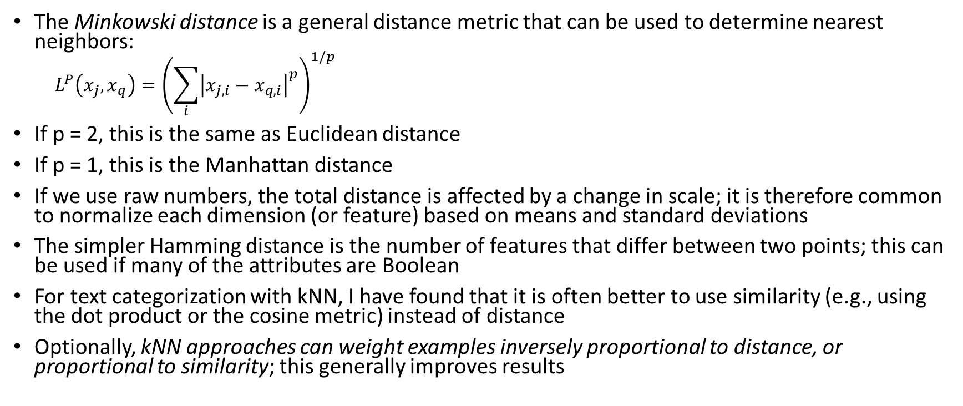
Determining Nearest Neighbors
The Minkowski distance is a general distance metric that can be used to determine nearest neighbors:
$$L^{P}\left(x_{j},x_{q}\right)={\left(\sum_{i}{{\left|x_{j,i}−x_{q,i}\right|}^{p}}\right)}^{1/p}$$
If p = 2, this is the same as Euclidean distance
If p = 1, this is the Manhattan distance
If we use raw numbers, the total distance is affected by a change in scale; it is therefore common to normalize each dimension (or feature) based on means and standard deviations
The simpler Hamming distance is the number of features that differ between two points; this can be used if many of the attributes are Boolean
For text categorization with kNN, I have found that it is often better to use similarity (e.g., using the dot product or the cosine metric) instead of distance
Optionally, kNN approaches can weight examples inversely proportional to distance, or proportional to similarity; this generally improves results

Slide 5
kNN Efficiency (or lack thereof)
Although kNN is very simple to implement, for some tasks, it achieves very good results
The training of a kNN system is virtually non-existent; the system basically just remembers the training examples
Unfortunately, applying a kNN system can be inefficient (to make predictions) in high-dimensional spaces (e.g., text categorization)
The textbook discusses how to use k-d trees to make this somewhat more efficient
There are also techniques for finding approximate nearest neighbors that are faster

Slide 6
Support Vector Machines
A very successful machine learning approach relies on support vector machines (SVMs)
The 3rd Edition of the book calls SVMs “currently the most popular approach for off-the-shelf supervised learning”
The 4th Edition says this “was the most popular approach” in the early 2000s
We are not going to cover this subtopic in detail; the mathematical analysis of SVMs is somewhat complex
SVMs allow efficient training and the ability to represent complex, non-linear functions (in effect, giving us the best of both worlds of machine learning approaches)
As with kNN learning, SVM learning is considered a non-parametric method
SVMs also retain the training examples, but often only a small fraction of them are needed
There has also been extensive mathematical analysis deriving expected error bounds when SVMs are used (although various assumptions are built into these analyses)

Slide 7
Maximum Margin Separators
Support vector machines find the maximum margin separator
This is defined as the linear separating hyperplane with the largest margin between the positive examples on one side and the negative examples on the other side
Finding the optimal linear separator is a quadratic programming optimization problem
We are not going to cover the details (neither does the book)
So far, this might sound like SVMs would be severely limited in expressivity, the same as perceptrons
However, we will see that SVMs do not find linear separators in the original feature space
The principal idea behind SVMs: Data that is not linearly separable can be mapped to a feature space of higher dimension in which it is linearly separable (or close to it)

Slide 8
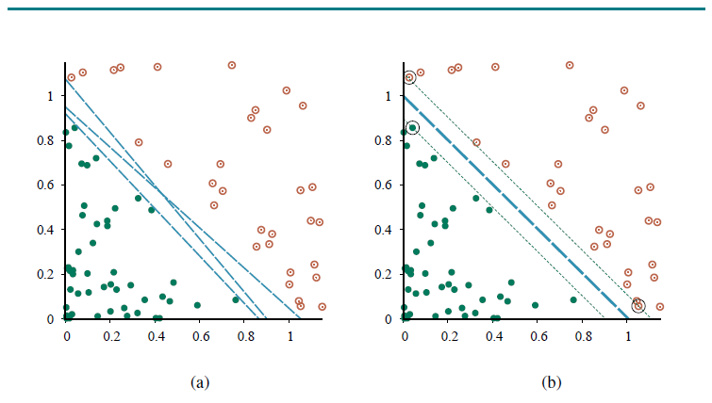
Maximum Margin Separator Example

Slide 9
Classifying New Examples
Assume for now that we are computing a hyperplane in the original feature space, and the data is linearly separable
Classification of a new data point can be performed by mapping the data point to the feature space and determining on which side of the hyperplane it falls
Determining on which side of a hyperplane some data point falls can be determined by the sign of a weighted sum of dot products: h(x) = sign(∑_{j} α_{j}y_{j}(x∙x_{j})-b)
Here, we are looping through the training examples; for the training example x_{j}, its class, y_{j}, is either +1 or -1 and α_{j} is the example’s weight
Important: The weights of all points are zero except for those points that are closest to the hyperplane
These closest points are called support vectors, and they define the margin
If you remove all the other training examples (except for the support vectors), the hyperplane would not change
This may seem counter-intuitive; but another thing that many descriptions of SVMs do not make clear is that, in practice, there are often many support vectors

Slide 10
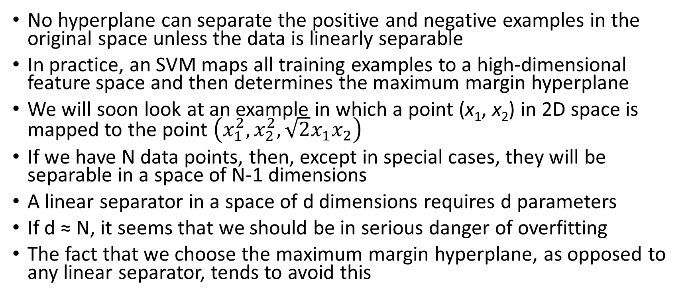
Higher Dimensional Feature Spaces
No hyperplane can separate the positive and negative examples in the original space unless the data is linearly separable
In practice, an SVM maps all training examples to a high-dimensional feature space and then determines the maximum margin hyperplane
We will soon look at an example in which a point (x₁, x₂) in 2D space is mapped to the point $\left(x_{1}^{2},x_{2}^{2},\sqrt{2}x_{1}x_{2}\right)$
If we have N data points, then, except in special cases, they will be separable in a space of N-1 dimensions
A linear separator in a space of d dimensions requires d parameters
If d ≈ N, it seems that we should be in serious danger of overfitting
The fact that we choose the maximum margin hyperplane, as opposed to any linear separator, tends to avoid this

Slide 11
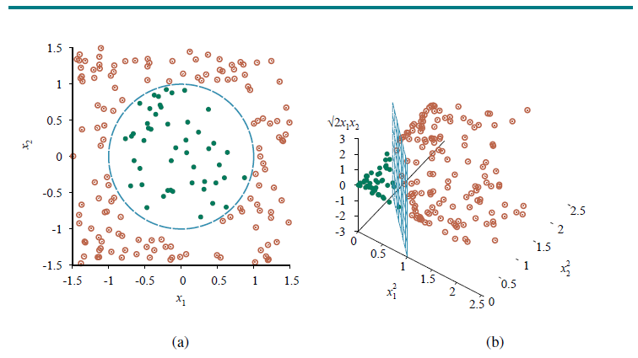
Higher Dimensional Feature Space Example

Slide 12
The Kernel Trick
So far, it would seem that x∙x_{j} in the formula needs to be replaced with F(x) ∙F(x_{j}), where F is a function that maps a vector from the original input space to the new feature space
This could be very expensive computationally, but it turns out it is not necessary
In many cases, a kernel function can be applied to data in the input space to evaluate dot products in some feature space
Different kernel functions correspond to different feature spaces
The kernel function is usually expressed as K(x_{i}, x_{j})
For example, for the 2D to 3D mapping we looked at, K(x_{i}, x_{j}) = F(x_{i}) ∙F(x_{j}) = (x_{i} ∙x_{j})²
Kernel functions are also used during training to make the learning more efficient
Some sources (including our textbook) refer to this use of a kernel as “the kernel trick”
According to the textbook, “optimal linear separators can be found efficiently in feature spaces with billions of (or, in some cases, infinitely many) dimensions”
The book continues: “The resulting linear separators, when mapped back to the original input space, can correspond to arbitrarily wiggly, non-linear decision boundaries…”

Slide 13
Other Notes about SVMs
Choosing a kernel function (which corresponds to a feature space) is sometimes a bit arbitrary in practice
For example, certain functions tend to do well for text categorization
Even in the new feature space, the examples will often not be entirely linearly separable
Then the algorithm actually finds a hyperplane that does a good, but not a perfect, job separating positive from negative examples
At one point, SVMs led to state-of-the-art performance for many classification tasks
I personally found in my own research that they generally performed very well for Boolean classification
Using SVMs for mutually exclusive, exhaustive categories is somewhat hacky
For example, a system may need choose the category leading to the largest positive distance (or smallest negative distance) from the hyperplane computed for that category

