Slide 1
ECE469: Artificial Intelligence
Probability

Slide 2
Chapters we are Skipping
We are skipping Chapter 6 from the "Problem-solving" section of the textbook
We are skipping all chapters from the "Knowledge, reasoning, and planning" section of the textbook
In the 4th Edition of the textbook, these chapters are:
Chapter 6: Constraint Satisfaction Problems
Chapter 7: Logical Agents
Chapter 8: First-Order Logic
Chapter 9: Inference in First-Order Logic
Chapter 10: Knowledge Representation
Chapter 11: Automated Planning
The textbook titles the next section, "Uncertain knowledge and reasoning"

Slide 3
Acting under Uncertainty
Many agents must often act under uncertainty due to partial observability or non-determinism
Strictly speaking, if a logical agent cannot conclude that any particular cause of action will achieve its goal, it will be unable to act
A logical agent may rely on a belief state, representing the set of all possible world states that it might be in
It might be able to generate a contingency plan that handles every possibility
However, the belief states and the contingency plans themselves may become arbitrarily large, and there might not be any plan that is guaranteed to achieve the goal
The belief state of a rational agent also specifies the probabilities of all possible world states
Book: "The right thing to do – the rational decision – therefore depends on both the relative importance of various goals and the likeliness that, and degree to which, they will be achieved.“
One real-world example dealing with uncertainty: Getting to the airport on time
Another example: diagnosis in various domains (medicine, automobile repair, dental, etc.)

Slide 4
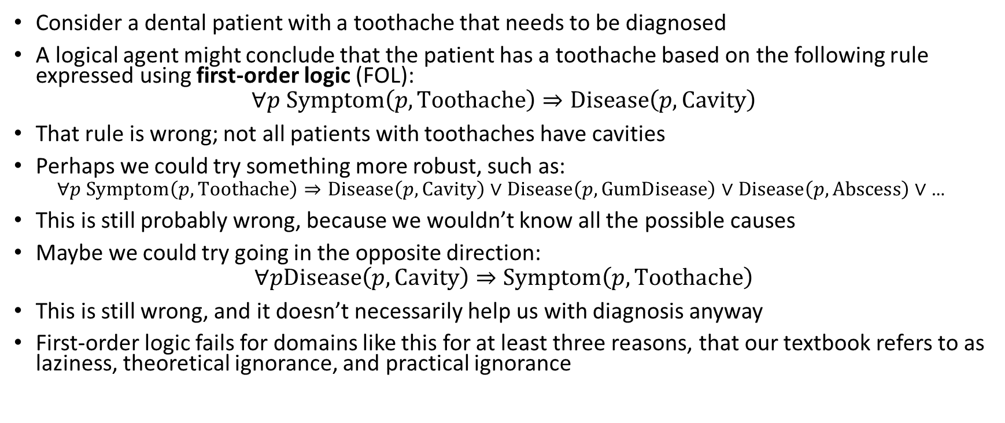
First-order Logic Doesn’t Cut It
Consider a dental patient with a toothache that needs to be diagnosed
A logical agent might conclude that the patient has a toothache based on the following rule expressed using first-order logic (FOL):
$$∀p Symptom\left(p,Toothache\right)⇒Disease\left(p,Cavity\right)$$
That rule is wrong; not all patients with toothaches have cavities
Perhaps we could try something more robust, such as:
$$∀p Symptom\left(p,Toothache\right)⇒Disease\left(p,Cavity\right) \text{∨} Disease\left(p,GumDisease\right) \text{∨} Disease\left(p,Abscess\right)\text{ ∨} \text{…}$$
This is still probably wrong, because we wouldn’t know all the possible causes
Maybe we could try going in the opposite direction:
$$∀pDisease\left(p,Cavity\right)⇒Symptom\left(p,Toothache\right)$$
This is still wrong, and it doesn’t necessarily help us with diagnosis anyway
First-order logic fails for domains like this for at least three reasons, that our textbook refers to as laziness, theoretical ignorance, and practical ignorance

Slide 5
Probability Theory
The agent's knowledge can only provide degrees of belief of relevant facts
The main tool to deal with degrees of belief is probability theory
According to our textbook, a probability of 0 or 1 represents the "unequivocal belief" that a sentence is either false or true (although the quoted phrase has been dropped from Ed. 4)
All other probabilities lie between 0 and 1, representing intermediate degrees of belief
This is different than degrees of truth
A sentence expressing a fact is still either true or false factually, we just don't know for certain
Fuzzy logic provides an alternate means of dealing with uncertainty in which values represent degrees of truth, but we will not discuss this further
Note: Not all sources agree with our textbook’s definition of probability
Our textbook uses what I would refer to as a Bayesian view of probability as opposed to what I would refer to as a frequentist view of probability; both views are common in the literature
Interpreting a probability as a degree of belief seemed unintuitive to me when I first encountered this
However, I’ve since concluded that both views are potentially problematic, and I currently think that the Bayesian view is probably better suited to deal with most AI contexts

Slide 6
Possible Worlds
In probability theory, the set of all possible worlds is called the sample space
In AI, we can think of the sample space as containing all possible configurations of an agent’s environment
The possible worlds are mutually exclusive and exhaustive; for now, we'll assume a discrete, countable set
A probability model assigns each possible world a probability between 0 and 1
The sum of the probabilities assigned to all possible worlds must be 1
Probabilistic assertions and queries are usually about particular sets of possible worlds; in probability theory, each such set is called an event
Note: I also find this definition of “event” unintuitive
However, in sources that take a frequentist view of probability, an event may be defined as the outcome of a hypothetical experiment

Slide 7
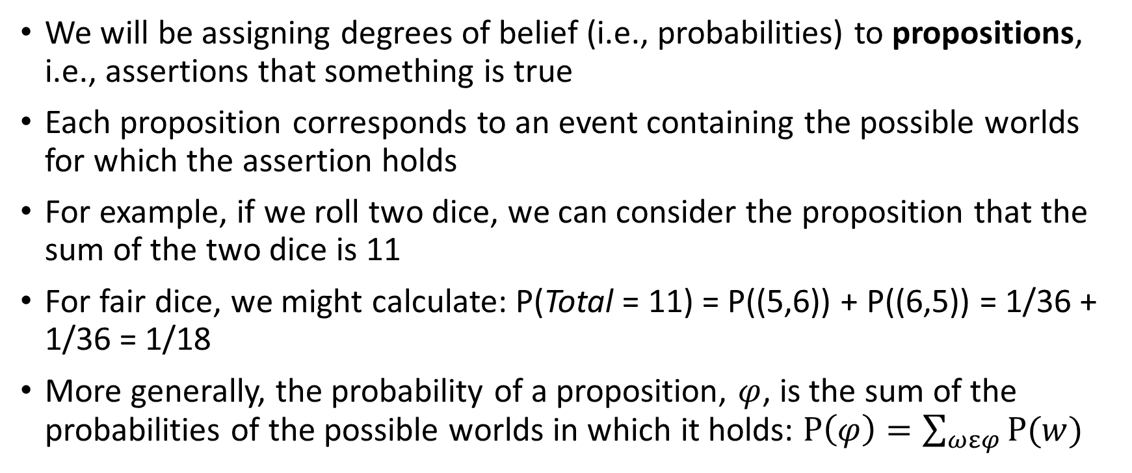
Propositions
We will be assigning degrees of belief (i.e., probabilities) to propositions, i.e., assertions that something is true
Each proposition corresponds to an event containing the possible worlds for which the assertion holds
For example, if we roll two dice, we can consider the proposition that the sum of the two dice is 11
For fair dice, we might calculate: P(Total = 11) = P((5,6)) + P((6,5)) = 1/36 + 1/36 = 1/18
More generally, the probability of a proposition, $φ$, is the sum of the probabilities of the possible worlds in which it holds: $P\left(φ\right)=\sum_{ωεφ}{P(w)}$

Slide 8
Prior and Conditional Probabilities
Before any evidence is obtained, there is an unconditional probability, a.k.a. a prior probability, for every proposition (these are also sometimes called priors)
An example of a prior probability is: P(Total = 11)
After evidence is obtained that changes our degree of belief, we have a conditional probability, a.k.a. posterior probability
For example, if we know the first die has landed on 5, we might consider P(Total = 11 | Die₁ = 5)
P(a | b) can be read as “the probability of a given b”
Mathematically, conditional probabilities are defined in terms of unconditional probabilities
For any propositions a and b: P(a | b) = P(a ^ b) / P(b)
We can rewrite this as the product rule: P(a ^ b) = P(a | b) * P(b)

Slide 9
Random Variables
Variables in probability theory are called random variables; by convention, we will represent random variables with capitalized names
Each random variable has a domain of values it can take on; there are three kinds of random variables that we will typically deal with, depending on the type of domain
Boolean random variables:
The domain of a Boolean random variable (e.g., Cavity) is <true, false>
We can abbreviate the proposition Cavity = true with the lowercase name cavity; Cavity = false can be abbreviated with ¬cavity
Discrete random variables (Boolean is really a special case of discrete):
They take on values from a countable domain; e.g., Weather has the domain <sun, rain, cloud, snow>
Values in the domain must be mutually exclusive and exhaustive; if there is no confusion, you can abbreviate Weather = snow with snow
Discrete random variables can have infinite domains (e.g., the integers)
Continuous random variables:
These take on values that are real numbers
The domain can be the entire real line or an interval; e.g., [0, 1]

Slide 10
Probability Distributions
Sometimes we want to express the probabilities of all possible values of a random variable
When dealing with a discrete random variable with a finite domain, this can be expressed as a vector
For example, suppose that P(Weather = sun) = 0.6, P(Weather = rain) = 0.1, P(Weather = cloud) = 0.29, and P(Weather = snow) = 0.01
We can write this as P(Weather) = <0.6, 0.1, 0.29, 0.01>, assuming we know which dimension of the vector corresponds to each possible value (also note the boldfaced ‘P’)
This defines a probability distribution for the random variable Weather
For a continuous random variable, it is not possible to write out the distribution as a vector, but we can express a probability density function
A joint probability distribution specifies the probabilities of all possible combinations of values for a set of random variables
The full joint probability distribution specifies probabilities for all random variables used to describe the world
If all the random variables are discrete with finite domains, then this can be specified by a table

Slide 11
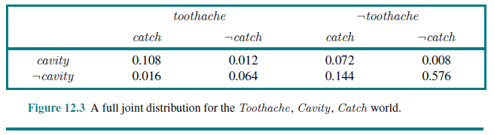
Full Joint Probability Distribution Example

Slide 12
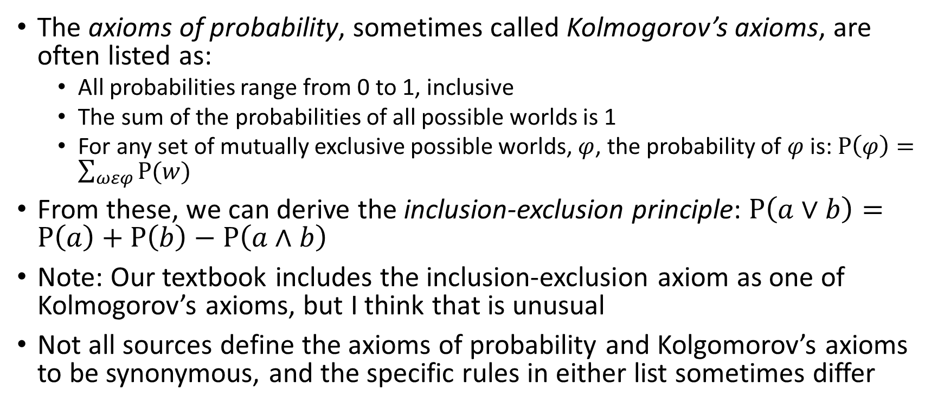
The Axioms of Probability
The axioms of probability, sometimes called Kolmogorov’s axioms, are often listed as:
All probabilities range from 0 to 1, inclusive
The sum of the probabilities of all possible worlds is 1
For any set of mutually exclusive possible worlds, $φ$, the probability of $φ$is: $P\left(φ\right)=\sum_{ωεφ}{P(w)}$
From these, we can derive the inclusion-exclusion principle: $P\left(a∨b\right)=P\left(a\right)+P\left(b\right)−P\left(a∧b\right)$
Note: Our textbook includes the inclusion-exclusion axiom as one of Kolmogorov’s axioms, but I think that is unusual
Not all sources define the axioms of probability and Kolgomorov’s axioms to be synonymous, and the specific rules in either list sometimes differ

Slide 13
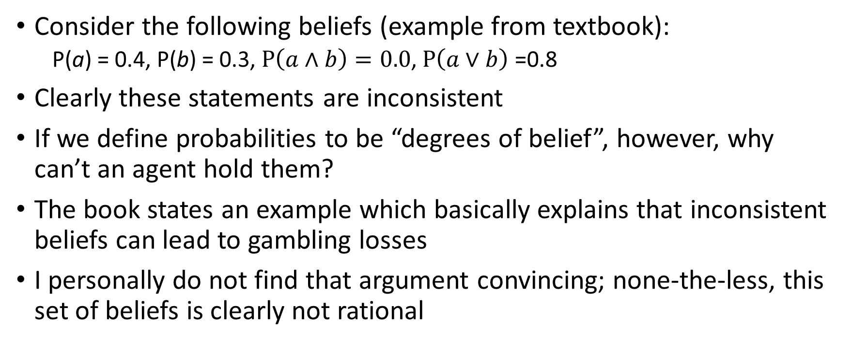
Inconsistent Beliefs
Consider the following beliefs (example from textbook):
P(a) = 0.4, P(b) = 0.3, $P\left(a∧b\right)=0.0$, $P\left(a∨b\right)$ =0.8
Clearly these statements are inconsistent
If we define probabilities to be “degrees of belief”, however, why can’t an agent hold them?
The book states an example which basically explains that inconsistent beliefs can lead to gambling losses
I personally do not find that argument convincing; none-the-less, this set of beliefs is clearly not rational

Slide 14
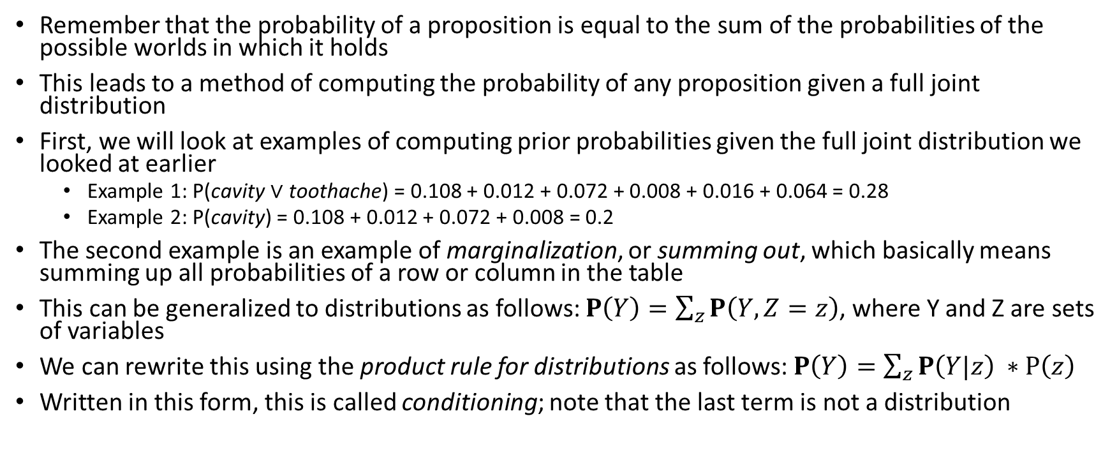
Computing Prior Probabilities
Remember that the probability of a proposition is equal to the sum of the probabilities of the possible worlds in which it holds
This leads to a method of computing the probability of any proposition given a full joint distribution
First, we will look at examples of computing prior probabilities given the full joint distribution we looked at earlier
Example 1: P(cavity $∨$ toothache) = 0.108 + 0.012 + 0.072 + 0.008 + 0.016 + 0.064 = 0.28
Example 2: P(cavity) = 0.108 + 0.012 + 0.072 + 0.008 = 0.2
The second example is an example of marginalization, or summing out, which basically means summing up all probabilities of a row or column in the table
This can be generalized to distributions as follows: $P\left(Y\right)=\sum_{z}{P\left(Y,Z=z\right)}$, where Y and Z are sets of variables
We can rewrite this using the product rule for distributions as follows: $P\left(Y\right)=\sum_{z}{P\left(Y|z\right)} ∗P\left(z\right)$
Written in this form, this is called conditioning; note that the last term is not a distribution

Slide 15
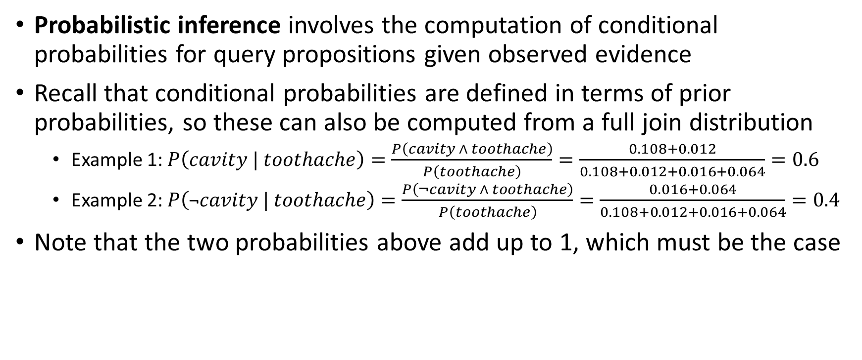
Probabilistic Inference
Probabilistic inference involves the computation of conditional probabilities for query propositions given observed evidence
Recall that conditional probabilities are defined in terms of prior probabilities, so these can also be computed from a full join distribution
Example 1: $P\left(cavity | toothache\right)=\frac{P\left(cavity ∧ toothache\right)}{P\left(toothache\right)}=\frac{0.108+0.012}{0.108+0.012+0.016+0.064}=0.6$
Example 2: $P\left(\text{¬}cavity | toothache\right)=\frac{P\left(\text{¬}cavity ∧ toothache\right)}{P\left(toothache\right)}=\frac{0.016+0.064}{0.108+0.012+0.016+0.064}=0.4$
Note that the two probabilities above add up to 1, which must be the case

Slide 16
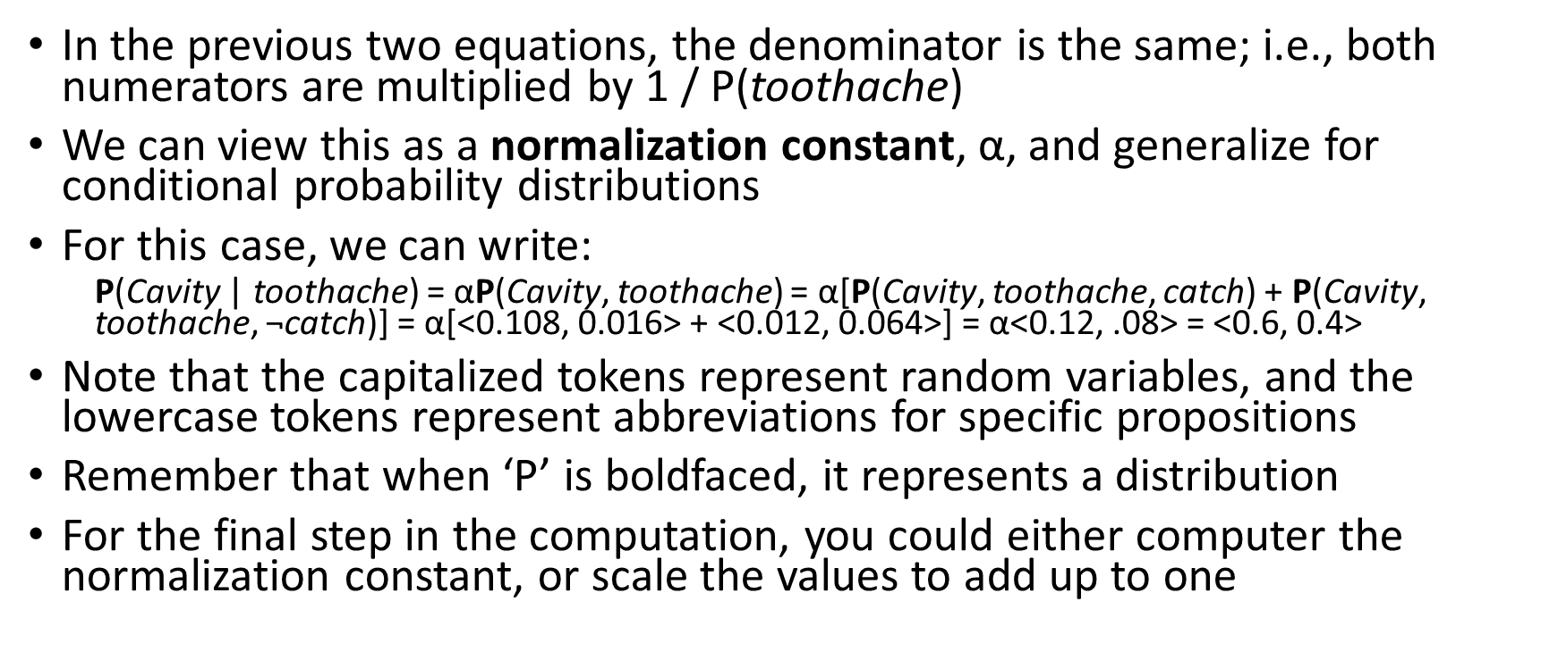
Normalization Constant
In the previous two equations, the denominator is the same; i.e., both numerators are multiplied by 1 / P(toothache)
We can view this as a normalization constant, α, and generalize for conditional probability distributions
For this case, we can write:
P(Cavity | toothache) = αP(Cavity, toothache) = α[P(Cavity, toothache, catch) + P(Cavity, toothache, $\text{¬}$catch)] = α[<0.108, 0.016> + <0.012, 0.064>] = α<0.12, .08> = <0.6, 0.4>
Note that the capitalized tokens represent random variables, and the lowercase tokens represent abbreviations for specific propositions
Remember that when ‘P’ is boldfaced, it represents a distribution
For the final step in the computation, you could either computer the normalization constant, or scale the values to add up to one

Slide 17
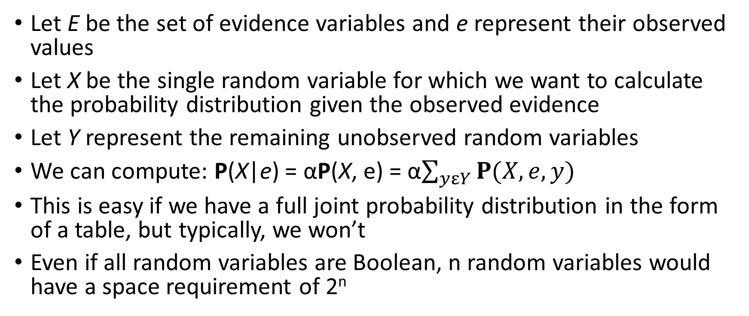
General Inference Procedure
Let E be the set of evidence variables and e represent their observed values
Let X be the single random variable for which we want to calculate the probability distribution given the observed evidence
Let Y represent the remaining unobserved random variables
We can compute: P(X|e) = αP(X, e) = α$\sum_{yεY}{P(X,e,y)}$
This is easy if we have a full joint probability distribution in the form of a table, but typically, we won’t
Even if all random variables are Boolean, n random variables would have a space requirement of 2^{n}

Slide 18
Independence
Now we will introduce Weather to the world of Cavity, Catch, and Toothache
Suppose we want to calculate P(toothache, catch, cavity, cloud)
Using the produce rule, we can equate this to P(cloud | toothache, catch, cavity) P(toothache, catch cavity)
It seems reasonably safe to conclude that the weather is not influenced by a patient’s dental conditions, and vice versa; with both assumptions, we can conclude that P(cloud | toothache, catch, cavity) = P(cloud)
From this, we can deduce that P(toothache, catch, cavity, cloud) = P(cloud) P(toothache, catch, cavity)
We can generalize this to distributions: P(Toothache, Catch, Cavity, Weather) = P(Weather | Toothache, Catch, Cavity) P(Toothache, Catch, Cavity) = P(Weather) P(Toothache, Catch, Cavity)
This works because the weather is (presumably) independent of a patient’s dental conditions; the property is known as independence (a.k.a. marginal independence or absolute independence)
The definition of independence between random variables X and Y can be written in any of these three ways: P(X | Y) = P(X) or P(Y | X) = P(Y) or P(X, Y) = P(X)P(Y)
Independence assertions are usually based on knowledge of the domain
If the complete set of random variables can be divided into independent subsets, the full joint distribution can be factored into separate joint distributions on each of those subsets

Slide 19
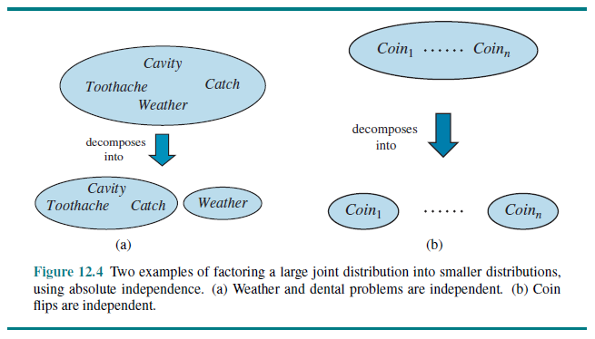
Factoring Examples

Slide 20
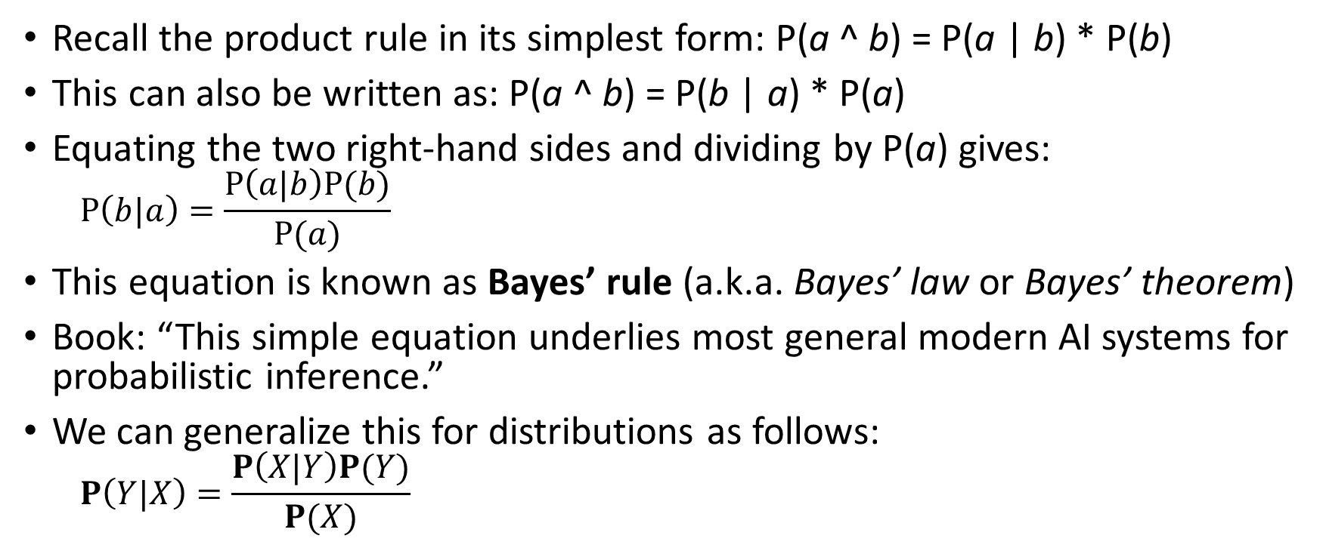
Bayes’ Rule
Recall the product rule in its simplest form: P(a ^ b) = P(a | b) * P(b)
This can also be written as: P(a ^ b) = P(b | a) * P(a)
Equating the two right-hand sides and dividing by P(a) gives:
$$P\left(b|a\right)=\frac{P\left(a|b\right)P(b)}{P(a)}$$
This equation is known as Bayes’ rule (a.k.a. Bayes’ law or Bayes’ theorem)
Book: “This simple equation underlies most general modern AI systems for probabilistic inference.”
We can generalize this for distributions as follows:
$$P\left(Y|X\right)=\frac{P\left(X|Y\right)P(Y)}{P(X)}$$

Slide 21
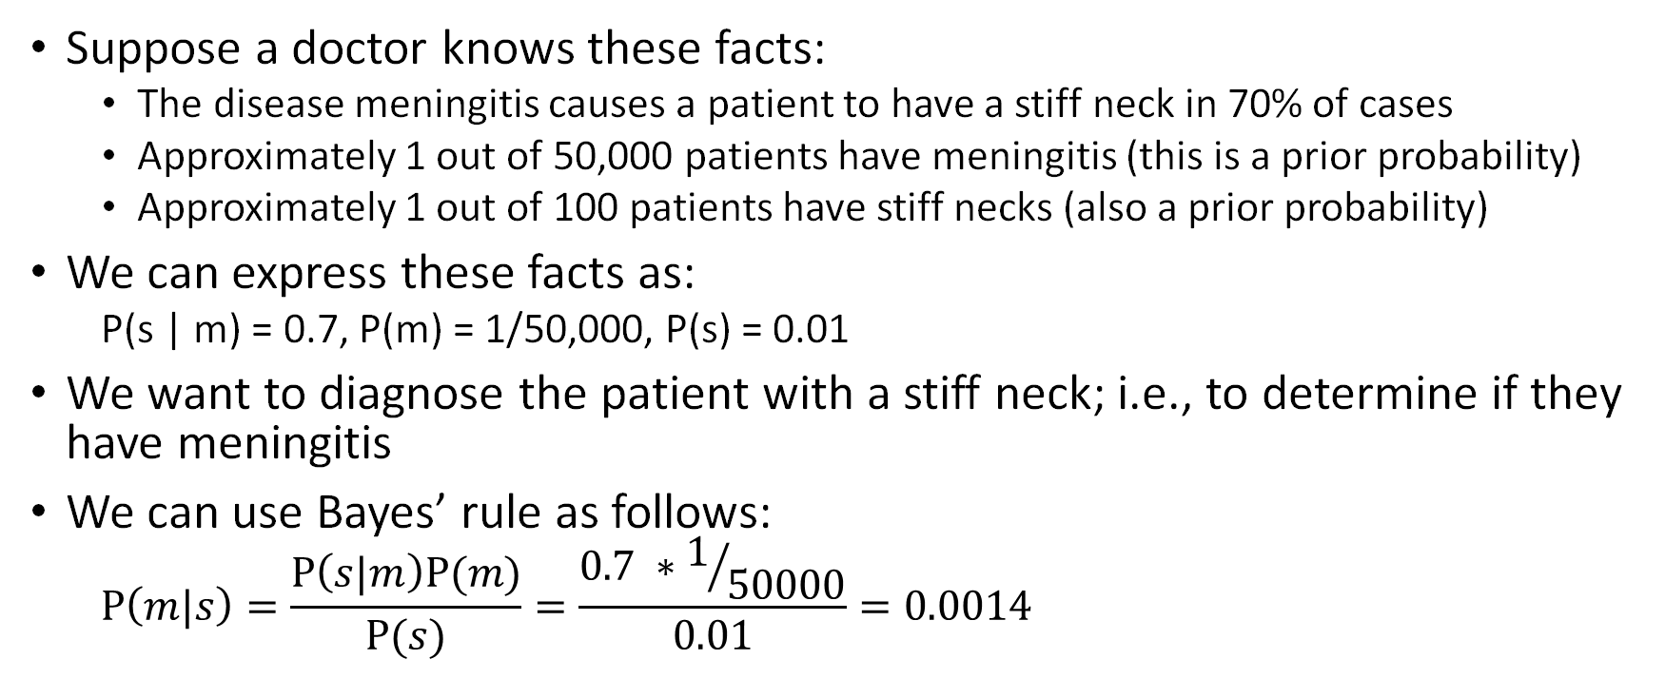
Bayes’ Rule Example
Suppose a doctor knows these facts:
The disease meningitis causes a patient to have a stiff neck in 70% of cases
Approximately 1 out of 50,000 patients have meningitis (this is a prior probability)
Approximately 1 out of 100 patients have stiff necks (also a prior probability)
We can express these facts as:
P(s | m) = 0.7, P(m) = 1/50,000, P(s) = 0.01
We want to diagnose the patient with a stiff neck; i.e., to determine if they have meningitis
We can use Bayes’ rule as follows:
$$P\left(m|s\right)=\frac{P\left(s|m\right)P(m)}{P(s)}=\frac{0.7 ∗1/{50000}}{0.01}=0.0014$$

Slide 22
Why is Bayes’ Rule Useful?
Bayes’ rule is useful when we have estimates of the right-hand probabilities and we need to estimate the left-hand probability
Let’s think about this in relation to the previous example
The doctor may know that a stiff neck implies meningitis in 0.14% of the time; this is an example of diagnostic knowledge
In practice, diagnostic knowledge is often more fragile than causal knowledge
For example, the percentage of times that a patient with a stiff neck has meningitis, P(m | s), could change during an epidemic of meningitis
However, P(s | m) would presumably not change, because it reflects the way that meningitis works
Probabilistic information is often available in the form P(effect | cause), and these values are unlikely to change

Slide 23
Combining Evidence
Now let’s say a patient goes to the dentist, and the dentist notes the following two facts:
The patient has a toothache
The dentist’s stick with a metal hook gets caught on the patient’s tooth
The dentist want to calculate the probabilities that the patient does (or does not) have a cavity
Note: I realize that, in reality, a dentist can check with their little mirror, or rely on x-rays, so we are taking this example with a grain of salt
We want to calculate: P(Cavity | toothache ^ catch)
Given the values in our full joint distribution, this becomes:
P(Cavity | toothache ^ catch) = α<0.018, 0.016> ≈ <0.871, 0.129>
However, in practice, we do not typically have a full joint distribution; it is not feasible for real-world problems with many variables

Slide 24
Applying Bayes’ Rule
We can apply Bayes’ rule to the multiple-variable case and obtain:
P(Cavity | toothache ^ catch) = α P(toothache ^ catch | Cavity) P(Cavity)
To finish this, we would need to have an estimate of the conditional probability of toothache ^ catch for each value of Cavity
This would be simpler if toothache and catch were independent; if so, we could write:
P(toothache ^ catch | Cavity) = P(toothache | Cavity) P(catch | Cavity)
However, toothache and catch are clearly not independent; e.g., if the hook catches, a cavity is more likely, making a toothache more likely
Fortunately, we can make a less strict assumption, and still use the same simplification; namely, toothache and catch are conditionally independent given Cavity
In this case, that means that once we know about the presence or absence of a cavity, knowing the value of toothache or catch provides no additional evidence of the other
Conditional independence assertions are more common in practice than absolute independence, and they allow probability systems to scale up
The definition of conditional independence of random variables X and Y given random variable Z can be written in these three ways: P(X | Y, Z) = P(X | Z) or P(Y | X, Z) = P(Y | Z) or P(X, Y | Z) = P(X | Z) P(Y | Z)

Slide 25
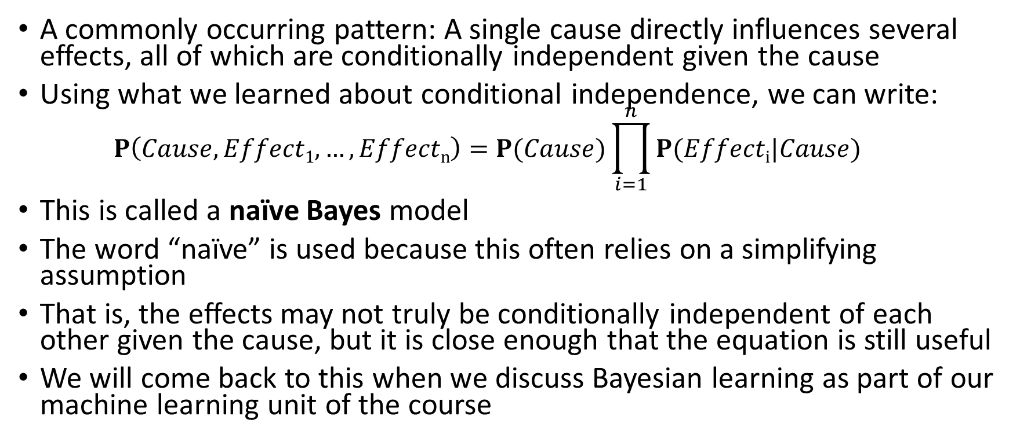
Naïve Bayes
A commonly occurring pattern: A single cause directly influences several effects, all of which are conditionally independent given the cause
Using what we learned about conditional independence, we can write:
$$P\left(Cause, Effect1, …, Effectn\right)=P(Cause)\prod_{i=1}^{n}{P(Effecti|Cause)}$$
This is called a naïve Bayes model
The word “naïve” is used because this often relies on a simplifying assumption
That is, the effects may not truly be conditionally independent of each other given the cause, but it is close enough that the equation is still useful
We will come back to this when we discuss Bayesian learning as part of our machine learning unit of the course

