Slide 1
ECE469: Artificial Intelligence
Simple Search

Slide 2
Problem-Solving Agents
A problem-solving agent is one type of goal-based agent
Such an agent will search for a sequence of actions that leads to a goal state; if found, the sequence of actions is said to be the solution
Such an agent often assumes that the environment is single agent, fully observable, deterministic, static, discrete, and known
The book also says episodic, but this is debatable
We can apply a simple "formulate, search, execute" strategy for such an agent
Solutions are executed without paying attention to percepts

Slide 3
Search Problems
A search problem can be defined by the following components:
The initial state indicates the state of the agent’s world at the start of the problem
The available actions: ACTIONS(s) returns the set of actions applicable in s
A transition model: RESULT(s, a) returns the state resulting from performing action a while in state s; we can call the resulting state a successor of s
A set of goal states (or a goal test) indicates what the agent is trying to achieve
An action cost function (or a path cost function):
ACTION-COST(s, a, s’) gives the cost of applying a at s to reach s’
The path cost is typically the sum of action costs, a.k.a. step costs
Optionally, the problem can also explicitly specify the set of reachable states
The process of removing detail from a representation, which is common when we formulate a search problem, is called abstraction
For example, in one of the map examples we will soon look at, there are many real-world parameters are left out

Slide 4
The State Space
The set of reachable states is also called the state space
The state space is also determined by the initial state, the available actions, and the transition model
The initial state is one member of the state space and the goal states are a subset of the state space
The state space can be viewed as a directed graph in which nodes represent states and edges represent actions
Earlier, we said that a solution to a search problem is a sequence of actions leading from the initial state to a goal state
We can alternatively consider a solution to be a path in the state space graph from the initial state to a goal state

Slide 5
Toy Problems
Toy problems are intended to illustrate various problem-solving methods
The 4th edition of the textbook calls them standardized problems (but I think this terminology is less common)
Real-world search problems (e.g., robot navigation) tend to be more difficult

Slide 6
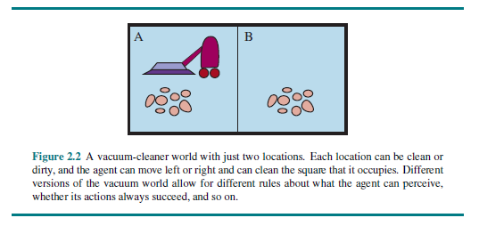
The Vacuum World Revisited

Slide 7
The Vacuum World Formulated
The vacuum world is an example of a grid world problem
The states: There are two locations, the agent is in one of them, and each location is or is not dirty
Therefore, there are 8 possible states
A larger environment with n locations would lead to n * 2^{n} states
The initial state: Any of the 8 states
The actions: Move left, move right, or clean (larger environments would have additional actions, and there are alternative formulations)
The transition model: Mostly intuitive, but moving left from the left square, moving right from the right square, and cleaning a clean square have no effect
The goal test: Checks if both squares are clean
The path cost: Each action costs 1

Slide 8
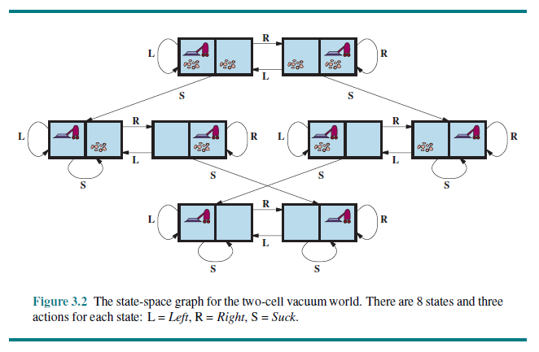
The Vacuum World State Space

Slide 9
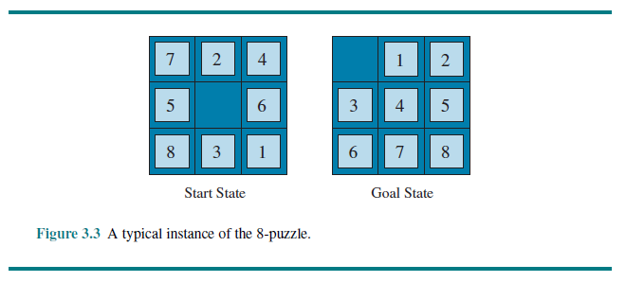
The 8-puzzle

Slide 10
The 8-puzzle Formulated
The 8-puzzle is an example of a sliding-block puzzle
The states: A state specifies the location of each of the 8 tiles and the blank
The 8-puzzle has 9!/2 = 181,440 reachable states, and this can be solved very fast
The 15-puzzle has about 10 trillion, or 10¹³, reachable states, and this can be solved in a few milliseconds by the best search algorithms
The 24-puzzle has about 10²⁵ reachable states; modern computers take hours to solve this
The initial state: Any of those states
The actions: The simplest formulation defines actions in terms of movements of the blank space (left, right, up, or down)
The transition model: Given a state and action, it specifies the next configuration
The goal test: Checks if we match the desired configuration
The path cost: Each action costs 1

Slide 11
The 8-queens Problem
The 8-queen problem: Place 8 queens on a chess board such that no two queens are attacking each other
The states: A state is any arrangement of 0 to 8 queens on the board
The initial state: No queens are on the board
The actions: Add a queen to any empty square (for now)
Transition model: Returns the board with a new queen added to the specified square
The goal test: Checks if 8 queens are on the board with none attacking any other
The path cost: This is of no interest for this problem
With this formulation, there are 64*63*…*57≈1.8*10¹⁴ possible sequences
A better idea: Add a queen to any square in the leftmost empty column such that it is not attacked; then there are only 2057 sequences (not all lead to solutions)

Slide 12
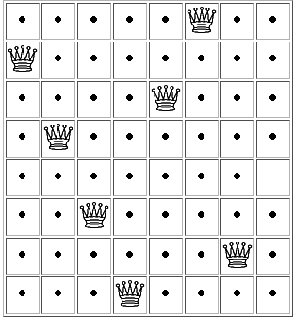
Solving the 8-queens Problem
As stated, there are 64*63*…*57 ≈ 1.8*10¹⁴ possible sequences
A better idea: Add a queen to any square in the leftmost empty column such that it is not attacked
Then there are only 2057 sequences (not all lead to solutions)
The state to the right is one action away from a solution
This is an incremental formulation; in our next topic, we will see a complete-state formulation
From http://www.brainmetrix.com/8-queens

Slide 13
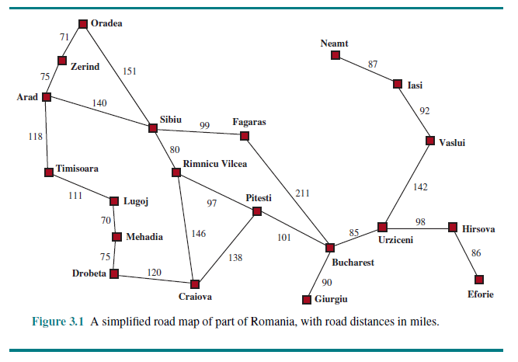
The Romania Map Problem

Slide 14
The Romania Map Problem Formulated
The Romania map problem: get from Arad to Bucharest
The states: Each possible city constitutes a state
The initial state: The starting city (we are assuming it is Arad)
The actions: For each possible city, the traveler can go to any adjacent city
Transition model: An action moves the traveler from the current city to the specified adjacent city
The goal test: Checks if we are at the desired destination (we are assuming it is Bucharest)
The path cost: The sum of the step costs

Slide 15
Examples of Real-World Search Problems
The airline travel problem (an example of a route-finding problem)
Travel websites need to solve this
The path cost should optimally consider monetary cost, flight time, waiting time, seat quality, time of day, type of airplane, frequent flyer awards, contingency plans, etc.
Driving directions (also a route-finding problem)
GPS devices and websites need to solve this
Unlike the Romania map problem, complications that must be considered include traffic, road closures, tolls, etc.
Robot navigation: This is a generalization of route-finding; there is a continuous space and an infinite set of actions
Others real-world search problems include touring problems, VLSI layout, protein design, etc.

Slide 16
Search Trees and Search Graphs
A search tree is generated by the initial state, the available actions, and the transition model
The node corresponding to the initial state is the root of the tree
If the same state can be reached by multiple paths, then we are really dealing with a more general search graph as opposed to a search tree
If actions are reversible, this leads to what the book calls loopy paths, which can lead to infinite loops in search implementations if we are not careful
More generally, a search graph can have redundant paths whenever there is more than one way to get from one state to another
Each node can be represented by a data structure with four components: its state, its parent node, the action (that took it here from the parent), and the path cost so far
It is important to remember the distinction between a node (stored in a data structure) and a state (a configuration of the world)
Multiple nodes can contain the same state

Slide 17
Expanding Nodes
We expand a node by applying all possible legal actions to generate a new set of nodes
The choice of which node to expand next depends on the chosen search strategy
The frontier (a.k.a. the open list or the fringe) is the collection of nodes that have been generated but not yet expanded
If we are considering the state space to be a tree (as opposed to a graph), each element of the frontier is a leaf node of the tree so far
The explored set (a.k.a. the closed list) keeps track of nodes that have already been expanded (so these are distinct from those on the frontier)
The reached nodes include those on the frontier and those on the explored set
Thus, the reached nodes include all nodes that have been generated, whether or not they have been expanded

Slide 18
Evaluating Search Algorithms
Four considerations when evaluating a search algorithm are:
Completeness: Is it guaranteed to find a solution if one exists?
Optimality: If it finds a solution, is that solution guaranteed to be optimal?
Time complexity: This could be measured according to actual time, number of computational steps, or number of nodes generated or expanded
Space complexity: The memory requirements
In computer science, time and space complexity are often considered with respect to some measure of the problem difficulty, generally the size of the input
Search problems are defined by the state space (the tree or graph); complexity for such a problem might be expressed in terms of the following parameters:
The branching factor, b, which is the maximum number of successors of any node
The depth, d, of the shallowest goal node
The maximum length, m, of any path in the state space (potentially infinite)

Slide 19
Uninformed Search
In this topic, we will cover six uninformed search, a.k.a. blind search, strategies:
Uniform-cost search
Breadth-first-search
Depth-first search
Depth-limited search
Iterative deepening
Bidirectional search
These searches can generate successors and distinguish a goal state from non-goal state
However, they do not know if one non-goal state is more promising than another
The output of a problem-solving search algorithm is an indication of failure or a correct solution
However, some of these algorithms might enter an infinite loop and never produce output for certain inputs

Slide 20
Best-first Search
Best-first search is a general approach that can be used to implement a few of the strategies we will discuss
Best-first search starts with only the initial state on the frontier; that becomes the root of the search tree if we consider it a tree
The best-first search pseudo-code we will look at considers the state space to be a search graph, not a search tree
Best-first search decides which node to expand next based on an evaluation function
In the pseudo-code that we look at, the evaluation function is used by a priority queue, but used appropriately, it can simulate a stack or a queue
I add: The textbook considers priority queues, stacks, and queues to all be types of queues, but this is odd
The pseudo-code returns a node containing a goal state (if it finds one) or failure
The pseudo-code can be used to implement uniform-cost search, breadth-first search, and depth-first search, but we will only use it for uniform-cost search

Slide 21
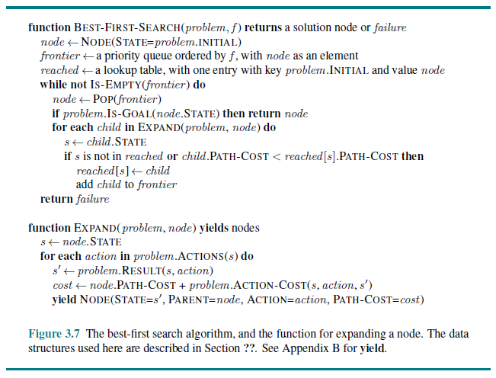
Best-first Search Pseudo-code

Slide 22
Uniform-cost Search
Uniform-cost search expands the node on the frontier with the lowest cost so far from the root to the current state
This can be implemented using best-first search with path cost as the evaluation function used by the priority queue
Uniform-cost search is the only uninformed search strategy we will cover that is optimal even if the step costs are not all identical (but they must be positive)
This strategy would lead to the optimal solutions for problems such as the Romania map problem
Uniform-cost search is complete if all step costs are above some ε > 0
The worst-case time and space complexity can be characterized as O(b^{1+[C*/ε]}), where b is the branching factor and C* is the cost of the optimal solution
Note that uniform-cost search is essentially identical to Dijkstra's algorithm

Slide 23
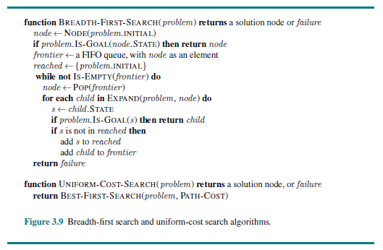
Uniform-cost Search Pseudo-code

Slide 24
Breadth-first Search
Breadth-first search (BFS) expands the root, then all successors of the root, then their successors, etc.
This can be implemented using best-first search with node depth as the evaluation function used by the priority queue
However, this would not be efficient
We would wind up generating nodes to the right of the shallowest goal node, and children of nodes to the left of the shallowest goal node
Typical implementations of breadth-first search use a regular queue as opposed to a priority queue
They also check for goal states as soon as nodes are generated

Slide 25
Breadth-first Search Pseudo-code

Slide 26
Properties of BFS
It can easily be seen that BFS is complete (assuming a finite branching factor)
BFS is optimal only if the shallowest goal node is optimal
More specifically, BFS is optimal if the path cost is a non-decreasing function of the depth of a node
BFS is not optimal for problems such as the Romania map problem; it is optimal for problems such as the 8-puzzle
The total number of nodes generated is at most b + b² + b³ + … + b^{d} = O(b^{d})
The time complexity for BFS is a major factor, but the memory requirements are an even bigger factor

Slide 27
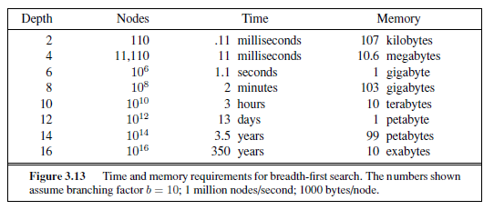
BFS Time and Memory (from 3rd Edition)

Slide 28
Depth-first Search
Depth-first search (DFS) expands the deepest node in the frontier
This can be implemented using best-first search with the negative of the node depth as the evaluation function for the priority queue
However, this would have the same memory issues as BFS
Instead, DFS is sometimes implemented as a tree search using a regular stack as opposed to a priority queue
We will consider a “tree-like search” that does not track reached nodes but does track nodes on the current path to avoid cycles

Slide 29
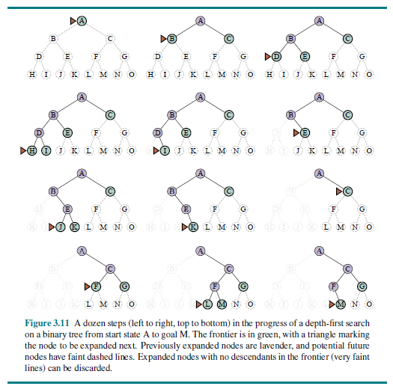
Depth-first Search Example

Slide 30
Properties of DFS
The pseudo-code we will look at shortly (for an expanded version of DFS) has a memory requirement that is O(bm)
Here, m is the maximum depth of the tree (recall that we are using a tree search, not a graph search, for DFS)
An alternative is to use a backtracking search, which has a better memory requirement of O(m)
This sort of approach generates only one successor of each node at a time
With backtracking search, there must be ways to determine the next successor, and to undo actions when backtracking
Backtracking search is often implemented with recursion
In general, DFS is not complete; DFS is complete for finite state spaces if it avoids cycles, although it may wind up expanding the same state many times via different paths
If DFS does not keep track of nodes on the current path, and there are cycles, DFS can get stuck in infinite loops; DFS can also get stuck in infinite loops in infinite state spaces
In general, DFS is not optimal

Slide 31
Depth-limited Search
Depth-limited search alleviates the problem of an unbounded tree by applying DFS with a depth limit, L
Nodes at the specified depth are treated as if they have no successors
This introduces another source of incompleteness if L < d; if L > d, the search is complete but not optimal
The limit, L, may be chosen based on the problem (e.g., for the Romania map problem, we can set L = 19, since there are 20 cities)
For many problems, we will not know an appropriate cutoff ahead of time
The search returns a solution, failure, or cutoff
If the call to the routine returns failure, there is no solution; if it returns cutoff, then there might or might not be a solution beyond the specified depth limit
Depth-limited search has a time complexity of O(b^{L}) and a space complexity of O(b*L)

Slide 32
Iterative Deepening Search
Iterative deepening search (IDS), a.k.a. iterative deepening depth-first search, performs sequential depth-limited searches, with depth limits 0, 1, 2, 3, etc.
Each state returns a solution, cutoff, or failure
This strategy combines the benefits of DFS and BFS; some advantages if IDS:
It is complete if there is a finite branching factor
It is optimal if the path cost is a non-decreasing function of node depth
It has the memory requirements of DFS
Many states are generated multiple times, but it turns out that this is not very costly; nodes on the bottom level are generated once, on the next to bottom level twice, etc.
N(BFS) = b + b² + … + b^{d}, N(IDS) = (d)b + (d-1)b² + … + (2)b^{d-1} + (1)b^{d}
Since the last term dominates, the time complexity of IDS is O(b^{d}), the same as that of BFS; the actual running time of IDS will be slightly larger than BFS, but not by much
Book (Ed. 3): "In general, iterative deepening is the preferred uninformed search method when the search space is large and the depth of the solution is not known."

Slide 33
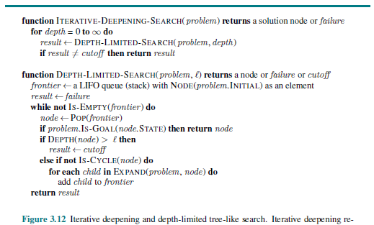
Depth-limited Search and IDS Pseudo-code

Slide 34
Bidirectional Search
Bidirectional search executes two searches simultaneously, one forward from the initial state, and another backwards from the goal state
We will assume both searches use BFS
It is only possible to search backwards if predecessors of a node are computable; this is easy if all actions are reversible (e.g., the 8-puzzle or the Romania map example)
The search must check if each new node generated is already in the other frontier
Motivation: b^{d/2} + b^{d/2} is much less than b^{d}
The time complexity is O(b^{d/2}) using BFS
The space requirement is also O(b^{d/2}); this is better than BFS but still a weakness
Assuming both searches use BFS, bidirectional search is complete with a finite branching factor; it is optimal if there are uniform step costs
Bidirectional search is difficult to implement if there are multiple goal states

Slide 35
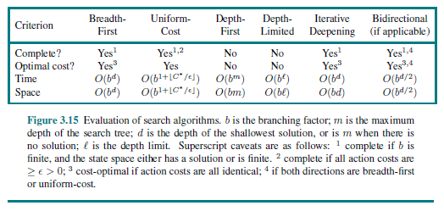
Comparing Uninformed Search Algorithms

Slide 36
Sensorless Problems
In a sensorless problem (a.k.a. a conformant problem), the agent has no sensors
The set of states an agent may be in is a belief state
In a fully observable environment, every belief state contains exactly one state
To solve sensorless problems, an agent must search in the space of belief states
A solution is a path leading to a belief state such that all members are goal states

Slide 37
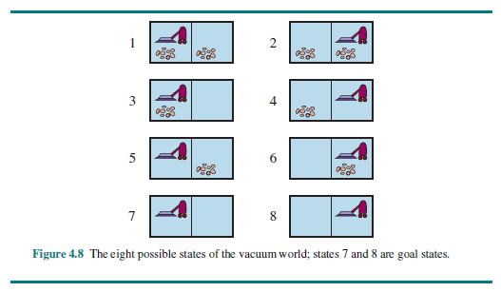
The Vacuum World Revisited (Again)

Slide 38
Sensorless Version of the Vacuum World
The 8 states of the vacuum world have now been numbered
States 7 and 8 are goal states
In a sensorless version of the vacuum world, the initial state (a belief state) is the set of all 8 states
There are 2⁸ = 256 plausible belief states (all possible subsets of the 8 real sates), but only 12 are reachable from the initial state
The action sequence [right, clean] will always lead to one of the states 4 or 8
The action sequence [right, clean, left, clean] will always lead to one specific goal state

Slide 39
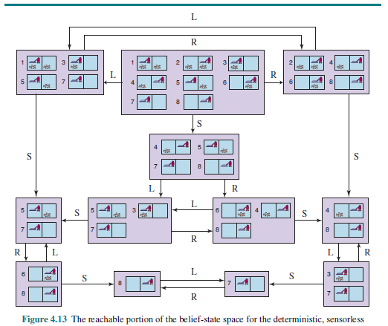
Sensorless Vacuum World Belief-state Space

