Slide 1
ECE469: Artificial Intelligence
Conventional Statistical NLP

Slide 2
Natural Language Processing
Natural language processing (NLP) is a subfield of artificial intelligence (AI) that deals with the processing of text specified using natural languages
Natural languages are languages that are spoken by (or written by or otherwise used by) people; e.g. English, French, Japanese, etc.
This is as opposed to formal languages, such as first-order logic or programming languages
In our course, our unit on NLP is divided into three topics; I am calling them:
"Conventional Statistical Natural Language Processing" – This will cover statistical NLP approaches that dominated the field until around 2013
"Conventional Computational Linguistics" – This covers natural languages, in general, and approaches to processing natural languages that consider linguistics
"Deep Learning and NLP" – This covers modern approaches to NLP
Some parts of these topics are based on “Speech and Language Processing” by Jurafsky and Martin (J&M); the 3rd Edition is in progress, and updates are freely posted online

Slide 3
Why Cover Old Stuff?
Some modern sources on NLP pay very little attention to conventional methods for NLP (i.e., those that predated deep learning)
I personally consider this a mistake for at least three reasons:
Conventional methods are still useful for certain tasks (e.g., information retrieval)
Aspects of conventional methods are sometimes used as precursors to deep learning methods (e.g., tokenization)
In order to appreciate how deep learning is applied to NLP tasks, it is important to understand how these tasks used to be done

Slide 4
Why is NLP hard?
Humans have an uncanny ability to learn a language (at least when they are very young)
However, we are (in my opinion) very far from having computers that appear to understand (or perhaps actually understand) human languages
The Jurafsky and Martin textbook give five possible interpretations of the sentence, "I made her duck" (although I would say that at least one of them is debatable)
Jurafsky and Martin point out:
The words "duck" and "her" are ambiguous in their part-of-speech; "duck" can be a verb or noun, "her" can be a dative pronoun or possessive pronoun
The word "make" is semantically ambiguous; it can mean "create" or "cook"
The word "make" is also syntactically ambiguous
It can be transitive, taking a single object ("her duck")
It can be ditransitive, taking two objects (if the sentence means that I changed her into a duck, but I think this would be an example of poor grammar)
It can take a direct object and a verb (if I forced her to duck her head)
If the sentence was spoken, there would also be ambiguity related to words that sound the same; e.g., "eye" or "maid"

Slide 5
Machine Learning for NLP
Using machine learning for NLP is, in some sense, simpler, and it is more robust than processing and representing natural language text using rules
However, with conventional machine learning, there are several initial phases that a system must apply when processing a text document
Often, sentence segmentation first divides a document into individual sentences
Then, tokenization splits each sentence into tokens (typically words)
None of this is trivial, and no phase is typically error-free
For example, sentences typically end with certain punctuation, such as periods; but periods are also used for abbreviations and acronyms (which can occur at the end of middle of a sentence)
It is also not clear what should count as a word
For example, stemming or lemmatization can be applied to map different forms of a word to the same token
Some systems split contractions or possessive words ending in ‘s to separate tokens
For some languages (e.g., polysynthetic languages), it may be important to apply more complex morphological parsing to split a word into morphemes
A morpheme is the smallest part of a word that has semantic meaning

Slide 6
Language Models
We can define a language to be a set of allowable strings (e.g., all allowable sequences of words, characters, or more general tokens)
We’ll cover attempts to formalize the syntax of natural languages (focusing on English) using grammars in our next topic
The statistical NLP approach deals with language models
A language model assigns a probability distribution to all possible string sequences
Language models can be used to predict the likelihood of a particular sequence of words, characters, or tokens
A language model is often a piece of a more general system, where the model is used to help produce output that is more likely to be fluent
A language model can also be used for natural language generation (NLG)

Slide 7
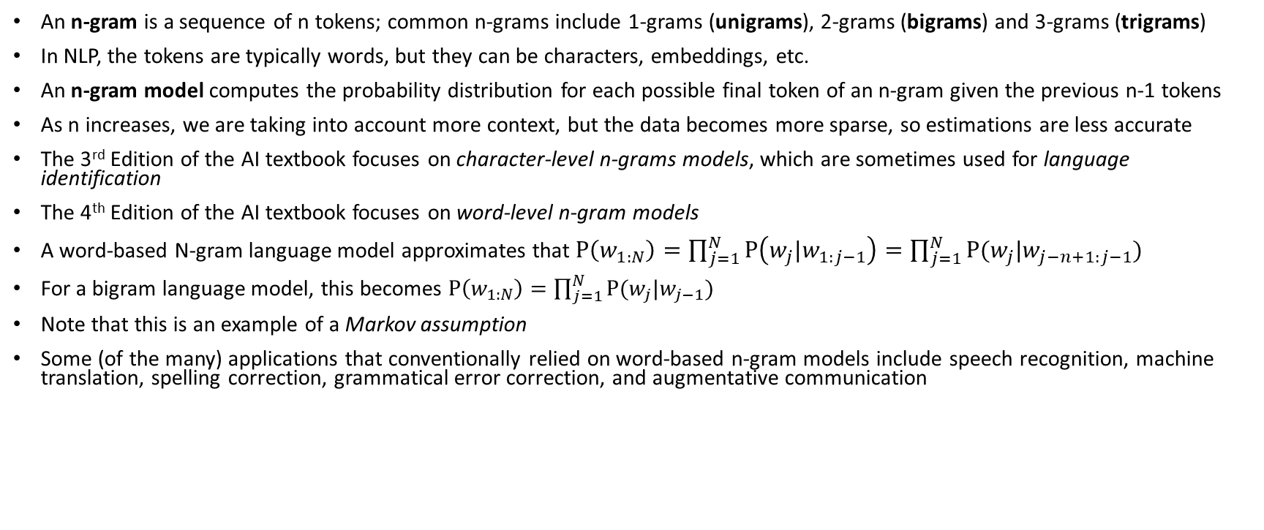
N-gram Models
An n-gram is a sequence of n tokens; common n-grams include 1-grams (unigrams), 2-grams (bigrams) and 3-grams (trigrams)
In NLP, the tokens are typically words, but they can be characters, embeddings, etc.
An n-gram model computes the probability distribution for each possible final token of an n-gram given the previous n-1 tokens
As n increases, we are taking into account more context, but the data becomes more sparse, so estimations are less accurate
The 3rd Edition of the AI textbook focuses on character-level n-grams models, which are sometimes used for language identification
The 4th Edition of the AI textbook focuses on word-level n-gram models
A word-based N-gram language model approximates that $P\left(w_{1:N}\right)=\prod_{j=1}^{N}{P\left(w_{j}|w_{1:j−1}\right)}=\prod_{j=1}^{N}{P(w_{j}|w_{j−n+1:j−1})}$
For a bigram language model, this becomes $P\left(w_{1:N}\right)=\prod_{j=1}^{N}{P(w_{j}|w_{j−1})}$
Note that this is an example of a Markov assumption
Some (of the many) applications that conventionally relied on word-based n-gram models include speech recognition, machine translation, spelling correction, grammatical error correction, and augmentative communication

Slide 8
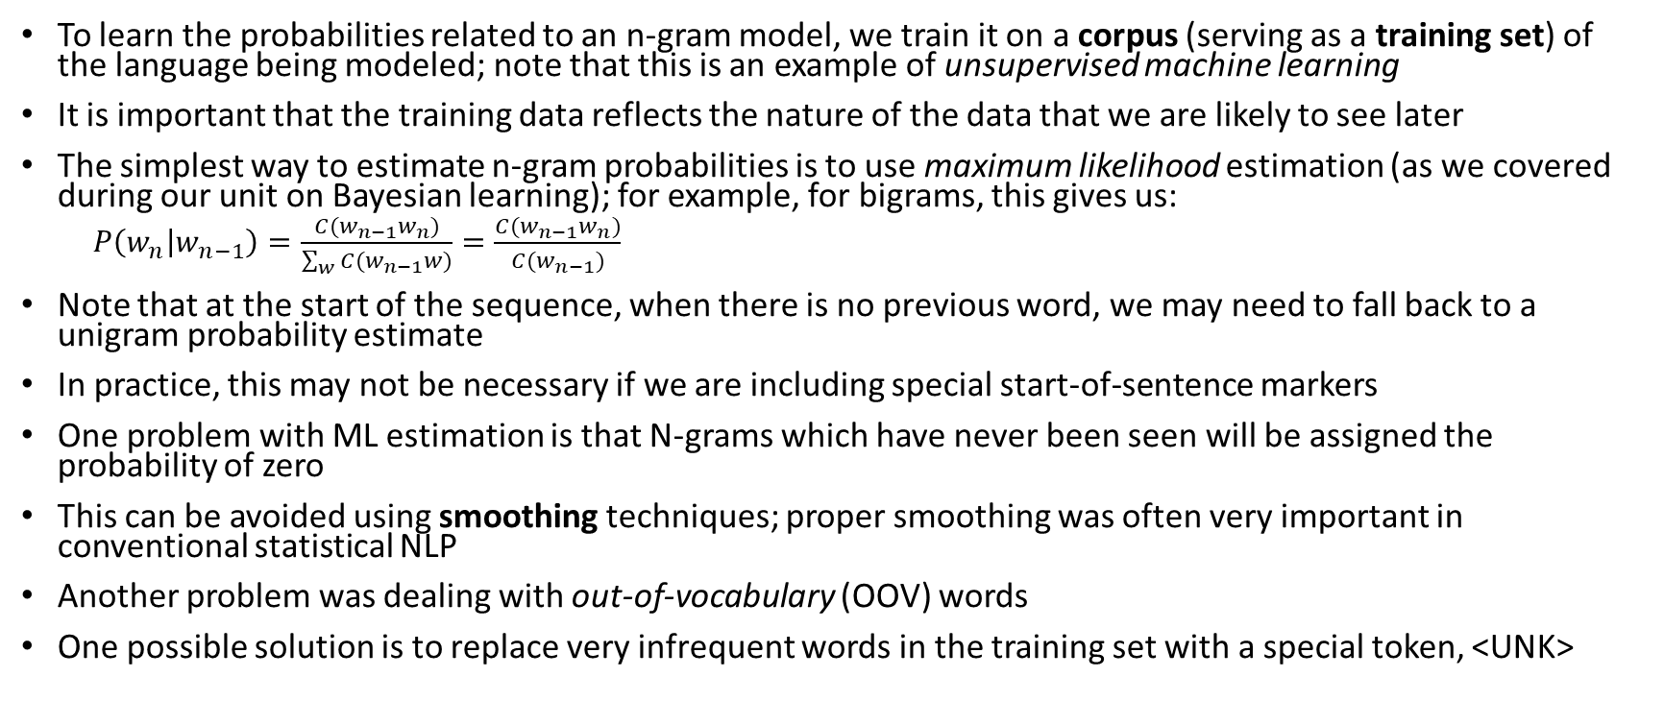
Estimating N-gram Probabilities
To learn the probabilities related to an n-gram model, we train it on a corpus (serving as a training set) of the language being modeled; note that this is an example of unsupervised machine learning
It is important that the training data reflects the nature of the data that we are likely to see later
The simplest way to estimate n-gram probabilities is to use maximum likelihood estimation (as we covered during our unit on Bayesian learning); for example, for bigrams, this gives us:
$P\left(w_{n} | w_{n−1}\right)=\frac{C(w_{n−1}w_{n})}{\sum_{w}{C(w_{n−1}w)}}=\frac{C(w_{n−1}w_{n})}{C(w_{n−1})}$
Note that at the start of the sequence, when there is no previous word, we may need to fall back to a unigram probability estimate
In practice, this may not be necessary if we are including special start-of-sentence markers
One problem with ML estimation is that N-grams which have never been seen will be assigned the probability of zero
This can be avoided using smoothing techniques; proper smoothing was often very important in conventional statistical NLP
Another problem was dealing with out-of-vocabulary (OOV) words
One possible solution is to replace very infrequent words in the training set with a special token, <UNK>

Slide 9
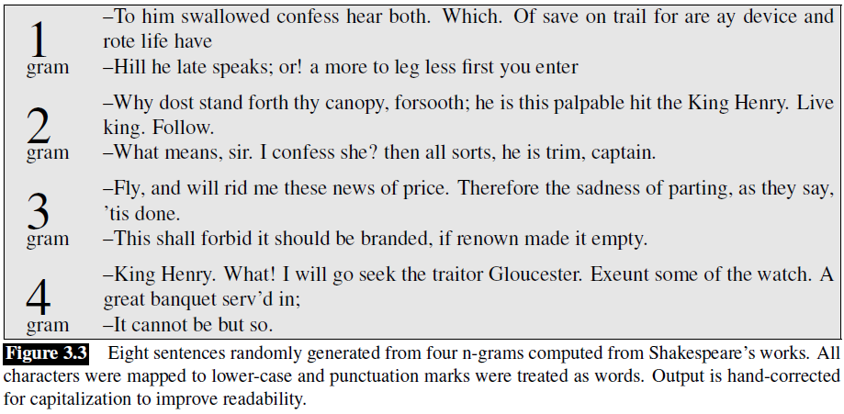
NLG Example: Shakespeare (from J&M)

Slide 10
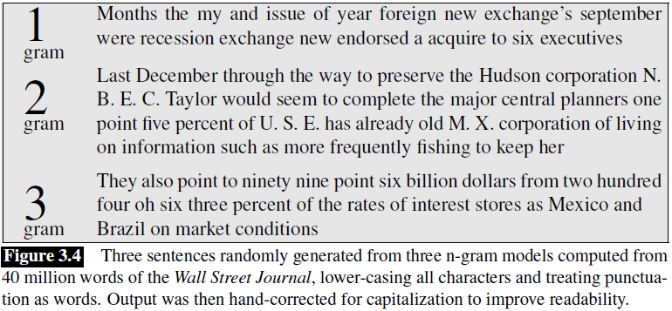
NLG Example: Wall Street Journal (from J&M)

Slide 11
Evaluating Language Models
One way to evaluate a language model is by applying it to a held-out test set and estimating the probability
This is an example of intrinsic evaluation
A better language model is one that assigns a higher probability to the test set
However, multiplying a lot of probabilities together is likely to zero-out the computation due to the finite precision of floating-point variables
Therefore, it is more common to add log-probabilities, which avoid this issue, and is also more efficient
Alternatively, a metric known as perplexity, which is related to the sum of the log probabilities, is often used
Sequences with higher probabilities have lower perplexities
Alternatively, we can evaluate a language model by embedding it in a more general application and seeing how it affects performance
This is an example of extrinsic evaluation
This may be a more important sort of metric, but it may require more time and effort

Slide 12
Parts of Speech
Parts of speech (POS) are categories of words; these are also known as word classes, lexical tags, and syntactic categories
Four major open classes of POS occur in languages of the world; they are: nouns, verbs, adjectives, and adverbs; not every language has all four
There are also many closed classes of POS; for example: prepositions, particles, determiners, conjunctions, pronouns, auxiliary verbs, numerals, etc.
Modern lists of parts of speech (or tagsets) for English include many additional POS tags; e.g., there are 45 for the Penn Treebank, 87 for the Brown corpus, and 146 for the C7 tagset
Linguists typically POS are based on syntactic and morphological function
A noun, for example may often describe a person, place, or thing, but not always; nouns also include abstractions (e.g., "bandwidth", "relationship"), verb-like terms (e.g., "pacing"), etc.
What defines a noun in English are things like:
Its ability to occur with determiners (e.g., "a goat", "its bandwidth", "Plato's Republic")
Its ability to take possessives (e.g., "IBM's annual revenue")
For most nouns, its ability to occur in the plural form (e.g., "goats", "abaci")

Slide 13
POS Tagging
Part-of-speech tagging (a.k.a. POS tagging or just tagging) is the automatic assignment of POS to words
Tagging a word with its POS can tell us about how a word is pronounced (e.g., "content" as a noun or an adjective); this can be useful for a text-to-speech system
POS can also be useful for several other NLP applications, including parsing, named entity recognition, and coreference resolution
The earliest POS taggers used manual rules, but later, machine learning approaches dominated
Conventionally, hidden Markov models (HMMs) were often used
Another conventional approach involved maximum entropy Markov models (MEMMs)
These days, deep learning approaches can do better, but not by much
According to the Jurafsky and Martin textbook, all of these ML approaches are capable of achieving around 97% accuracy on standard datasets

Slide 14
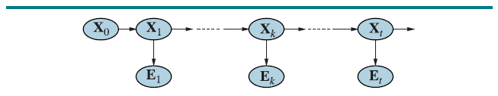
HMMs Revisited
We have learned that HMMs can easily be represented as dynamic Bayesian networks:
The Xs represent hidden states that are not seen (typically, these are what we are trying to predict)
The Es represent evidence variables which are observed
In many sources, an E₀ would be included; but we can view the X₀ as a start-of-sequence marker that does not have an associated evidence variable
The links between Xs represent transitions between hidden states, and there are associated transition probabilities
The links from Xs to Es have associated emission probabilities

Slide 15
HMMs for POS Tagging
When applied to POS tagging, the hidden states represent parts of speech, and the evidence variables represent words
The parameters of the HMM for POS tagging can be easily learned from a treebank
A treebank is a corpus in which words have been labeled with their POS, and sentences have been manually parsed
Maximum likelihood learning can be used to learn the parameters of an HMM for POS tagging
The transition probabilities can be estimated as the frequency of seeing each possible POS after another POS (or as the first POS)
The emission probabilities can be estimated as the frequency of seeing every possible word in the language given the current POS
Smoothing techniques can be applied, but it isn’t really crucial for POS tagging
Once the parameters of the HMM have been learned, the Viterbi algorithm can be used to predict the most likely POS for a given sentence

Slide 16
Information Retrieval
Information Retrieval (IR) refers to the task of finding documents from a collection or corpus that are relevant to a user's query
What constitutes a document varies form system to system (e.g., a web page, e-mails, news documents, single paragraphs or sentences, etc.)
The query might be expressed in natural language or some formal query language
Early IR systems used a Boolean keyword model (allowing AND and OR) for queries
This had several drawbacks; for example, if "information AND retrieval AND models AND optimization" returns an empty result set, what do you do next?
IR systems also differ in how results are presented (e.g., displaying a ranked list)
There was also a time when probabilistic IR methods (e.g., naïve Bayes) were used in practice; however, these did not dominate conventional NLP for IR

Slide 17
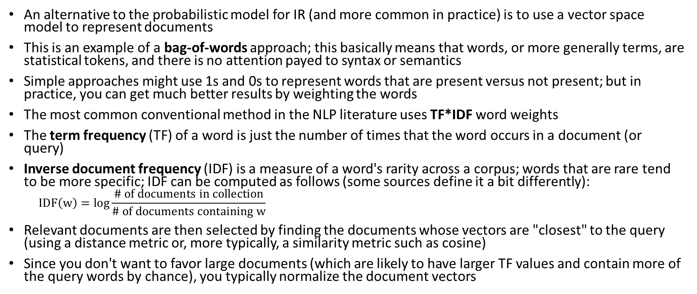
Vector Space Models
An alternative to the probabilistic model for IR (and more common in practice) is to use a vector space model to represent documents
This is an example of a bag-of-words approach; this basically means that words, or more generally terms, are statistical tokens, and there is no attention payed to syntax or semantics
Simple approaches might use 1s and 0s to represent words that are present versus not present; but in practice, you can get much better results by weighting the words
The most common conventional method in the NLP literature uses TF*IDF word weights
The term frequency (TF) of a word is just the number of times that the word occurs in a document (or query)
Inverse document frequency (IDF) is a measure of a word's rarity across a corpus; words that are rare tend to be more specific; IDF can be computed as follows (some sources define it a bit differently):
$$IDF\left(w\right)=\log{\frac{\# of documents in collection}{\# of documents containing w}}$$
Relevant documents are then selected by finding the documents whose vectors are "closest" to the query (using a distance metric or, more typically, a similarity metric such as cosine)
Since you don't want to favor large documents (which are likely to have larger TF values and contain more of the query words by chance), you typically normalize the document vectors

Slide 18
Implementing IR Systems
We can also consider the entire collection to be represented as a sparse matrix of weights, where w_{i,j} represents the weight of word i in document j
This is known as a term-document matrix
Each column represents a document in the collection and each row represents a term
In practice, we do not store the entire matrix; rather, for each term or word, we store an inverted index
For IR, an inverted index efficiently maps each term (e.g., using a hash table) to a list of documents in which the term appears
The inverted index can also include positions and/or term weights (such as TF*IDF)
Including positions is important if you want the user to be able to search for exact phrases
Other issues related to IR include how to tokenize queries and documents, case sensitivity, whether to apply stemming, whether to prune stop words, whether to consider metadata, etc.
When presenting results of an IR system, you might want to take utility into account in addition to relevance; e.g., you might not want to list very similar documents

Slide 19
Evaluating IR Systems
IR systems can be evaluated using the precision, recall, and F1 metrics
We can't use overall accuracy because a simple system that says nothing is relevant might achieve a very high accuracy
Consider a confusion matrix (a.k.a. contingency table) representing how many relevant and non-relevant documents were and were not retrieved:
We can define:
Precision = A / (A + B); of the documents that were retrieved, what fraction of them are actually relevant to the user’s query
Recall = A / (A + C); of those documents in the collection that are relevant to the query, what fraction of them were retrieved by the system
F1 = (2 * Precision * Recall) / (Precision + Recall); this combines precision and recall into a single metric, in between precision and recall, closer to the lower of the two
 | Relevant | Not Relevant
Retrieved | A | B
Not Retrieved | C | D

Slide 20
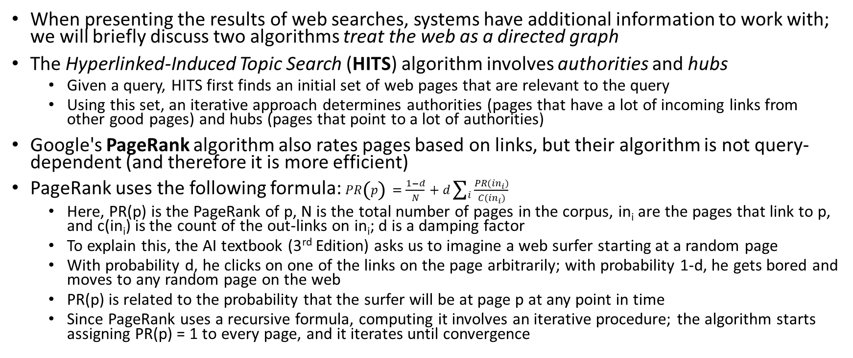
Presenting Results of Web Searches
When presenting the results of web searches, systems have additional information to work with; we will briefly discuss two algorithms treat the web as a directed graph
The Hyperlinked-Induced Topic Search (HITS) algorithm involves authorities and hubs
Given a query, HITS first finds an initial set of web pages that are relevant to the query
Using this set, an iterative approach determines authorities (pages that have a lot of incoming links from other good pages) and hubs (pages that point to a lot of authorities)
Google's PageRank algorithm also rates pages based on links, but their algorithm is not query-dependent (and therefore it is more efficient)
PageRank uses the following formula: $PR\left(p\right)=\frac{1−d}{N}+d\sum_{i}{\frac{PR({in}_{i})}{C({in}_{i})}}$
Here, PR(p) is the PageRank of p, N is the total number of pages in the corpus, in_{i} are the pages that link to p, and c(in_{i}) is the count of the out-links on in_{i}; d is a damping factor
To explain this, the AI textbook (3rd Edition) asks us to imagine a web surfer starting at a random page
With probability d, he clicks on one of the links on the page arbitrarily; with probability 1-d, he gets bored and moves to any random page on the web
PR(p) is related to the probability that the surfer will be at page p at any point in time
Since PageRank uses a recursive formula, computing it involves an iterative procedure; the algorithm starts assigning PR(p) = 1 to every page, and it iterates until convergence

Slide 21
Text Categorization
Text Categorization (TC), a.k.a. text classification, is the automatic labeling of text documents (or documents with associated text) into one or more predefined categories or classes
As with other ML categorization methods, text categorization can deal with independent, Boolean categories, or it can deal with multiple mutually exclusive and exhaustive categories
Some applications of text categorization include:
Classification of e-mail as spam or not spam (a.k.a. ham), a.k.a. spam filtering
Classification of news into topical sections (e.g., NewsBlaster, Google News)
Websites as pornography or not pornography
Reviews as positive or negative (a type of sentiment classification)
Automatic grading of essays (actually used by ETS)
An interesting early application of text categorization was authorship attribution
Mostellar and Wallace (1964) examined a subset of the Federalist Papers
There was a historical dispute about whether the author was James Madison or Alexander Hamilton
Using techniques that were quite different than modern techniques (involving words such as "of" and "upon"), they definitively concluded that Madison was the author

Slide 22
Some General TC Implementation Details
Conventional TC systems typically employ bag-of-words approaches, as do IR systems
These approaches work well for some, but not all, of the applications listed above
Most conventional TC systems use single words (unigrams) as terms
Several TC methods use TF*IDF weights for document vectors; some also use TF*IDF weights for category vectors
As with IR systems, other implementation details that must be decided include tokenization, case sensitivity, stemming, stop words, etc.
A training set for TC consists of manually labeled documents
If categories are Boolean, we need positive and negative examples of each category
If categories are mutually exclusive and exhaustive, we need a significant number of examples of each category
Tuning based on a validation set and evaluation using a test set are performed using standard machine learning techniques

Slide 23
Rocchio/TF*IDF
One conventional TC approach is known as Rocchio/TF*IDF; this technique was based on the idea of relevance feedback, which is sometimes used by some IR systems
The approach uses a bag-of-words vector space model to represent not only documents but also categories
Each category is represented by the sum of the documents that belong to the category; generally, these vectors are normalized
Each category vector can be thought of as a centroid for the category
Thus, a similarity score (e.g., using the cosine metric) can be computed between any document and each category
If the categories are mutually exclusive and exhaustive, the document can be classified as belonging to the category with the most similar category vector
Some systems also include a vector based on all non-instances of each category from the training set and subtract a lower-weighted similarity to this centroid
The Rocchio method for TC is more complicated when dealing with Boolean categories
The similarity scores need to be converted to YES/NO decisions; there are a few ways to do this

Slide 24
kNN and SVM Systems for Text Categorization
A kNN system for TC represents documents as TF*IDF vectors
The system compares the TF*IDF vector for the document to classify to TF*IDF vectors for each document in the training set
It retrieves the k nearest (most similar or least different) training documents
These k documents can be used to make decisions as with any other kNN classification system
An SVM system for TC can also represent all training documents using TF*IDF vectors
For Boolean categories, the optimal hyperplane is computed in a higher-dimensional space, as with other SVM classification systems
When given a document to classify, the decision to place it in a category depends on what side of the hyperplane its TF*IDF vector, mapped to the higher-dimensional space, falls on
As with other SVM classification tasks, the "kernel trick" is used for efficient training and testing
To use an SVM for mutually exclusive, exhaustive categories, something hacky must be applied

Slide 25
Neural Networks and TC
Conventional neural networks did not typically work too well for most TC tasks
The inputs would represent TF*IDF scores of words
There would be an input node for every distinct word in the languge
Deep neural networks work very well for certain TC tasks, such as sentiment analysis, especially for short documents
Conventional TC, on the other hand, tends to work better for topical categories and large documents
We’ll talk about deep learning and NLP in a later topic

Slide 26
Naïve Bayes for TC
Rewriting the naïve Bayes formula to specifically apply to text categorization gives:
P(C | w_{1:N}) = αP(C)∏_{i}P(w_{j} | C)
Some naïve Bayes systems for TC only loop through the distinct words in a document; others loop through all instances of words
This is considered a bag-of-words approach, but note that we are not using TF*IDF weights
The normalization constant can be ignored if we are just choosing the most likely category (for mutually exclusive and exhaustive categories)
For Boolean categories, we can assign the category to a document if the probability is over 0.5
The final term, P(w_{j} | C) can be estimated as the percentage of training documents belonging to category C that contain w_{j} (at least one time)
The fact that we are multiplying these probabilities together is the “naïve” assumption
For TC, it is almost certainly wrong, but the method overall can still lead to good results
In my work as a graduate student, I found that Naïve Bayes performed very well for mutually exclusive and exhaustive, topical categories
In the conventional TC literature, which more often dealt with Boolean categories, TC typically did not perform very well

Slide 27
Evaluating a TC System
To evaluate a TC system, overall accuracy can be a reasonable metric if both of the following are true:
The categories are mutually exclusive and exhaustive, and
Each category occurs with a significant frequency
Otherwise, we can measure the precision, recall, and F1 for each category
Micro-averaging or macro-averaging can be used to obtain a metric for an entire dataset
Recall that the no free lunch theorem tells us that no machine learning method will work well for all possible tasks
It should therefore not be too surprising that different systems tend to work well for different types of TC tasks
This probably depends, at least in part, on the properties of the categories and the of the data that we are dealing with

Slide 28
Properties of Categories
Are they mutually exclusive and exhaustive or independent, Boolean categories?
Are they general or specific categories?
Related to the last question, do the documents within a category vary a lot, or do they tend to be very similar to each other?
Are they topic-based categories? Are they action oriented? Do they involve sentiment? Are they abstract?
Are there many categories or few?
Are some categories significantly more likely than others (i.e., do some categories contain a relatively high percentage of documents)?

Slide 29
Properties of Data
Are the documents short or long?
How big is the training set (i.e., how many documents are in it)?
Is the training set likely to be very representative of the documents to which the system will be applied later?
Are the training labels accurate or is there a high degree of error? (This could depend on how the training data is collected)
Is there any missing data? (This is not generally an issue with TC, but it is an issue that some machine learning methods handle better than others)
Is there additional metadata (text or otherwise) associated with documents?

