Slide 1


VelOps
Allister Kohn
contact@allisterkohn.com

Slide 2



Who am I?
• Allister, 24 years old
• Based in the Paris region
• Scientific Baccalaureate (2019)
• Graduate Engineer (2024)
• MSc in Data Sciences & Business Analytics (2025)
• Career focus: Data Science → ML Engineering → MLOps

Slide 3
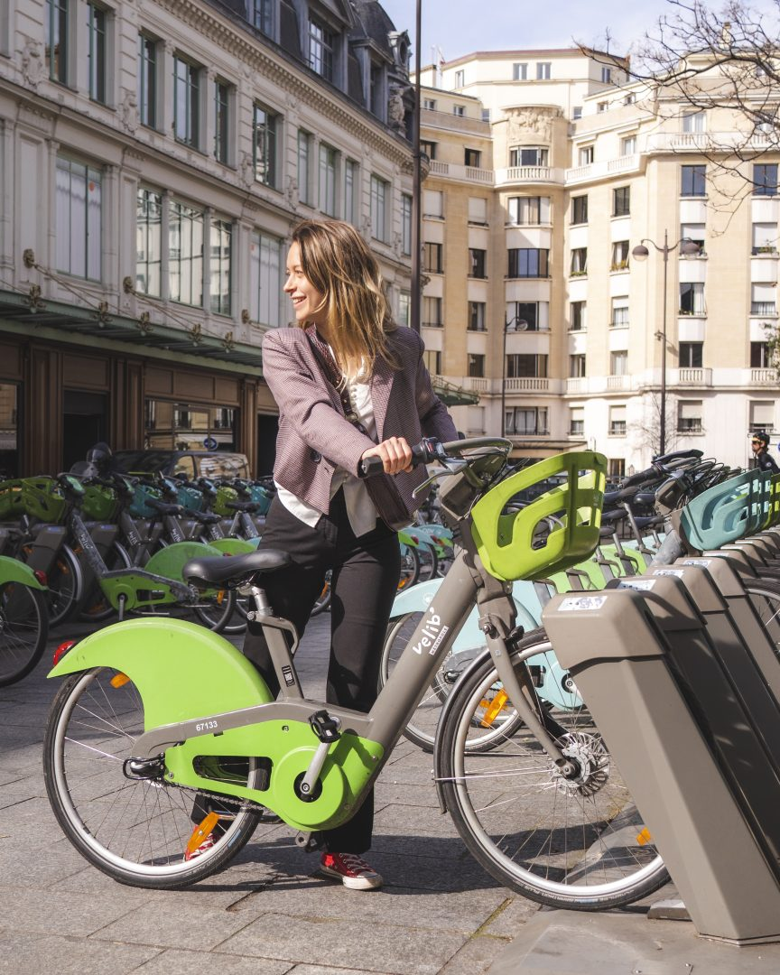


Vélib’
• Smovengo is the operator of Vélib’ Métropole, the public bike-sharing service of the Paris metropolitan area
• Vélib’ is the largest station-based bike-sharing system in the world, covering Paris and the wider Île-de-France region
• Smovengo provides open access to Vélib’s real-time operational data through a public API
Key figures: • 1 station approximately every 300 meters in Paris • 1,500 stations across Paris and the Île-de-France region • 20,000 bicycles, including 40% electric-assisted bikes • 940,000 unique users in 2025
Source: group-indigo.com

Slide 4
Introduction
• VelOps is an end-to-end machine learning project using Vélib’ data
• Its goal is to predict bike availability states at station level within a two-hour horizon
• The system runs on a Raspberry Pi, highlighting a lightweight and resource-efficient setup
• The project relies on a broad set of modern data technologies across the full workflow
• The project is structured into two independent components: one dedicated to data ingestion and transformation, and another focused on machine learning

Slide 5
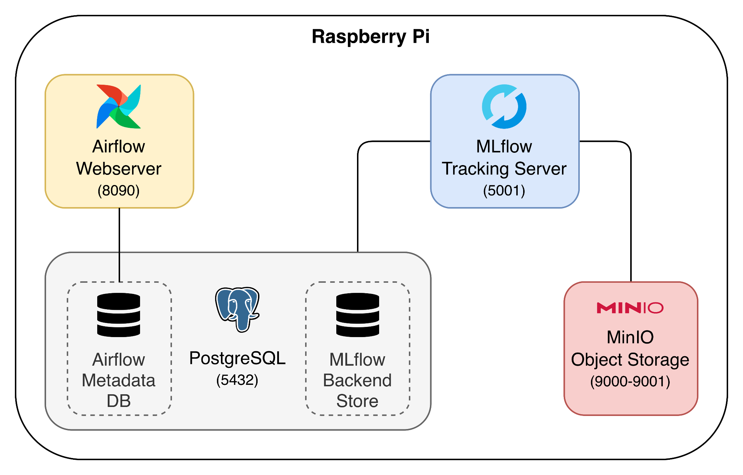
Infrastructure

Slide 6
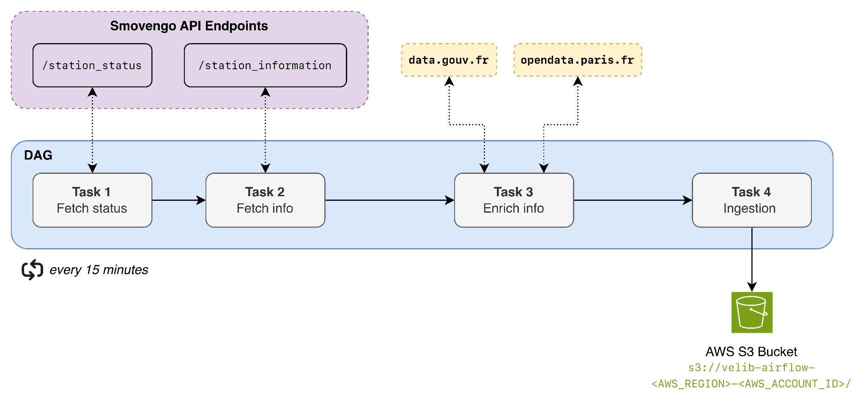
Data Ingestion

Slide 7




Data Storage: Amazon S3
Glue Data Catalog & Athena
Incremental Processing: dbt
Amazon S3 acts as the raw storage layer of the pipeline.
Data is ingested and stored
as CSV files using a date-partitioned structure:
station_status/raw/
└── year/
└── month/
└── day/
└── hour-minute.csv
Terraform defines the table structures, S3 storage paths, and date-based partitioning. AWS Glue lives as the metadata index, storing a "map" that explains exactly how the raw CSV files are structured. Finally, Amazon Athena uses Glue’s map to locate and understand the files, allowing to run standard SQL queries directly against the data stored in S3.
dbt uses Athena as its SQL execution engine to transform raw ingestion tables into machine-learning-ready Parquet datasets. The pipeline runs incrementally and writes partitioned feature tables back into S3 for downstream machine learning training.

Slide 8

Machine Learning: Predicting Bike Availability
By analyzing historical station data across different times and locations, the system learns recurring usage patterns to accurately predict Paris Vélib bike availability throughout the day.
Rather than predicting an exact number of bikes, the model classifies each station into availability states — such as "empty", "medium", or "full" — at five time horizons: +15, +30, +45, +60, and +120 minutes.
Given a station, it can then predict what state it will be in at each horizon, so users don't show up to an empty or full station.

Slide 9
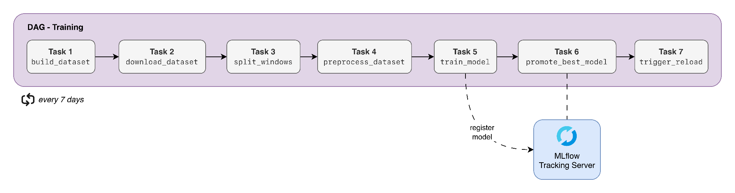
Training Pipeline
To maintain high accuracy, the automated pipeline retrains the model weekly on fresh data. Each new model is evaluated against recent real-world observations, ensuring that only a better-performing challenger replaces the current production model.

Slide 10
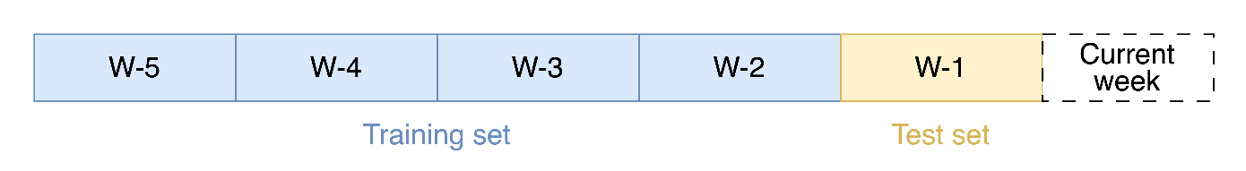
Training Dataset Construction
Every week, the training pipeline starts by building the dataset that will be used to train a new model.
The training dataset covers a 5-week period, corresponding to 35 days = 840 hours = 3,360 15-minute intervals.
Given the 1,500 stations in the network, this results in a total of 5,040,000 status records (>700 Mb).
☝︎The 5-week window is strategically selected to fit within the limited RAM capacity of the Raspberry Pi 5.)
Features include the station code and its geographic coordinates, capacity, and borough, alongside temporal features extracted from the timestamp (hour, minute, day of week, and binary flags for weekend, rush hour, morning, night, and summer), plus the current bike count and its discretized label.

Slide 11
Model Training
The model is a single LightGBM multiclass classifier that predicts bike availability across 5 time horizons simultaneously: 15, 30, 45, 60, and 120 minutes ahead.
The target variable is the bike count bucketed into 3 classes: low (≤2), medium (3–7), and high (≥8).
Rather than training one model per horizon, the dataset is reshaped into a long format where each row is duplicated 5 times with horizon added as a feature. This lets a single model learn all horizons at once, cutting training time and memory by 5×.
☝︎Hyperparameters are fixed from the best run identified in a prior search session, as the Raspberry Pi 5's limited CPU makes repeated training runs impractical.

Slide 12
Model Evaluation & Champion Promotion
Each training run is fully logged to MLflow: parameters, per-horizon accuracy and F1, weighted accuracy, model artifact, encoder, and feature names.
Every Thursday at midnight, the 5 most recent runs are evaluated on a common holdout covering Monday to Wednesday of the current week — data that was never seen during training.
The selection metric is a weighted accuracy across the 5 horizons, giving more weight to shorter-term predictions (weight 5 for t+15 down to weight 1 for t+120).
A candidate only replaces the current champion if it exceeds its holdout_weighted_accuracy by a margin of 0.001, avoiding promotion from negligible improvements. If it does, the new model is registered in the MLflow Model Registry and the champion alias is reassigned to it, triggering a hot-reload of the API without restarting the container.

Slide 13

Inference API

Slide 14








Next step: transitioning to AWS
☑ Amazon S3
☑ AWS Glue
☑ Amazon Athena
☐ AWS Managed Workflows for Apache Airflow (to replace the local Airflow instance)
☐ AWS Lambda (for running the lightweight 10-minute ingestion script)
☐ Amazon Elastic Container Registry (to replace local project storage with Docker images)
☐ Amazon SageMaker (for model training pipelines and deploying the inference API)
☐ Amazon EC2 (for hosting the continuous MLflow tracking server and UI)

Slide 15
Sources
https://www.group-indigo.com/metier/smovengo/
https://www.smovengo.fr/
https://www.velib-metropole.fr/

Slide 16


contact@allisterkohn.com

