Slide 1
Buflab
Recitation - 11/4/2016

Slide 2
Outline
Stack Discipline
A brief review
Buflab
What?
How?

Slide 3
Stack?
What is the stack?
It’s NOT
The memory regions returned by malloc()
The memory where your program itself is loaded
Where the bits for general purpose register are stored
Where the return value of a function is stored
It IS
Where you can often find a function’s local variables
How parameters are passed in 32-bit x86
Where the return ADDRESS is stored
A highly structured (easily corruptible) data structure essential to the execution of your code!

Slide 4
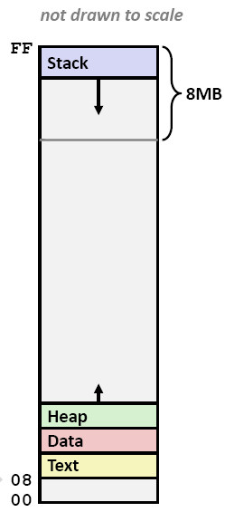
Virtual Address Space
The stack starts very close to
0xFFFFFFFF (for 32-bit) and grows DOWN

Slide 5
Stack Discipline
Each function has a stack frame
Local variables
Saved registers
Anything that function wants to put in its stack
Functions CALL other functions
Arguments
Return address
Base pointer

Slide 6
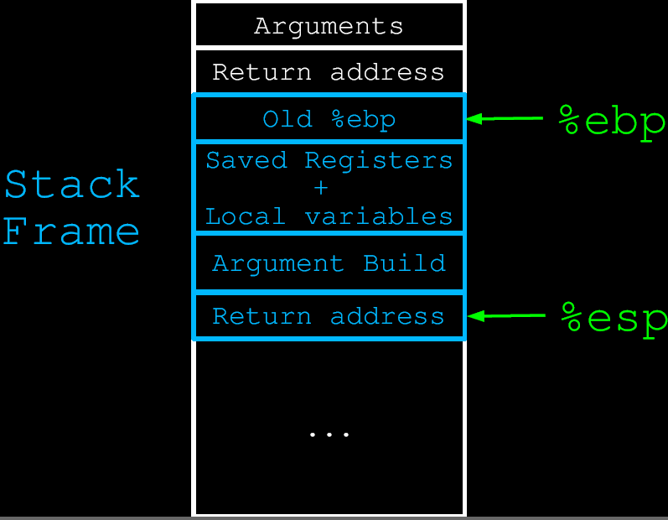
Stack Discipline

Slide 7
Stack Discipline
What happens when ret is executed?
Pop the stack and “jmp” to that address
In Java, think: eip = stack.pop();
Where can I find the return address of my function?
*(ebp + 4)
How can I find the second parameter to my function?
*(ebp + 12) == the second parameter
How can I find the return address of the function that CALLED me?
Remember that *ebp == old ebp
*(*ebp + 4)
How are arguments pushed onto the stack?
Reverse order! Stacks are LIFO

Slide 8
Stack Discipline
How will the “transition stack” look like for a function foo which makes the function call
printf(“str = %s, num = %d”, name, 16)
Values | Description
… | Stack frame for foo
0x00000010 | Arguments pushed in REVERSE order
<address of name>
<address of format string in .rodata> | All hard-coded strings are put into .rodata before runtime
return address (where EIP should return in foo after the printf call) | Return address
foo’s ebp | Old base pointer
… | Stack frame for printf

Slide 9
Buflab
It’s a hack.
Overflow the buffer to write over the return address
/* Buffer size for getbuf */
#define NORMAL_BUFFER_SIZE 32
int getbuf()
{
char buf[NORMAL_BUFFER_SIZE];
Gets(buf);
return 1;
}

Slide 10
Buflab
Five level hacking.
Level 0 Simply modify return address
Level 1 Insert arguments
Level 2 Set global value; insert codes
Level 3 Hack and restore
Level 4 Dynamic stack base

Slide 11
Buflab
Tools are needed.
Disassembler
Debugger
Assembler
On linux, we have…
objdump
gdb
gcc

Slide 12
Buflab
Handin Instructions
Five answers, five lines
In HEX format
Upload to http://acn.thucloud.com/
Due: 11/20/2016 23:59:59

