Slide 1
30 Maps in 30 Days
With Python
Alexander Kmoch
Research Fellow
Department of Geography
University of Tartu, Estonia
https://kodu.ut.ee/~kmoch/

Slide 2
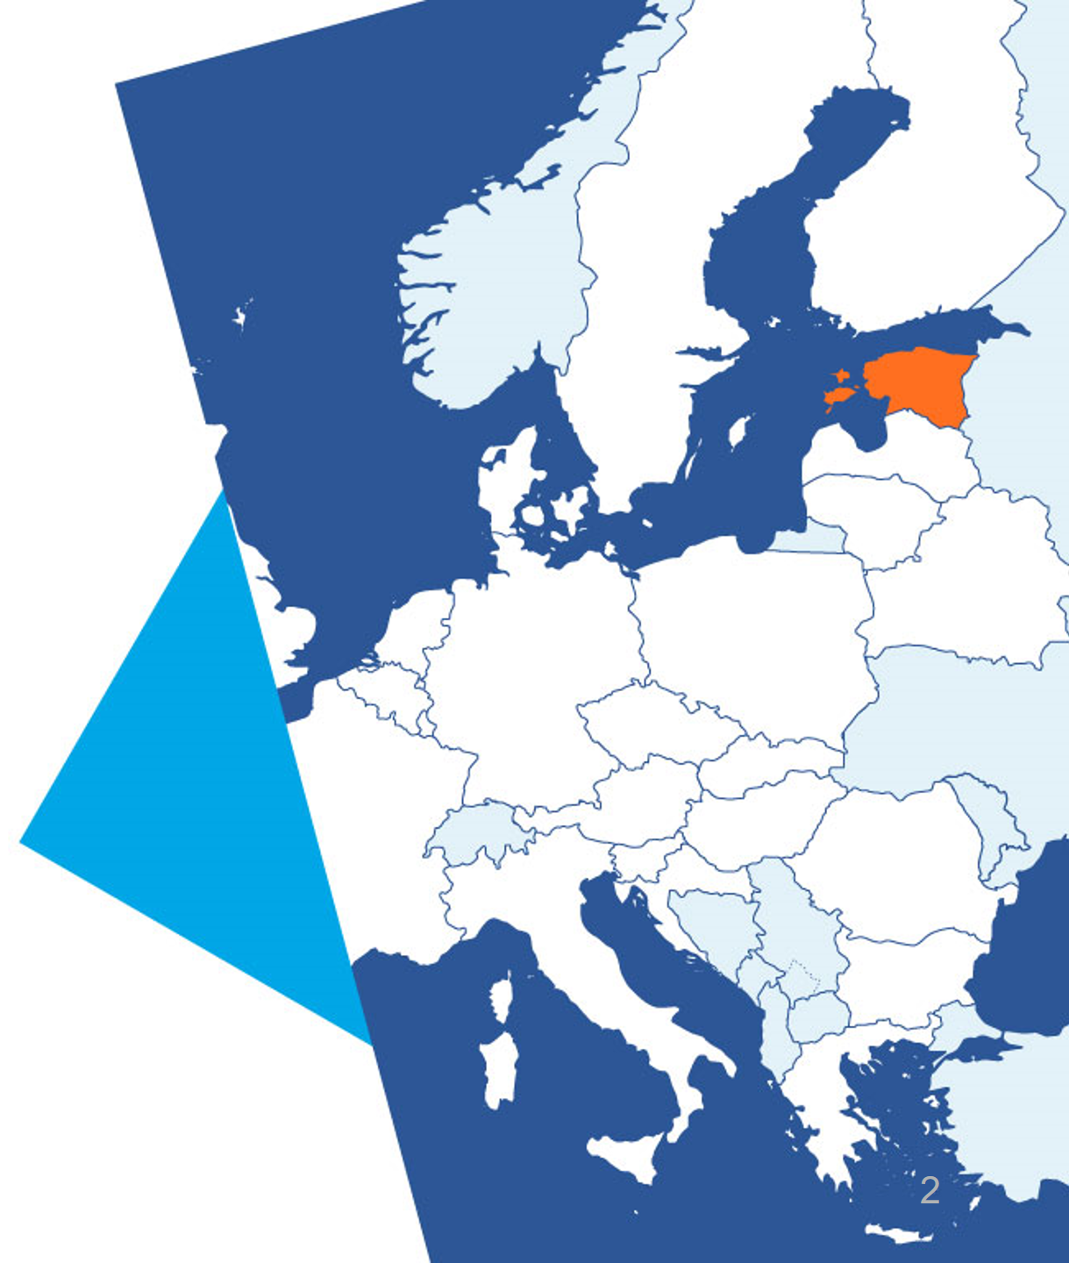
Topi & Challenge
Map themes
Concepts
Libraries
Lessons learned

Slide 3
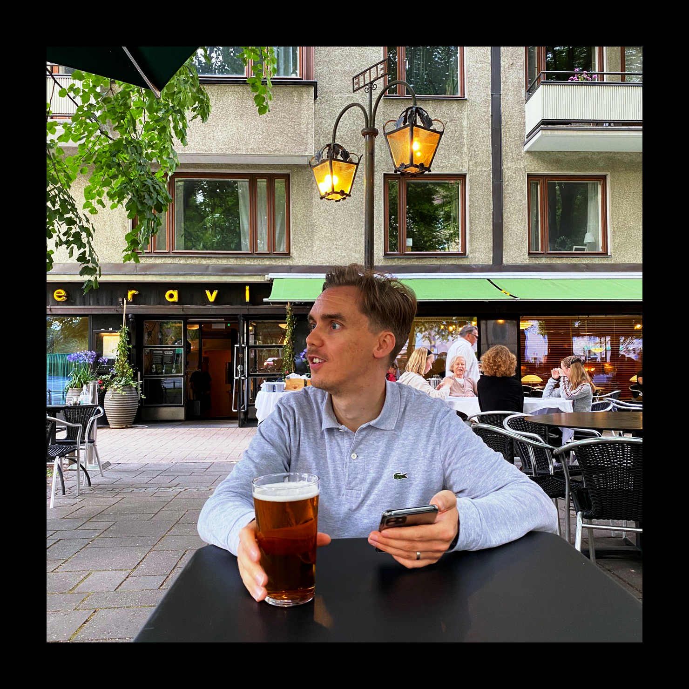
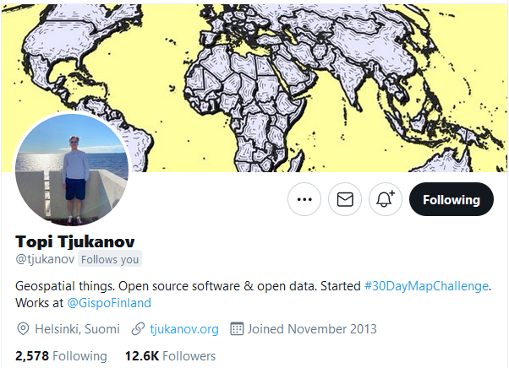
Topi Tjukanov
https://tjukanov.org/
@tjukanov

Slide 4
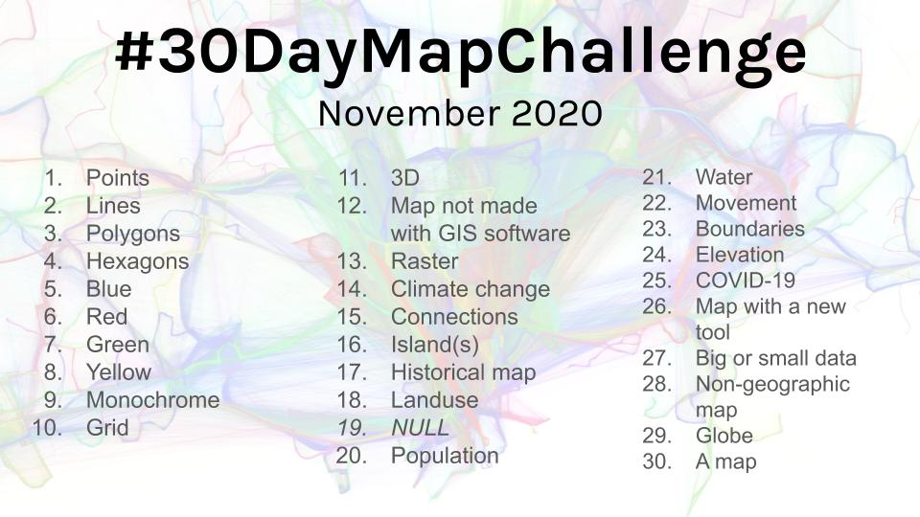
https://twitter.com/hashtag/30DayMapChallenge
Notes:
The #30DayMapChallenge is an increasingly popular phenomenon, started on Twitter just 2 years ago by Topi Tjukanov, where he encourages fellow geo folks to make a map to different themes each day during the month of November. In this talk we introduce the MapChallenge and describe how to solve all the challenges within the available Python/PyViz geospatial library ecosystem, including packages, themes, challenges, gotchas and revelations during making 30 maps in 30 days.

Slide 5
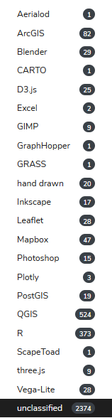
Somebody even made an inventory
https://david.frigge.nz/30DayMapChallenge2020/
There were 25/67 people who managed the massive task of creating all 30 maps!

Slide 6

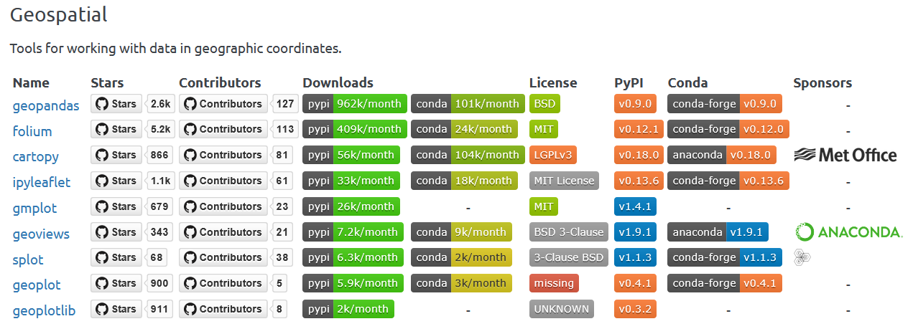
Geo – Python / Pyviz
https://pyviz.org/tools.html

Slide 7
https://allixender.github.io/30MapChallenge2020/
Github repo
Sphinx :-)
Notebooks + (most) data, at least data cites
reproducible

Slide 8
Challenges
Idea + Data + Skill → Good Map
Open Data related to themes (cool idea?)
Too much/big data hard to effectively churn into a nice map
Styling options (existing vs. known vs. skill)

Slide 9
Concepts
Idea + Data + Skill → Good Map
Open Data related to themes (cool idea?)
Too much/big data hard to effectively churn into a nice map
Styling options (existing vs. known vs. skill)

Slide 10
Libs and stats
Geopandas.plot aka Matplotlib - 11
Datashader - 2
GeoViews / cartopy - 4
GeoPlot - 5
EarthPy - 4
Python PILLOW, raw image/gifs - 3
folium - 1
Pysal (MapClassify) - 6
DGGS grids - 3
Shapely/Geopandas clip, sjoin or otherwise subselect - 7
GeoPlot functions (KDE, cartogram) - 4
EarthPy (Hillshade) - 3
pysheds - 1
idw_knn interpolation - 1
pymannkendall - 1
Geopandas
Rasterio/GDAL
osmnx
requests
urllib.requests
Owslib
Contextily - 4
num layers
1 - 4
2 - 6
3 - 4
4 - 1
5 - 5
6 - 0
7 - 1

Slide 11
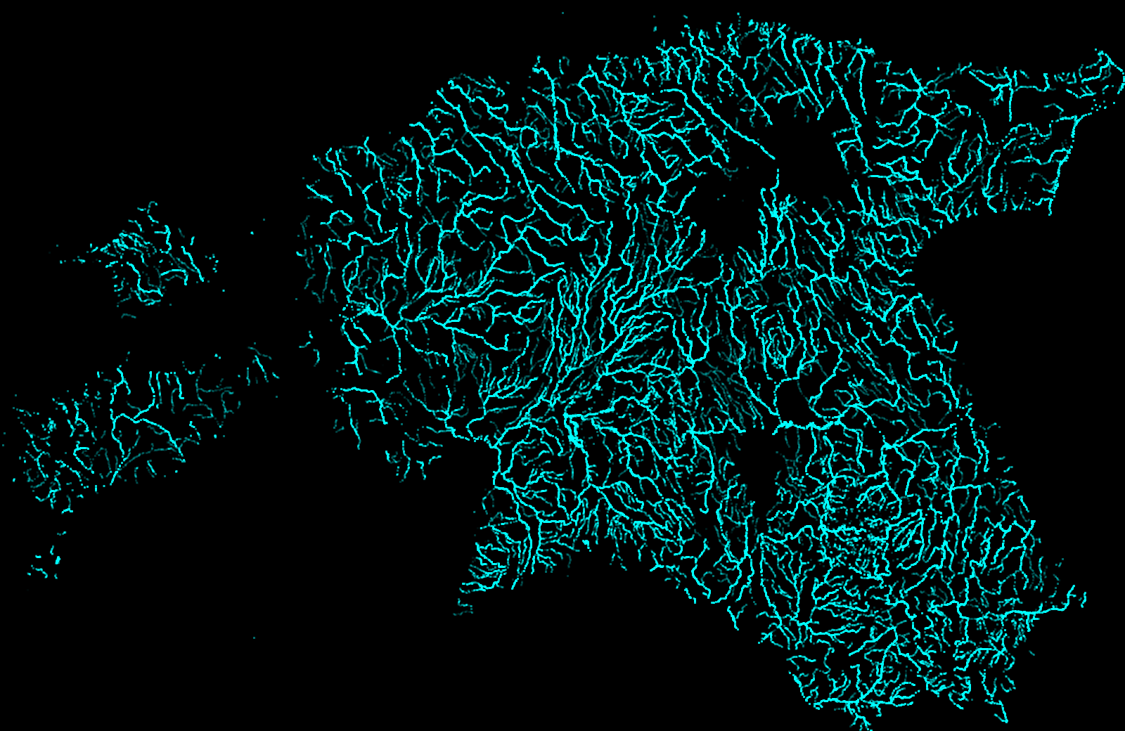

Slide 12
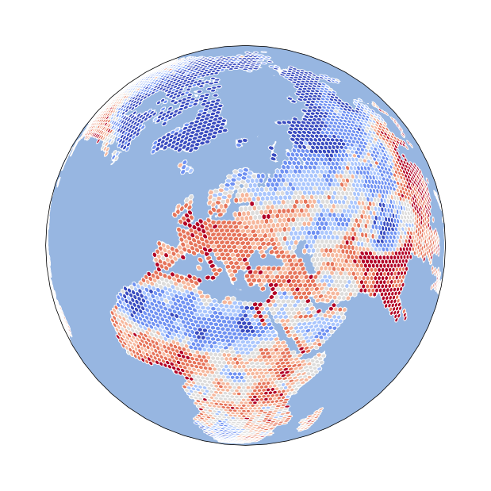
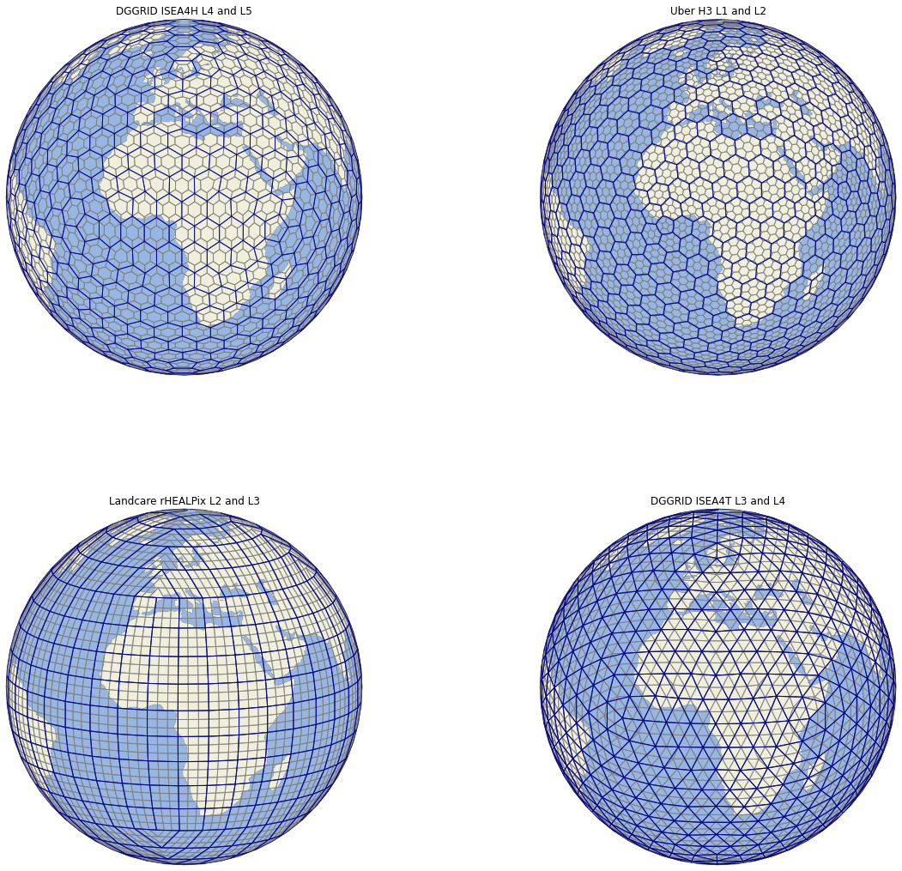

Slide 13
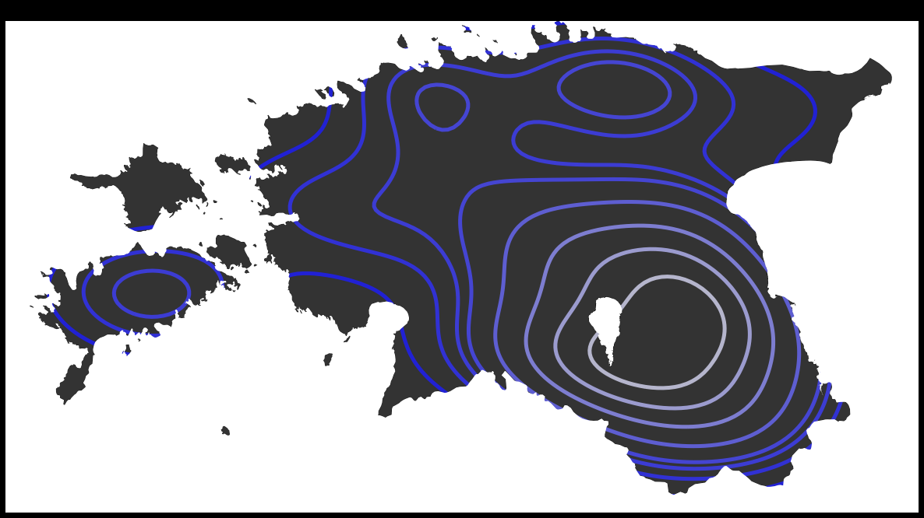

Slide 14
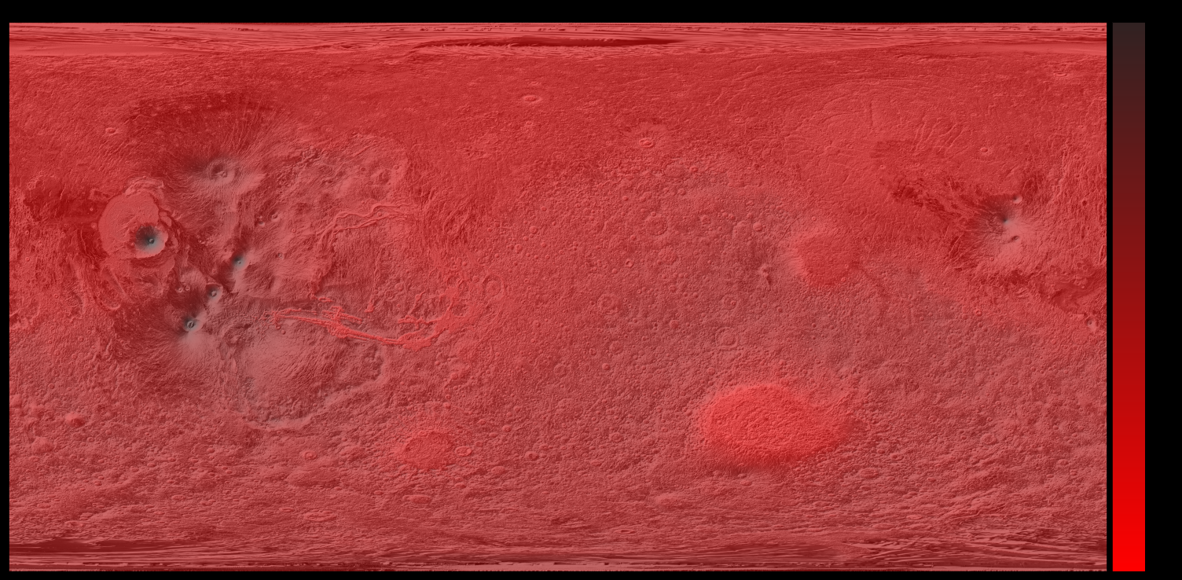

Slide 15
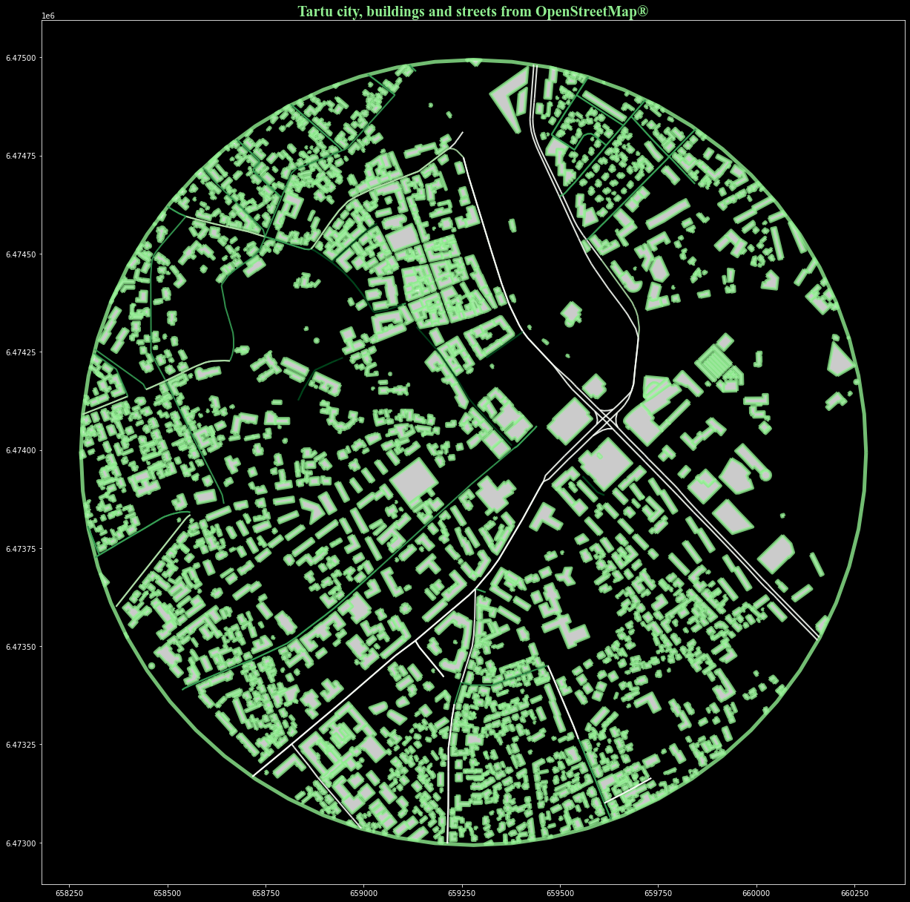

Slide 16


