Slide 1
Predictive Modeling and Fairness in Health Insurance Pricing
Flaminia Trinca, Allizha Theiventhiram
Final Presentation Machine Learning and Data Mining, JMCS 2025
Notes:
Welcome everyone.
In this project, we aanalyze health insurance pricing using machine learning, and we examine how fairly a predictive model treats smokers and non-smokers.

Slide 2
Research Questions
Part 1 - Data Preparation & Exploration Part 2 - Predictive Modeling Part 3 - Fairness Analysis (Smokers vs Non-Smokers) Part 4 - Discussion & Conclusion
Q1. Cost Differences
Do smokers systematically incur higher insurance charges ?
Q2. Algorithmic Fairness
Does a predictive model reproduce real medical risk in a fair way ?
Together, these questions evaluate both real-world cost differences and algorithmic behaviour.
Machine Learning & Data Mining
Notes:
Our project is guided by two main research questions.
First, we ask whether smokers systematically incur higher insurance costs.
This helps us understand real-world differences in the data before modeling.
Second, we explore whether a predictive model reproduces those differences in a fair way, or whether it introduces additional bias.
Together, these questions let us study both actual medical risk and algorithmic behavior.

Slide 3
Dataset Overview & Pipeline
Part 1 - Data Preparation & Exploration Part 2 - Predictive Modeling Part 3 - Fairness Analysis (Smokers vs Non-Smokers) Part 4 - Discussion & Conclusion
Synthetic but realistic U.S. insurance dataset (Kaggle)
The dataset contains 1’000’000 observations
Variables include :
Demographics : age, gender, region
Lifestyle : BMI, exercise frequency, smoking
Medical history (individual and family)
Insurance plan (premium vs. standard)
Annual charges (target)
Steps performed :
Enforce types
Handle missing values
Encode categoricals
Split data
Correlation analysis
Distribution analysis
Machine Learning & Data Mining
Notes:
We work with a synthetic but realistic U.S. insurance dataset containing one million observations. It includes demographic factors, lifestyle variables such as BMI and exercise frequency, medical history features, and of course the annual insurance charges we want to predict.
To prepare the data, we enforced types, handled missing values, encoded categorical variables, split into train and test sets, and then performed correlation and distribution analysis. This established a clean foundation for building fair and accurate predictive models.

Slide 4
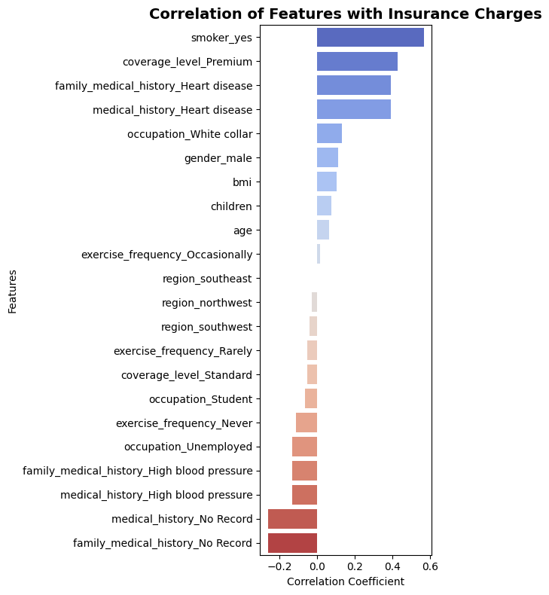
Feature Correlations
Part 1 - Data Preparation & Exploration Part 2 - Predictive Modeling Part 3 - Fairness Analysis (Smokers vs Non-Smokers) Part 4 - Discussion & Conclusion
“This correlation structure already anticipates fairness : smokers truly cost more, so the model will also reflect that and this is medically justified.”
Key observations:
smoker_yes strongly correlates with charges
Coverage level (premium) is also a major driver
Medical history contributes significantly
BMI and exercise have moderate effects
Machine Learning & Data Mining
Notes:
Here we look at which variables correlate most strongly with insurance charges. The standout feature is smoking status — smokers have substantially higher costs. Premium-level insurance plans and medical history also play major roles. BMI and exercise have moderate but meaningful effects.
This correlation structure already hints at fairness considerations: if smokers genuinely cost more, the model should reflect that — but without unnecessarily exaggerating the differences.

Slide 5
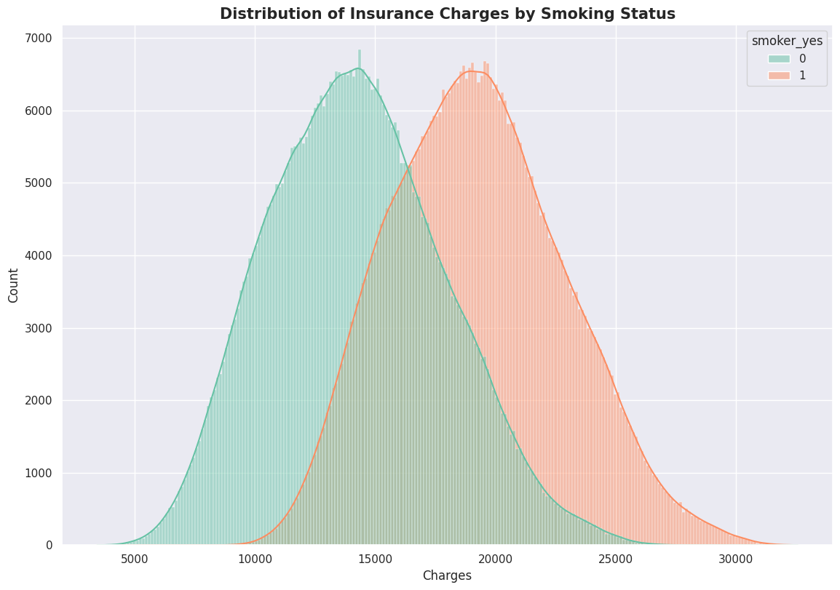
True Cost Differences in the Data
Part 1 - Data Preparation & Exploration Part 2 - Predictive Modeling Part 3 - Fairness Analysis (Smokers vs Non-Smokers) Part 4 - Discussion & Conclusion
“Before training any model, smokers already have significantly higher costs ”
Smokers show higher and more variable insurance charges.
Non-smokers have a lower and tighter distribution.
These differences reflect true medical risk, not model bias.
Establishes the baseline for fairness evaluation.
Machine Learning & Data Mining
Notes:
Before training any model, we compare the actual charge distributions of smokers and non-smokers. We see a clear shift: smokers not clearly do cost more on average, where non-smokers pay significantly less
These differences are important — they reflect true underlying medical risk, not algorithmic bias. This gives us the baseline we’ll later use to evaluate fairness: are the models simply capturing real differences, or amplifying them?

Slide 6
Machine Learning Models
Part 1 - Data Preparation & Exploration Part 2 - Predictive Modeling Part 3 - Fairness Analysis (Smokers vs Non-Smokers) Part 4 - Discussion & Conclusion
We trained several regression models to predict insurance charges.
Model trained :
• Linear Regression
• Elastic Net Regression
• Gradient Boosting (HistGB)
• MLP Neural Network
• GLM (Gamma-log)
Evaluation metrics :
R² : How well does the model explain differences in insurance costs across individuals ?
MAE : On average, how many CHF does the model miss by per individual?
RMSE : How large are the model’s biggest mistakes?
Machine Learning & Data Mining
Notes:
In this part of the project, our goal was to build predictive models that estimate individual medical charges. We trained five different regression approaches, each representing a different modelling philosophy.
We included Linear Regression as a simple baseline. Elastic Net gives us a more robust linear model by regularizing the coefficients, which helps prevent overfitting. Then we tested Gradient Boosting, which can capture complex nonlinear interactions automatically. We also trained a Multi-Layer Perceptron—a neural network—to see whether a flexible, non-linear architecture provides further gains. Finally, we added a Gamma Generalized Linear Model with a log link, because medical costs are strictly positive and highly skewed and this model is distribution-aware.
To evaluate all models fairly, we used three metrics:
R² tells us how much of the variation in medical charges we can explain.
MAE shows the average prediction error in Swiss francs—this is easy to interpret and relevant for fairness analysis later on.
RMSE penalises large errors more strongly, which is important because a small number of individuals can have very high medical costs.
Together, these metrics give us a complete picture of performance.

Slide 7
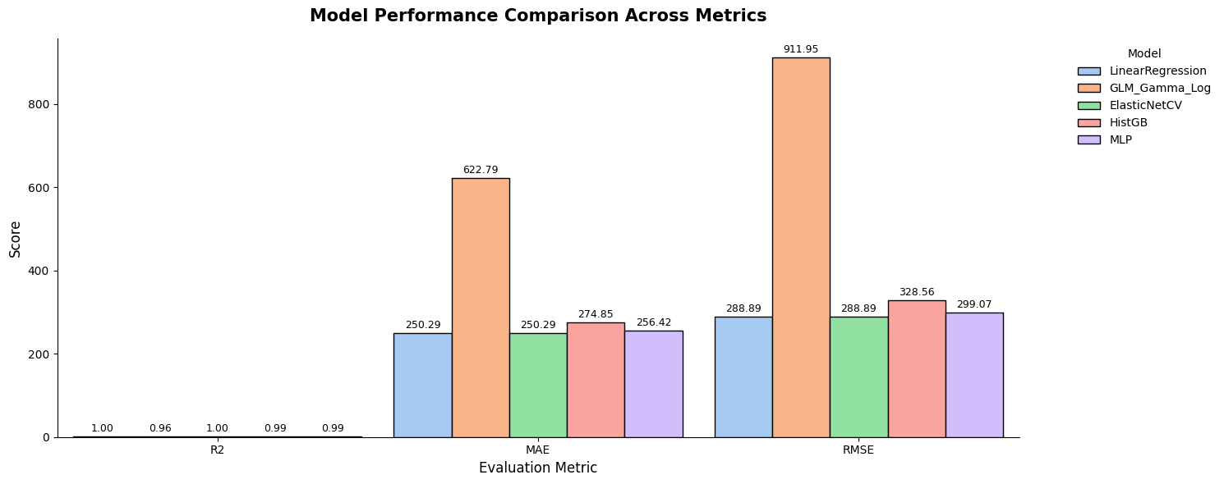
Performance Comparison
Part 1 - Data Preparation & Exploration Part 2 - Predictive Modeling Part 3 - Fairness Analysis (Smokers vs Non-Smokers) Part 4 - Discussion & Conclusion
→ Best model by RMSE : Linear Regression
Machine Learning & Data Mining
Notes:
Here you can see the performance of all five models across the three metrics.
The first thing to notice is that all models except the Gamma GLM achieve extremely high R² values—around 0.99—meaning that they explain almost all variability in medical charges. This confirms that the dataset contains very strong predictive signals.
Looking at MAE and RMSE, we see clearer differences. Linear Regression surprisingly performs best, with the lowest MAE and the lowest RMSE. Elastic Net is essentially identical, which makes sense because Elastic Net reduces to a linear model when regularisation isn’t strongly needed. The Neural Network performs slightly worse, and Gradient Boosting also doesn't surpass the linear models in this case. The Gamma GLM performs the worst across all metrics—it struggles with very high-cost individuals.
The key takeaway is that despite testing more complex and flexible models, the simple Linear Regression model is the best performer in terms of RMSE, which is our main evaluation metric—because it reflects how well the model avoids large prediction errors. This tells us that the relationships in the data are mostly linear and well-structured, meaning that additional model complexity does not translate into better predictions.”
Based on this comparison, we select Linear Regression as our final predictive model for the fairness analysis.

Slide 8
Fairness evaluation Framework
Part 1 - Data Preparation & Exploration Part 2 - Predictive Modeling Part 3 - Fairness Analysis (Smokers vs Non-Smokers) Part 4 - Discussion & Conclusion
We want to determine : Does the predictive model treat smokers and non-smokers fairly, or does it introduce additional bias beyond true medical cost differences ?
Our fairness evaluation includes :
Residual-based statistical fairness : Do errors differ between groups ?
Bootstrap confidence intervals : Are differences statistically significant ?
Fairness metrics (DP, EO, Eodds) : Adapted from the classification framework of the course.
Each component provides a different lens on fairness.
Machine Learning & Data Mining

Slide 9
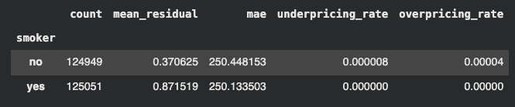
Residual-Based Fairness
Part 1 - Data Preparation & Exploration Part 2 - Predictive Modeling Part 3 - Fairness Analysis (Smokers vs Non-Smokers) Part 4 - Discussion & Conclusion
We compare smokers and non-smokers on :
mean residuals (bias / over- or underpricing)
MAE (error magnitude)
underpricing/overpricing rates
Residuals measure the difference between actual and predicted charges.
Results :
A model is fair if :
both groups have similar average residuals
error magnitudes (MAE) are comparable
neither group is systematically underpriced or overpriced
Groups are balanced
Close to 0 + tiny difference
→ No bias
Errors are almost identical
→ The model is equally accurate for both groups
Practically 0 for both
→ No group is treated worse
Machine Learning & Data Mining

Slide 10

Bootstrap confidence intervals
Part 1 - Data Preparation & Exploration Part 2 - Predictive Modeling Part 3 - Fairness Analysis (Smokers vs Non-Smokers) Part 4 - Discussion & Conclusion
To test whether group differences are meaningful or due to noise, we compute 95% bootstrap confidence intervals.
We repeatedly resample the test data with replacement
For each resample, we recompute the difference between smokers and non-smokers
We do this 2’000 times
We look at the distribution of these differences
From that distribution, we compute a 95% confidence interval (CI)
Results :
A positive value → smokers have higher value
A negative value → non-smokers have higher value
0 → no difference between groups
All bootstrap confidence intervals include 0 → no statistically significant group differences. In other words → The model is statistically fair with respect to smoking status.
Machine Learning & Data Mining

Slide 11
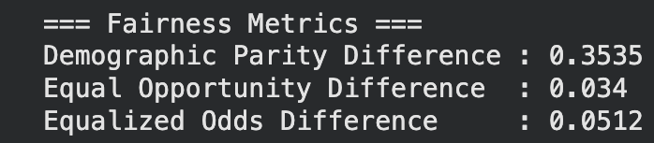
Fairness metrics (DP, EO, Eodds)
Part 1 - Data Preparation & Exploration Part 2 - Predictive Modeling Part 3 - Fairness Analysis (Smokers vs Non-Smokers) Part 4 - Discussion & Conclusion
We adapt Lab 7 fairness definitions by transforming charges into a binary high-cost vs low-cost label. These three numbers measure group fairness between Non-smokers (protected group = 0) and Smokers (protected group = 1). They are computed after converting the regression problem into a binary one: “Is this person high-cost or not ?” Each metric measures a difference between groups.
DP → asks Do smokers and non-smokers receive a high-cost prediction at the same rate ? EO → aks Among truly high-cost individuals, does the model detect smokers and non-smokers equally well ? Eodds → aks Does the model make similar mistakes for smokers and non-smokers ?
Results :
0 = perfectly fair Closer to 0 = more fair Larger values = larger group disparity
Large difference → due to real medical risk
→ is NOT the right fairness criterion
Close to 0 → Errors are balanced across groups
Close to 0 → Groups treated equally when it matters
Machine Learning & Data Mining

Slide 12
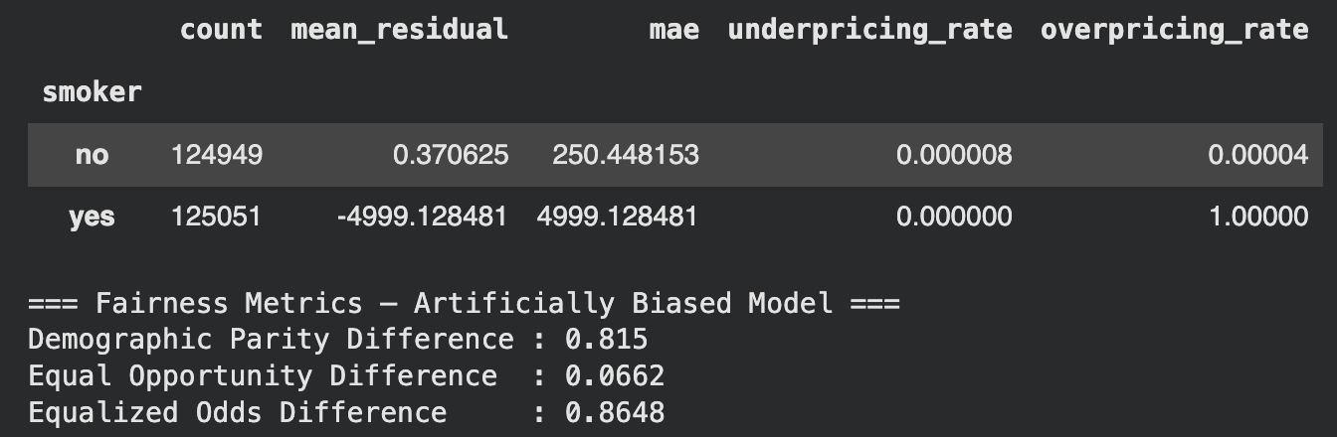
Fairness Stress Test: What If the Model Were Unfair?
Part 1 - Data Preparation & Exploration Part 2 - Predictive Modeling Part 3 - Fairness Analysis (Smokers vs Non-Smokers) Part 4 - Discussion & Conclusion
To verify that our fairness pipeline is actually sensitive to unfair behaviour (and not just always “green”), we now build an artificially biased model :
We take the predictions of the best model and add a fixed unfair surcharge for smokers (+ 5000 CHF).
This simulates a pricing policy where the insurer decides to penalize smokers more than their actual risk justifies. We then recompute the fairness metrics on these biased predictions and compare them to the original model
Results :
almost no change
100 % overpricing rate
the model consistently overpredicts their medical charges
typical pricing error for smokers becomes 20 times larger than before → group-level unfairness
Machine Learning & Data Mining

Slide 13
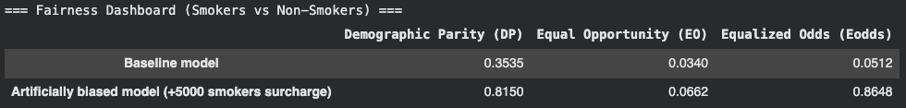
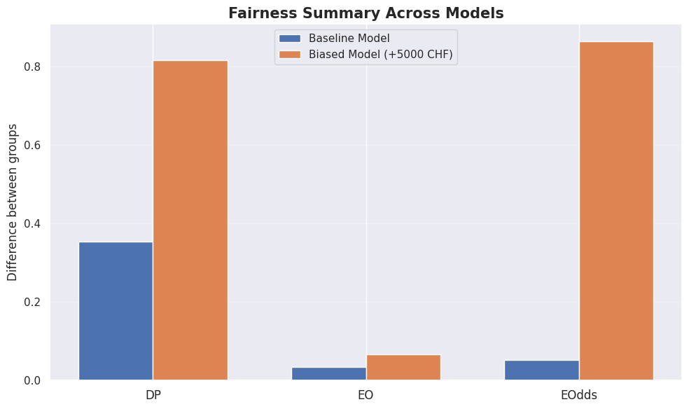
Fairness Dashboard (Baseline vs Biased)
Part 1 - Data Preparation & Exploration Part 2 - Predictive Modeling Part 3 - Fairness Analysis (Smokers vs Non-Smokers) Part 4 - Discussion & Conclusion
increases slightly but not dramatically
→ adding a constant bias doesn’t change who is truly high-cost very much
strongest signal of discrimination
→ smokers are almost always misclassified as high-cost
This confirms two things :
our original model is fair
our fairness pipeline is sensitive and correctly detects discrimination when it exists.
Machine Learning & Data Mining

Slide 14
Conclusion
Part 1 - Data Preparation & Exploration Part 2 - Predictive Modeling Part 3 - Fairness Analysis (Smokers vs Non-Smokers) Part 4 - Conclusion
Our two-part answer :
Do smokers cost more ? ✔ Yes, due to real medical risk
Is the model fair ? ✔ Yes, it mirrors true differences without introducing artificial bias
Additional validation :
Statistical tests confirm fairness
Stress test shows fairness metrics correctly detect discrimination
Machine Learning & Data Mining

Slide 15
Thank You for your attention !
Machine Learning & Data Mining

