Slide 1
Train Data
(Sample with replacement)
……
Subset 1
Subset 2
Subset 3
Subset 4
(Training)
Model 1
Model 2
Model 3
Model 4
……
Test Data
y1
y2
y3
y4
Average / Voting

Slide 2
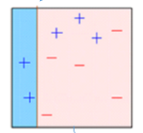
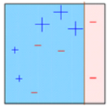
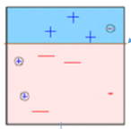
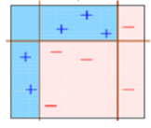
M1
M2
M3
被M1分錯的資料權重加大 然後建 M2
被M2分錯的資料權重加大 然後建 M3
建簡單的模型 M1
M1 + M2 + M3

Slide 3
New observation
Model 1
(linear regression)
Model 2
(SVR)
Model 3
(CART)
(Predict)
y1
y2
y3
Meta-Model
(Blender / meta learner)
(Blending)
y.final

Slide 4
Model 1
(Linear Regression)
Model 1
(Linear Regression)
Model 1
(Linear Regression)
(Meta-Data)
Meta-Model
Subset-1
Subset-1
Subset-1
Predict_1
Meta-X
Meta-Model
(Blender / meta learner)
Training
Train Data
Subset-2
Subset-2
Subset-2
Predict_2
=
Subset-3
Subset-3
Subset-3
Predict_3
Test Data
Predict
Predict
Predict
Average
Avg.
Predict_Y
=
Meta-Y
Predict

Slide 5
Data
(Train and Test)
Model 1
(linear regression)
Model 2
(SVR)
Model 3
(CART)
Meta-X
Meta-Y
Meta-X
Meta-Y
Meta-X
Meta-Y
Meta-X
Meta-X
Meta-Y
Meta-Y
Meta-X
Meta-Y
(Training)
(Blending)
Meta-Model
(Blender / meta learner)
Predicted results

Slide 6
Meta-Train
X
Y
X
Meta-X
Y
訓練
Train
Meta-Model
Meta-X
(Avg.)
Meta-X( Avg.)
預測
X
Y
X
Y
Test
Meta-Test

