Slide 1


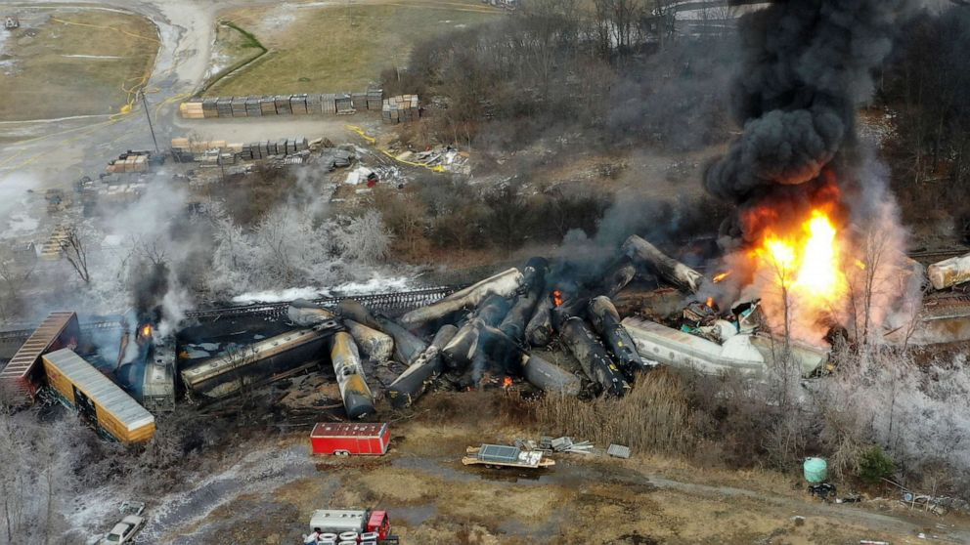
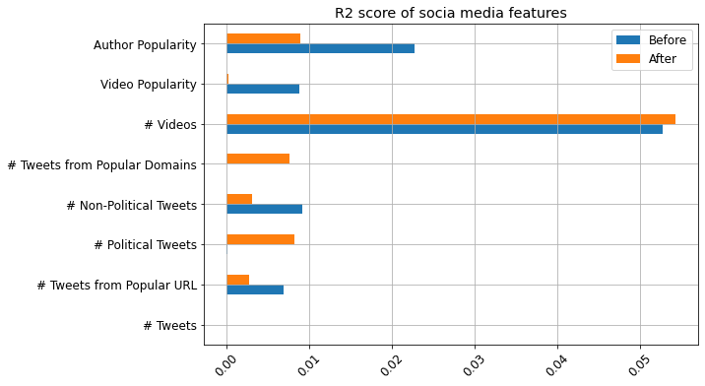
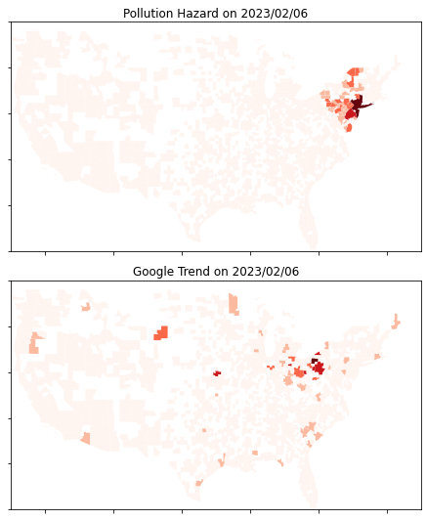
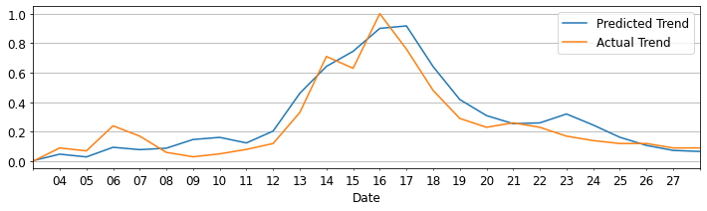
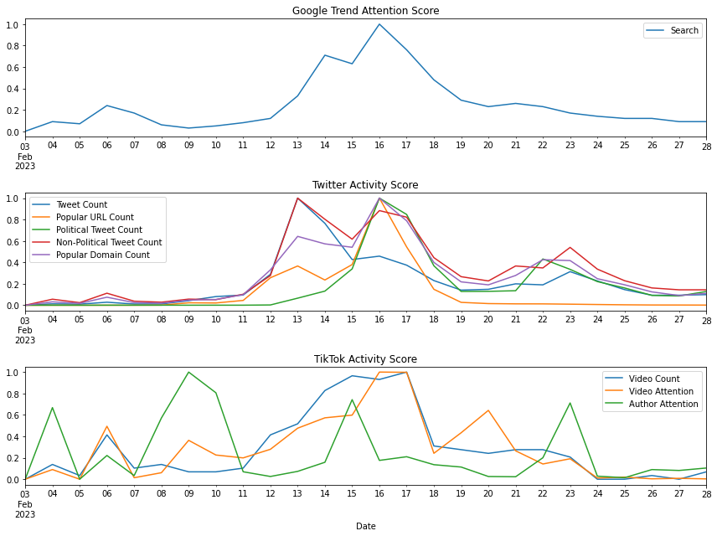
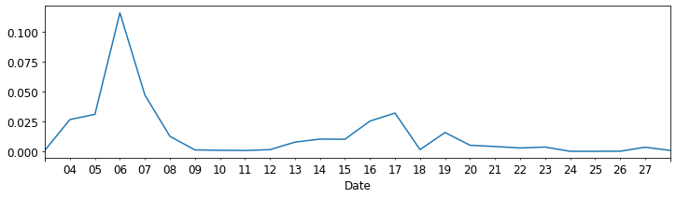
Social Media’s Effectiveness in Timely Disaster Communication
Chongdan Pan, Hang Chen, Chang Chia-Hsun, Yun Lee
University of Michigan – School of Information
we compare the attention patterns with disaster hazard simulation results in a geographical manner. We also analyze time series data to from TikTok and Twitter to shed light on the promptness and precision of media in disaster communication.
Then the result is used to evaluate the effectiveness and accuracy of media through geographic comparison.
Fig. 1 Ohio Train Derailment
Methodology
Fig. 4 Social media feature importance
Abstract
This project examines social media’s accuracy and timeliness to inform the public about disasters such as Ohio train derailment. We find news and social medias are quite impactful but untimely, a pattern that was similarly reflected in the nuclear leak accident in Minnesota. Geographic analysis based on hazard gases dispersion simulation reveals unawareness in high-risk area due to media's delayed reporting. Hence, we emphasizes the significance of prompt and precise information propagation through in disaster communication.
We measure public attention by search trend of ‘Derailment’, with both time series and geographic distribution data on Google. To explore the relationship between public attention and social media activities, we retrieve related tweets and TikTok video from API and build aggregated features. We also extract popular URLs and domains from tweets since they can stand for major news source.
The relationship between the trend of public attention and social media activities and is furtherly supported by another case. We trained a GRU model based on the derailment accident’s data, and it gives very close prediction wish MSE of 0.0086, as shown in Fig. 5
Fig. 3 Geographic comparison
Fig. 5 Validation by nuclear leak accident
However, geographic analysis shows social media may not effectively alert individuals in high-risk area. Fig. 6 shows the daily change in R^2 between actual attention trends and simulated hazard levels across US metros. The low values indicates that people in high-risk area were not initially fully aware of the hazard, and the public only know about the disaster through social media when there’s not too much threat.
Methodology
Fig. 2 shows that there was little initial attention given to the disaster until Feb. 13th, suggesting significant delays in the spread of information. In Fig. 4, the feature importance is displayed before and after that date. TikTok videos were found to be timelier but did not receive much public attention. On the contrary,
popular tweets and news, especially political ones, were impactful but very lagging as well. These factors together contributed to the late highest peak on Feb. 16th shown in Fig 2.
Introduction
Media has a crucial role in informing the public about disasters. However, the Ohio train derailment in February raises concerns about the timeliness of public attention, with Google Trend showing a delay over 10 days after the accident. This delay may be too late for effective disaster response. To assess media’s potency in capturing public attention,
Fig. 2 Time series trends and features
To estimate the disaster’s impact on people, we simulate the geographical distribution of hazard based on a 2D Lagrange Dispersion model and wind data from Google Earth Engine.
Fig. 6 R^2 between hazard and attention

