Slide 1


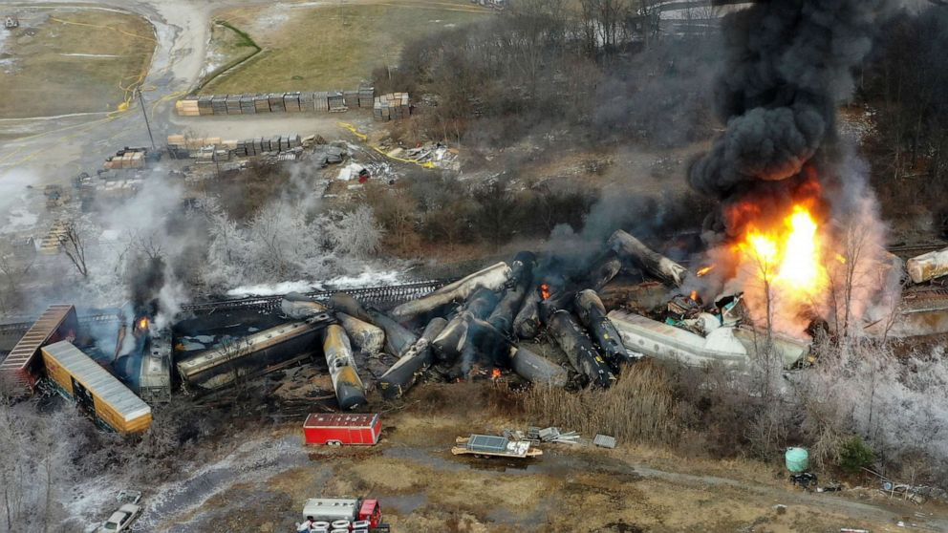
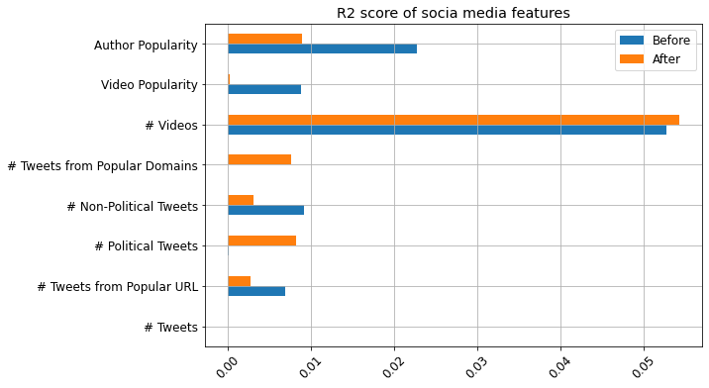
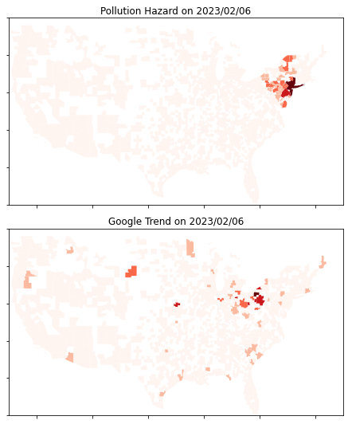
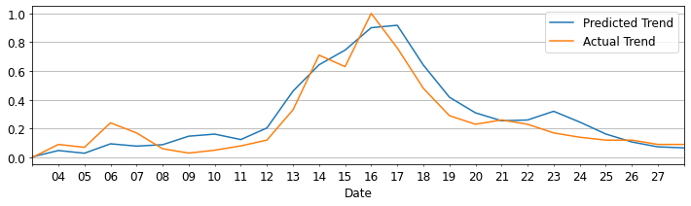
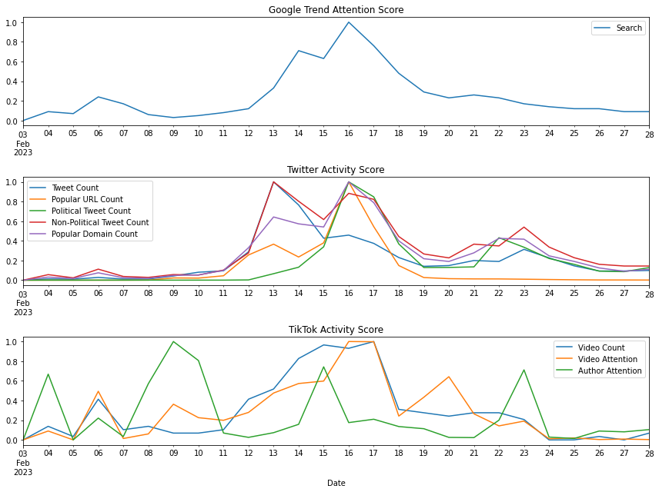
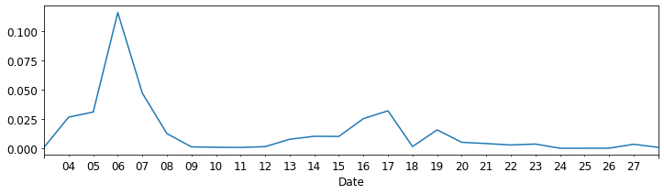
The Effectiveness of Social Media in Timely Disaster Communication
Chongdan Pan, Hang Chen, Chia-Hsun Chang, Yun Lee
University of Michigan – School of Information
we analyzed attention patterns in comparison to disaster hazard simulation results on a geographic basis. We also analyzed time series data from TikTok and Twitter to shed light on the promptness and precision of media in disaster communication.
Then, the results were used to evaluate the effectiveness and accuracy of media through geographic comparison.
Fig. 1 Ohio Train Derailment
Methodology
Fig. 4 Social media feature importance
Abstract
This project examines the accuracy and timeliness of social media in informing the public about disasters such as the Ohio train derailment. We found that news and social media are quite impactful but untimely, a pattern that was similarly reflected in the Minnesota nuclear leak incident. Geographic analysis based on hazardous gas dispersion simulation revealed low awareness in high-risk areas due to delayed media reporting. Hence, we emphasize the significance of prompt and precise disaster communication.
We measured public attention through the search trend of ‘Derailment’ using both time series and geographic distribution data on Google. To explore the relationship between public attention and social media activities, we retrieved related tweets and TikTok videos using API to create aggregated features. We also extracted popular URLs and domains from tweets as major news sources.
The relationship between the trend of public attention and social media activities is further supported by another case. We trained a GRU model based on the derailment incident data, which gives very close prediction with an MSE of 0.0086, as shown in Fig. 5.
Fig. 3 Geographic comparison
Fig. 5 Validation by nuclear leak accident
However, geographic analysis reveals that social media may not effectively alert individuals in high-risk areas. Fig. 6 displays the daily change in R^2 between actual attention trends and simulated hazard levels across US metros, indicating low awareness levels among people in high-risk areas. The public only became aware of the disaster through social media when the threat was not significant.
Findings
Fig. 2 shows that there was little initial attention given to the disaster until Feb. 13th, suggesting a significant delay in the spread of information. Fig. 4 displays the feature importance before and after that date. TikTok videos were found to be timelier but did not receive much public attention. On the contrary,
popular tweets and news, especially political ones, were impactful but very lagging as well. These factors together contributed to the late highest peak on Feb. 16th , as shown in Fig. 2.
Introduction
Media plays a crucial role in informing the public about disasters. However, the Ohio train derailment in February has raised concerns about the timeliness of public attention, as Google Trends data showed a delay over 10 days after the incident. This delay could hinder effective disaster response effort. To assess the effectiveness of media in capturing public attention,
Fig. 2 Time series trends and features
To estimate the impact of disaster on people, we simulated the geographical distribution of hazard based on a 2D Lagrangian Dispersion model and wind data from Google Earth Engine.
Fig. 6 R^2 between hazard and attention

Slide 2
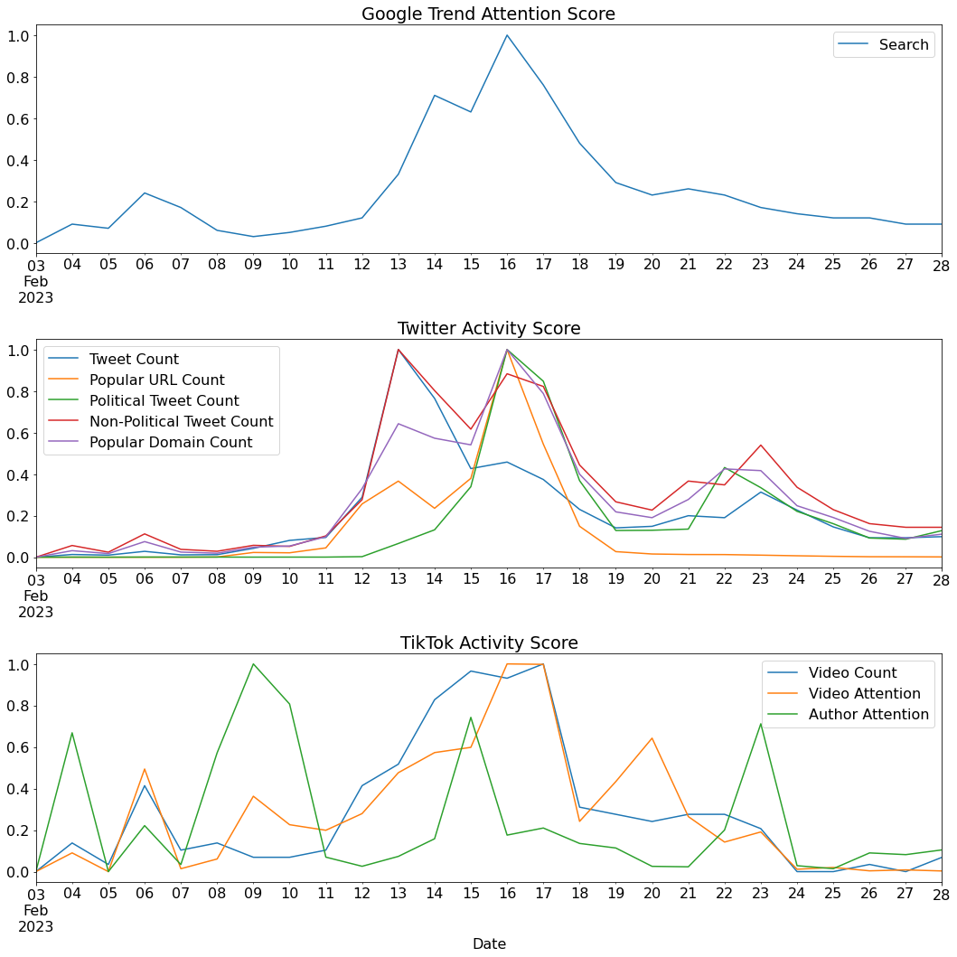
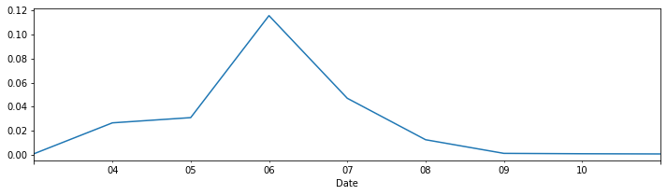
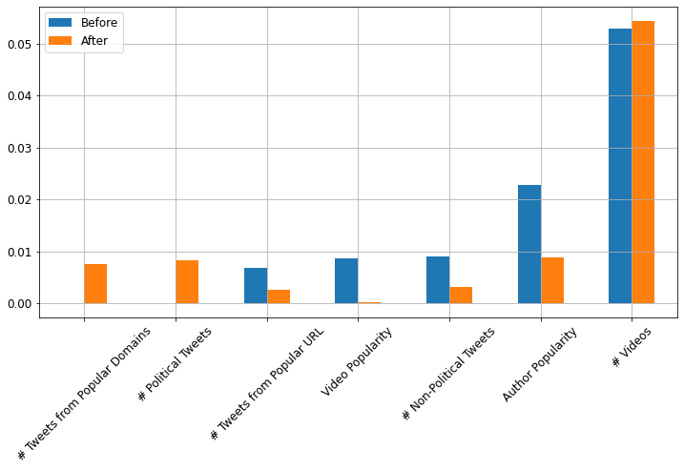
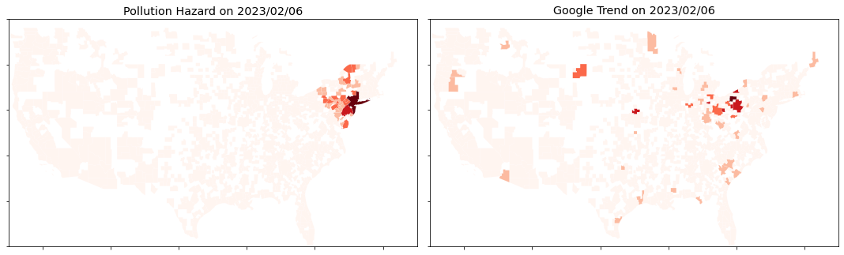
The Effectiveness of Social Media in Timely Disaster Communication
Chongdan Pan, Hang Chen, Chia-Hsun Chang, Yun Lee
University of Michigan – School of Information
Introduction
The recent Ohio train derailment is a tragic disaster, while public attention wasn’t well caught until 10 days afterwards. To help social media be more effective in such cases, our research focuses on 2 questions:
1. How are social media activities related to public attention during the disaster?
2. Were residents of high-risk areas properly informed?
Methodology
TikTok videos and popularity statistics
Compared with daily Google Trend of ‘Derailment’
Evaluate time series model through Minnesota nuclear leak accident
Tweets, trending URLs and news counts
Simulate the dispersion of hazard gases after the accident
Identify geographic distribution of high-risk areas
Fig. 1: Predicted vs. actual attention trend
Primary Findings
Significance
Our research reinforce the public attention to people suffering from disasters, like the East Palestine community.
The pros and cons of social media we found can help set up a more effective information channel. We proposed a method of comparing the distribution of risk from simulation with actual attention trend.
The method effectively estimates people’s awareness of the risk, which is very critical in disasters management.
Late peak of attention (Fig. 2) indicates social medias failed to inform the public of the disaster timely.
Time Series feature analysis (Fig. 2, 3) suggest popular TikTok is timelier but didn’t capture much attention while Tweets and news are impactful but very lagging, especially political ones. All these factors together effectively drive the public attention, as supported by the predictivity in the nuclear leak accident.
Low R^2 (Fig. 4) generated by inconsistent result from daily comparison of geographic distribution between simulated hazard and actual attention trend (Fig. 5) implies people’s unawareness in the high-risk areas
Fig. 4: R^2 of daily comparison
Fig. 2: Daily social media activities and general attention trend
Fig. 3: Feature importance before and after
the major spread of related information
Fig. 5: Geographic Comparison Example

