Slide 1

Online Book Store
FInal Presentation
Course title : Database Management System Lab
Course code: CSE-314
Submitted to :
Razorshi Prozzwal Talukder
Lecturer
North East University Bangladesh
Submitted By:
Allo Rani Malakar
Id: 0562220005101013
Session: Summer - 22

Slide 2
Overview
This project successfully developed a user-friendly online bookstore platform catering to a broad audience. Customers can now browse a well-organized collection of books, categorized by genre and author for easy navigation. A built-in search function facilitates efficient exploration of the book collection. To enhance the user experience, detailed information pages for each book provide comprehensive descriptions. This completed project has demonstrably improved access to literature by creating a user-friendly online bookstore experience.

Slide 3
Technologies
Frontend:
HTML
CSS
JAVASCRIPT
BOOTSTRAP
Backend:
PHP
MYSQL (DATABASE)

Slide 4
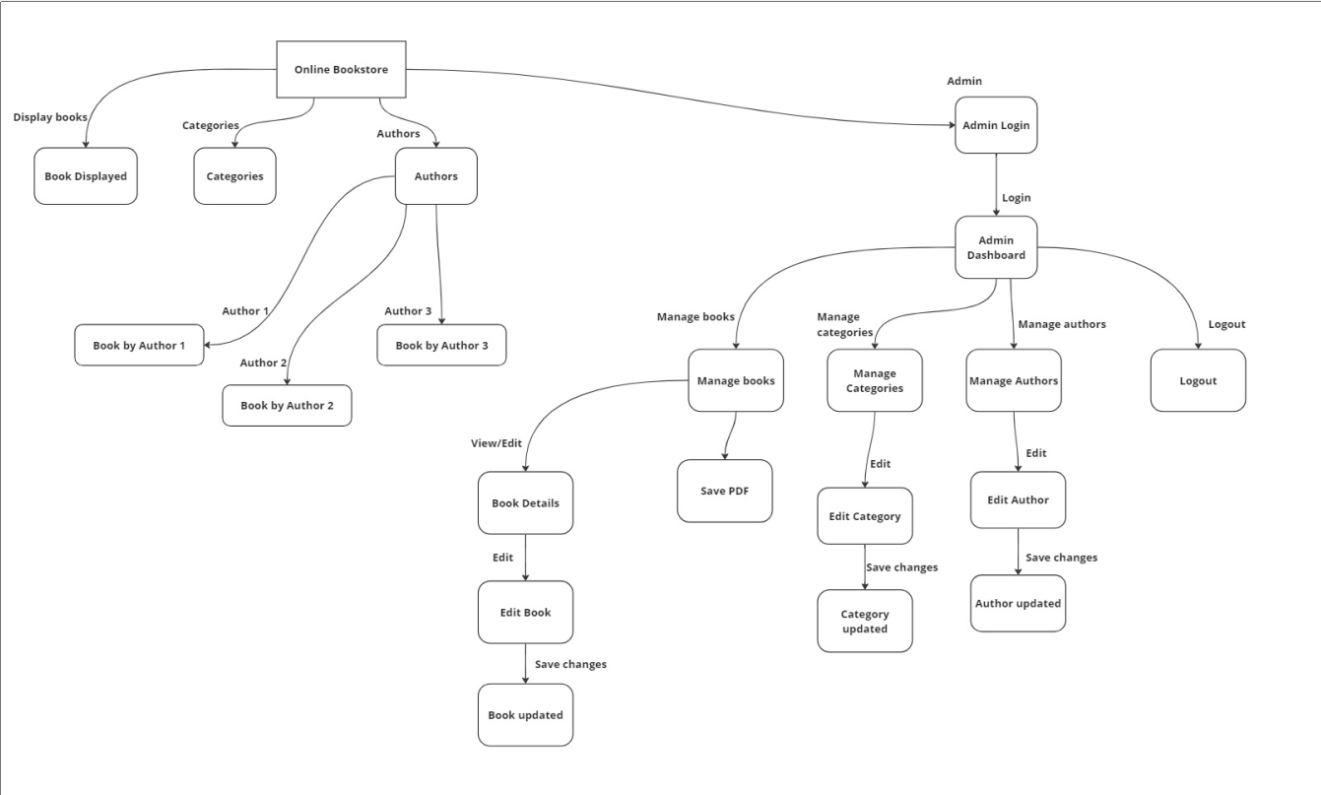
FLOWCHART

Slide 5
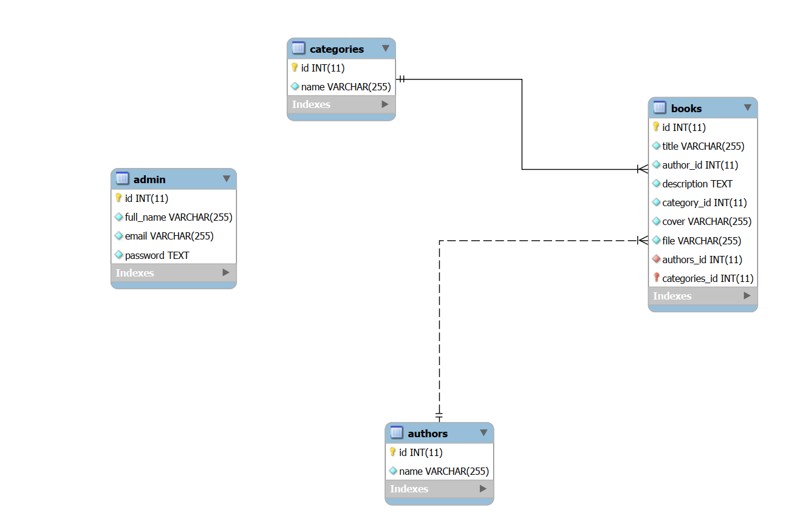
Database Design (ERD)
The tables include books, categories, authors, and potentially admins.
Each table has an id field as a primary key.
The books table has foreign keys referencing the category_id and author_id fields from the respective tables.
This design allows for efficient storage and retrieval of data related to books, categories, and authors.

Slide 6
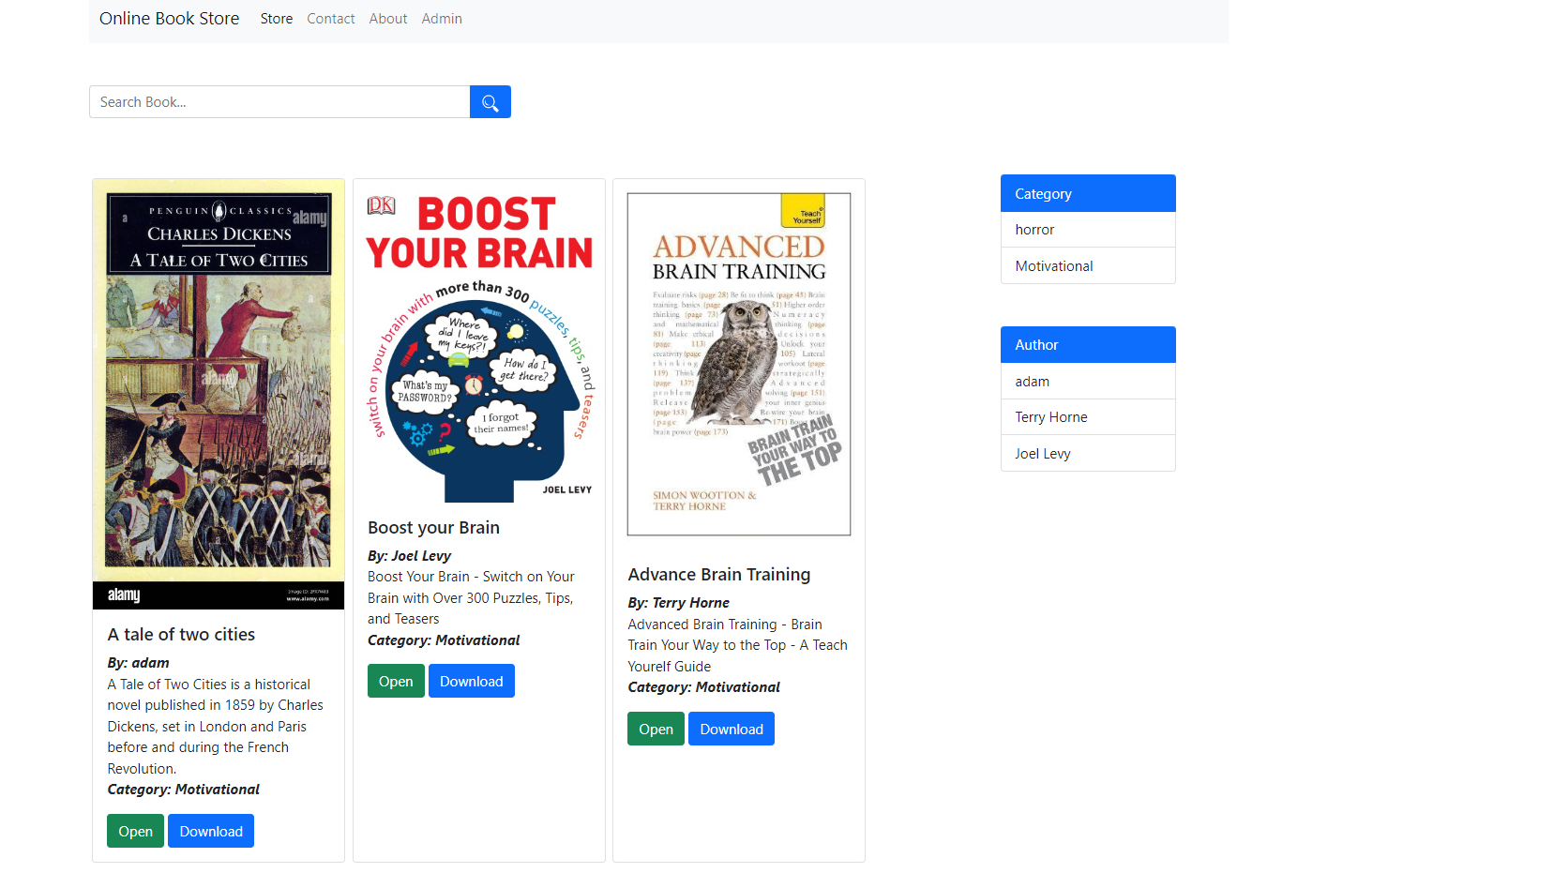
Home Page
The homepage showcases various books users can purchase to improve their brain function.
It features a search bar to allow users to find specific titles easily.
The homepage also highlights categories like motivational and advanced brain training, potentially indicating the website’s range of book topics.And highlights the authors name ,potentially indicating the website’s range of book’s authors.

Slide 7
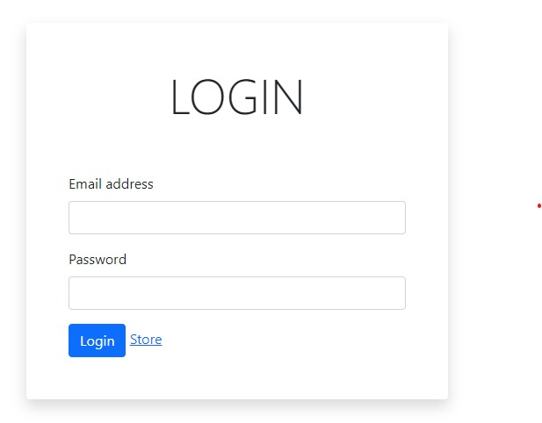
Login
This login page only requires two pieces of information: email address and password. This makes it easy for an admin to log in quickly.
The labels for the email address and password fields are easy to understand. This helps users to avoid confusion when entering their credentials.
This is also Secure. While this login page doesn’t show any security features, it’s likely that the website uses secure encrypted data.

Slide 8
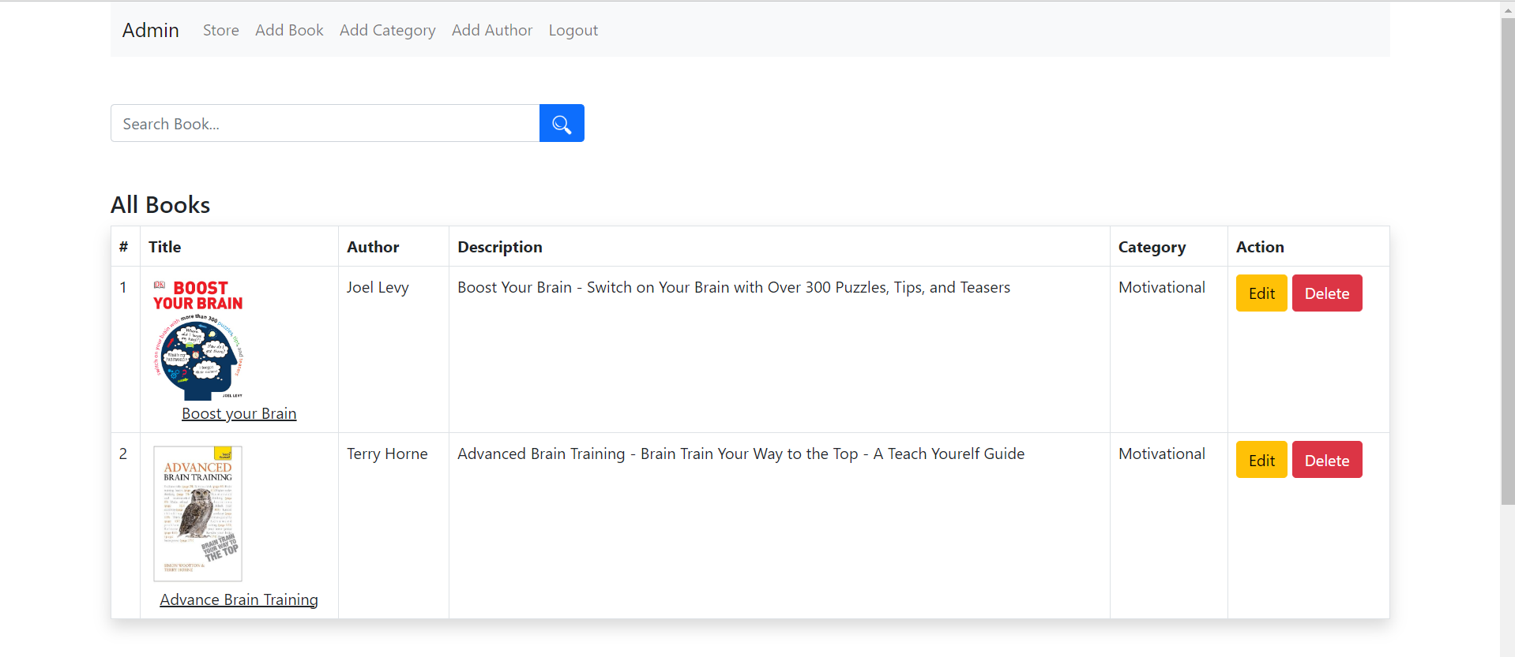
Admin Dashboard
The admin dashboard provides an overview of the store's book collection, including title, author, description, and category.
It seems like admins can edit and delete book information directly on the dashboard.
There's also a search bar to filter the list of books.

Slide 9
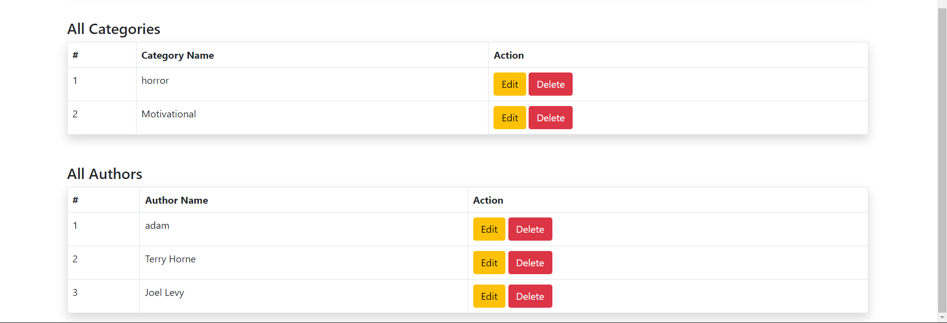
Admin Dashboard
This page displays a list of categories and and authors from a database.
Each table allows admins to edit or delete individual entries.

Slide 10
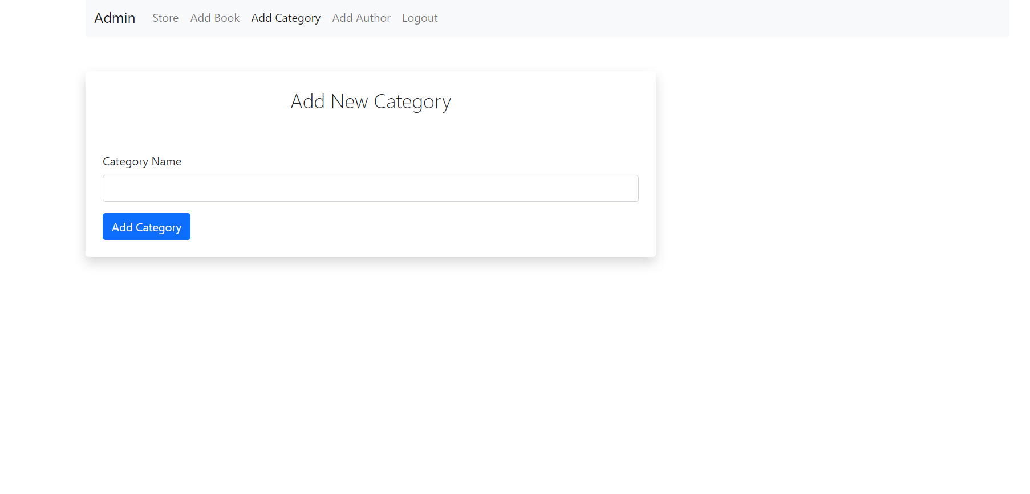
Add Category
This page allows admins to add new categories for books in the store.
There's a text field where admins can enter the name of the new category.
Once the name is entered, clicking the "Add Category" button likely saves the new category to the database

Slide 11
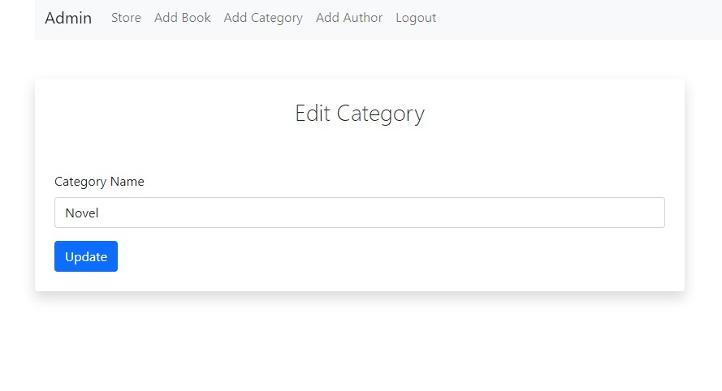
Edit Category
This page allows admin to edit the name of an existing category on his website.
The page has a text field for entering the new category name and a button to save the changes.
Once you have made your changes, you can click the "Update" button to update the category name on your website.

Slide 12
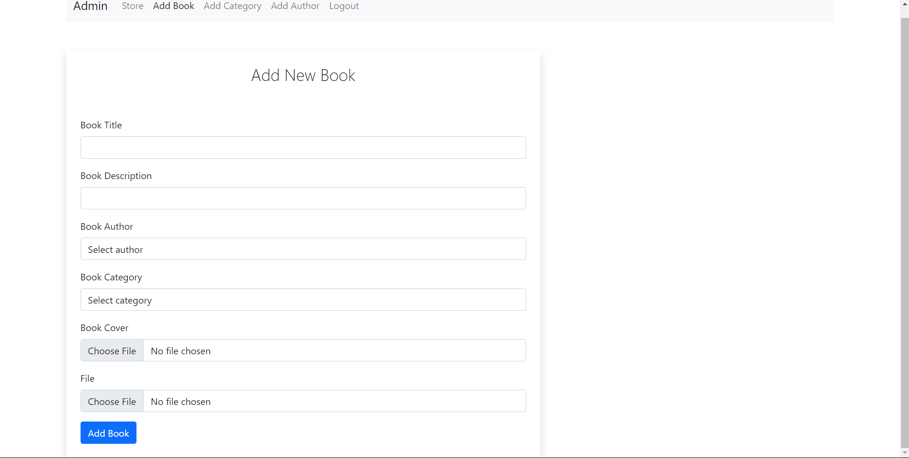
Add Book
This page allows admins to add new books to the store's inventory.
The form includes fields for book title, description, author selection, category selection, cover image upload, and book file upload.
Clicking "Add Book" likely submits the form data to create a new book entry in the database.

Slide 13
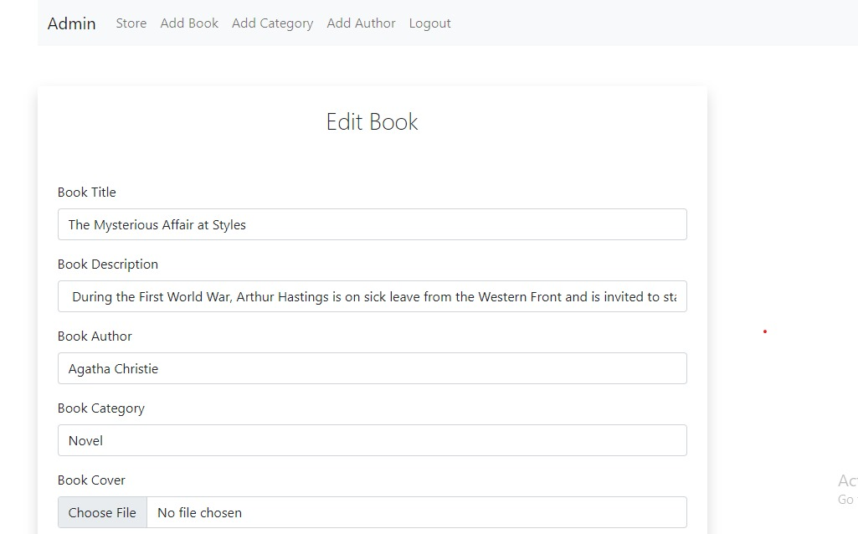
Edit Books
This page allows admin to edit the details of a book. The admin can edit the title, description, category, and cover image of the book.
The labels for each field are clear and easy to understand. This makes it easy for you to find and edit the information you need.
Once you have made your changes, you can click the "Save" button to update the book information in your bookstore .

Slide 14
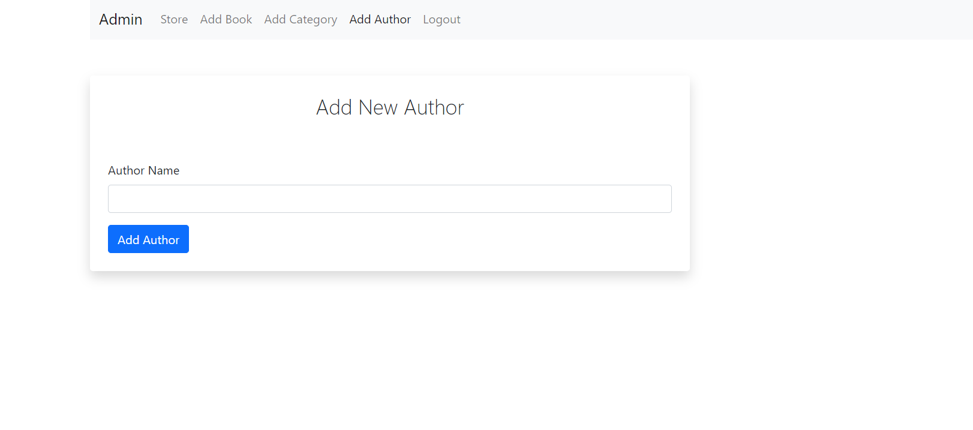
Add authors
This page allows admins to add new authors to the store's database.
There's a text field where admins can enter the author's name.
Clicking "Add Author" likely saves the new author's information and creates a new entry in the database.

Slide 15
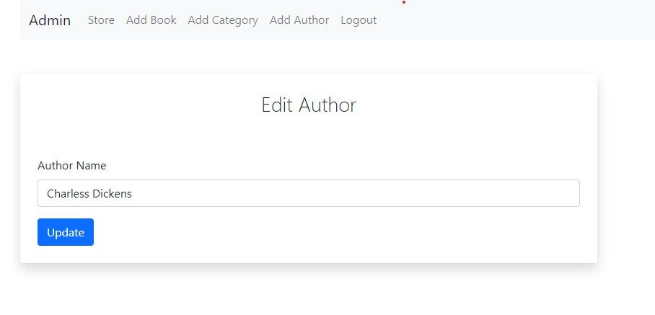
Edit Authors
This page allows an admin to edit the information of an existing author in his bookstore website.
The page includes a label for "Author Name" and a text field to enter the author's name.
Once you've made the changes, you can click the "Update" button to save the updated information.

Slide 16
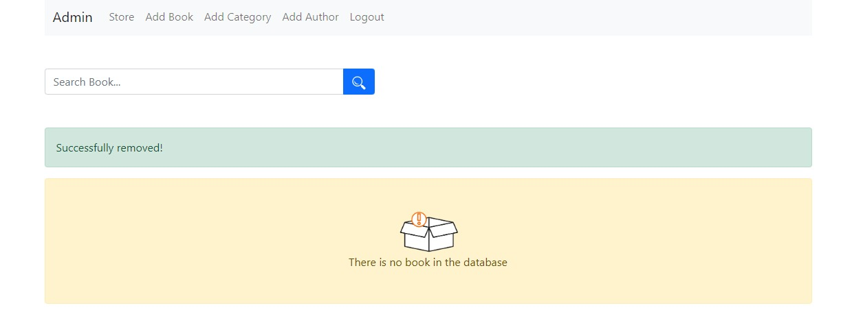
Delete Books
This page provides an overview of the bookstore's management system. It includes sections for adding books, adding categories, adding authors, logging out, searching for books, and displaying a message indicating there are currently no books in the database.

Slide 17
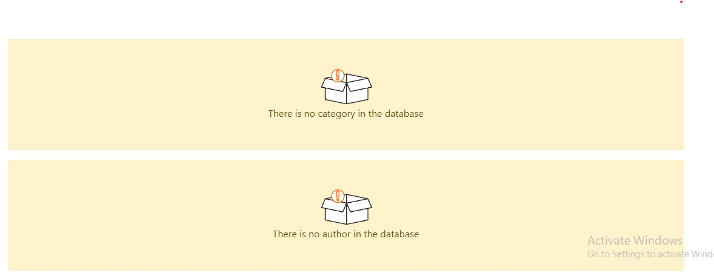
Delete Categories and Authors
This page indicates an error message stating "There is no category in the database" and "There is no author in the database". This suggests that the system is unable to find any categories or authors currently.

