Slide 1
Physics Graph
Ben Payne

Slide 2
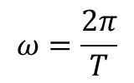

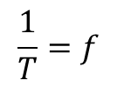
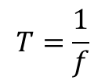

Derivation
“Given $ω=2πf$ and $T=\frac{1}{f}$ , then $ω=\frac{2π}{T}$ .”
Angular and linear frequency are related by
$$ω=2πf$$
Period and linear frequency are related by
$$T=\frac{1}{f}$$
Invert both sides of equation 2
$$\frac{1}{T}=f$$
What steps show this derivation?
Substitute equation 3 into equation 1
$$ω=\frac{2π}{T}$$
Notes:
Animation is from
http://www.physics.uoguelph.ca/tutorials/shm/phase0.html

Slide 3
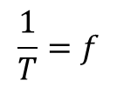
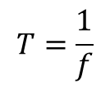
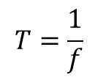


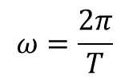
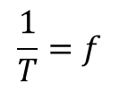
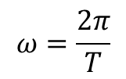
Graph representation of Derivation
Statements are nodes on a graph
Angular and linear frequency are related by
$$ω=2πf$$
$$T=\frac{1}{f}$$
$$ω=2πf$$
Period and linear frequency are related by
$$T=\frac{1}{f}$$
$$\frac{1}{T}=f$$
Invert both sides of equation 2
$$\frac{1}{T}=f$$
Substitute equation 3 into equation 1
$$ω=\frac{2π}{T}$$
$$ω=\frac{2π}{T}$$
Problem: Graph isn’t helpful since the steps aren’t atomic
→ Need a second type of node describing steps between statements

Slide 4





Derivation of frequency relations
declareInitialEq
$$T=\frac{1}{f}$$
$$ω=2πf$$
multiplyBothSidesBy
$$f$$
$$Tf=1$$
divideBothSidesBy
$$T$$
Inference rules:
(True) propositions:
$$\frac{1}{T}=f$$
subEq1intoRHSofEq2
→ Now we can use a
Computer Algebra System
to check derivation (each inference rule)
$$ω=\frac{2π}{T}$$

Slide 5
Benefits and Costs
Use graph as teaching aid
Large number of work-hours to build graph, but it only needs to be done once
Can we describe all of physics using a graph?
Standardized notation is needed
How many inference rules are there?
Caveat: Godel’s incompleteness theorem
Has a project of this scope been completed before?
Donald Knuth’s Tex for type-setting

Slide 6
