Slide 1
Storyboard for space invaders

Slide 2
Context
First glance at game
Player shooting and collision
When the player loses
When the player wins

Slide 3
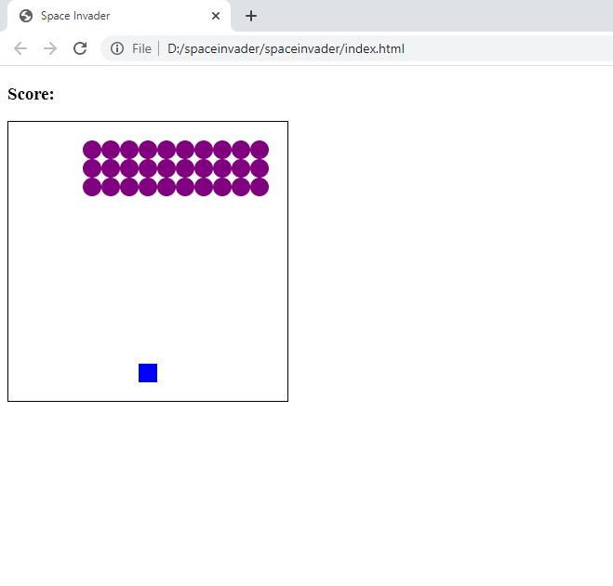
First glance at game
This is a how the game will look when it is started up

Slide 4
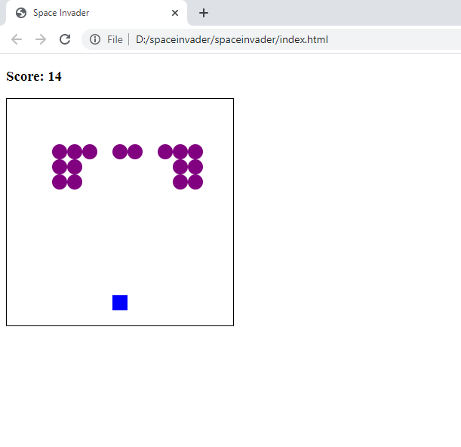
Player shooting and collision
When the shooter shoots, the laser collides with the aliens. The collision turns red.

Slide 5
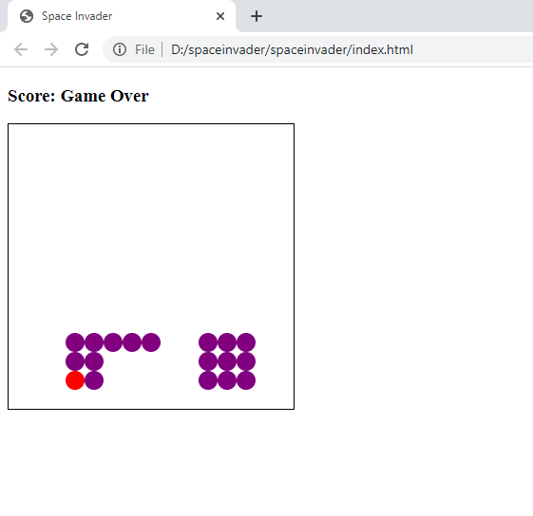
When the player loses
When you lose the score at the top tells you it is game over. You can see as well that when all the aliens drop on you the shooter collides with the aliens and it turns red.

Slide 6
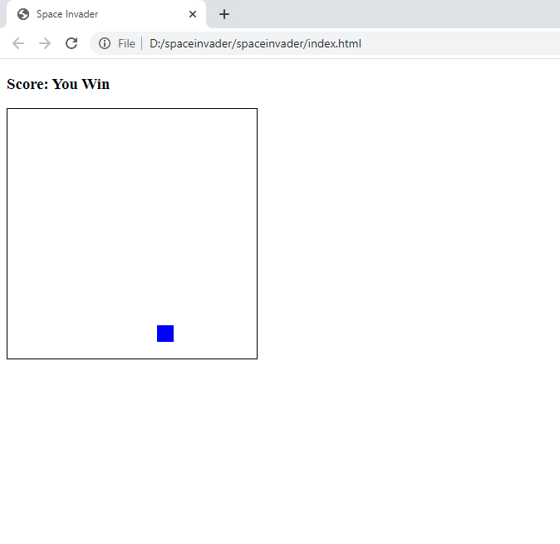
When the player wins
When you shoot all the enemies, the score tells you that you have won.

